Slide 1
Science of Reading Levels
Timothy Shanahan
University of Illinois at Chicago
www.shanahanonliteracy.com

Slide 2
Book Leveling History
The idea that texts vary in difficulty along a continuum can be traced back to Aristotle
The role of such a continuum in teaching came to America on the Mayflower (Protestant Tutor)
The idea that students should be taught with texts that start simple and grow more challenging over time has consistently been a part of American reading education
New England Primer
Webster’s Blue Back Speller
McGuffey’s Eclectic Readers

Slide 3
Book Leveling History (cont.)
Leveling was an idea widely shared among printers, publishers, and educators evidently based on the premise that learning proceeded from simple to complex
Their control of this complexity continuum was either subjective or they had methods for this that were unstated
These efforts increased with the introduction of age graded schools in 1837
This kind of informal leveling continued into the 20th century

Slide 4
Book Leveling History (cont.)
1910s marks the beginning of the “measurement movement”
The basic idea was that it was possible to evaluate human skills and abilities on various continuum and that this would have pedagogical value
1915 – William S. Gray publishes first reading measurement the Standardized Oral Reading Paragraphs Grades 1-8
Other informal methods of assessment begin appearing in educational journals

Slide 5
Book Leveling History (cont.)
An early survey (1918) indicated that 6% of primary teachers tested their students’ reading rate and comprehension, 58% taught reading in small ability groups, and 42% used graded reading materials to differentiate instruction
Student placement for the most part were based on subjective and unstated methods (e.g., Laura Zirbes)
This shows early recognition of the idea that text difficulty represented a continuum, student reading ability represented a continuum, and that the coordination of these continua could facilitate teaching and learning

Slide 6
Book Leveling History (cont.)
Psychologists began the scientific study of text readability (Lively & Pressley, 1923)
This was an attempt to objectively identify text features that could be measured for the purpose of predicting reading comprehension – or to place books on a continuum of difficulty
Initially, they tried to identify all structural text features that contributed to text difficulty, but because of the difficulties of measurement and shared covariance among variables they eventually focus on efficiency (2 variables)
Despite the increasing availability of readability schemes, the control of reading challenge in basal readers was determined almost entirely on rigorous vocabulary controls (with stories written for the purpose of teaching)
These vocabulary controls led to inauthenticity of language and negative reactions

Slide 7
Book Leveling History (cont.)
From 1910-1940, there are occasional mentions of the idea that students should be taught at “their levels” in the professional literature (e.g., Gray, Thorndike, Durrell), but with no specification of how that should be done
In 1946, Emmett Betts publishes the Foundations of Reading, the ur textbook of that era – it provides a specific definition of the ”instructional level” and provides a methodology that teachers can use to place their students in the level of texts that the science indicated to be most appropriate to support learning
Not clear how widely used this scheme but it is a popular approach both in general and special education by the 1970s

Slide 8
Book Leveling History (cont.)
In the 1970s, the use of rigid formulaic basal reader text began to give way to the anthologizing of existing texts based on readability -- usually with some revision to ensure adequate simplicity of the texts
This resulted in somewhat more difficult text – in terms of word reading demands in the primary grades – but not to a remarkable extent
However, in 1986 California’s Whole Language framework banned the use of texts written for the purpose of teaching – and disallowed revisions of texts to make them more accessible to students
This dramatically elevated the difficulty of beginning reading texts (e.g., singletons), and provided no instructional support

Slide 9
Book Leveling History (cont.)
In the 1990s, in response to the inaccessibility of the basals of the time (particularly in the primary grades), Fountas and Pinnell published their landmark textbook, Guided Reading, which called for teaching students from books leveled based on a scheme they had developed
Teachers were greatly relieved and flocked to this because it meant that students did not have to be placed in books they could not read
They developed a system for placing books on am A-Z scale using subjective evaluations of genre; text structure; content; themes & ideas; language & literacy features; sentence complexity; vocabulary; illustrations; book and print features

Slide 10
Book Leveling History (cont.)
That scheme has some general merit – there is a significant correlation of text difficulties with reading ability
There are problems with it too: it encourages the use of predictable texts, and it is so subjective that it is possible there are differences among different publishers, etc.
Also, U.S. Department of Education grants lead to the development of Lexiles – a practical readability scheme that took advantage of the technical developments of the time (increased reliability, validity, efficiency)

Slide 11
Book Leveling History (cont.)
In 2010-2011, the Common Core State Standards were adopted by more than 40 states
These standards required that students learn to read texts at their grade levels (and used Lexiles, etc. to operationalize what grade-level reading meant)
Textbook companies raised the reading levels of their books

Slide 12
Book Leveling History (cont.)
National surveys reveal that since standards began requiring that students be able to read grade level text, teachers have increased the likelihood that they teach with easier books (Fordham, 2010, 2018)
77% of teachers claim that teaching students with texts at their “reading levels” was aligned with their state standards (Rand, 2016)
Reading programs that emphasize teaching students at their levels predominate (Education Week, 2019)

Slide 13
The Problem
That texts are on a difficulty continuum and that children’s reading levels are also on such a continuum is without question (scientifically sound and obvious)
How these two continua have been connected to facilitate learning has worked to some extent – readers usually make progress when placed in leveled readers
However, research has also found this approach not to be optimum – students make lower gains than they would with more challenging text

Slide 14
The Problem (cont.)
Teaching students at their “instructional levels” to facilitate learning can be challenged on several grounds
Problems in determining text difficulty (e.g., Fountas & Pinnell, lack of precision of traditional readability formulae)
Problems in determining student reading levels (e.g., reliability issues)
Today we’ll ignore those difficulties (let’s assume they can be overcome) – our focus will be on the basic premise – is there a student level-text level match that improves learning?

Slide 15
The Problem (cont.)
My contention is that there is not
Instructional levels are too low – students should be trying to read more difficult books
Teaching should support, guide, and scaffold students’ attempts to read these more challenging texts

Slide 16
A Caution
The focus here is not on beginning reading
It does not include preschool, kindergarten, or first grade
Or the teaching of any student who has not mastered the foundational levels of decoding
If students cannot yet read at a high first grade level or a low second grade level, then he/she should be working in texts that have high decodability and a great deal of word repetition
Making beginning reading texts more difficult usually means making it difficult for students to recognize spelling patterns – which will slow student progress
reading texts more difficult usually means making it difficult for students to recognize spelling patterns – which will slow student progress

Slide 17
Why Teach with Challenging Text?
Why did the states adopt standards that require attention to text levels?
Historically, state educational standards emphasized the teaching of comprehension skills and strategies with the idea that whatever levels students were reading at they could learn to identify certain types of information, infer, compare, draw conclusion, identify main ideas, etc.
They found out that such comprehension skills do not reveal how well students can read, but text levels do
Reading tests measure how well students can comprehend text passages— not how well they can answer types of questions (ACT, 2006; Davis, 1944; Muijselaar, et al., 2017; Spearritt, 1972; Thorndike, 1972)

Slide 18
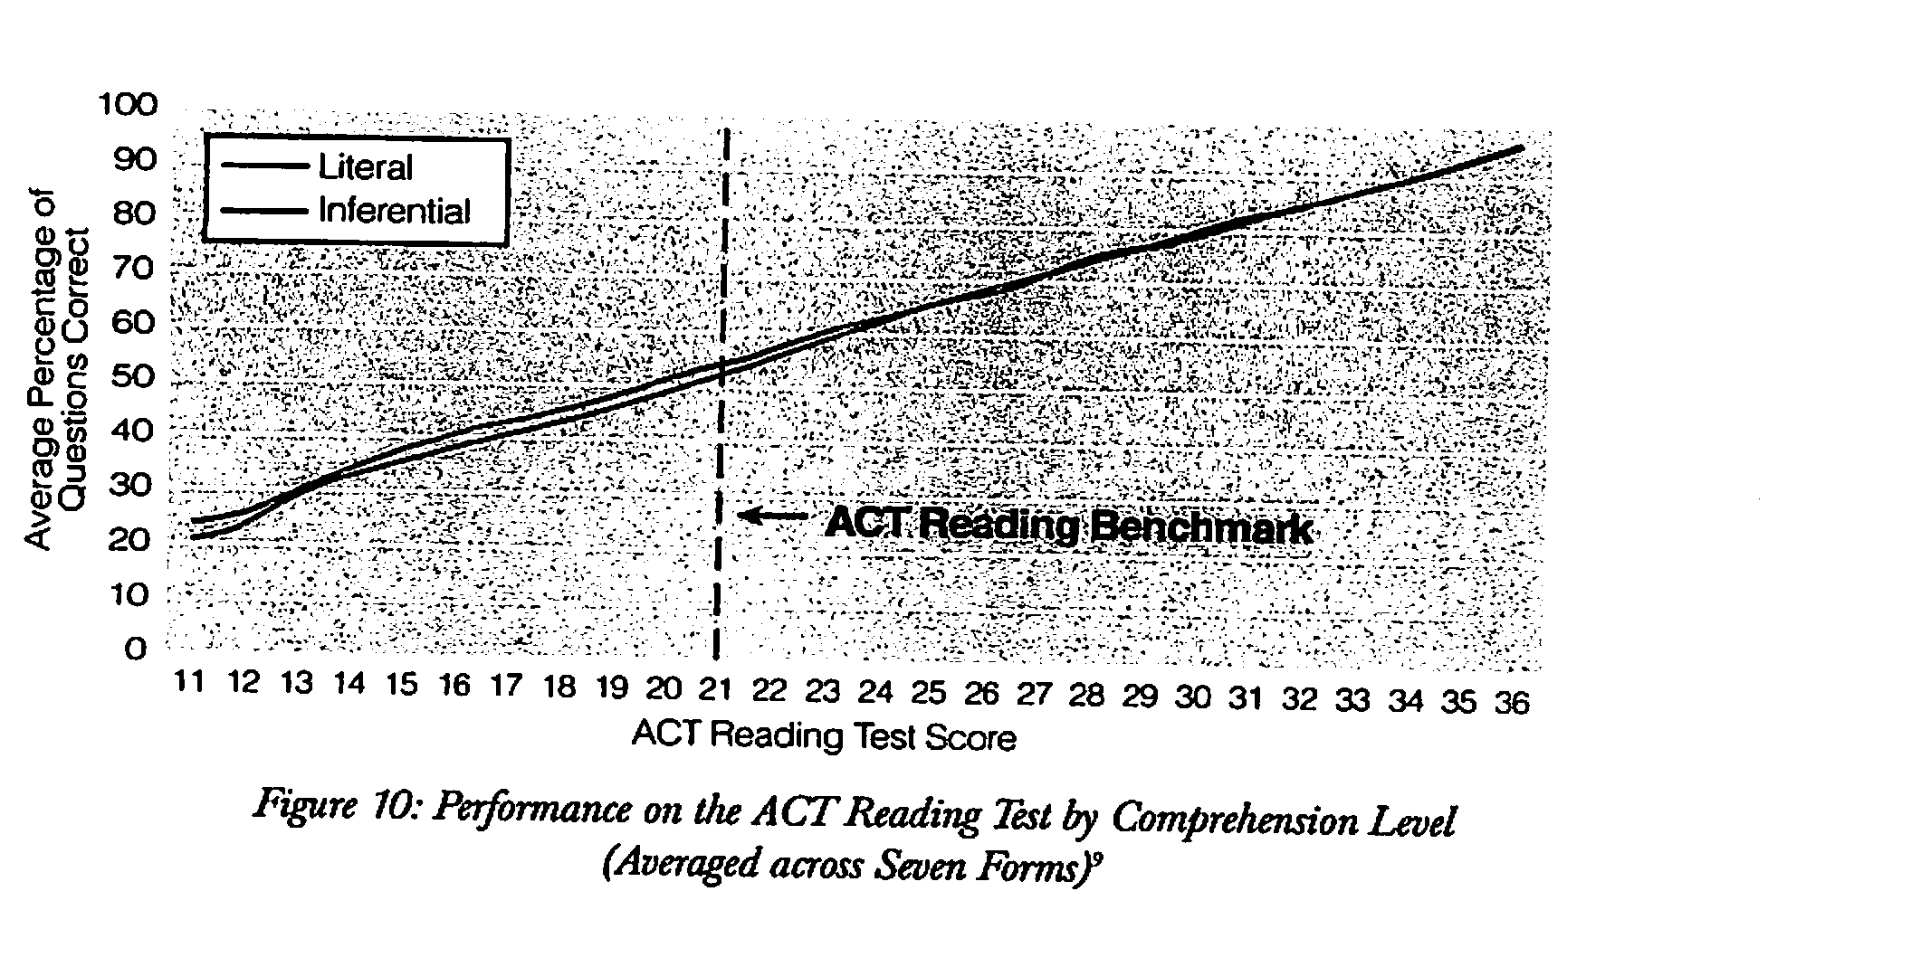
No performance differences due to question types (skills)

Slide 19
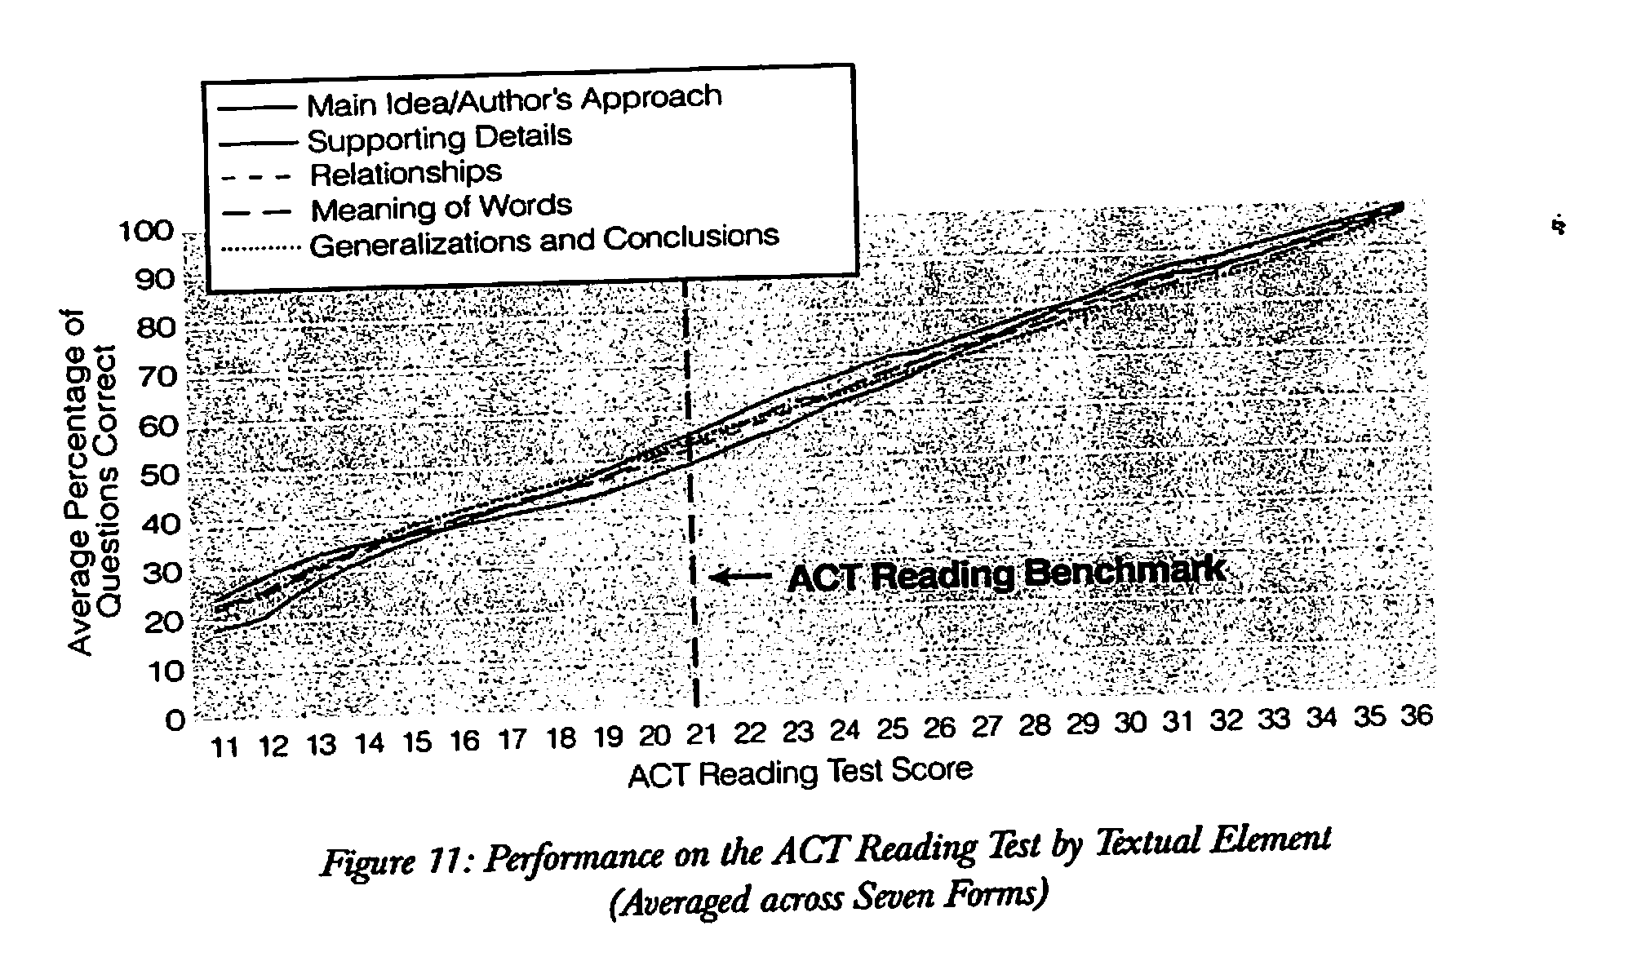
No performance differences due to question types (skills)

Slide 20
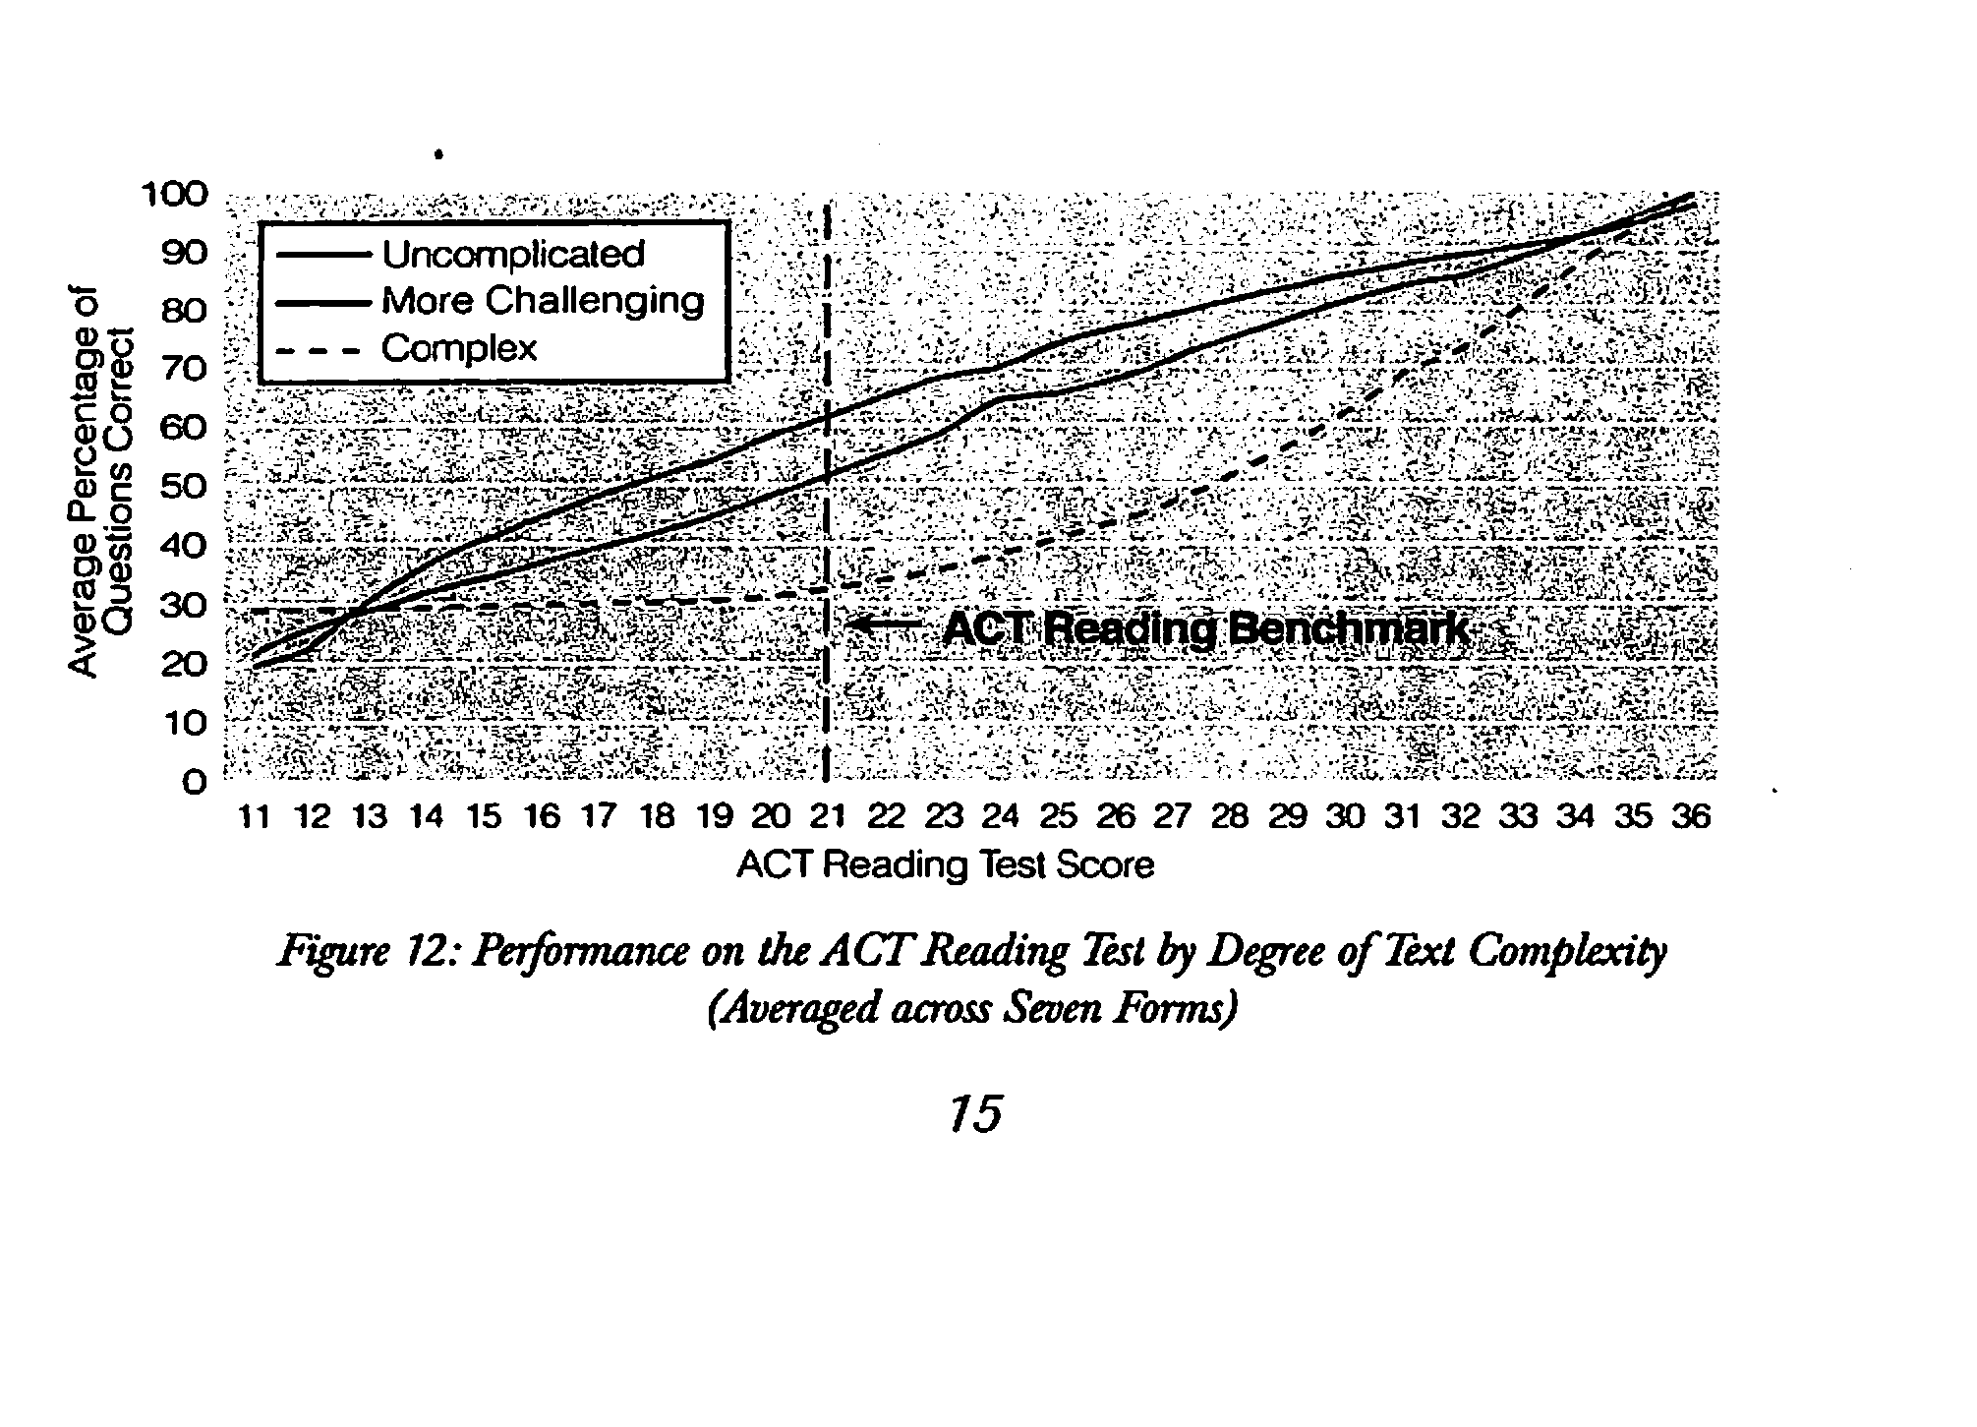
Text differences affect reading performance

Slide 21
Why Teach with Challenging Text (cont.(?
ACT concluded if the text was easy enough, students could answer any kind of question; and if the text was hard enough, students couldn’t answer any of kind of question
Teaching students to answer certain types of questions of texts written at their supposed “instructional levels” does not maximize student learning

Slide 22
What teachers do when texts get complex
Move kids to easier texts
Read the texts to the students
Tell students what the texts say
Ignore the fact that many students can’t make sense of the text
Teachers have no methods for teaching with challenging texts – so they avoid it

Slide 23
Instructional Level Theory
According to Betts (1946), research shows that all students have three reading levels, and they make optimum gains when taught at the instructional level
Also, very important to avoid frustration level texts since their use disrupts learning and suppresses motivation
Independent (fluency 99-100%; comprehension 90-100%)
Instructional (fluency 95-98%; comprehension 75-89%)
Frustration (fluency 0-92%; comprehension 0-50%)

Slide 24
What does science say?
Given the long history of the use of the instructional level, it should be clear that it is possible to teach students to read with such texts
The issue here isn’t ”does it work,” but “does it work best?”
The following studies make up the universe of data that we have on this issue

Slide 25
Killgallon, 1942
This was the study that Betts referred to in his textbook
Killgallon was his doctoral student, and this doctoral dissertation was never published (until an excerpt was published in 1983 by me)
The study was used to set the fluency criteria for informal reading inventories
It examined a small group of 4th graders to find out how many oral reading mistakes they could make and still accomplish 75% reading comprehension
Problem with the comprehension criteria as well

Slide 26
Powell, 1968
Powell agreed with the Killgallon/Betts methodology, but he believed they ended up with the wrong criteria
Collected multiple sets of data with large numbers of children in grades 1-8
These analyses found different relationships between fluency and comprehension at different grade levels
They also reported that students could handle much more disfluency than Betts/Killgallon claimed
Despite his extensive, contemporary data, Powell was treated as a kook in the field

Slide 27
Dunkeld, 1971
Dunkeld was a student of Powell, and this was his doctoral dissertation
This was not an experiment
Dunkeld tested a bunch of 2nd graders to determine how accurately they could read the words and comprehend the texts used to teach them to read
At the end of the year, students were retested to see how much growth
The greatest learning gains were for students with approximately 85% word reading accuracy and below 50% reading comprehension (frustration level– not instructional level)

Slide 28
Jorgensen, et al., 1977
Similar study to Dunkeld’s
This version monitored the reading progress of boys in the 3rd, 4th, and 5th grade
Found no consistent relationship between their instructional text placement and their learning progress (it didn’t make any difference whether students were placed at instructional or frustration level

Slide 29
Morgan, et al., (2000)
Morgan conducts the first true experiment evaluating the effectiveness of placing students at their instructional level
She tests second graders using the DRA and Betts’ criteria, then randomly assigns students to one of three treatment groups
One works at their instructional level, one works with texts two grade levels above their instructional level, and one at four grade levels above instructional level
The students taught at the instructional level made the lowest gains (those texts reduced opportunity to learn)

Slide 30
Brown, et al., (2017)
This study replicates theMorgan study
Same methodology but with third graders
Same result – frustration level placements allowed for greater learning progress

Slide 31
O’Connor et al. (2002)
Conducted an experiment with students who had IEPs (3rd, 4th, 5th graders)
The best readers were at the 2nd grade level (the rest were below this)
Students were tutored in PA, phonics, vocabulary, oral reading fluency, and reading comprehension
Random assignment to 3 groups: control group, and 2 groups tutored either with text at instructional or grade level
Problems with the study that I will ignore
She found that instructional level placement led to greater learning

Slide 32
O’Connor et al. (2010)
O’Connor reports problem with the first study – different tutor responses to misreadings (confound)
Decides to redo study – this time, training all tutors to respond to errors in the same way
Re-did the experiment (without the confound or the implementation problem)
Instructional level placement provided no benefit for students with learning disabilities – they made no more progress than the grade level placed students
Response of students with dyslexia?

Slide 33
Kuhn, et al., 2006
Quasi-experiment with 2nd graders
Students either taught with FORI using grade level texts or Guided Reading with students taught at reading levels
FORI kids made greater learning gains than Guided Reading
Continued study into 3rd grade – increased their advantages

Slide 34
Homan, et al., (2010)
They either taught sixth graders with instructional level text or with texts one year above their instructional levels
No benefit to the instructional level placements

Slide 35
Lupo, et al., (2019)
Taught 9th graders either at their instructional levels or at their grade level
Provided instructional guidance and support
There was no learning benefit to being placed in the easier texts, and the students preferred the grade level placements
The students who did better with the easier texts were “newcomer” English Learners

Slide 36
What that means
No studies have found instructional level placements to be beneficial (grades 2-9)
Older students preferred more challenging texts, though they needed more help with these
Studies either found no benefits to instructional level placement or that they hindered learning

Slide 37
Can we just throw students into challenging texts?
The basic idea of the instructional level is that if you match students to text appropriately you can increase learning and minimize the need for teaching
The basic idea of placing students in grade level text is that you can maximize learning – but there is no evidence that students can accomplish this without greater instructional efforts
Supplementing the reading of complex text with instructional guidance and scaffolding will allow students to deal with frustration level texts AS IF those texts were at their instructional level

Slide 38
Evidence scaffolding can do this
Bonfiglio, Daly, Persampieri, & Andersen, 2006
Burns, 2007
Burns, Dean, & Foley, 2004
Carney, Anderson, Blackburn, & Blessings, 1984
Daly & Martens, 1994
Eckert, Ardoin, Daisey, & Scarola, 2000
Faulkner & Levy, 1999
Gickling & Armstrong, 1978
Hall, Sabey, & McClellan, 2005
Levy, Nicholls, & Kohen, 1993
McComas, Wacker, & Cooper, 1996
Neill, 1979

Slide 39
Evidence scaffolding can do this (cont.)
O’Shea, Sindelar, & O’Shea, 1985
Pany & McCoy, 1988
Rasinski, 1990
Reitsma, 1988
Rose & Beattie, 1986
Sanford & Horner, 2013
Sindelar, Monda, & O’Shea, 1990
Smith, 1979
Stoddard, Valcante, Sindelar, O’Shea, et al., 1993
Taylor, Wade, & Yekovich, 1985
Turpie & Paratore, 1995
VanWagenen, Williams, & McLaughlin, 1994
Weinstein & Cooke, 1992
Wixson, 1986

Slide 40
Reconceptualizing Reading
Reading is not the ability to answer certain kinds of questions (skills)
It is the ability to read and understand text – to negotiate the conceptual, linguistic, and textual affordances

Slide 41
Scaffolding Complex Text
Text Scaffolds
Match of text and reader prior knowledge
Complexity of vocabulary
Complexity of syntax
Complexity of coherence
Familiarity of genre demands
Complexity of text organization
Subtlety of author’s tone
Sophistication of literary devices
Sophistication of data-presentation devices
Familiarity of print features (e.g., typography, page layouts, etc.)

Slide 42
Scaffolding Complex Text (cont.)
Other Instructional Supports
Oral reading fluency
Rereading
Comprehension strategies
Motivation

Slide 43
Build/Access Prior Knowledge
Readers do not just take in information – all learning is interpretive
We take in information through the lens of what we know (we interpret it, we combine it with already known information)
Texts may be challenging if they presuppose or require overt use of prior knowledge
Students can be guided to use their related experiences in ways that scaffolds the new knowledge
Too often we do this poorly in classrooms

Slide 44
Supporitng Knowledge Use
Knowledge activation : bringing to mind what one already knows
Knowledge building (integration/revision) : extending or adjusting what they have

Slide 45
Supporting knowledge use (cont.)
Previewing
Writing or discussing relevant knowledge
Apprentice texts
Text sets
Concept maps
Refutation texts
Connecting text info to knowledge

Slide 46
Previewing: Knowledge Activation
Quickly examining a text before reading it should provide some direction for prior knowledge considerations
Teachers (and textbooks) tend to provide a good deal of previewing which should facilitate comprehension
What is needed, however, is a more efficient and strategic approach to previewing
Previewing should be purposeful – it should reveal the genre, topic and direction of a text, and the type of information that will be provided
Different kinds of texts require different kinds of previewing
Previewing should be efficient – what text features will reveal what I’m looking for?

Slide 47
Writing & Discussion: Knowledge Activation
Doing a ”brain dump” of what you know about a topic
Brainstorm a list
Write for 1-3 minutes
Think/Pair/Share

Slide 48
Apprentice Texts: Building Knowledge
If text focuses on content that students are unlikely to know anything about, consider starting with a shorter, easier text on the same content
In other words, use their reading to build relevant prior knowledge – such reading reduces the degree of difficulty of the text to come by familiarizing students with the content that will be explained in a more extended, complete, and/or complex fashion in the later text

Slide 49
Text Sets: Building Knowledge
Building relevant knowledge through reading
Text sets provide mutual supports
Visual texts
Accessible texts
Motivational texts
Repeated reading of complex texts (chunks)

Slide 50
Supporting Knowledge Use
Don’t overdo it – supporting information should not be a repetition of the text (that does not enable more successful reading it replaces it)
A “prior knowledge” emphasis instead of “knowledge” emphasis has put too much focus on pre-reading
Supporting students use of their knowledge can include pre-reading, reading, and post-reading actions (Lupo, 2019
Relational reasoning: looking for similarities and differences with what you know or believe (Hattan & Lupo, 2020)

Slide 51
Supporting Knowledge Use (cont.)
Prior knowledge may overwhelm a text (readers tend to stay with their preconceptions, so if text information disagrees with a reader’s knowledge, the reader often fails to learn)
Too much prereading emphasis on prior knowledge may encourage this kind of non-learning
Refutation texts and relational reasoning exercises can help with this

Slide 52
Vocabulary Supports
Texts can be hard because of unfamiliar vocabulary (difference between academic vocabulary and key vocabulary in a text)
For most people, vocabulary challenge is the most obvious difficulty in reading a text
We teach vocabulary, but there are two major goals in vocabulary teaching:
  (1) building a lexicon
  (2) enabling immediate understanding of text

Slide 53
Building a Lexicon
This refers to increasing knowledge of word meanings
We want students to gain an increasingly large collection of words that they know the meanings of – this should help with future reading comprehension
These should be useful words that are useful – with frequent appearance in text
Lexicon building is what publishers usually focus on when it comes to vocabulary – they emphasize words with high utility (no matter their immediate utility in terms of the text about to be read)
Building a lexicon is labor intensive – it requires thorough instruction and review
This is important, but it is not our focus today

Slide 54
Enabling Comprehension
If my purpose is not to teach vocabulary, but to enable the successful comprehension of reading a particular text then instruction needs to shift
First, I wouldn’t focus on the most useful words (in terms of generalization to other texts), but to which words will be most disruptive to my immediate comprehension
We need to identify words that students are not likely to know or that can’t be figured out easily that may have high impact on reading comprehension (no matter their general value)
Second, I won’t try to teach such words thoroughly, but will aim for minimal but sufficient familiarization or support

Slide 55
Which Words to Teach
Photosynthesis may sound like a big word, but it's actually pretty simple. You can divide it into two parts: "Photo" is the Greek word for "Light," and "synthesis," is the Greek word for "putting together," which explains what photosynthesis is. It is using light to put things together. You may have noticed that all animals and humans eat food, but plants don't eat anything. Photosynthesis is how plants eat. They use this process to make their own food. Since they don't have to move around to find food, plants stay in one place, since they can make their food anywhere as long as they have three things.

Slide 56
Which Words to Teach (cont.)
Some scientists argued that these gases have heated up our atmosphere. They say global warming will affect our climate so dramatically that glaciers will melt and sea levels will rise. In addition, it is not just our atmosphere that can be polluted. Oil from spills often seeps into the ocean.

Slide 57
Which Words to Teach (cont.)
I can never forget the scene that met us. Between us and the Barrier was a lane of some fifty yards wide, a seething cauldron. Bergs were calving off as we watched: and capsizing: and hitting other bergs, splitting into two and falling apart. The Killers filled the whole place. Looking downwards into a hole between our berg and the next, a hole not bigger than a small room, we saw at least six whales. They were so crowded that they could only lie so as to get their snouts out of the water and my memory is that their snouts were bottle-nosed. At this moment our berg split into two parts and we hastily retreated to the lower and safer floes.
The Worst Journey in the World

Slide 58
Preteaching Vocabulary Words
Identify words that you suspect students won’t know, won’t be able to determine the meanings of from explicit definition, morphology, or context AND that will make a difference in comprehending the text
Those are the words that may be pre-introduced (there are times that I will not introduce them, such as when I’m teaching dictionary usage or distinguishing words that I can get from context from those I can’t)
Do not provide extensive prior instruction — telling the definitions or providing a glossary is sufficient (students only need familiarity or an immediate support)

Slide 59
Empower students to deal with vocabulary
Build vocabulary conscience -- teach students
  (1) to recognize when they don’t know the meaning of a word
  (2) to determine whether that lack of knowledge is a comprehension barrier
What to do if lack of vocabulary knowledge is a barrier

Slide 60
Empower students to deal with (cont.)vocabulary
Do not preteach any words that are explicitly defined in a text
Provide instruction/guidance in recognizing and understanding textually-explicit definitions
Provide instruction/guidance in use of text provided vocabulary supports (e.g., italics, marginal glosses, glossaries)

Slide 61
Empower students to deal with (cont.)vocabulary
  Do not preteach words that can be figured out from context
  Provide context interpretation exercises aimed both at identifying the utility of context in a given situation and in using context
  Ask vocabulary questions as part of comprehension discussion and follow up with scaffolded re-reading of relevant parts of text when students aren’t successful

Slide 62
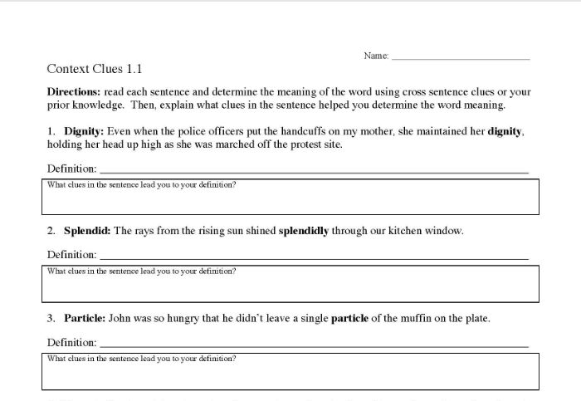
Empower students to deal with (cont.)vocabulary

Slide 63
Empower students to deal with (cont.)vocabulary
Additional items for a context exercise:
They want bullies to know that they are accountable.
As I looked around the room desperately, the teacher started handing out the papers.
Ineluctable modality of the visible: at least that if no more, thought through my eyes.

Slide 64
Empower students to deal with (cont.)vocabulary
Teach use of electronic and paper dictionaries
Teach students how to use a glossary
Encourage and reward dictionary/ glossary use
Teach morphology –meaningful parts of words

Slide 65
Comprehending Sentences
Texts may be hard because of grammar or syntax
Explain clearly using at least three different reasons or drawing three diagrams why McClellan lost the battle.
Explain clearly why McClellan lost the battle. Give at least three reasons or draw three diagrams.

Slide 66
Comprehending Sentences (cont.)
Reading requires more than an ability to make sense of word meanings
Comprehension also depends on one’s ability to make sense of syntax, too
Academic texts have much more challenging syntactic forms and relations than conversation or non-academic text

Slide 67
Comprehending Sentences (cont.)
“However, on August 24, 2006, the International Astronomical Union (IAU), a group of individual astronomers and astronomical societies from around the world, made an announcement.
25 words
5 commas
Acronym, caps, parentheses

Slide 68
Comprehending Sentences (cont.)
However,
on August 24 2006
the International Astronomical Union (IAU), a group of individual astronomers and astronomical societies from around the world
made
an announcement

Slide 69
Comprehending Sentences (cont.)
Who was the sentence about?
the International Astronomical Union (IAU)
Who are they?
a group of individual astronomers and astronomical societies from around the world
What did they do?
made
Made what?
an announcement
When?
on August 24 2006

Slide 70
Comprehending Sentences (cont.)
Sentence density: unpacking complex nouns
Experimental verification of Einstein’s explanation of the photoelectric effect was made 11 years later by the American physicist Robert Millikan.
Every aspect of Einstein’s interpretation was confirmed, including the direct proportionality of photon energy to frequency.

Slide 71
Comprehending Sentences (cont.)
“The women of Montgomery, both young and older, would come in with their fancy holiday dresses that needed adjustments or their Sunday suits and blouses that needed just a touch—a flower or some velvet trimming or something to make the ladies look festive.”
--Nikki Giovanni (Rosa)
44 words
2 commas, 1 em-dash

Slide 72
Comprehending Sentences (cont.)
“The women of Montgomery , both young and older, would come in with their fancy holiday dresses that needed adjustments or their Sunday suits and blouses that needed just a touch—a flower or some velvet trimming or something to make the ladies look festive.”

Slide 73
Comprehending Sentences (cont.)
“The women of Montgomery would come in with their fancy holiday dresses that needed adjustments or their Sunday suits and blouses that needed just a touch—a flower or some velvet trimming or something to make the ladies look festive.”

Slide 74
Comprehending Sentences (cont.)
“The women of Montgomery would come in with their fancy holiday dresses that needed adjustments or their Sunday suits and blouses that needed just a touch—a flower or some velvet trimming or something to make the ladies look festive.”

Slide 75
Comprehending Sentences (cont.)
“The women of Montgomery would come in with their fancy holiday dresses that needed adjustments
or their Sunday suits and blouses that needed just a touch
—a flower
or some velvet trimming
or something to make the ladies look festive.”

Slide 76
Comprehending Sentences (cont.)
“The women of Montgomery would come in with their fancy holiday dresses that needed adjustments
or their Sunday suits and blouses that needed just a touch
—a flower
or some velvet trimming
or something to make the ladies look festive.”

Slide 77
Comprehending Sentences (cont.)
“The women of Montgomery would come in with their fancy holiday dresses that needed adjustments
or The women of Montgomery would come in with their Sunday suits and blouses that needed just a touch
—a flower
or some velvet trimming
or something to make the ladies look festive.”

Slide 78
Identify Challenging Sentences
Particularly long sentences
Internal punctuation
Dependent clauses
Multiple phrases
Parentheticals
Passive voice
Etc.
Write a question for the sentences
Break the sentences down (punctuation, conjunctions, demonstrative pronouns, prepositions, etc.)

Slide 79
Sentence Instruction
Teach oral reading fluency with a focus on prosody (making sentences sound meaningful)
Involve students in sentence combining and reduction (like in the examples)
Identify complex sentences in texts students are to read and ask questions that will reveal whether those particular sentences were comprehended
Guide students a sentence at a time through a complex text – getting students to paraphrase the sentences and breaking down those that they can’t successfully paraphrase
https://www.shanahanonliteracy.com/blog/trying-again-what-teachers-need-to-know-about-sentence-comprehension#sthash.sgOJnmS0.dpbs

Slide 80
Teaching Cohesion
Texts are not just lists of sentences
The ideas in text are connected within and across sentences
Texts can be hard because the relationships and connections may be unclear to readers
These difficulties can be traced to the distance between concepts, the subtlety of the connections, and the potential for ambiguity

Slide 81
Teaching Cohesion (cont.)
The killer whale tosses the penguin into the air and generally torments its prey before it eats it
The killer whale tosses the penguin into the air and generally torments the penguin before eating it.

Slide 82
Teaching Cohesion (cont.)
Meanwhile, the nebula continued to orbit the new Sun until it formed a large flat ring around it. Scientists call this ring a “protoplanetary disk.” The disk, or ring, was hottest where it was closest to the Sun, and coolest at its outer edge. As the disk swirled around the Sun, the Sun’s gravity went to work. It pulled and tugged at the bits of rock, dust, ice, and gas until they came together in clumps of material we now call the planets.

Slide 83
Teaching Cohesion (cont.)
Meanwhile, the nebula continued to orbit the new Sun until it formed a large flat ring around it. Scientists call this ring a “protoplanetary disk.” The disk, or ring, was hottest where it was closest to the Sun, and coolest at its outer edge. As the disk swirled around the Sun, the Sun’s gravity went to work. It pulled and tugged at the bits of rock, dust, ice, and gas until they came together in clumps of material we now call the planets.

Slide 84
Teaching Cohesion (cont.)
Meanwhile, the nebula continued to orbit the new sun until it formed a large flat ring around it. Scientists call this ring a “protoplanetary disk.” The disk, or ring, was hottest where it was closest to the Sun, and coolest at its outer edge. As the disk swirled around the Sun, the Sun’s gravity went to work. It pulled and tugged at the bits of rock, dust, ice, and gas until they came together in clumps of material we now call the planets.

Slide 85
Teaching Cohesion (cont.)
Meanwhile, the nebula continued to orbit the new Sun until it formed a large flat ring around it. Scientists call this ring a “protoplanetary disk.” The disk, or ring, was hottest where it was closest to the Sun, and coolest at its outer edge. As the disk swirled around the Sun, the Sun’s gravity went to work. It pulled and tugged at the bits of rock, dust, ice, and gas until they came together in clumps of material we now call the planets.

Slide 86
Teaching Cohesion (cont.)
Meanwhile, the nebula continued to orbit the new Sun until it formed a large flat ring around it. Scientists call this ring a “protoplanetary disk.” The disk, or ring, was hottest where it was closest to the Sun, and coolest at its outer edge. As the disk swirled around the Sun, the Sun’s gravity went to work. It pulled and tugged at the bits of rock, dust, ice, and gas until they came together in clumps of material we now call the planets.

Slide 87
Teaching Cohesion (cont.)
Meanwhile, the nebula continued to orbit the new Sun until it formed a large flat ring around it. Scientists call this ring a “protoplanetary disk.” The disk, or ring, was hottest where it was closest to the Sun, and coolest at its outer edge. As the disk swirled around the Sun, the Sun’s gravity went to work. It pulled and tugged at the the bits of rock, dust, ice, and gas until they came together in clumps of material we now call the planets.

Slide 88
Teaching Cohesion (cont.)
Meanwhile, the nebula continued to orbit the new Sun until it formed a large flat ring around it. Scientists call this ring a “protoplanetary disk.” The disk, or ring, was hottest where it was closest to the Sun, and coolest at its outer edge. As the disk swirled around the Sun, the Sun’s gravity went to work. It pulled and tugged at the bits of rock, dust, ice, and gas until they came together in clumps of material we now call the planets.

Slide 89
Guidelines for Cohesion Scaffolding
Identify the repetitions, synonyms, pronouns (mark the text to show the connections)
Identify the conjunctions (and, moreover, however, but, consequently, etc.)
Spanish speakers have particular difficulty with abstract pronouns (e.g., one, any) and with gender markers (e.g., his, her, him, it)
Ask questions that reveal whether students are successfully making the links (The text says, “He rose early.” Who rose early? Why? -- Guide students to make links among the various repetitions, pronouns, synonyms, etc.)

Slide 90
Text Structure
Texts can be hard because they are organized in complex ways
The structure of what is read can help students determine importance.
Need to make sure that students know common text organization schemes (description; compare/contrast; problem-solution; sequence; enumeration)
Need to guide students to use headings and subheadings can help students learn the scope and sequence of information
Need to examine particular texts to see if organization holds a special key to the meaning (like in a comparison text or problem-solution text) and to guide students to attend to this structure

Slide 91
Text Structure (cont.)
Authors organize their ideas
Some structures are used by many authors
Widely used structures:
Description/enumeration
Sequence/chronological order
Comparison/contrast
Problem/solution
Cause/effect
Argument

Slide 92
Story Map
Setting :
Main Character:
Problem:
Internal Response:
Attempt:
Outcome:
Reaction:
Theme:

Slide 93
Text Structure (cont.)
Readers use the authors structure to guide their understanding and recall
If the reader is able to recognize the organizational plan, then this can be used to remember the text
If the reader does not recognize a common organizational plan, it helps to impose one
This often can be done by briefly identifying the main point of each paragraph or section

Slide 94
Research-based PD on text structure
http://literacy.io/

Slide 95
Build Text Reading Fluency
Texts can be hard because they demand more advanced reading skills than the students have
Students need practice reading (orally) with accuracy, appropriate speed, and prosody
Not round-robin reading (use these instead: repeated reading, echo reading, paired reading, reading while listening, etc.)
Putting fluency first might make sense
Parsing texts can be helpful

Slide 96
Parsing Text
Sunbeams/ are flickering/ over the landscape/ as the sun rises./ A kit fox/ heads/ for her den/ as another day/ in the desert/ begins./
Deserts/ are surrounded/ by other kinds of landscapes./ Scientists/ call/ these different land zones/ biomes. All the plants and animals/ in a biome/ form/ a community./ In that community,/ every living thing/ depends/ on other community members/ for its survival./ A biome’s climate, soil, plants, and animals/ are all connected/ this way./

Slide 97
Repetition
One of the most powerful scaffolds is also one of the most obvious—reading a text more than once makes it more accessible
In the past, we tended to have students read a text a single time, but as the text challenge increases it is essential that we encourage students to read texts (and parts of texts) more than once to make sense of it
This is an effective strategy, but it is expensive too (the idea is to become successful with these texts—which should make it possible to succeed with other texts later with less work)
Explain this to students

Slide 98
Comprehension Strategies
Research shows that when students are active readers—that is, when they are actively trying to understand a text—they comprehend and remember more
Comprehension strategies are a proven way to get students to think about the ideas in a text
Summarization, questioning, monitoring, seeking particular kinds of information have all been found to stimulate learning

Slide 99
Motivation
The instructional level is based on the idea that students seek easy work--that if the work is challenging, they will stop trying
But research shows that students seek challenge and are motivated by it
Challenge only works if it is not overwhelming and if students see the possibility of getting better/stronger, etc.
Don’t make challenging text a secret—tell kids what is happening and show them how you will make them effective
Research also shows that students are interested in more challenging content (and on their own, they’ll fight through more challenging text to get to this content)—using challenging text opens up content possibilities

Slide 100
Conclusions
I can’t learn from a text that I can’t figure out.
But I can learn from one that I don’t understand initially if I operate on it properly
Persistence depends upon my awareness that I can successfully take control in such situations
A steady diet of instructional level text restricts/limits the text barriers that I can gain experience with
But providing students complex text alone – without scaffolding, guidance, and teaching – provides opportunity without ensuring learning
Make students powerful, teach them to read complex texts

