Slide 1
Teaching Students to Read Disciplinary Text, Grade 6-12
Timothy Shanahan
University of Illinois at Chicago
www.shanahanonliteracy.com

Slide 2
State Educational Standards and Text Complexity
Most state reading standards require that students implement comprehension standards with texts of specific levels of difficulty
These text requirements are at higher levels than has been typical of grade level texts
By making text level part of the learning kids are to achieve—they discourage teaching reading with out-of-level texts

Slide 3
Reasons for the shift to an emphasis on text complexity
Studies showing that students can’t read the required texts when they leave high school (Achieve, 2015; Military Officers Association of America, 2018; Nale, et al., 1998; Williamson, 2006; Workforce Readiness Project, 2006)
Schools teach kids with below grade level texts (Shanahan, 2013; Griffith & Duffett, 2018)

Slide 4
Reasons for the shift to an emphasis on text complexity (cont.)
Skills performances do not reveal how well students can read, but text performances do
Studies show that reading tests measure how well students can comprehend text passages—not how well they can answer particular types of questions (skills) (ACT, 2006; Davis, 1944; Muijselaar, et al., 2017; Spearritt, 1972; Thorndike, 1972)

Slide 5
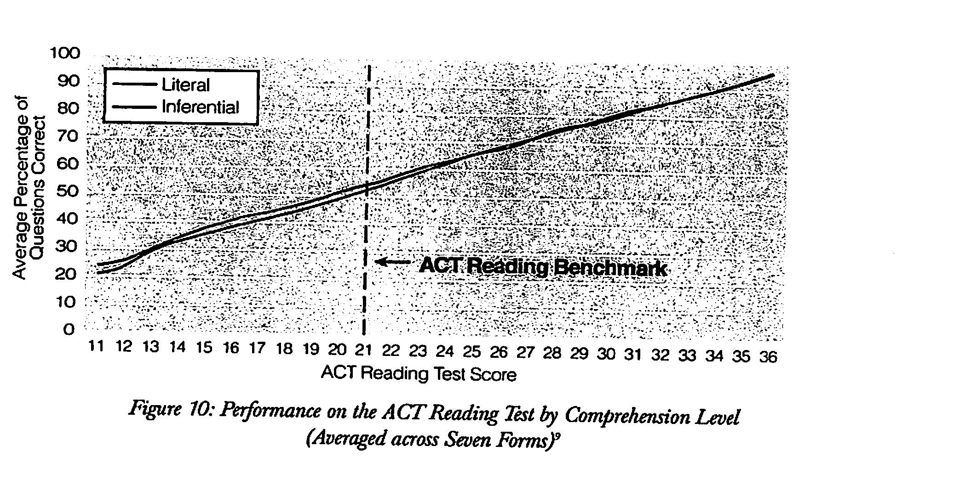
No performance differences due to question types (skills)

Slide 6
No performance differences due to question types (cont.)

Slide 8
Text differences affect reading performance

Slide 9
Reconceptualization on Reading
Reading is not the ability to answer certain kinds of questions
It is the ability to read and understand text—to negotiate the conceptual, linguistic, and textual affordances and barriers included in a text

Slide 10
Results of complex texts mandates
RAND conducted nationwide survey of elementary and secondary teachers (2016)
77% of elementary teachers thought that teaching students with texts at their “reading levels” was aligned with the standards
45% of secondary teachers believed this
Only about one-third of elementary teachers and ½ secondary teachers thought that they should assign a grade level text for classes
Teachers who knew the standards were less likely to use leveled readers to teach reading

Slide 11
Results of complex texts mandates (cont.)
Thomas Fordham Foundation conducted national survey of teachers in 2018 and found that teachers were less likely to have students read grade level texts for reading than was true in 2010 when they previously surveyed
What these studies tell us is that teachers often lack understanding of their state’s educational standards and that students are less likely to be taught to read complex texts than before so many states mandated it

Slide 12
What teachers do when texts get complex
Move kids to easier texts
Read the texts to the students
Tell students what the texts say
Ignore the fact that many students can’t make sense of the text

Slide 13
Reasons for teaching students with easier text
The basic idea has been that students learn to read best from texts that are relatively easy
Various experts have claimed that if the books are too hard, then students will not be able to learn to read them
Consequently, there are many schemes for placing kids in text levels and for teaching with “instructional level” texts

Slide 14
Teaching students with easier text
Theory has been that students learn best when taught with relatively easy text (Betts,1946)
Independent (fluency 99-100%; comprehension 90-100%)
Instructional (fluency 95-98%; comprehension 75-89%)
Frustration (fluency 0-92%; comprehension 0-50%)

Slide 15
Source of Betts’ criteria
Betts claimed text-matching was validated by Killgallon study
But, Killgallon examine only a small group of children at one grade level with no measure of learning
I discovered this huge gap in the research record (Shanahan, 1983)

Slide 16
Matching texts to student levels doesn’t improve achievement
Killgallon (1942): only looked at relationship of oral reading fluency and reading comprehension—not learning
Powell (1968): same methodology as Killgallon, but more grade levels and different results
Dunkeld (1981): students taught at frustration level made greatest learning gains
Jorgensen, et al. (1977): no relation between placement and achievement gains

Slide 17
Matching texts to student levels doesn’t improve achievement
Morgan, et al. (2000): frustration level placements led to greater learning gains
Brown et al. (2017): replicates this result with third grade
O’Connor et al (2002, 2010): only benefit was for students reading at grade 1 level, but this benefit went away if scaffolding was equated
Kuhn et al (2006): frustration level placement led to greater learning gains
Homan, et al., (2010): teaching 6th graders with instructional level text gave no advantage over teaching with text one year above instructional level
Lupo et al., (2019): no learning benefit for 9th graders from working with easier texts

Slide 18
But can we just throw students into difficult text?
No real evidence based on learning that shows instructional level works
However, the idea has burgeoned because just placing students in demanding texts that they cannot read well was not working well
Where does that leave us?

Slide 19
Traditional instructional level theory
Instructional level theory: learning is facilitated by ensuring students can read instructional texts with relatively good fluency and comprehension; accomplished by placing students in relatively easy texts
Reader Level
Text Level
2 variables

Slide 20
Powell’s mediated text theory
Learning from relatively harder texts is superior because teaching can facilitate/mediate students’ interactions with text in ways that allows students to bridge the gap
Mediation
Reader Level
Text Level
3 variables

Slide 21
Any evidence that this is possible?
Yes, quite a bit
Many studies show that – with scaffolding – students can read “frustration level” texts as if they had been placed in books at their “instructional levels”
Remember the O’Connor studies: instructional level made a learning differences until she standardized the teacher scaffolding…that’s one

Slide 22
Learning from complex text
Having students reading challenging text with accountability increases opportunity to learn
But students--if they are to be successful with this--require scaffolding, guidance, and teaching
A basic idea of instructional level teaching is to minimize teaching
The basic idea of teaching with complex text is to maximize achievement

Slide 23
Scaffolding an Instructional Level
Bonfiglio, Daly, Persampieri, & Andersen, 2006
Burns, 2007
Burns, Dean, & Foley, 2004
Carney, Anderson, Blackburn, & Blessings, 1984
Daly & Martens, 1994
Eckert, Ardoin, Daisey, & Scarola, 2000
Faulkner & Levy, 1999
Gickling & Armstrong, 1978
Hall, Sabey, & McClellan, 2005
Levy, Nicholls, & Kohen, 1993
McComas, Wacker, & Cooper, 1996
Neill, 1979

Slide 24
Scaffolding an Instructional Level
O’Shea, Sindelar, & O’Shea, 1985
Pany & McCoy, 1988
Rasinski, 1990
Reitsma, 1988
Rose & Beattie, 1986
Sanford & Horner, 2013
Sindelar, Monda, & O’Shea, 1990
Smith, 1979
Stoddard, Valcante, Sindelar, O’Shea, et al., 1993
Taylor, Wade, & Yekovich, 1985
Turpie & Paratore, 1995
VanWagenen, Williams, & McLaughlin, 1994
Weinstein & Cooke, 1992
Wixson, 1986

Slide 25
Lupo, et al., 2019

Slide 26
Scaffolding Challenging Text
Scaffolding Text Features
Complexity of ideas/content
Match of text and reader prior knowledge
Complexity of vocabulary
Complexity of syntax
Complexity of coherence
Familiarity of genre demands
Complexity of text organization
Subtlety of author’s tone
Sophistication of literary devices or data-presentation devices
Other Approaches
Provide sufficient fluency
Use stair-steps or apprentice texts
Teach comprehension strategies
Motivation

Slide 27
Build/Access Prior Knowledge
Readers do not just take in information – all learning is interpretive
This, in part, means that we take in information through the lens of what we know (we interpret it, we combine it with already known information)
Texts can be challenging if they presuppose or require overt use of particular prior knowledge
Students can be guided to use their related experiences in ways that scaffolds the new knowledge
Too often we do this poorly

Slide 28
"The procedure is actually quite simple. First you arrange items into different groups. Of course one pile may be sufficient depending on how much there is do. If you need to go somewhere else due to a lack of facilities, then this is the next step; otherwise, you are pretty well set. It is important not to overdo things. That is, it is better to do too few things at once than too many. In the short run, this may not seem important but complications can easily arise. A mistake can be expensive as well. At first, the whole procedure will seem complicated. Soon, however, it will become just another facet of life. It is difficult to foresee any end to the necessity for this task in the future, but then, one can never tell. After the procedure is completed, one arranges the materials into different piles again. Eventually they will be used one more and the whole cycle will then have to be repeated. However, that is part of life."

Slide 29
Washing Clothes
"The procedure is actually quite simple. First you arrange items into different groups. Of course one pile may be sufficient depending on how much there is do. If you need to go somewhere else due to a lack of facilities, then this is the next step; otherwise, you are pretty well set. It is important not to overdo things. That is, it is better to do too few things at once than too many. In the short run, this may not seem important but complications can easily arise. A mistake can be expensive as well. At first, the whole procedure will seem complicated. Soon, however, it will become just another facet of life. It is difficult to foresee any end to the necessity for this task in the future, but then, one can never tell. After the procedure is completed, one arranges the materials into different piles again. Eventually they will be used one more and the whole cycle will then have to be repeated. However, that is part of life."

Slide 30
Recht & Leslie, 1988

Slide 31
Supporting Knowledge Use
Knowledge activation: bringing to mind what one already knows
Knowledge integration/revision: extending or adjusting what they have

Slide 32
Supporting knowledge use (cont.)
Don’t overdo it – provide supporting information not just a repetition of the text
“Prior knowledge” emphasis instead of knowledge emphasis has put too much focus on pre-reading
Supporting students use of knowledge can include pre-reading, reading, and post-reading actions

Slide 33
Supporting knowledge use (cont.)
A student’s prior knowledge may also overwhelm a text (readers tend to stay with their preconceptions, so if text information is in disagreement with reader knowledge, the reader often fails to learn)
Too much prereading emphasis on prior knowledge can encourage this kind of non-learning

Slide 34
Supporting knowledge use (cont.)
Writing or discussing relevant knowledge
Text sets
Concept maps
Refutation texts
Connecting text info to knowledge

Slide 35
Text sets
Building relevant knowledge through reading
Text sets provide mutual supports
Visual texts
Accessible texts
Motivational texts
Repeated reading of complex texts (chunks)

Slide 36
Risko & Alvarez, 1986

Slide 38
Hattan & Alexander, 2021

Slide 39
Tell Vocabulary
Texts can be hard because of unfamiliar vocabulary (difference between academic vocabulary and key vocabulary in a text)
We teach vocabulary, but there are two major issues in vocabulary teaching: (1) building a lexicon; (2) enabling immediate understanding of text
We need to identify relatively high frequency (usefulness) words that kids won’t learn on their own from oral language to build lexicon (no matter what their immediate impact)
We need to identify words that students are not likely to know or that can’t be figured out easily that have high impact on reading comprehension (no matter their importance).

Slide 40
Which words do you teach?
Photosynthesis may sound like a big word, but it's actually pretty simple. You can divide it into two parts: "Photo" is the Greek word for "Light," and "synthesis," is the Greek word for "putting together," which explains what photosynthesis is. It is using light to put things together. You may have noticed that all animals and humans eat food, but plants don't eat anything. Photosynthesis is how plants eat. They use this process to make their own food. Since they don't have to move around to find food, plants stay in one place, since they can make their food anywhere as long as they have three things.

Slide 41
Which words do you teach?
Photosynthesis may sound like a big word, but it's actually pretty simple. You can divide it into two parts: "Photo" is the Greek word for "Light," and "synthesis," is the Greek word for "putting together," which explains what photosynthesis is. It is using light to put things together. You may have noticed that all animals and humans eat food, but plants don't eat anything. Photosynthesis is how plants eat. They use this process to make their own food. Since they don't have to move around to find food, plants stay in one place, since they can make their food anywhere as long as they have three things.

Slide 42
Which words would you teach?
Some scientists argued that these gases have heated up our atmosphere. They say global warming will affect our climate so dramatically that glaciers will melt and sea levels will rise. In addition, it is not just our atmosphere that can be polluted. Oil from spills often seeps into the ocean.

Slide 43
Which words would you teach?
I can never forget the scene that met us. Between us and the Barrier was a lane of some fifty yards wide, a seething cauldron. Bergs were calving off as we watched: and capsizing: and hitting other bergs, splitting into two and falling apart. The Killers filled the whole place. Looking downwards into a hole between our berg and the next, a hole not bigger than a small room, we saw at least six whales. They were so crowded that they could only lie so as to get their snouts out of the water and my memory is that their snouts were bottle-nosed. At this moment our berg split into two parts and we hastily retreated to the lower and safer floes.

Slide 44
Which words would you teach?
I can never forget the scene that met us. Between us and the Barrier was a lane of some fifty yards wide, a seething cauldron. Bergs were calving off as we watched: and capsizing: and hitting other bergs, splitting into two and falling apart. The Killers filled the whole place. Looking downwards into a hole between our berg and the next, a hole not bigger than a small room, we saw at least six whales. They were so crowded that they could only lie so as to get their snouts out of the water and my memory is that their snouts were bottle-nosed. At this moment our berg split into two parts and we hastily retreated to the lower and safer floes.

Slide 45
Guidelines for vocabulary scaffold
Focus on words that make a difference in comprehending the text.
Do not preteach words that are explicitly defined in the text.
Do not preteach words that can be figured out from context.
Do not provide extensive prior instruction—telling or providing a glossary is enough.
Follow up: reading should stimulate growth in vocabulary.

Slide 46
Vocabulary
 | Key Vocabulary Text Defined | Key Vocabulary Context Defined | Key Vocabulary Preteach
1.
2.
3.
4.
5.
6
7.
8.
9.
10.

Slide 47
Common Prefixes
Prefix | Meaning | Example
anti- | against | antisocial
de- | opposite | decode
dis- | not, opposite of | disagree
en-, em- | put into, provide with | enslave, empower
fore- | before | foresee
in-, im- | in | infield
in-, im-, il-, ir- | not | impossible, inaction
inter- | between | intersection
mid- | middle | midway
mis- | wrongly | mispronounce
non- | not | nonsense

Slide 48
Common Prefixes
Prefix | Meaning | Example
over- | over | overwork
pre- | before | prepay
re- | again | remember
semi- | half | semicircle
sub- | under | submarine
super- | above | Superman
trans- | across | transplant
un- | not | unfriendly
under- | under | underwear
White, T.G., Sowell, J., & Yanagihara, A. (1989). Teaching elementary students to use word-part clues. The Reading Teacher, 42, 302-308.

Slide 49
Common suffixes
Suffix | Meaning | Example
-ity, -ty | state of | infinity
-ive, -ative, -itive | adjective form of noun | attentive
-less | without | hopeless
-ly | characteristic of | kindly
-ment | action or process | enjoyment
-ness | state of, condition of | happiness
-ous, -eous, -ious | possessing the qualities of | joyous
-s, -es | more than one | cars
-y | characterized by | funny
White, T.G., Sowell, J., & Yanagihara, A. (1989). Teaching elementary students to use word-part clues. The Reading Teacher, 42, 302-308.

Slide 50
Common suffixes
Suffix | Meaning | Example
-able, ible | can be done | comfortable
-al, ial | having characteristics of | partial
-ed | past-test verbs | helped
-en | made of | golden
-er | one who | player
-er | comparative | faster
-est | comparative | fastest
-ful | full of | careful
-ic | having characteristics of | romantic
-ing | present-tense verbs | running
-ion,-tion,-ation, -ition | act, process | action

Slide 51
Morphology varies by discipline
Of course, different disciplines use different words
But the frequency or value of prefixes, suffixes, and (especially) combining
forms differs by discipline
See: Word ID: Assessment Across the Content Areas by Linda Gutlohn
& Frances Besselieu

Slide 52
Prefixes
 | ELA | Math | Science | Soc Studies
com- | X | X | X | X
con- | X | X | X | X
de- | X | X | X | X
dis- |  | X |  | X
ex- | X | X | X | X
in- | X | X | X | X
inter- |  | X
pre- | X
pro- | X | X |  | X
re- | X | X | X | X
sub- | X | X
trans- |  |  | X
un- |  | X

Slide 53
Derivational Suffixes
 | ELA | Math | Science | Soc Studies
-al | X | X | X | X
-ar |  | X | X
-ary | X |  |  | X
-ate | X | X | X | X
-ation | X | X | X | X
-ent |  | X | X | X
-ic | X | X | X | X
-ism |  |  | X | X
-ist |  |  |  | X
-ity | X | X | X | X
-ive | X | X | X | X
-ize | X |  | X | X
-ment | X | X | X | X

Slide 54
Derivational Suffixes (cont.)
 | ELA | Math | Science | Soc Studies
-or |  |  | X | X
-sion | X | X | X | X
-tion | X | X | X | X
-ture | X |  |  | X

Slide 55
Greek Combining Forms
 | ELA | Math | Science | Soc Studies
ana | X
arch |  |  |  | X
auto |  |  |  | X
bio |  |  | X | X
chem |  |  | X
cracy, crat |  |  |  | X
dem, demo |  |  |  | X
eco |  |  |  | X
electro, elect |  |  | X
endo |  |  | X
geo |  |  | X | X
gon |  | X
gram |  | X

Slide 56
Greek Combining Forms (cont.)
 | ELA | Math | Science | Soc Studies
graph | X |  |  | X
hedron |  | X
hydro |  |  | X
logy (ology) | X |  | X | X
meter, metr |  | X | X
micro |  |  | X
nym, onym | X
-oid |  |  | X
para | X | X
photo |  |  | X
poly |  | X
scope |  |  | X
sphere |  |  | X | X

Slide 57
Greek Combining Forms (cont.)
 | ELA | Math | Science | Soc Studies
sym- |  | X
syn- | X |  | X
therm, thermo |  |  | X
tri- |  | X

Slide 58
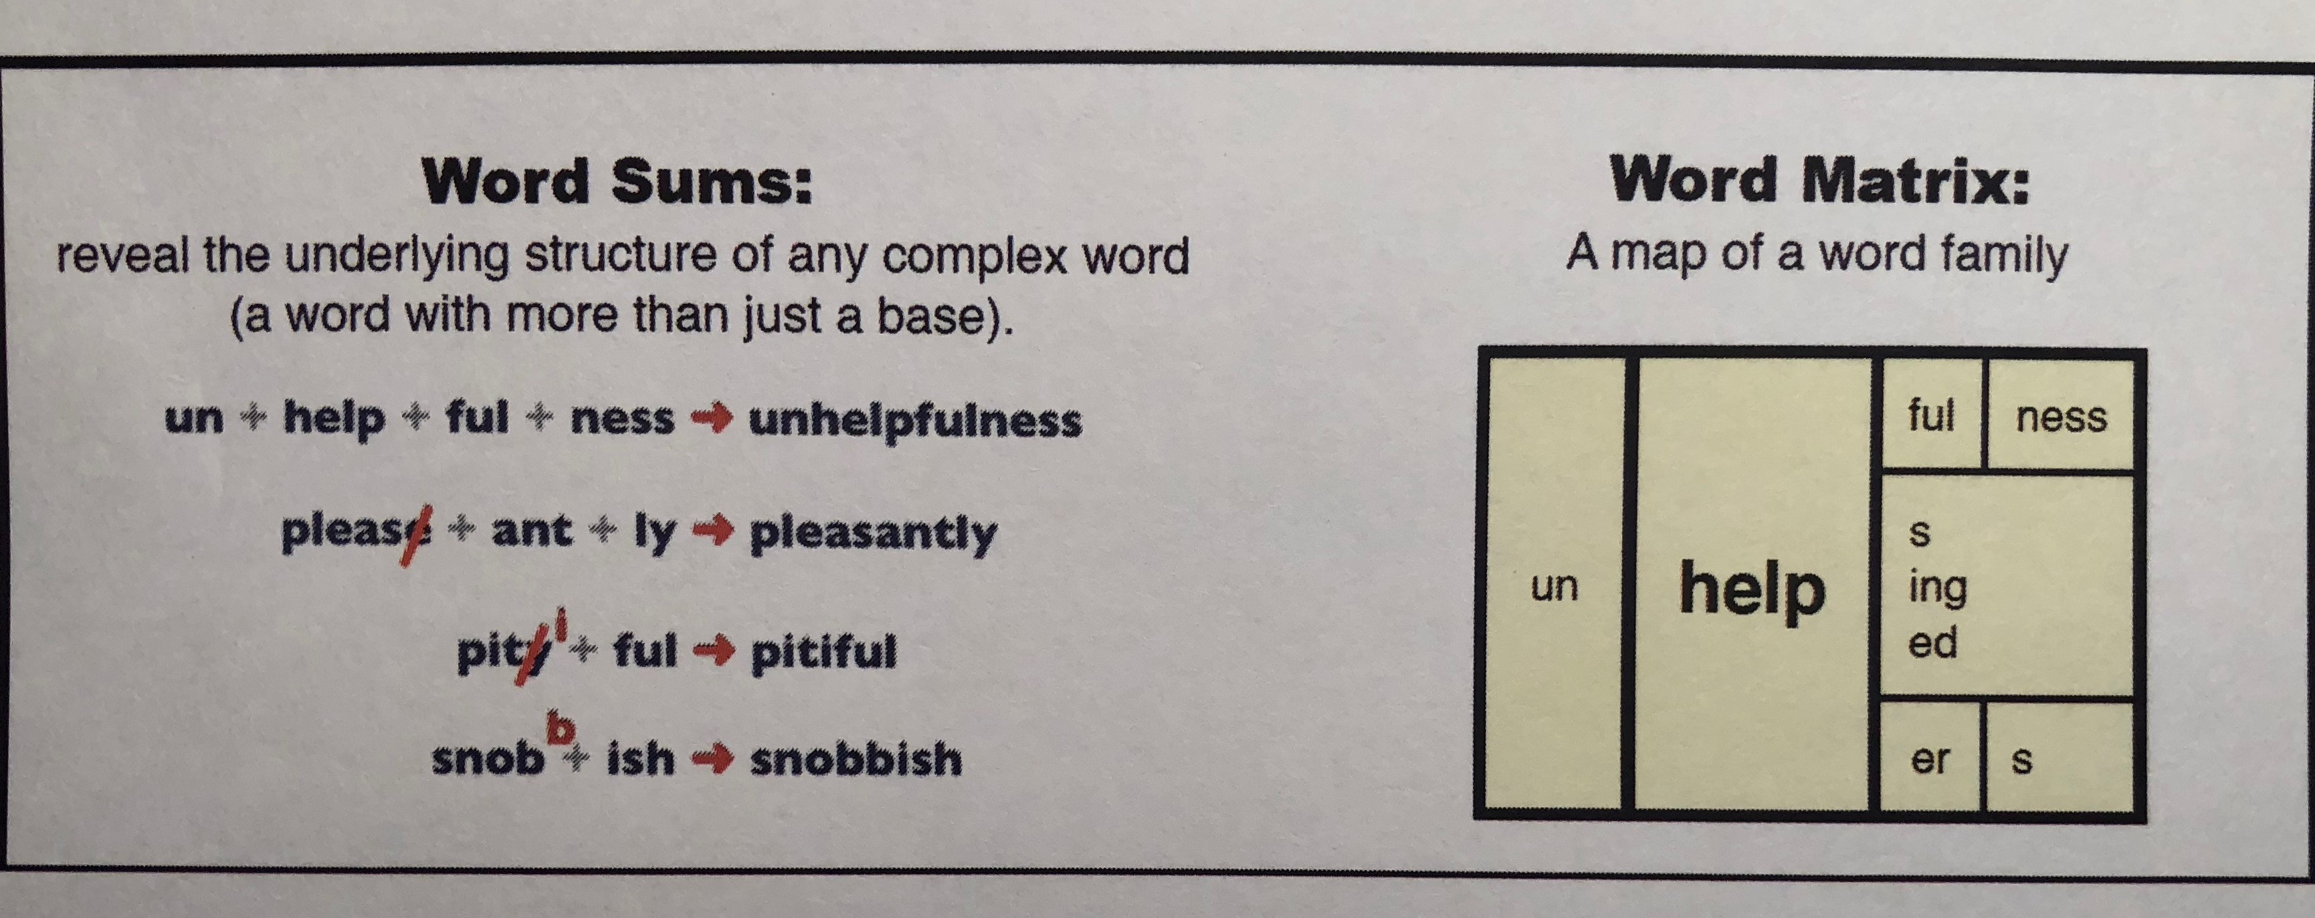
Vocabulary: Morphology
Analyzing words
Peter & Jeffrey Bowers

Slide 59
Help with Sentence Structure
Texts may be hard because of grammar or syntax
Explain clearly using at least three different reasons or drawing three diagrams why McClellan lost the battle.
Explain clearly why McClellan lost the battle. Give at least three reasons or draw three diagrams.

Slide 60
Comprehending Sentences
Reading requires more than an ability to make sense of word meanings
Comprehension also depends on one’s ability to make sense of syntax, too
Academic texts have much more challenging syntactic forms and relations than conversation or non-academic text

Slide 61
Biber & Gray, 2016

Slide 62
Grammatical features in academic prose
Nouns and noun phrases
Nouns: overall | ~60% of all content words in academic prose are nouns
Nouns vs. pronouns | Nouns much more common than pronouns
Absence of pronouns | Generally rare in academic prose
Specific pronouns: this, and one | Much more common in academic prose (this is used for textual reference; one used for general rather than specific reference
Plural nouns | Much more common in writing than conversation, used most in academic
Nominalizations | Much more common in academic (especially with –tion, -ity
Anaphoric expressions | Usually expressed with a determiner + noun (rather than pronoun)

Slide 63
Grammatical features in academic prose (cont.)
Nouns and noun phrases (cont.)
Nouns and/or noun binomial phrases | Much more common in academic prose

Slide 64
Grammatical features in academic prose (cont.)
Nouns and noun phrases (cont.)
Definite article: the | Much more common in writing than conversation, most common in academic prose
Demonstrative determiners | Most common in academic prose (this and these)
Noun phrases with modifiers | 60% of all noun phrases in academic prose have a modifier
Noun phrases with pre-modifiers | Common in academic prose and newspapers
Nouns as pre-modifiers | Very common in academic prose
Noun phrases with post-modifiers | Very common in academic prose and newspapers
Noun phrases with multiple pre-modifiers | Most common in academic prose

Slide 65
Grammatical features in academic prose (cont.)
Adjecties and adjective phraes
Adjectives overall | Much more common in academic prose than fiction or conversation
Attributive adjectives | Much more common in academic prose
Specific predicative adjectives | More in academic particularly: different, important, difficult, possible, necessary, available, useful
Derived adjectives | Much more common in academic prose (especially adjectives form with -al)

Slide 66
Grammatical features in academic prose (cont.)
Verbs and verb phrases
Copula be copular verb become | Most common in academic prose
Existence verbs | Much more common in writing than conversation (most common in academic: e.g., include, involve, indicate)
Specific lexical verbs | Several verbs more common in academic prose: Activity verbs: use, produce, provide, apply, form, obtain, reduce Communication verbs: describe, suggest Mental verbs: consider, assume, determine Causative/Occurrence/Existence verbs: follow, allow, require, include, involve, contain, exist, indicate, represent

Slide 67
Grammatical features in academic prose (cont.)
Verbs and verb phrases (cont.)
Specific prepositional verbs | Many p. verbs are more frequent in academic text: Activity: deal with, be applied to, be used in, be derived from Communication: refer to Mental: be known as Causative/Occurrence/Existence: lead to, result in, occur in, depend on, consist of, be based on, be associated with, be related to
Verbs with inanimate subjects | Common only in academic prose (e.g., such comparisons, suggest….)
Derived verbs | More common in academic prose, especially verbs formed with re- and -ize

Slide 68
Grammatical features in academic prose (cont.)
Adverbs and adverbials
Specific adverbs | Notably more common in academic prose: often, usually, significantly more, relatively, especially, particularly, generallly, indeed
Specific amplifiers | A few notably more common in academic prose: extremely, highly
Specific degree adverbs | A few are more common relatively, fairly, slightly
Linking adverbials | More common in academic prose, especially: however, thus, therefore, for example
Purpose and concessive adverbials | Most common in academic prose (e.g., in order to, although)

Slide 69
Grammatical features in academic prose (cont.)
Dependent clause features
Finite relative clauses with adverbial gaps | Most common in academic prose; especially with in which (e.g., a mutant viemntin in which Ser82 is changed to S82E)
Participle clauses as post-modifiers in noun phrases | Very common in academic prose and newspapers (e.g., the assumptions given above)
Noun complement clauses with a that-clause | Very common in academic prose (e.g., the fact that, a possibility that, no doubt that)
Noun complement clauses with a to-clause | Very common in academic prose (an attempt to, the ability to)
Abstract noun + of + ing-clause | Very common in academic prose, especially with head nouns: way, cost, means, methods, possibility, effect, probelem, process, rule (methods of assessing error)

Slide 70
Grammatical features in academic prose (cont.)
Other features
Prepositions | Most common in academic prose
Of-phrases | MosMuch more common in writing than oral language; most common in academic prose
Prepositional phrases as post-modifiers in noun phrases | Very common in academic prose (e.g, the effect on the final state)
Stance noun + of-phrase | Most common in academic prose, especially possibility of, value of, importance of, problem of, understanding of
That/those + of-phrase | Common only in academic prose

Slide 71
Grammatical features in academic prose (cont.)
Other features (cont.)
Preposition + which in relative clauses with adverbial gaps | Common only in academic prose, especially in which and to which
Qualifier each | Most common in academic prose
Semi-determiners same, other, certain, and such | Much more common in academic prose
Dual gender reference | Common only in academic prose
Lexical bundles with noun phrases and/or prepositional phrases | Very common in academic prose (e.g., the end ot the, the nature of the, one of the most, the way in which, the extent to which, the fact that the, as a result of, at the same time of, on the other hand)

Slide 72
Sentence example
“However, on August 24, 2006, the International Astronomical Union (IAU), a group of individual astronomers and astronomical societies from around the world, made an announcement.
25 words
5 commas
Acronym, caps, parentheses

Slide 73
Sentence example
However,
on August 24 2006
the International Astronomical Union (IAU), a group of individual astronomers and astronomical societies from around the world
made
an announcement

Slide 74
Sentence example
Who was the sentence about?
the International Astronomical Union (IAU)
Who are they?
a group of individual astronomers and astronomical societies from around the world
What did they do?
made
Made what?
an announcement
When?
on August 24 2006

Slide 75
Science Example: Noun-centric prose
Sentence density: unpacking complex nouns
Experimental verification of Einstein’s explanation of the photoelectric effect was made 11 years later by the American physicist Robert Millikan. Every aspect of Einstein’s interpretation was confirmed, including the direct proportionality of photon energy to frequency

Slide 76
Nominalization (Halliday, 2004)
Glass cracks more quickly the harder you press on it.
Cracks in glass grow faster the more pressure is put on.
Glass crack growth is faster if greater stress is applied.
The rate of glass crack growth depends on the magnitude of the applied stress.
Glass crack growth rate is associated with applied stress magnitude.

Slide 77
Clausal and Phrasal Complexity
Clausal complexity
The French tended [to trap and trade for furs,] but the British settlers [who were starting [to survey land in [what is now Tennessee and Kentucky]], looked like incipient farmers.
Phrasal complexity
This may indeed be part [of the reason [for the statistical link] [between schizophrenia and membership [in the lower socioeconomic classes.]]]]

Slide 78
Another example
“I am from the rusty little tin roof house, from washing by hand and line drying.”
-NY Times: Why Kids Can’t Write

Slide 79
Another example
“I am from the rusty little tin roof house, from washing by hand and line drying.”
I am from the rusty little tin roof house,
from washing by hand
and line drying.”

Slide 80
Another example
“I am from the rusty little tin roof house, from washing by hand and line drying.”
I am from the rusty little tin roof house,
from [I am from] washing by hand
and [I am from] line drying.”

Slide 81
Another example
“I am from the rusty little tin roof house, from washing by hand and line drying.”
I am from the rusty little tin roof house,
from [I am from] washing by hand
and [I am from] line drying.”
What does it mean to be from these things?

Slide 82
Another example
“The women of Montgomery, both young and older, would come in with their fancy holiday dresses that needed adjustments or their Sunday suits and blouses that needed just a touch—a flower or some velvet trimming or something to make the ladies look festive.”
--Nikki Giovanni (Rosa)
44 words
2 commas, 1 em-dash

Slide 83
“The women of Montgomery , both young and older, would come in with their fancy holiday dresses that needed adjustments or their Sunday suits and blouses that needed just a touch—a flower or some velvet trimming or something to make the ladies look festive.”

Slide 84
“The women of Montgomery would come in with their fancy holiday dresses that needed adjustments or their Sunday suits and blouses that needed just a touch—a flower or some velvet trimming or something to make the ladies look festive.”

Slide 85
“The women of Montgomery would come in with their fancy holiday dresses that needed adjustments or their Sunday suits and blouses that needed just a touch—a flower or some velvet trimming or something to make the ladies look festive.”

Slide 86
Another example
“The women of Montgomery would come in with their fancy holiday dresses that needed adjustments
or their Sunday suits and blouses that needed just a touch
—a flower
or some velvet trimming
or something to make the ladies look festive.”

Slide 87
Another example
“The women of Montgomery would come in with their fancy holiday dresses that needed adjustments
or their Sunday suits and blouses that needed just a touch
—a flower
or some velvet trimming
or something to make the ladies look festive.”

Slide 88
Another example
“The women of Montgomery would come in with their fancy holiday dresses that needed adjustments
or The women of Montgomery would come in with their Sunday suits and blouses that needed just a touch
—a flower
or some velvet trimming
or something to make the ladies look festive.”

Slide 89
Sentence Reduction
The doubling time for the DNA of coliphage T2 is about 2 minutes, compared to 20 minutes or more for that of the host cells; for polio-virus RNA it is 20 to 30 minutes, for polyoma about 1 hour, compared to 18 to 24 hours for their host cells.

Slide 90
Sentence Reduction
The doubling time for the DNA of coliphage T2 is about 2 minutes, compared to 20 minutes or more for that of the host cells; for polio-virus RNA it is 20 to 30 minutes, for polyoma about 1 hour, compared to 18 to 24 hours for their host cells.
Technical vocabulary: DNA/RNA: proteins that promote reproduction
coliphage T2: a bacteriophage that is active against e. coli
polio-virus
polyoma
host cells: cells that a bacteriophage is
introduced into

Slide 91
Sentence Reduction (cont.)
The doubling time for the DNA of coliphage T2 is about 2 minutes, compared to 20 minutes or more for that of the host cells; for polio-virus RNA it is 20 to 30 minutes, for polyoma about 1 hour, compared to 18 to 24 hours for their host cells.
What is the subject:

Slide 92
Sentence Reduction (cont.)
The doubling time for the DNA of coliphage T2 is about 2 minutes, compared to 20 minutes or more for that of the host cells; for polio-virus RNA it is 20 to 30 minutes, for polyoma about 1 hour, compared to 18 to 24 hours for their host cells.
What is the subject: The doubling time for the DNA of coliphage T2

Slide 93
Sentence Reduction (cont.)
The doubling time for the DNA of coliphage T2 is about 2 minutes, compared to 20 minutes or more for that of the host cells; for polio-virus RNA it is 20 to 30 minutes, for polyoma about 1 hour, compared to 18 to 24 hours for their host cells.
What is the subject: The doubling time for the DNA of coliphage T2
Is it nominalized?

Slide 94
Sentence Reduction (cont.)
The doubling time for the DNA of coliphage T2 is about 2 minutes, compared to 20 minutes or more for that of the host cells; for polio-virus RNA it is 20 to 30 minutes, for polyoma about 1 hour, compared to 18 to 24 hours for their host cells.
What is the subject: The doubling time for the DNA of coliphage T2
Is it nominalized? Yes, “doubling” is taken from the verb “doubles” (to increase by a factor of 2)

Slide 95
Sentence Reduction (cont.)
The doubling time for the DNA of coliphage T2 is about 2 minutes, compared to 20 minutes or more for that of the host cells; for polio-virus RNA it is 20 to 30 minutes, for polyoma about 1 hour, compared to 18 to 24 hours for their host cells.
What is the subject: The doubling time for the DNA of coliphage T2
Is it nominalized? Yes, “doubling” is taken from the verb “doubles” (to increase by a factor of 2)
What doubles?

Slide 96
Sentence Reduction (cont.)
The doubling time for the DNA of coliphage T2 is about 2 minutes, compared to 20 minutes or more for that of the host cells; for polio-virus RNA it is 20 to 30 minutes, for polyoma about 1 hour, compared to 18 to 24 hours for their host cells.
What is the subject: The doubling time for the DNA of coliphage T2
Is it nominalized? Yes, “doubling” is taken from the verb “doubles” (to increase by a factor of 2)
What doubles? The DNA of coliphage T2

Slide 97
Sentence Reduction (cont.)
The doubling time for the DNA of coliphage T2 is about 2 minutes, compared to 20 minutes or more for that of the host cells; for polio-virus RNA it is 20 to 30 minutes, for polyoma about 1 hour, compared to 18 to 24 hours for their host cells.
What is the subject: The doubling time for the DNA of coliphage T2
Is it nominalized? Yes, “doubling” is taken from the verb “doubles” (to increase by a factor of 2)
What doubles? The DNA of coliphage T2
Restate first clause:

Slide 98
Sentence Reduction (cont.)
The doubling time for the DNA of coliphage T2 is about 2 minutes, compared to 20 minutes or more for that of the host cells; for polio-virus RNA it is 20 to 30 minutes, for polyoma about 1 hour, compared to 18 to 24 hours for their host cells.
What is the subject: The doubling time for the DNA of coliphage T2
Is it nominalized? Yes, “doubling” is taken from the verb “doubles” (to increase by a factor of 2)
What doubles? The DNA of coliphage T2
Restate first clause: The DNA of coliphage T2 doubles in about
2 minutes

Slide 99
Sentence Reduction (cont.)
The doubling time for the DNA of coliphage T2 is about 2 minutes, compared to 20 minutes or more for that of the host cells; for polio-virus RNA it is 20 to 30 minutes, for polyoma about 1 hour, compared to 18 to 24 hours for their host cells.
Part of speech: “compared”?

Slide 100
Sentence Reduction (cont.)
The doubling time for the DNA of coliphage T2 is about 2 minutes, compared to 20 minutes or more for that of the host cells; for polio-virus RNA it is 20 to 30 minutes, for polyoma about 1 hour, compared to 18 to 24 hours for their host cells.
Part of speech “compared”? Verb

Slide 101
Sentence Reduction (cont.)
The doubling time for the DNA of coliphage T2 is about 2 minutes, compared to 20 minutes or more for that of the host cells; for polio-virus RNA it is 20 to 30 minutes, for polyoma about 1 hour, compared to 18 to 24 hours for their host cells.
Part of speech “compared”? Verb
What does “that” refer to?

Slide 102
Sentence Reduction (cont.)
The doubling time for the DNA of coliphage T2 is about 2 minutes, compared to 20 minutes or more for that of the host cells; for polio-virus RNA it is 20 to 30 minutes, for polyoma about 1 hour, compared to 18 to 24 hours for their host cells.
Part of speech “compared”? Verb
What does “that” refer to? The amount of time it takes for DNA to double

Slide 103
Sentence Reduction (cont.)
The doubling time for the DNA of coliphage T2 is about 2 minutes, compared to 20 minutes or more for that of the host cells; for polio-virus RNA it is 20 to 30 minutes, for polyoma about 1 hour, compared to 18 to 24 hours for their host cells.
Part of speech “compared”? Verb
What does “that” refer to? The amount of time it takes for DNA to double
What is being compared?

Slide 104
Sentence Reduction (cont.)
The doubling time for the DNA of coliphage T2 is about 2 minutes, compared to 20 minutes or more for that of the host cells; for polio-virus RNA it is 20 to 30 minutes, for polyoma about 1 hour, compared to 18 to 24 hours for their host cells.
Part of speech “compared”? Verb
What does “that” refer to? The amount of time it takes for DNA to double
What is being compared? Time it takes for the DNA of coliphage T2 to double

Slide 105
Sentence Reduction (cont.)
The doubling time for the DNA of coliphage T2 is about 2 minutes, compared to 20 minutes or more for that of the host cells; for polio-virus RNA it is 20 to 30 minutes, for polyoma about 1 hour, compared to 18 to 24 hours for their host cells.
Part of speech “compared”? Verb
What does “that” refer to? The amount of time it takes for DNA to double
What is being compared? Time it takes for the DNA of coliphage T2 to double
With what is it being compared?

Slide 106
Sentence Reduction (cont.)
The doubling time for the DNA of coliphage T2 is about 2 minutes, compared to 20 minutes or more for that of the host cells; for polio-virus RNA it is 20 to 30 minutes, for polyoma about 1 hour, compared to 18 to 24 hours for their host cells.
Part of speech “compared”? Verb
What does “that” refer to? The amount of time it takes for DNA of the host cells to double
What is being compared? Time it takes for the DNA of coliphage T2 to double
With what is it being compared? Time it takes for the DNA of the host cells to double

Slide 107
Sentence Reduction (cont.)
The doubling time for the DNA of coliphage T2 is about 2 minutes, compared to 20 minutes or more for that of the host cells; for polio-virus RNA it is 20 to 30 minutes, for polyoma about 1 hour, compared to 18 to 24 hours for their host cells.
Part of speech “compared”? Verb
What does “that” refer to? The amount of time it takes for DNA of the host cells to double
What is being compared? Time it takes for the DNA of coliphage T2 to double
With what is it being compared? Time it takes for the DNA of the host cells to double
What does the ; tell you?

Slide 108
Sentence Reduction (cont.)
The doubling time for the DNA of coliphage T2 is about 2 minutes, compared to 20 minutes or more for that of the host cells; for polio-virus RNA it is 20 to 30 minutes, for polyoma about 1 hour, compared to 18 to 24 hours for their host cells.
Part of speech “compared”? Verb
What does “that” refer to? The amount of time it takes for DNA of the host cells to double
What is being compared? Time it takes for the DNA of coliphage T2 to double
With what is it being compared? Time it takes for the DNA of the host cells to double
What does the ; tell you?

Slide 109
Sentence Reduction (cont.)
The doubling time for the DNA of coliphage T2 is about 2 minutes, compared to 20 minutes or more for that of the host cells; for polio-virus RNA it is 20 to 30 minutes, for polyoma about 1 hour, compared to 18 to 24 hours for their host cells.
Part of speech “compared”? Verb
What does “that” refer to? The amount of time it takes for DNA of the host cells to double
What is being compared? Time it takes for the DNA of coliphage T2 to double
With what is it being compared? Time it takes for the DNA of the host cells to double
What does the ; tell you? A separate idea will be added
What does “it” refer to?

Slide 110
Sentence Reduction (cont.)
The doubling time for the DNA of coliphage T2 is about 2 minutes, compared to 20 minutes or more for that of the host cells; for polio-virus RNA it is 20 to 30 minutes, for polyoma about 1 hour, compared to 18 to 24 hours for their host cells.
Part of speech “compared”? Verb
What does “that” refer to? The amount of time it takes for DNA of the host cells to double
What is being compared? Time it takes for the DNA of coliphage T2 to double
With what is it being compared? Time it takes for the DNA of the host cells to double
What does the ; tell you? A separate idea will be added
What does “it” refer to?

Slide 111
Sentence Reduction (cont.)
The doubling time for the DNA of coliphage T2 is about 2 minutes, compared to 20 minutes or more for that of the host cells; for polio-virus RNA it is 20 to 30 minutes, for polyoma about 1 hour, compared to 18 to 24 hours for their host cells.
Part of speech “compared”? Verb
What does “that” refer to? The amount of time it takes for DNA of the host cells to double
What is being compared? Time it takes for the DNA of coliphage T2 to double
With what is it being compared? Time it takes for the DNA of the host cells to double
What does the ; tell you? A separate idea will be added
What does “it” refer to? The time it takes polio-virus RNA to double

Slide 112
Sentence Reduction (cont.)
The doubling time for the DNA of coliphage T2 is about 2 minutes, compared to 20 minutes or more for that of the host cells; for polio-virus RNA it is 20 to 30 minutes, for polyoma about 1 hour, compared to 18 to 24 hours for their host cells.
What does “for polyoma about 1 hour mean?

Slide 113
Sentence Reduction (cont.)
The doubling time for the DNA of coliphage T2 is about 2 minutes, compared to 20 minutes or more for that of the host cells; for polio-virus RNA it is 20 to 30 minutes, for polyoma about 1 hour, compared to 18 to 24 hours for their host cells.
What does “for polyoma about 1 hour The amount of time it mean? takes for DNA to double in polyoma

Slide 114
Sentence Reduction (cont.)
The doubling time for the DNA of coliphage T2 is about 2 minutes, compared to 20 minutes or more for that of the host cells; for polio-virus RNA it is 20 to 30 minutes, for polyoma about 1 hour, compared to 18 to 24 hours for their host cells.
What does “for polyoma about 1 hour The amount of time it mean”? takes for DNA cells to double in polyoma
What is the polio-virus comparison?

Slide 115
Sentence Reduction (cont.)
The doubling time for the DNA of coliphage T2 is about 2 minutes, compared to 20 minutes or more for that of the host cells; for polio-virus RNA it is 20 to 30 minutes, for polyoma about 1 hour, compared to 18 to 24 hours for their host cells.
What does “for polyoma about 1 hour The amount of time it mean”? takes for DNA cells to double in polyoma
What is the polio-virus comparison? It takes polio-virus RNA 20-30 minutes to double, but it takes 18-24 hours for their host cells to double

Slide 116
Sentence Reduction (cont.)
The doubling time for the DNA of coliphage T2 is about 2 minutes, compared to 20 minutes or more for that of the host cells; for polio-virus RNA it is 20 to 30 minutes, for polyoma about 1 hour, compared to 18 to 24 hours for their host cells.
What does “for polyoma about 1 hour The amount of time it mean”? takes for DNA cells to double in polyoma
What is the polio-virus comparison? It takes polio-virus RNA 20-30 minutes to double, but it takes 18-24 hours for their host cells to double
What is the polyoma comparison?

Slide 117
Sentence Reduction (cont.)
The doubling time for the DNA of coliphage T2 is about 2 minutes, compared to 20 minutes or more for that of the host cells; for polio-virus RNA it is 20 to 30 minutes, for polyoma about 1 hour, compared to 18 to 24 hours for their host cells.
What does “for polyoma about 1 hour The amount of time it mean”? takes for DNA cells to double in polyoma
What is the polio-virus comparison? It takes polio-virus RNA 20-30 minutes to double, but it takes 18-24 hours for the host cells to double
What is the polyoma comparison? It takes 1 hour for the DNA in polyoma to double, but it takes 18-24 hours for the host cells to double

Slide 118
Sentence Reduction (cont.)
The doubling time for the DNA of coliphage T2 is about 2 minutes, compared to 20 minutes or more for that of the host cells; for polio-virus RNA it is 20 to 30 minutes, for polyoma about 1 hour, compared to 18 to 24 hours for their host cells.
 | Coliphage DNA/RNA Doubling time | Host Cell DNA Doubling Time
Coliphage T2 | 2 mins. | 20 mins.
Polio-virus RNA | 20-30 mins. | 18-24 hrs.
Polyoma | 1 hr. | 18-24 hrs.

Slide 119
Another example
“While filling out my certificate, Baba realized that he didn’t know my sex for sure but that didn’t matter; he’d always known I was a boy, had spoken to me as a boy while I was in Mama, and as he approached the box that contained the question, NAME OF CHILD, he wrote with a quivering hand and in his best English cursive, Nidal (strife; struggle).”

Slide 120
Another example
“While filling out my certificate, Baba realized that he didn’t know my sex for sure but that didn’t matter; he’d always known I was a boy, had spoken to me as a boy while I was in Mama, and as he approached the box that contained the question, NAME OF CHILD, he wrote with a quivering hand and in his best English cursive, Nidal (strife; struggle).”
-68 words
-7 commas or semi-colons
-parentheses
-typographic cues (caps)

Slide 121
Another example
First I break this up just using punctuation:
“While filling out my certificate, Baba realized that he didn’t know my sex for sure but that didn’t matter; he’d always known I was a boy, had spoken to me as a boy while I was in Mama, and as he approached the box that contained the question, NAME OF CHILD, he wrote with a quivering hand and in his best English cursive, Nidal (strife; struggle).”

Slide 122
Another example
First I will break this up just using the punctuation:
“While filling out my certificate,
Baba realized that he didn’t know my sex for sure but that didn’t matter;
he’d always known I was a boy,
had spoken to me as a boy while I was in Mama,
and as he approached the box that contained the question,
NAME OF CHILD,
he wrote with a quivering hand and in his best English cursive,
Nidal
(strife;
struggle).”
-

Slide 123
Another example
Second, I’ll find the verbs…
“While filling out my certificate,
Baba realized that he didn’t know my sex for sure but that didn’t matter;
he’d always known I was a boy,
had spoken to me as a boy while I was in Mama,
and as he approached the box that contained the question, NAME OF CHILD,
he wrote with a quivering hand and in his best English cursive,
Nidal (strife;
struggle).”
-

Slide 124
Another example
Second, I’ll find the verbs…
“While filling out my certificate,
Baba realized that he didn’t know my sex for sure but that didn’t matter;
he’d always known I was a boy,
had spoken to me as a boy while I was in Mama,
and as he approached the box that contained the question, NAME OF CHILD,
he wrote with a quivering hand and in his best English cursive, Nidal (strife; struggle).”

Slide 125
Another example
Second, I’ll find the verbs…and divide the multiple verbs…
“While filling out my certificate,
Baba realized that he didn’t know my sex for sure but that didn’t matter;
he’d always known I was a boy,
had spoken to me as a boy while I was in Mama,
and as he approached the box that contained the question, NAME OF CHILD,
he wrote with a quivering hand and in his best English cursive, Nidal (strife; struggle).”

Slide 126
Another example
Second, I’ll find the verbs…and divide the multiple verbs…
“While filling out my certificate,
Baba realized
that he didn’t know my sex for sure
but that didn’t matter;
he’d always known I was a boy,
had spoken to me as a boy
while I was in Mama,
and as he approached
the box that contained the question,
NAME OF CHILD,
he wrote with a quivering hand and in his best English cursive, Nidal
(strife; struggle).”

Slide 127
Another example
Third, make sure I know the subject of each verb…
“While filling out my certificate,
Baba realized
that he didn’t know my sex for sure
but that didn’t matter;
he’d always known
I was a boy,
had spoken to me as a boy
while I was in Mama,
and as he approached
the box that contained the question,
NAME OF CHILD,
he wrote with a quivering hand and in his best English cursive,
Nidal
(strife;
struggle).”

Slide 128
Another example
Third, make sure I know the subject of each verb…
“While [Baba was] filling out my certificate,
Baba realized
that he [Baba] didn’t know my sex for sure
but that [Baba’s not knowing my sex for sure] didn’t matter;
he’d [Baba’d] always known
I was a boy,
[Baba] had spoken to me as a boy
while I was in Mama,
and as he [Baba] approached
the box that contained the question,
NAME OF CHILD,
he [Baba] wrote with a quivering hand and in his best English cursive, Nidal
(strife;
struggle).”

Slide 129
Identify challenging sentences?
Particularly long sentences
Internal punctuation
Dependent clauses
Multiple phrases
Parentheticals
Passive voice
Etc.
Write a question for the sentences
Break the sentences down (punctuation, conjunctions, demonstrative pronouns, prepositions, etc.)

Slide 130
Help with Cohesion
Texts can be hard because the relationships and connections may be unclear to readers
The killer whale tosses the penguin into the air and generally torments its prey before it eats it
The killer whale tosses the penguin into the air and generally torments the penguin before eating it.

Slide 131
Meanwhile, the nebula continued to orbit the new Sun until it formed a large flat ring around it. Scientists call this ring a “protoplanetary disk.” The disk, or ring, was hottest where it was closest to the Sun, and coolest at its outer edge. As the disk swirled around the Sun, the Sun’s gravity went to work. It pulled and tugged at the bits of rock, dust, ice, and gas until they came together in clumps of material we now call the planets.

Slide 132
Meanwhile, the nebula continued to orbit the new Sun until it formed a large flat ring around it. Scientists call this ring a “protoplanetary disk.” The disk, or ring, was hottest where it was closest to the Sun, and coolest at its outer edge. As the disk swirled around the Sun, the Sun’s gravity went to work. It pulled and tugged at the bits of rock, dust, ice, and gas until they came together in clumps of material we now call the planets.

Slide 133
Meanwhile, the nebula continued to orbit the new Sun until it formed a large flat ring around it. Scientists call this ring a “protoplanetary disk.” The disk, or ring, was hottest where it was closest to the Sun, and coolest at its outer edge. As the disk swirled around the Sun, the Sun’s gravity went to work. It pulled and tugged at the bits of rock, dust, ice, and gas until they came together in clumps of material we now call the planets.

Slide 134
Meanwhile, the nebula continued to orbit the new Sun until it formed a large flat ring around it. Scientists call this ring a “protoplanetary disk.” The disk, or ring, was hottest where it was closest to the Sun, and coolest at its outer edge. As the disk swirled around the Sun, the Sun’s gravity went to work. It pulled and tugged at the bits of rock, dust, ice, and gas until they came together in clumps of material we now call the planets.

Slide 135
Meanwhile, the nebula continued to orbit the new Sun until it formed a large flat ring around it. Scientists call this ring a “protoplanetary disk.” The disk, or ring, was hottest where it was closest to the Sun, and coolest at its outer edge. As the disk swirled around the Sun, the Sun’s gravity went to work. It pulled and tugged at the bits of rock, dust, ice, and gas until they came together in clumps of material we now call the planets.

Slide 136
Meanwhile, the nebula continued to orbit the new Sun until it formed a large flat ring around it. Scientists call this ring a “protoplanetary disk.” The disk, or ring, was hottest where it was closest to the Sun, and coolest at its outer edge. As the disk swirled around the Sun, the Sun’s gravity went to work. It pulled and tugged at the bits of rock, dust, ice, and gas until they came together in clumps of material we now call the planets.

Slide 137
Meanwhile, the nebula continued to orbit the new Sun until it formed a large flat ring around it. Scientists call this ring a “protoplanetary disk.” The disk, or ring, was hottest where it was closest to the Sun, and coolest at its outer edge. As the disk swirled around the Sun, the Sun’s gravity went to work. It pulled and tugged at the bits of rock, dust, ice, and gas until they came together in clumps of material we now call the planets.

Slide 138
Another cohesion example
There were several roads near by, but it did not
take her long to find the one paved with yellow bricks.

Slide 139
Another cohesion example
There were several roads near by, but it did not
take her long to find the one paved with yellow bricks.

Slide 140
Another cohesion example
There were several roads near by, but it did not
take her long to find the one paved with yellow bricks.

Slide 141
Another cohesion example
“Surely,” said John, like one who had lost faith in his memory, “he used not to sleep in the kennel?”
“John,” Wendy said falteringly, “perhaps we don’t remember the old life as well as we thought we did.”

Slide 142
Another cohesion example
“Surely,” said John, like one who had lost faith in his memory, “he used not to sleep in the kennel?”
“John,” Wendy said falteringly, “perhaps we don’t remember the old life as well as we thought we did.”

Slide 143
Another cohesion example
“Surely,” said John, like one who had lost faith in his memory, “he used not to sleep in the kennel?”
“John,” Wendy said falteringly, “perhaps we don’t remember the old life as well as we thought we did.”

Slide 144
Another cohesion example
‘I didn’t know that Cheshire cats always grinned; in
fact, I didn’t know that cats could grin.’
‘They all can,’ said the Duchess; ‘and most of ‘em do.’
‘I don’t know of any that do,’ Alice said very politely, feeling quite pleased to have got into a conversation.

Slide 145
Another cohesion example
‘I didn’t know that Cheshire cats always grinned; in
fact, I didn’t know that cats could grin.’
‘They all can,’ said the Duchess; ‘and most of ‘em do.’
‘I don’t know of any that do,’ Alice said very politely, feeling quite pleased to have got into a conversation.

Slide 146
Another cohesion example
‘I didn’t know that Cheshire cats always grinned; in
fact, I didn’t know that cats could grin.’
‘They all can,’ said the Duchess; ‘and most of ‘em do.’
‘I don’t know of any that do,’ Alice said very politely, feeling quite pleased to have got into a conversation.

Slide 147
Another cohesion example
‘I didn’t know that Cheshire cats always grinned; in
fact, I didn’t know that cats could grin.’
‘They all can,’ said the Duchess; ‘and most of ‘em do.’
‘I don’t know of any that do,’ Alice said very politely, feeling quite pleased to have got into a conversation.

Slide 148
Another cohesion example
‘I didn’t know that Cheshire cats always grinned; in
fact, I didn’t know that cats could grin.’
‘They all can,’ said the Duchess; ‘and most of ‘em do.’
‘I don’t know of any that do,’ Alice said very politely, feeling quite pleased to have got into a conversation.

Slide 149
Another cohesion example
‘I didn’t know that Cheshire cats always grinned; in
fact, I didn’t know that cats could grin.’
‘They all can,’ said the Duchess; ‘and most of ‘em do.’
‘I don’t know of any that do,’ Alice said very politely, feeling quite pleased to have got into a conversation.

Slide 150
Another cohesion example
“The horseless carriage was just arriving in San Francisco, and its debut was turning into one of those colorfully unmitigated disasters that bring misery to everyone but historians. Consumers were staying away from the “devilish contraptions” in droves. In San Francisco in 1903, the horse and buggy was not going the way of the horse and buggy.”

Slide 151
Another cohesion example
Identify first term worth tracking:
“The horseless carriage was just arriving in San Francisco, and its debut was turning into one of those colorfully unmitigated disasters that bring misery to everyone but historians. Consumers were staying away from the “devilish contraptions” in droves. In San Francisco in 1903, the horse and buggy was not going the way of the horse and buggy.”

Slide 152
Another cohesion example
Identify first term worth tracking:
“The horseless carriage was just arriving in San Francisco, and its debut was turning into one of those colorfully unmitigated disasters that bring misery to everyone but historians. Consumers were staying away from the “devilish contraptions” in droves. In San Francisco in 1903, the horse and buggy was not going the way of the horse and buggy.”

Slide 153
Another cohesion example
Then find all its references:
“The horseless carriage was just arriving in San Francisco, and its debut was turning into one of those colorfully unmitigated disasters that bring misery to everyone but historians. Consumers were staying away from the “devilish contraptions” in droves. In San Francisco in 1903, the horse and buggy was not going the way of the horse and buggy.”

Slide 154
Another cohesion example
Then find all its references:
“The horseless carriage was just arriving in San Francisco, and its debut was turning into one of those colorfully unmitigated disasters that bring misery to everyone but historians. Consumers were staying away from the “devilish contraptions” in droves. In San Francisco in 1903, the horse and buggy was not going the way of the horse and buggy.”

Slide 155
Another cohesion example
And so on:
“The horseless carriage was just arriving in San Francisco, and its debut was turning into one of those colorfully unmitigated disasters that bring misery to everyone but historians. Consumers were staying away from the “devilish contraptions” in droves. In San Francisco in 1903, the horse and buggy was not going the way of the horse and buggy.”

Slide 156
Another cohesion example
And so on:
“The horseless carriage was just arriving in San Francisco, and its debut was turning into one of those colorfully unmitigated disasters that bring misery to everyone but historians. Consumers were staying away from the “devilish contraptions” in droves. In San Francisco in 1903, the horse and buggy was not going the way of the horse and buggy.”

Slide 157
Another cohesion example
And so on:
“The horseless carriage was just arriving in San Francisco, and its debut was turning into one of those colorfully unmitigated disasters that bring misery to everyone but historians. Consumers were staying away from the “devilish contraptions” in droves. In San Francisco in 1903, the horse and buggy was not going the way of the horse and buggy.”

Slide 158
Another cohesion example
Be open to antithesis (opposite or contrast):
“The horseless carriage was just arriving in San Francisco, and its debut was turning into one of those colorfully unmitigated disasters that bring misery to everyone but historians. Consumers were staying away from the “devilish contraptions” in droves. In San Francisco in 1903, the horse and buggy was not going the way of the horse and buggy.”

Slide 159
Another cohesion example
Be open to antithesis (opposite or contrast):
“The horseless carriage was just arriving in San Francisco, and its debut was turning into one of those colorfully unmitigated disasters that bring misery to everyone but historians. Consumers were staying away from the “devilish contraptions” in droves. In San Francisco in 1903, the horse and buggy was not going the way of the horse and buggy.”
horseless carriage ⍯ horse and buggy

Slide 160
Another cohesion example
Be open to antithesis (opposite or contrast):
“The horseless carriage was just arriving in San Francisco, and its debut was turning into one of those colorfully unmitigated disasters that bring misery to everyone but historians. Consumers were staying away from the “devilish contraptions” in droves. In San Francisco in 1903, the horse and buggy was not going the way of the horse and buggy.”

Slide 161
Guidelines for cohesion scaffolding
Identify the repetitions, synonyms, pronouns (mark the text to show the connections)
Identify the conjunctions (and, moreover, however, but, consequently, etc.)
Spanish speakers have particular difficulty with abstract pronouns (e.g., one, any) and with gender markers (e.g., his, her, him, it)

Slide 162
Guide Use of Text Structure
Texts can be hard because they are organized in complex ways
The structure of what is read can help students determine importance.
Need to make sure that students know common text organization schemes (description; compare/contrast; problem-solution; sequence; enumeration)
Need to guide students to use headings and subheadings can help students learn the scope and sequence of information
Need to examine particular texts to see if organization holds a special key to the meaning (like in a comparison text or problem-solution text) and to guide students to attend to this structure

Slide 163
Text Structure
Authors organize their ideas
Some structures are used by many authors
Widely used structures:
Description/enumeration
Sequence/chronological order
Comparison/contrast
Problem/solution
Cause/effect
Argument

Slide 164
Text Structure (cont.)
Readers use the authors structure to guide their understanding and recall
If the reader is able to recognize the organizational plan, then this can be used to remember the text
If the reader does not recognize a common organizational plan, it helps to impose one
This often can be done by briefly identifying the main point of each paragraph or section

Slide 165
Text structure example
“The horseless carriage was just arriving in San Francisco, and its debut was turning into one of those colorfully unmitigated disasters that bring misery to everyone but historians. Consumers were staying away from the “devilish contraptions” in droves. In San Francisco in 1903, the horse and buggy was not going the way of the horse and buggy.”

Slide 166
Text structure example
What is the purpose of this paragraph or what is it about?
“The horseless carriage was just arriving in San Francisco, and its debut was turning into one of those colorfully unmitigated disasters that bring misery to everyone but historians. Consumers were staying away from the “devilish contraptions” in droves. In San Francisco in 1903, the horse and buggy was not going the way of the horse and buggy.”

Slide 167
Text structure example
What is the purpose of this paragraph or what is it about?
“The horseless carriage was just arriving in San Francisco, and its debut was turning into one of those colorfully unmitigated disasters that bring misery to everyone but historians. Consumers were staying away from the “devilish contraptions” in droves. In San Francisco in 1903, the horse and buggy was not going the way of the horse and buggy.”
The “horseless carriage” was unpopular in San Francisco.

Slide 168
Text structure example:
What is the purpose of this paragraph or what is it about?
For good reason. The automobile, so sleekly efficient on paper, was in practice a civic menace, belching out exhaust, kicking up storms of dust, becoming hopelessly mired in the most innocuous-looking puddles, and tying up horse traffic. Incensed local lawmakers responded with monuments to legislative creativity. The laws of at least one town required automobile drivers to stop, get out, and fire off Roman candles every time horse-drawn vehicles came into view. Massachusetts tried and, fortunately, failed to mandate that cars be equipped with bells that would ring with each revolution of the wheels. In some towns police were authorized to disable passing cars with ropes, chains, and wires. San Francisco didn’t escape the legislative wave. Bitter local officials pushed through an ordinance banning automobiles from all tourist areas, effectively exiling them from the city.

Slide 169
Text structure example:
What is the purpose of this paragraph or what is it about?
For good reason. The automobile, so sleekly efficient on paper, was in practice a civic menace, belching out exhaust, kicking up storms of dust, becoming hopelessly mired in the most innocuous-looking puddles, and tying up horse traffic. Incensed local lawmakers responded with monuments to legislative creativity. The laws of at least one town required automobile drivers to stop, get out, and fire off Roman candles every time horse-drawn vehicles came into view. Massachusetts tried and, fortunately, failed to mandate that cars be equipped with bells that would ring with each revolution of the wheels. In some towns police were authorized to disable passing cars with ropes, chains, and wires. San Francisco didn’t escape the legislative wave. Bitter local officials pushed through an ordinance banning automobiles from all tourist areas, effectively exiling them from the city.
Laws across the country were passed against horseless carriages.

Slide 170
Text structure example:
What is the purpose of this paragraph or what is it about?
Nor were these the only obstacles. The asking price for the cheapest automobile amounted to twice the $500 annual salary of the average citizen—some cost three times that much—and all that bought you was four wheels, a body, and an engine. “Accessories” like bumpers, carburetors, and headlights had to be purchased separately. Navigation was a nightmare. The first of San Francisco’s road signs were only just being erected, hammered up by an enterprising insurance underwriter who hoped to win clients by posting directions into the countryside, where drivers retreated for automobile “picnic parties” held out of the view of angry townsfolk.

Slide 171
Text structure example:
What is the purpose of this paragraph or what is it about?
Nor were these the only obstacles. The asking price for the cheapest automobile amounted to twice the $500 annual salary of the average citizen—some cost three times that much—and all that bought you was four wheels, a body, and an engine. “Accessories” like bumpers, carburetors, and headlights had to be purchased separately. Navigation was a nightmare. The first of San Francisco’s road signs were only just being erected, hammered up by an enterprising insurance underwriter who hoped to win clients by posting directions into the countryside, where drivers retreated for automobile “picnic parties” held out of the view of angry townsfolk.
Horseless carriages were expensive.

Slide 172
Text structure example:
What is the purpose of this paragraph or what is it about?
The first automobiles imported to San Francisco had so little power that they rarely made it up the hills. The grade of Nineteenth Avenue was so daunting for the engines of the day that watching automobiles straining for the top to become a local pastime.

Slide 173
Text structure example:
What is the purpose of this paragraph or what is it about?
The first automobiles imported to San Francisco had so little power that they rarely made it up the hills. The grade of Nineteenth Avenue was so daunting for the engines of the day that watching automobiles straining for the top to become a local pastime.
Horseless carriages were not powerful enough to climb San Francisco’s hills.

Slide 174
Text structure example:
Read through the paragraph summaries
The “horseless carriage” was unpopular in San Francisco.
Laws across the country were passed against horseless carriages.
Horseless carriages were expensive.
Horseless carriages were not powerful enough to climb San Francisco’s hills.

Slide 175
Text structure example:
What is the text about?
The “horseless carriage” was unpopular in San Francisco.
Laws across the country were passed against horseless carriages.
Horseless carriages were expensive.
Horseless carriages were not powerful enough to climb San Francisco’s hills.
This is an explanation or an argument of why cars were not immediately popular in San Francisco—it gives three reasons (paragraphs 2-4).
But I don’t think I summarized the second paragraph correctly.
More correctly: Autos were menacing and disruptive (to such an extent that laws were passed to limit the auto).

Slide 176
Story Map
Setting :
Main Character:
Problem:
Internal Response:
Attempt:
Outcome:
Reaction:
Theme:

Slide 177
Great research-based PD on text structure
http://literacy.io/

Slide 178
Guide Awareness of Literary Devices
Literary devices allow a writer to show rather than just tell (they communicate ideas in aesthetically powerful ways)
Alliteration
Allusion
Analogy
Connotation
Hyperbole
Irony
Metaphor
Point of view
Symbolism,
Understatement
etc.

Slide 179
Guide Awareness of Data Presentation Devices
Data presentation devices allow a writer to show rather than just tell (they communicate ideas in powerful ways)
Tables
Charts
Three-dimensional projections
Graphics
Formulas
Statistics
Etc.

Slide 180
Graphic elements in the disciplines
Spatial: spatial placement of objects or physical relations;
Sequential: steps in a process or cycle;
Comparative: similarities and differences, correlations
Categorical: taxonomic relations;
Causal: causal relations;
Classification/Hierarchical: how things group together;

Slide 181
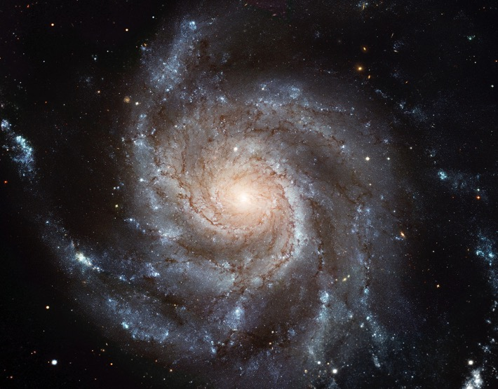
Spatial
Sequential
Comparative
Classif/Hierarch
Causal
Notes:
Most spiral galaxies consist of a flat, rotating disk containing stars, gas and dust, and a central concentration of stars known as the bulge. ... Together with irregular galaxies, spiral galaxies make up approximately 60% of galaxies in today'suniverse.
NOUN
SPATIAL

Slide 182
Spatial
Sequential
Comparative
Classif/Hierarch
Causal
Notes:
Process/verb: Water cycle
The water cycle describes how water evaporates from the surface of the earth, rises into the atmosphere, cools and condenses into rain or snow in clouds, and falls again to the surface as precipitation.
Transpiration: plants give off water through their pores
Infiltration: water seeping through the soil to the water table

Slide 183
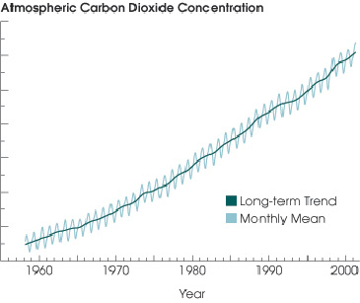
Spatial
Sequential
Comparative
Classif/Hierarch
Causal
Notes:
This is a comparison… it allows one to compare how much atmospheric carbon dioxide there was each decade since 1960

Slide 184
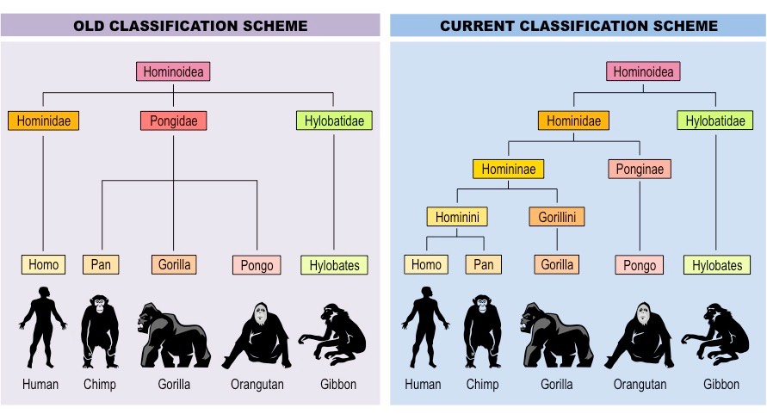
Spatial
Sequential
Comparative
Classif/Hierarch
Causal
Notes:
Classification and Comparison
Classification of hom-in-oid-ea;
We used to think man was a distinct or unique member of the hominoidea family… newer classification schemes recognize more fine grained distinctions and closer connections with some other members of the family.

Slide 185
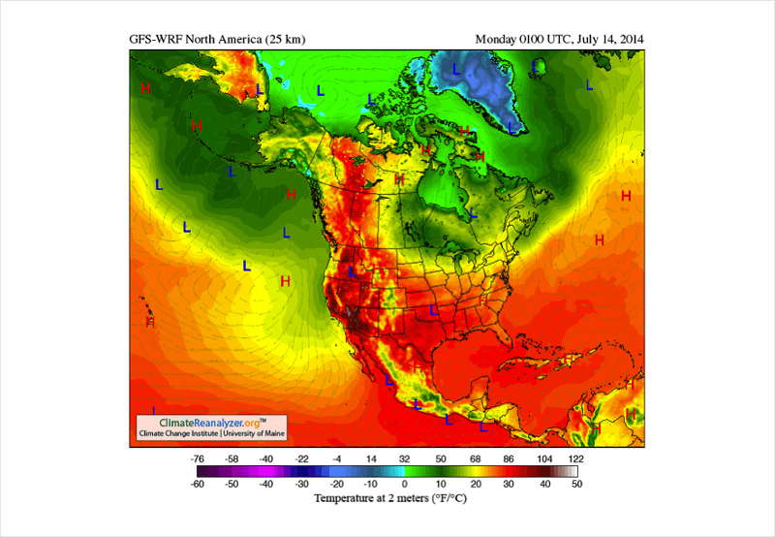
Spatial
Sequential
Comparative
Classif/Hierarch
Causal
Notes:
Spatial / Comaprative
Shows temperature locations

Slide 186
Spatial
Sequential
Comparative
Classif/Hierarch
Causal
Notes:
Classification (taxonomy) in hierarchical tree form (general to specific)

Slide 187
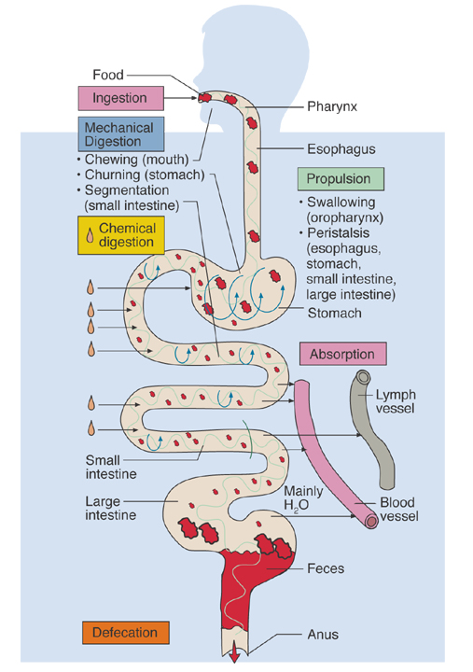
Spatial
Sequential
Comparative
Classif/Hierarch
Causal
Notes:
Sequential—illustrates the digestion process
Spatial—shows the placement of the digestion system

Slide 188
Data Presentation Devices
Identify key ideas from prose
Have students read the propositions and compare them with the various figures and graphics
Students should determine whether the information is unique or redundant

Slide 189
Build Text Reading Fluency
Texts can be hard because they demand more advanced reading skills than the students have
Students need practice reading (orally) with accuracy, appropriate speed, and prosody
Not round-robin reading (use these instead: repeated reading, echo reading, paired reading, reading while listening, etc.)
Putting fluency first might make sense
Parsing texts can be helpful

Slide 190
A Walk in the Desert
Sunbeams are flickering over the landscaper as the sun rises. A kit fox heads for her den as another day in the desert begins.
Deserts are surrounded by other kinds of landscapes. Scientists call these different land zones biomes. All the plants and animals in a biome form a community. In that community, every living thing depends on other community members for its survival. A biome’s climate, soil, plants, and animals are all connected this way.

Slide 191
A Walk in the Desert
Sunbeams/ are flickering/ over the landscape/ as the sun rises./ A kit fox/ heads/ for her den/ as another day/ in the desert/ begins./
Deserts/ are surrounded/ by other kinds of landscapes./ Scientists/ call/ these different land zones/ biomes. All the plants and animals/ in a biome/ form/ a community./ In that community,/ every living thing/ depends/ on other community members/ for its survival./ A biome’s climate, soil, plants, and animals/ are all connected/ this way./

Slide 192
Chunking
Apprehension seems to exist among the people of the Southern States that by the accession of a Republican Administration their property and their peace and personal security are to be endangered. There has never been any reasonable cause for such apprehension. Indeed, the most ample evidence to the contrary has all the while existed and been open to their inspection. It is found in nearly all the published speeches of him who now addresses you. I do but quote from one of those speeches when I declare that--
I have no purpose, directly or indirectly, to interfere with the institution of slavery in the States where it exists. I believe I have no lawful right to do so, and I have no inclination to do so.
Abraham Lincoln, First Inaugural Address

Slide 193
Chunking
Apprehension seems to exist / among the people of the Southern States / that by the accession / of a Republican Administration / their property / and their peace / and personal security / are to be endangered. / There has never been / any reasonable cause / for such apprehension. / Indeed, / the most ample evidence to the contrary / has all the while existed / and been open to their inspection. / It is found / in nearly all the published speeches / of him who now addresses you. / I do but quote / from one of those speeches / when I declare that--
I have no purpose, / directly or indirectly, / to interfere with the institution of slavery / in the States / where it exists./ I believe / I have no lawful right to do so, / and I have no inclination to do so.
Abraham Lincoln, First Inaugural Address

Slide 194
Provide Stair-step Texts
Texts can be hard because students lack sufficient background knowledge
If students have multiple texts on the same topic that are at different difficulty levels,
easier “apprentice” texts can help students build background knowledge for the more difficult ones.
The overlap in important information should increase the likelihood that students will pay attention to it.
Should increase a student’s ability to independently deal with the information in the hard text

Slide 195
Repetition
One of the most powerful scaffolds is also one of the most obvious—reading a text more than once makes it more accessible
In the past, we tended to have students read a text a single time, but as the text challenge increases it is essential that we encourage students to read texts (and parts of texts) more than once to make sense of it
This is an effective strategy, but it is expensive too (the idea is to become successful with these texts—which should make it possible to succeed with other texts later with less work)
Explain this to students

Slide 196
Comprehension strategies
Research shows that when students are active readers—that is, when they are actively trying to understand a text—they comprehend and remember more
Comprehension strategies are a proven way to get students to think about the ideas in a text
Summarization, questioning, monitoring, seeking particular kinds of information have all been found to stimulate learning

Slide 197
Motivation
The instructional level is based on the idea that students seek easy work--that if the work is challenging they will stop trying
But research shows that students seek challenge and are motivated by it
Challenge only works if it is not overwhelming and if students see the possibility of getting better/stronger, et.
Don’t make challenging text a secret—tell kids what is happening and show them how you will make them effective
Research also shows that students are interested in more challenging content (and on their own, they’ll fight through more challenging text to get to this content)—using challenging text opens up content possibilities

Slide 198
The physical fitness metaphor
If reading and physical exercise are similar, then text complexity is akin to weight or distance
Students need to practice reading with multiple levels of difficulty and for varied amounts (these variations can even occur within a single exercise session)
Guiding students to read text with support is like spotting for someone during weight lifting (you have to be careful not to do the exercise for them and you have to avoid dependence)
Do not always head off the challenges, but always be ready to respond and support

Slide 199
16-Week Marathon Training Schedule
Week | Mon | Tue | Wed | Thu | Fri | Sat | Sun | Total
1 | 3 | Rest | 4 | 3 | Rest | 5 | Rest | 15
2 | 3 | Rest | 4 | 3 | Rest | 6 | Rest | 16
3 | 3 | Rest | 4 | 3 | Rest | 7 | Rest | 17
4 | 3 | Rest | 5 | 3 | Rest | 8 | Rest | 19
5 | 3 | Rest | 5 | 3 | Rest | 10 | Rest | 21
6 | 4 | Rest | 5 | 4 | Rest | 11 | Rest | 24
7 | 4 | Rest | 6 | 4 | Rest | 12 | Rest | 26
8 | 4 | Rest | 6 | 4 | Rest | 14 | Rest | 28
9 | 4 | Rest | 7 | 4 | Rest | 16 | Rest | 31
10 | 5 | Rest | 8 | 5 | Rest | 16 | Rest | 34
11 | 5 | Rest | 8 | 5 | Rest | 17 | Rest | 35
12 | 5 | Rest | 8 | 5 | Rest | 18 | Rest | 36
13 | 5 | Rest | 8 | 5 | Rest | 20 | Rest | 38
14 | 5 | Rest | 8 | 5 | Rest | 9 | Rest | 27
15 | 3 | Rest | 5 | 3 | Rest | 8 | Rest | 19
16 | 3 | Rest | 3 | Walk 2 | Rest | 26.2 | Rest | 34.2

Slide 200
Differentiation?
Not different books, but different scaffolding
Students should read multiple texts across a range of challenge levels (including “frustration” level), but the degree of scaffolding should be higher the harder the text
Large group text vs. small group texts?
Pull-out instruction?

Slide 201
Conclusions
I can’t learn from a text that I can’t figure out.
But I can learn from one that I may not understand but that I can make sense of
Persistence depends upon my awareness that I can successfully take control in such situations
A steady diet of instructional level text restricts/limits the text barriers that I can gain experience with
But providing students complex text alone – without scaffolding, guidance, and teaching – will provide opportunity without ensuring learning
Make students powerful, teach them to read complex texts

