Slide 1
Sometimes Reading Surprises You
Timothy Shanahan
University of Illinois at Chicago
www.shanahanonliteracy.com

Slide 2
Pretest
Phonics instruction is needed if young students are going to learn to read English.
Reading and writing are so closely related that, for most children, learning one usually accomplishes the learning of the other.
It is a good idea to “use your data.” Teachers should analyze their students’ reading comprehension, as this will help them to diagnose reading problems and determine which reading skills to emphasize in instruction.
The harder or more intellectually demanding a text, the harder students will find it to comprehend.
Fluency instruction/practice is a good way to build up students’ decoding skills.
Vocabulary is one of the most important early reading skills that we can teach.

Slide 3
Role of Research
We often talk about the importance or value of research in reading education
However, that often means that there is some approach that we want teachers to use that has research behind it
Thus, advocates go ga-ga over Reading Recovery or Orton-Gillingham or the teaching of vocabulary (all of which have some studies supporting them)

Slide 4
Research has many roles to play
Proving that some technology can work is only one purpose for research
Research can also solve governance problems (if I want O-G and you want RR, is there a way of settling the issue without resorting to power?)
Research also can play a heuristic role and that is the one I intend to talk about today

Slide 5
Heuristic value of research
A heuristic is a process or method that allows us to learn something for ourselves
My contention here is that the greatest value of research is that it helps us to understand things better
I know it is doing that when I think the world works one way, and research suggests that it doesn’t work that way at all (in other words, the best research surprises you)

Slide 6
Lots of people don’t like this
I know that research has surprised someone when they tell me that it must be wrong
And, the more heated they are in their responses the bigger the surprise must have been
My progressive colleagues get very upset if I say that there is evidence supporting Orton-Gillingham, while my special education buddies usually like me right up until the point where I say studies support Reading Recovery

Slide 7
The reason for the grief
The reason some people get so upset is that they think of research as being a kind of on-off switch—it will either support or reject an approach
It rarely is that simple in reading education or any social science
That’s because findings are less reliable than in the “hard sciences”—they get shaped and reshaped by context and intention

Slide 8
How should research be used?
I would suggest that it is very interesting that programs as different as OG and RR can work
Instead of trying to champion those studies that support our beliefs (and trashing those that don’t), I think we should be asking ourselves… why did that work when it shouldn’t have (by my theory)?
That’s why single studies tend not to be very interesting (or why the correlational parts of meta-analyses tend to be more interesting than the more solid experimental findings in a meta-analysis)

Slide 9

I’ve been in this field for 40+ years, what has surprised me?

Slide 10
1. Kids can learn to read without phonics.
The National Reading Panel concluded that explicit systematic phonics instruction was beneficial, and yet kids can learn to read without phonics
One tends to think of reading as being a set collection of skills that everyone fires off or utilizes in pretty much the same way
That may be true, but that doesn’t tell us everything about teaching someone to read

Slide 11
Compensation
Stanovich used the term “compensatory process” to refer to the fact that readers tend to travel the path of least resistance in making sense of a text
There are many examples of this… but basically, it means readers can figure out a text’s message by various combinations of words, pictures, prior knowledge, context, etc.
If I’m weak in decoding, I can fill in the gaps by using what I know about text or the world to help me figure out words or ideas

Slide 12
We often rely on compensation in the teaching of reading
That reading works like this allows readers to struggle successfully with texts that by any realistic measure they should not be able to read—which can help them to build their reading ability
We also rely—and often over-rely—on this compensatory mechanism often when teaching young children to read (think of the role pictures play in helping beginning texts to be text)

Slide 13
We can learn to read without phonics
Many teachers are aware of children who seem to have learned to read without phonics instruction and this makes them less committed to the idea of teaching phonics
Their insight is correct: it is possible to learn to read English without phonics instruction
Studies have shown that methods that did not rely at all on phonics—pure sight word teaching—work (Barr, 1970; Biemiller, 1971)

Slide 14
But what about the National Reading Panel?
The NRP did not look at whether phonics instruction was a necessary or sufficient condition for learning to read, but whether phonics was helpful in learning to read

Slide 15
How do kids do it?
By learning phonics…
“But you said, these children didn’t receive phonics instruction?”
That’s right, they weren’t taught phonics, but that doesn’t mean that they didn’t learn phonics
That distinction between teaching and learning phonics has important implications

Slide 16
Implications
What Barr and Biemiller found was that by grade 2, you couldn’t tell which of the readers had been taught phonics and which had learned by sight methods—they all could decode
Explicit phonics instruction helps kids because it gives them clues as to what they have to figure out
But figure it out is still what they have to do
Kids who continue to try to handle word recognition in a compensatory manner—relying on pictures and context—are on the wrong track

Slide 17
Implications (cont.)
We need to clear with those whose insights about compensation may be discouraging them from delivering phonics instruction very intensively
We also need to recognize the value—and the limitations on the value—of phonics instruction and phonics interventions
Phonics can be taught too thoroughly (set for consistency vs. set for diversity)
Phonics lessons often lack sufficient amounts of word reading or word spelling or in phonics applications within texts that give them the practice needed in trying to use the spelling patterns to figure out meaning
Phonics needs to be taught not before reading, but in the context of learning to read

Slide 18
2. Reading and writing aren’t so close after all.
Educators have claimed since the 1910’s that reading and writing were very closely related since they rely on the same spelling, language, and cognitive systems
It is a point of view that I bought into as a young teacher and a young researcher
Because I believed that reading and writing were just two sides of the same coin, I quite appropriately had my students writing and reading every day—and yet, it turns out that reading and writing aren’t as closely aligned as was long claimed—and that surprise has implications

Slide 19
It makes sense that reading and writing would be the same
Letters
Sounds
Morphology
Words
Grammar
Punctuation
Cohesion
Content
Structure

Slide 20
Research history
From 1910s to 1979 all of the research on reading-writing relations took the form of simple bivariate correlations
Researchers would take a measure of reading and a measure of writing and would usually find a positive correlation between them (.10-.40)
They would then conclude that since that was just one aspect of the relationship, one could simply add the different variables together and they would add up to 1.00
In 1980, I conducted the largest study of reading-writing relations ever conducted, and boy was I surprised

Slide 21
My findings and their aftermath
Although I measured spelling, decoding, vocabulary, grammar, comprehension, text structure, etc., I could only explain about half the variance in reading with the writing measures (and vice versa)
Later, Virginia Berninger and her colleagues improved upon my methods and managed to increase the variance explanation to ~.70
And we might not be able to do much better than that—and it is important to understand why that is

Slide 22
Reading and writing are not mirror processes, though they rely on the same information
READING
sh /sh/
WRITING
/sh/ sh (ship)
s (sure)
ch (chantey)
ti (nation)
si (decision)

Slide 23
The same could be said about any other aspect of r-w
Reading and writing use the same information, but they do not start from the same point nor do they use it in the same way
That means that you have to teach both reading and writing—historically we have taught one, hoping the other would come along (that makes sense if they are the same, but not if they are different)
They both should be taught from the beginning—there are cross-modal benefits, but they are dispersed across the process (younger and older children)

Slide 24
Reading and writing provide different perspectives
Important to have kids both reading and writing because of the unique vantage that each provides (Tierney & McGinley, 1986)
Having kids reading about text/ideas versus having them read and write about it (Graham & Hiebert, 2010)
Having kids trying to decode words and encode them (phonics impacts spelling early on, but not later)
They activate different parts of the brain (which is why you can lose one or the other after a neurological accident)

Slide 25
Implications
Drop the 90 minute reading block or the separate reading and writing classes and find space for teaching both reading and writing and for connecting them
Have students work on coordinated skills together (like using story maps for reading and writing or working on spelling and decoding together)
Have students both read and write about text and ideas in your classes—it is not as repetitive as it sounds because of their separation

Slide 26
3. Don’t use your comprehension data.
For the past decade, “experts” have been promoting the idea of school improvement through the use of test data
The idea has been that we could turn our accountability tests into diagnostics that would reveal the deficient skills or standards–which could then be followed up with targeted teaching that would raise reading scores
Great idea if it wasn’t wrong
Research shows that this is a fool’s errand (Davis, 1944; Thorndike, 1973; ACT, 2006)

Slide 27
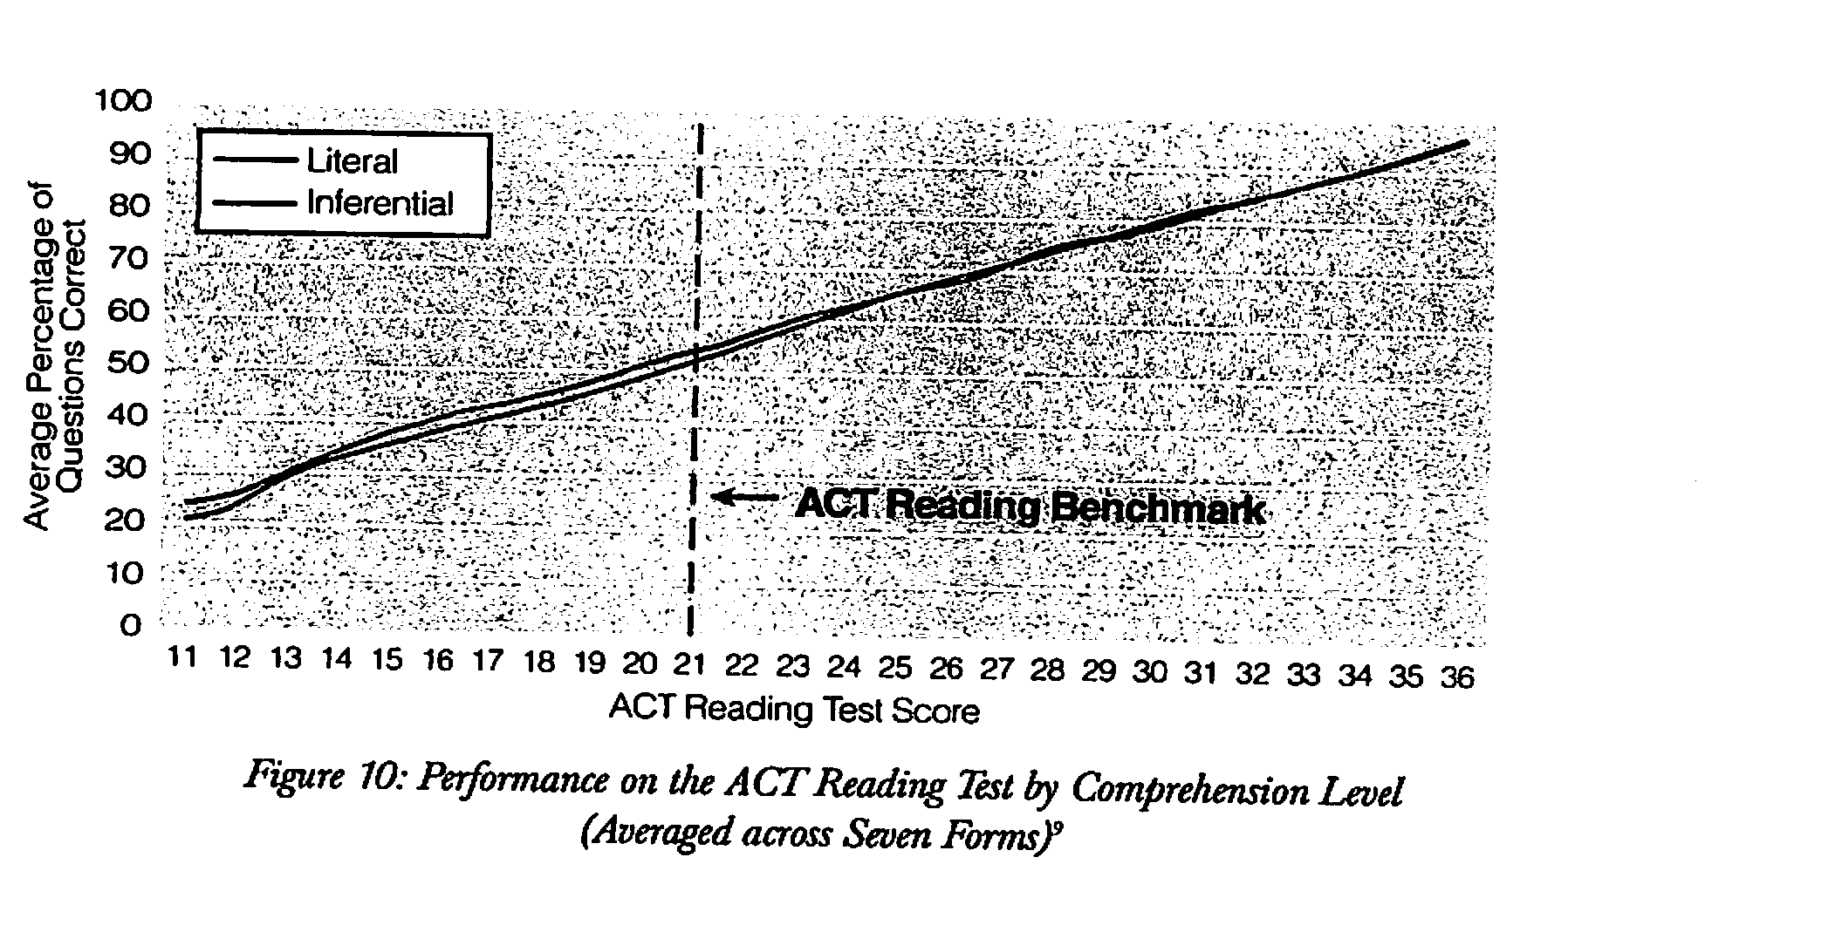
No performance differences due to question types (skills)

Slide 28
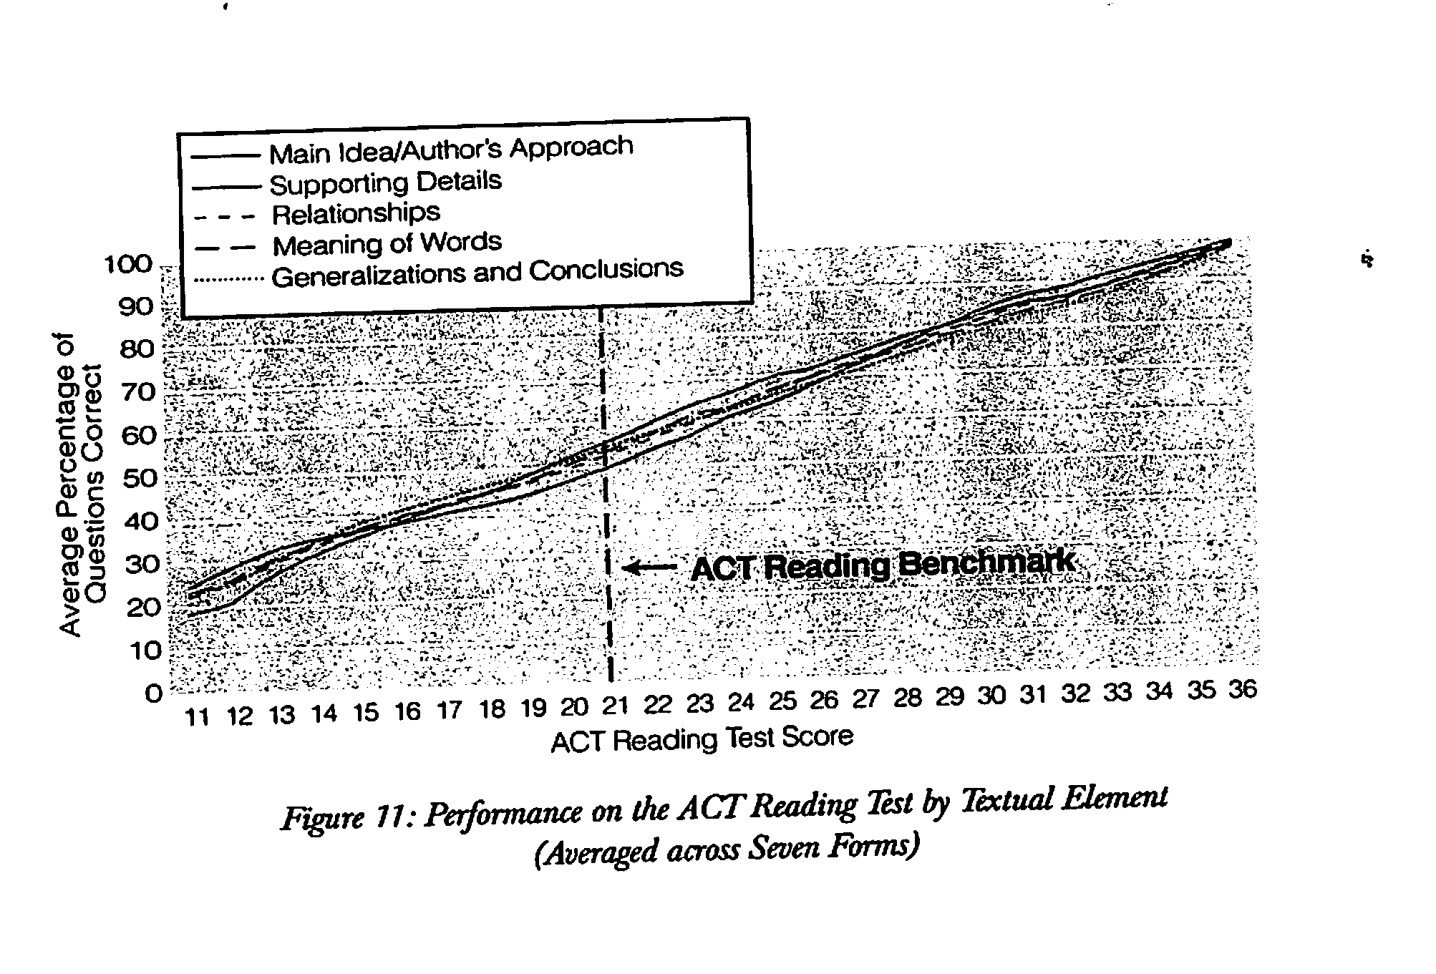
No performance differences due to question types (cont.)

Slide 29
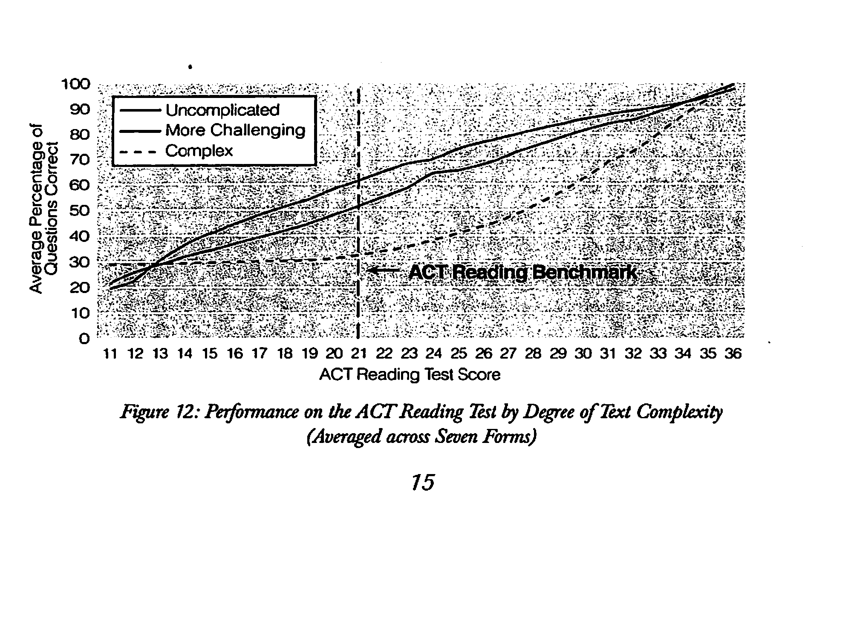
Text differences affect reading performance

Slide 30
Reading comprehension tests only measure 1 skill
Nature of reading doesn’t allow reading skills to be separated out during reading comprehension
Nature of test design limits how many skills could actually be identified
Studies shows that comprehension tests assess comprehension if we look at question types
However, comprehension proficiency will vary depending on text difficulty

Slide 31
Implications
Do not analyze question types for reading comprehension
Specific skills work based on types of comprehension questions does not generally improve reading achievement (or even test performance on specific tests)
Teach students to make sense of texts of different levels of difficulty

Slide 32
4. Easier texts can be harder to understand
Text complexity has been a big deal since the Common Core appeared
Teachers are being told everything including: complex text refers to to the instructional level, to whatever teachers decide text complexity is, to particular Lexile levels, etc.
Let’s straighten that out first: the standards are asking you to teach students how to read texts of particular levels of difficulty in grades 2-12

Slide 33
Complexity, difficulty, readability
Text complexity refers to all of the linguistic, formatting, or content features that may serve as a barrier to readers’ comprehension or that may require additional intellectual effort to make sense of
Text difficulty describes a progression of comprehensibility—if we arrayed texts on the basis of how well we could understand them, we would have a difficulty progression
Text readability is a quantitative prediction of text difficulty and it is based on measures of two aspects of text complexity (vocabulary and grammar)

Slide 34
It would make sense that more complex texts would be more difficult
That is the typical pattern, but it is more complicated than that—and that’s where it gets interesting
Several studies have found that when they eased the complexity of a text in various ways, the texts got easier for some students (Beck, et al, 1991; Britton & Gulgoz, 1991; Britton, et al., 1989; Duffy, et al., 1989; Graves, et al., 1991; Liederholm, et al., 2001; McKeown, et al., 1992)
These studies improved coherence, sequence, clarity, etc.

Slide 35
However, these revisions made it harder for others
The revisions definitely were helpful to readers who didn’t know much about the topics
But these texts got harder for readers who had knowledge of the topics (McNamara, et al., 1996; McNamara, 2001)—that is reducing the barriers to comprehension actually lowered their ultimate comprehension
Their reading went faster with the easier texts, and they did not have to work through the information in order to understand it—which consequently harmed their comprehension (complexity reduction tends to reduce inferences, but inferences are good for readers)

Slide 36
Texts can be too easy
We have made lots of claims for 95-98% fluency (or now, 90-95%) and 75-89% comprehension level for the texts that we teach with
Research not only has never shown these levels to matter in learning
Following the research in this area would suggest that instead of placing kids at some fabricated instructional levels, that is is more sensible to place kids in texts that are complex—that they would not understand easily, and then to teach them to overcome or to negotiate those barriers
Instead, we have placed kids in texts that are systematically too easy for them to comprehend well (because the texts don’t require them to work hard enough)

Slide 37
We need to provide a set to comprehend
Kids need to learn to approach text expecting it to be difficult, but recognizing that it is kind of like a puzzle, the meaning of which can be understood (at least with a little help)
We have tried to place students in text so easy that comprehension would be automatic
It would be better to place students in relatively more difficult text and to help them to figure out the puzzle

Slide 38
5. Fluency instruction builds decoding skills.
Usually we think of reading skills having a progression… children must learn their letters and sounds and decoding skills which enables vocabulary which enables fluency which enables reading comprehension… etc.
And it is clear that in developmental terms that does seem to be a general sequence of how things develop
However, the learning of individual kids does not take place generally, and when we examine the impact of fluency instruction there is an interesting pattern

Slide 39
National Reading Panel and Fluency
NRP examined 16 group experimental studies of the effectiveness of fluency instruction
Those studies focused on beginning readers (Grades 1-4) and remedial readers (1-12)
The fluency studies included a wide range of measures: reading comprehension, fluency, word recognition/decoding
Overall, fluency instruction had a positive impact on all of these outcomes… but that’s where it gets interesting

Slide 40
And the biggest effect is?
Usually in this kind of situation, the biggest impact is on the skill being taught, and then there are additional, smaller effects on other related variables
That is the pattern you see with fluency and comprehension—fluency practice has a relatively big effect on fluency and a positive, but somewhat smaller impact on reading comprehension
But it is not the pattern with decoding—fluency instruction consistently improves decoding skills and word reading skills better than it improves fluency

Slide 41
Implications
This is important because studies of phonics instruction often find it to have a very limited impact on reading and spelling—once you get beyond the primary grades
Torgesen’s analysis suggests that fluency has an impact with beginning readers through the repetition of words—it is important that there is repetition of words/patterns form text to text
Kuhn & Stahl found that fluency practice worked best with harder texts; thus repeatedly reading such texts and then seeing those words again in other texts is a good way to build phonics skills or to teach kids to use those skills

Slide 42
6. Vocabulary instruction is not very important—initially.
If there is any topic where there seems to be strong agreement, it is vocabulary
Various analyses have concluded that vocabulary instruction improves reading comprehension (NRP examined 45 such studies)
Lots of methods and textbooks on the teaching of vocabulary

Slide 43
Vocabulary must be a big predictor of reading comprehension
It makes sense that young children’s vocabulary knowledge would be predictive of later reading achievement
Young children with higher vocabularies would be expected to do better in reading
What is surprising is that this isn’t really the case

Slide 44
Early vocabulary surprise
National Early Literacy Panel examined more than 50 studies on the relationship between young children’s language development and their later reading achievement
With approximately 50 studies including more than 7500 children we found only a .30 correlation between language and reading
Few of the experimental studies showing that vocabulary instruction improves reading achievement were carried out younger students (there are many for older ones)

Slide 45
What’s going on?
We reanalyzed the data and found that there were many different measures of language used in these studies—ranging from studies of single components of language, like vocabulary, to full-scale multicomponent language measures
The vocabulary items had a small relationship to reading, but language had a big impact (correlations: .70)
Vocabulary doesn’t have a big impact on reading comprehension, but vocabulary along with grammar, listening comprehension, cohesion does… (impact of vocabulary learning increases over the years)

Slide 46
Implications
My point isn’t that we shouldn’t teach vocabulary to young children, but its initial value is much lower than one would expect
That makes it immediately less important than some other early components of reading, but it is one that has long term implications that cannot be ignored
It suggests that vocabulary instruction can be less intense early on (lack of big immediate payoff), and it suggests that a focus on vocabulary alone would not be as helpful as a broader emphasis on language

Slide 47
Summation
Explicit phonics instruction is beneficial, but not because it teaches kids to read or is the only path to reading. Explicit phonics instruction provides students with clues about how to decode text, and is learned best when students are given opportunities to read words and texts that are not overly simplified or constrained.
Reading and writing might seem to be so closely allied processes, that learning one would largely teach the other. And there are substantial here are substantial overlaps, but there are also gaps and differences. It is critical that kids be taught both as much is learned from exploring language and ideas through these differences of perspective.

Slide 48
Summation (cont.)
Reading comprehension tests cannot identify meaningful differences in performance in reading skills and should not be used as a guide to what is taught in reading.
Reducing text complexity does not necessarily make texts easier to read, and it does remove from children the opportunity to learn to negotiate these text features.
For older students who “know” their phonics, but still don’t read well, fluency practice seems to teach them to apply their phonics skills effectively—in other words the harder, later developing process seems to foster the lower, earlier developing one.
Vocabulary is a proxy for language; don’t just teach vocabulary, but try to foster stronger language development overall—especially in the early years.

Slide 49
Pretest
Phonics instruction is needed if young students are going to learn to read English.
Reading and writing are so closely related that, for most children, learning one usually accomplishes the learning of the other.
It is a good idea to “use your data.” Teachers should analyze their students’ reading comprehension, as this will help them to diagnose reading problems and determine which reading skills to emphasize in instruction.
The harder or more intellectually demanding a text, the harder students will find it to comprehend.
Fluency instruction/practice is a good way to build up students’ decoding skills.
Vocabulary is one of the most important early reading skills that we can teach.

