Slide 1
Foundational Skills
Timothy Shanahan
University of Illinois at Chicago
www.shanahanonliteracy.com

Slide 2
Purposes
What are the foundational skills for reading?
Why are they so important?
What does research reveal about them?
What are the controversies around them?
What do teacher preparation programs have to accomplish with foundational skills?

Slide 3
Simple View of Reading (Gough & Tunmer, 1986)
Decoding (D) x Language Comprehension (LC) = Reading Comprehension
Reading comprehension depends upon both decoding skills and language comprehension abilities.
Decoding and language comprehension skills are separable for both assessment and teaching

Slide 4
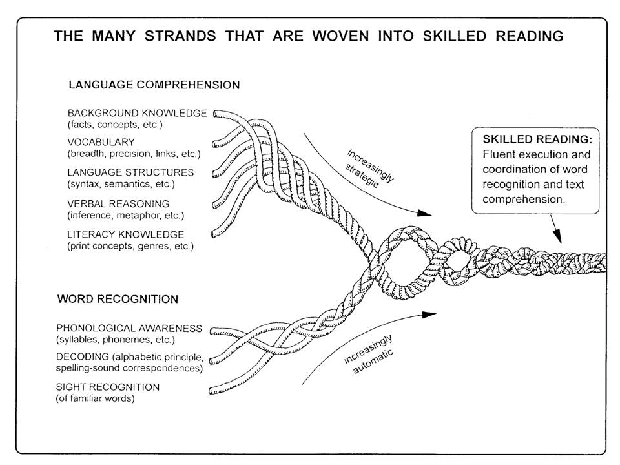

Slide 5
Foundational skills
In the simple view “decoding” refers to that constellation of skills that are usually thought of as being foundational
Foundational reading skills include:
Phonological awareness
Phonemic awareness
Alphabet
Phonics
High frequency words
Oral reading fluency

Slide 6
Automaticity
Foundational skills need to be learned to the point of automaticity
Automaticity refers to the ability to recognize and process information without really thinking about it on a conscious level
Our brains can only process limited amounts of information
If we can learn to do some tasks automatically, then we free up cognitive space that can be used to do other things (like think)
A related idea is parallel processing

Slide 7
Fast Mapping
While we teach students to “sound out” words, the actual reading process is obviously different from that – we neither learn words that laboriously, nor do we read words that slowly
Fast mapping refers to mental processes in which new concepts are learned based on minimal exposures to the new information

Slide 8
Statistical Learning
Statistical learning or probabilistic response is an alternative explanation for how learners come to respond to words
The idea is that our minds collect statistical information about the likelihood of occurrence of particular orthographic-phonemic pairings and that we learn to respond accordingly
Example: we come to expect p to represent /p/ as in pan, more often than it will represent /f/ as in phone – and that will occur more often than the silent role it plays in a word like ptermigan

Slide 9
Research Evidence
There is an extensive research base showing that students make faster learning progress when provided explicit instruction in various foundational skills
I will limit my use of research mainly to meta-analyses of experimental studies that have evaluated the effectiveness of instruction in these various foundational skills (particularly public analyses)
There is also a substantial body of psychological and neurological research that helps explain what this instruction is beneficial (we won’t pursue that here)

Slide 11
Preventing Reading Difficulties
National Research Council appointed a group of literacy experts to provide research-based recommendations on how to address early literacy
They issued a report in 1998 focused on preschool, kindergarten, and primary grade reading instruction and support

Slide 12
COMMITTEE ON THE PREVENTION OF READING DIFFICULTIES IN YOUNG CHILDREN
CATHERINE SNOW (Chair), Graduate School of Education, Harvard University, Chair
MARILYN JAGER ADAMS, Bolt, Beranek, and Newman Inc., Cambridge, Massachusetts
BARBARA T. BOWMAN, Erikson Institute, Chicago, Illinois
BARBARA FOORMAN, Depart of Pediatrics, University of Texas, and Houston Medical School
DOROTHY FOWLER, Fairfax County Public Schools, Annandale, Virginia
CLAUDE N. GOLDENBERG, Department of Teacher Educ, California State University, Long Beach
EDWARD J. KAME'ENUI, College of Education, University of Oregon, Eugene
WILLIAM LABOV, Department of Linguistics and Psychology, University of Pennsylvania
RICHARD K. OLSON, Department of Psychology, University of Colorado, Boulder
ANNEMARIE SULLIVAN PALINCSAR, School of Education, University of Michigan, Ann Arbor
CHARLES A. PERFETTI, Department of Psychology, University of Pittsburgh
HOLLIS S. SCARBOROUGH, Brooklyn College, City University of New York, and Haskins
Laboratories, New Haven, Connecticut
SALLY SHAYWITZ, Department of Pediatrics, Yale University
KEITH STANOVICH, Ontario Institute for Studies in Education, University of Toronto
DOROTHY STRICKLAND, Graduate School of Education, Rutgers University
SAM STRINGFIELD, Center for the Social Organization of Schools, Johns Hopkins University
ELIZABETH SULZBY, School of Education, University of Michigan, Ann Arbor

Slide 13
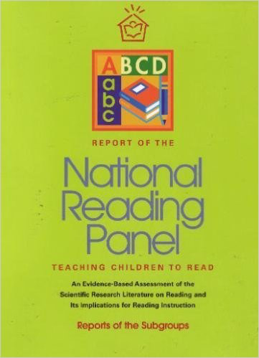

Slide 14
National Reading Panel
In 1998, Congress asked for a review of what works in reading instruction
U.S. Department of Education and the National Institute of Child Health and Human Development appointed a panel
Panel reviewed more than 500 studies on reading instruction (K-12)

Slide 15
National Reading Panel
Donald Langenberg, University of Maryland, Chair
Gloria Correro, Mississippi State University
Linnea Ehri, City University of New York
Gwenette Ferguson, Houston Public Schools
Norma Garza, parent
Michael L. Kamil, Stanford University
Cora Bagley Marrett, University of Massachussetts-Amherst
S.J. Samuels, University of Minnesota
Timothy Shanahan, University of Illinois at Chicago
Sally E. Shaywitz, Yale University
Thomas Trabasso, University of Chicago
Joanna Williams, Columbia University
Dale Willows, University of Toronto
Joanne Yatvin, Portland State University

Slide 16
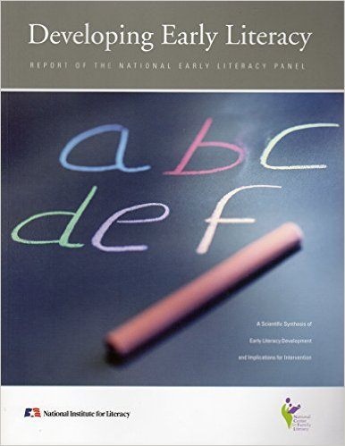

Slide 17
National Early Literacy Panel
National Early Literacy Panel (2003-2008) reviewed research on the teaching of reading in preschool and kindergarten
Largest meta-analysis of research data on the teaching of reading during these years (examined 400-500 studies)
Set out to determine which skills needed to be taught early on and what confers literacy learning advantages to young children

Slide 18
National Early Literacy Panel
Timothy Shanahan, University of Illinois at Chicago, Chair
Anne Cunningham, University of California Berkeley
Kathy C. Escamilla, University of Colorado
Janet Fischel, State University of New York at Stony Brook
Susan Landry, University of Texas Health Science Center at Houston
Christopher J. Lonigan, Florida State University
Victoria J. Molfese, University of Louisville
Chris Schatschneider, Florida State University
Dorothy Strickland, Rutgers University

Slide 19
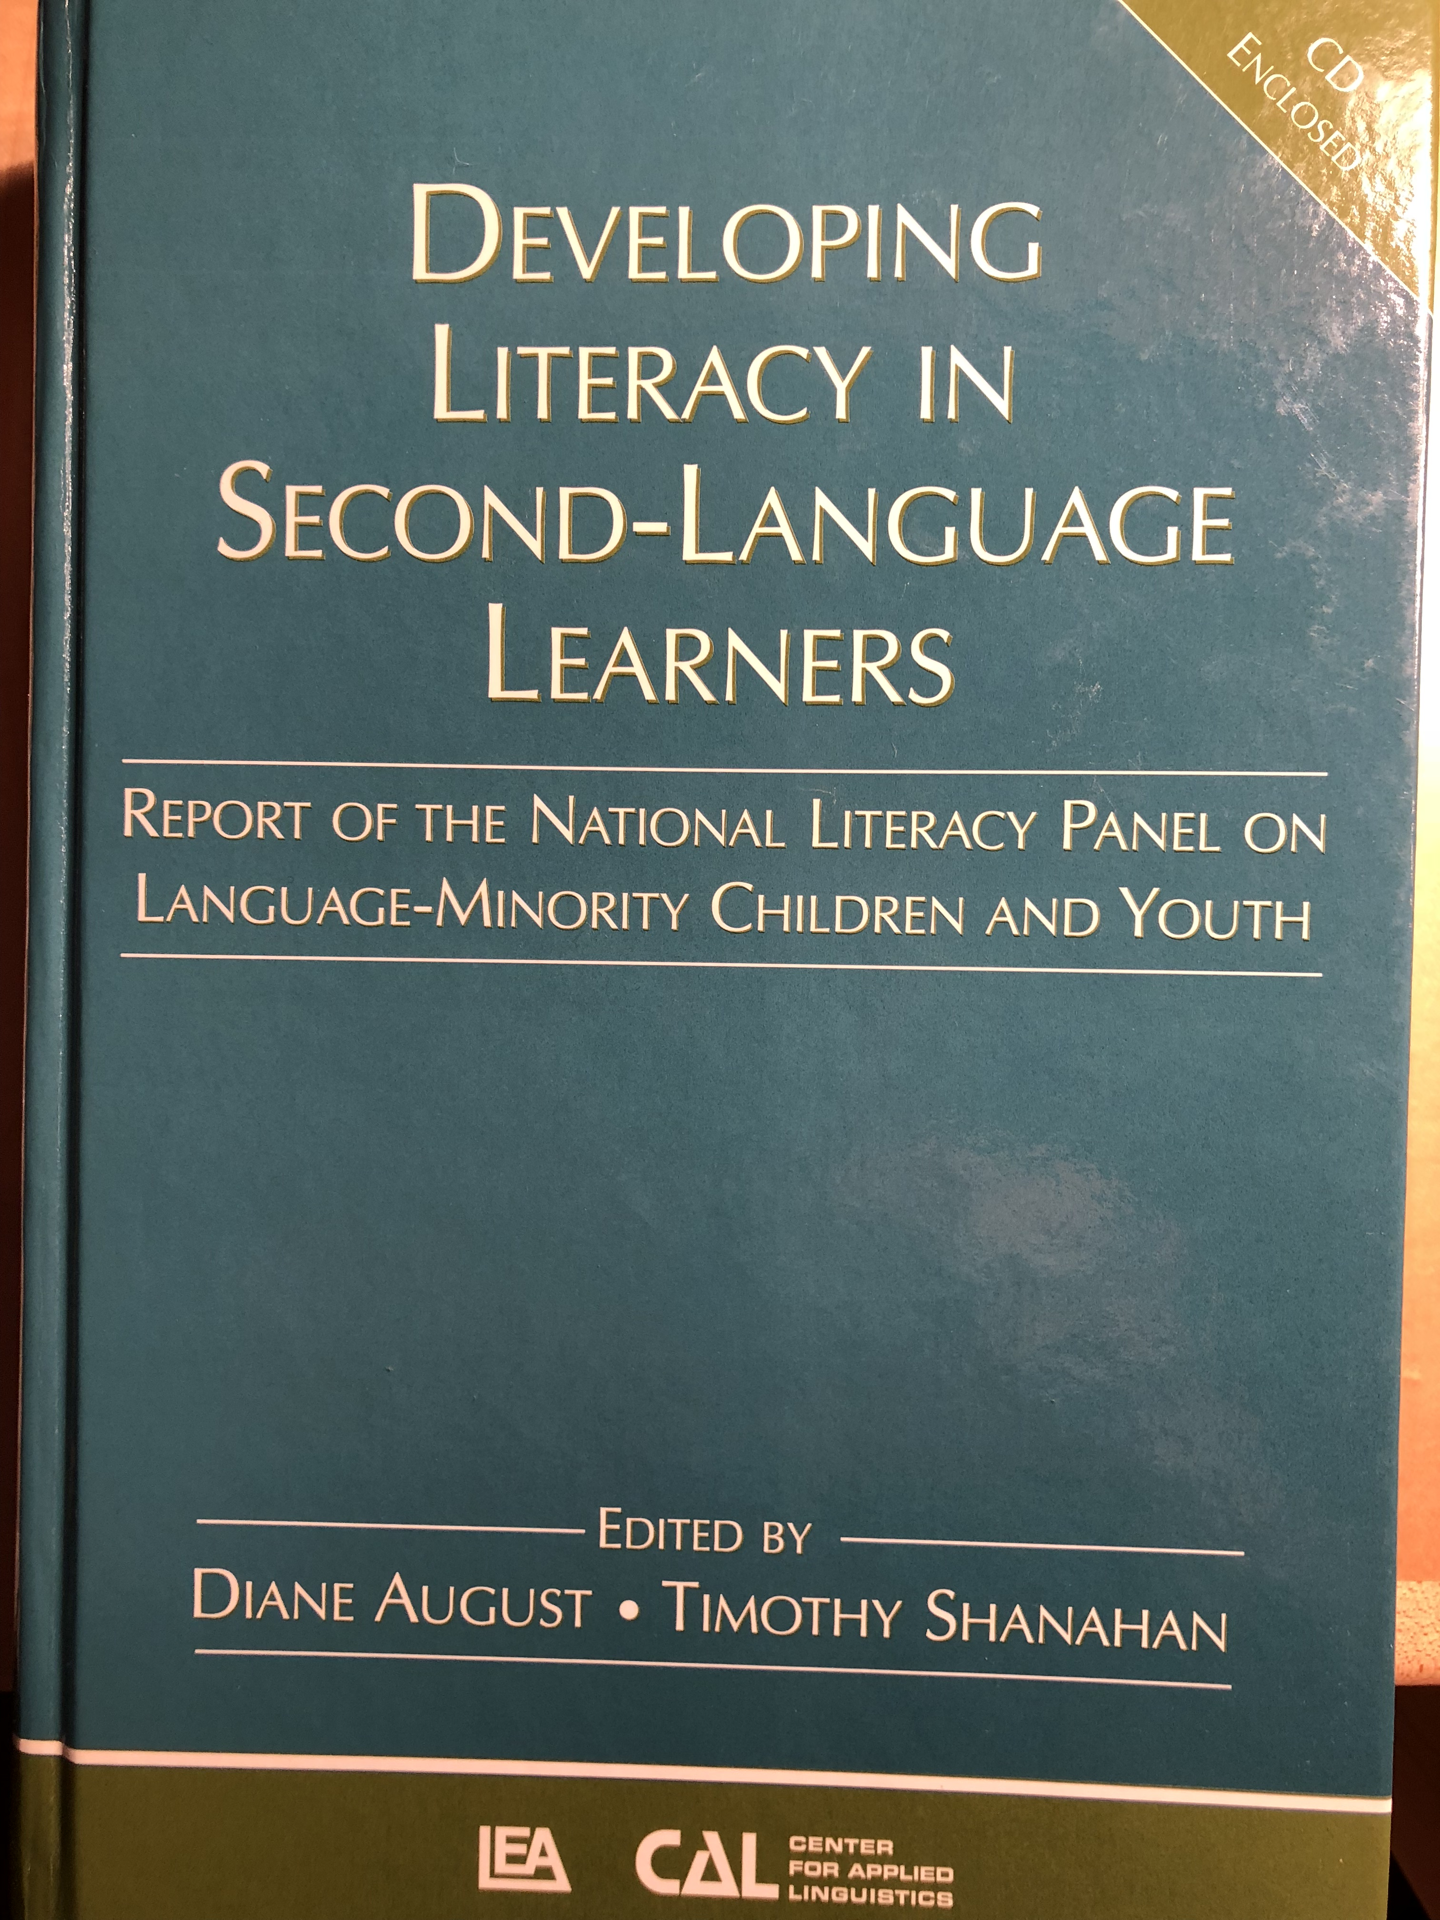

Slide 20
National Literacy Panel for Language Minority Children and Youth
National Literacy Panel (2003-2006) reviewed research on the teaching of reading to children (ages birth to 18) from language minority families
Largest analysis of research data on the teaching of reading during this population
Set out to make a wide range of determinations concerning what facilitates the English-language literacy learning of non-English speakers (including young children)

Slide 21
National Panel for Language Minority Children and Youth
Timothy Shanahan, University of Illinois at Chicago, Chair
Diane August, Center for Applied Linguistics
Isabel L. Beck, University of Pittsburgh
Margarita Calderón, Johns Hopkins University
David J. Francis, University of Houston
Georgia Earnest García, University of Illinois at Urbana-Champaign
Fred Genesee, McGill University
Esther Geva, University of Toronto
Claude Goldenberg, California State University, Long Beach
Michael L. Kamil, Stanford University
Keiko Koda, Carnegie Mellon University
Gail McKoon, Ohio State University
Robert S. Rueda, University of Southern California
Linda S. Siegel, University of British Columbia

Slide 23
What Works Clearinghouse
U.S. Department of Education
Panels of experts assembled based on particular topics
Panels can make any recommendations that they choose, but WWC evaluates supporting research and indicates the strength of the underlying evidence

Slide 24
What Works Clearinghouse Panelists (sample)
Carol Connor, Florida State University
Janice Dole, University of Utah
Nell Duke, Michigan State University
Jill Fitzgerald, University of North Carolina
Barbara Foorman, Florida State University
Steve Graham, Arizona State University
Laura Justice, Ohio State University
Michael L. Kamil, Stanford University
James Kim, Harvard University
P. David Pearson, University of California, Berkeley
Timothy Shanahan, University of Illinois at Chicago
Joe Torgesen, Florida State University

Slide 25
Other Research Evidence
Bus, A. G., & van IJzendoorn, M. H. (1999). Phonological awareness and early reading: A meta-analysis of experimental training studies. Journal of Educational Psychology, 91(3), 403-414. doi:http://dx.doi.org.proxy.cc.uic.edu/10.1037/0022-0663.91.3.403
Chard, D. J., Vaughn, S., & Tyler, B. (2002). A synthesis of research on effective interventions for building reading fluency with elementary students with learning disabilities. Journal of Learning Disabilities, 35(5), 386-406. doi:http://dx.doi.org.proxy.cc.uic.edu/10.1177/00222194020350050101
Ehri, L. C., Nunes, S. R., Stahl, S. A., & Willows, D. M. (2001). Systematic phonics instruction helps students learn to read: Evidence from the national reading panel's meta-analysis. Review of Educational Research, 71(3), 393-447. doi:http://dx.doi.org.proxy.cc.uic.edu/10.3102/00346543071003393
Ehri, L. C., Nunes, S. R., Willows, D. M., Schuster, B. V., Yaghoub-Zadeh, Z., & Shanahan, T. (2001). Phonemic awareness instruction helps children learn to read: Evidence from the National Reading Panel's meta-analysis. Reading Research Quarterly, 36(3), 250-287. doi:http://dx.doi.org.proxy.cc.uic.edu/10.1598/RRQ.36.3.2
Kuhn, M. R., & Stahl, S. A. (2003). Fluency: A review of developmental and remedial practices. Journal of Educational Psychology, 95(1), 3-21. doi:http://dx.doi.org.proxy.cc.uic.edu/10.1037/0022-0663.95.1.3
Lee, J., & Yoon, S. Y. (2017). The effects of repeated reading on reading fluency for students with reading disabilities: A meta-analysis. Journal of Learning Disabilities, 50(2), 213-224. doi:http://dx.doi.org.proxy.cc.uic.edu/10.1177/0022219415605194
Melby-Lervåg, M., Lyster, S. H., & Hulme, C. (2012). Phonological skills and their role in learning to read: A meta-analytic review. Psychological Bulletin, 138(2), 322-352. doi:http://dx.doi.org.proxy.cc.uic.edu/10.1037/a0026744
Therrien, W. J. (2004). Fluency and comprehension gains as a result of repeated reading: A meta-analysis. Remedial and Special Education, 25(4), 252-261. doi:http://dx.doi.org.proxy.cc.uic.edu/10.1177/07419325040250040801

Slide 26
Phonological Awareness
English is an alphabetic language – letters/spellings refer directly to the sounds of the language
Young children can usually hear well, but that doesn’t mean that they can perceive language sounds separately from meaning
Phonological Awareness is the ability to hear and manipulate language sounds including word and syllable separations and the phonemes within spoken words
Phonemic Awareness refers to the ability to hear and manipulate the smallest sounds within words (it is a part of Phonological Awareness)
Development of PA progresses from gross sounds (words, syllables) to finer-grained sounds (phonemes)
The instructional goal is to enable children to be able to easily and quickly fully segment the phonemes within words

Slide 27
Phonological Awareness (cont.)
National Early Literacy Panel (2008) reviewed nearly 70 studies showing that phonological awareness was a strong predictor of later reading achievement
PA remains a significant predictor even controlling for age, SES, alphabet knowledge, oral language, IQ, or prior decoding ability
NELP meta-analyzed approximately 50 studies finding that instruction in PA in pre-K and/or K (alone, combined with ABCs, combined with phonics) led to significant impacts on PA, AK, Reading, Spelling
Age/developmental level made no difference in the benefits of this kind of teaching, but what was taught varied (larger to smaller units)

Slide 28
Phonological Awareness (cont.)
NRP meta-analyzed 51 studies finding that phonemic awareness instruction in K, 1, and for remedial students led to significant improvements in phonemic awareness, decoding, reading comprehension, and spelling (NICHD, 2000)
NLP (2008) found that phonemic awareness instruction was beneficial for second-language students, too

Slide 29
PA Instruction
Students have to hear the sounds (without text clues)
Brief intensive instruction
Instruction should emphasize 1-2 skills at a time
Progression is from grosser sounds to smaller sounds (words-syllables-phonemes)
Should be combined with alphabet instruction

Slide 30
Phonological Awareness Skills
Word separation
Syllable segmentation
Onset/rime
Phoneme identity
Phoneme isolation
Phoneme blending
Phoneme segmentation
Phoneme addition
Phoneme substitution
Phoneme deletion

Slide 31
Examples of PA Skills
PA Skill | Example
Word separation | The---man---ran---up---the---hill.
Syllabic segmentation | Ti--mo--thy--Shan--a--han
Onset/rime | b—ig; m—an; r—ug; l--amb
Phoneme identity | ball, game, baby, bat
Phoneme isolation | p—an, pa—n
Phoneme blending | /p/-/a/-/n/
Phoneme segmentation | m/a/p, t/a/b/l
Phoneme addition | re, red, redea, redeam, redeams
Phoneme substitution | map, cap, pap, rap, sap—sam, sad, saf, sag
Phoneme deletion | Ready, read, re, r

Slide 32
Alphabet Letters
Letter name knowledge is one of best predictors of later reading achievement (Adams, 1990; Hammill, 2004; Scarborough, 1998; Schatschneider, et al., 2004; National Early Literacy Panel, 2008)
Letter name knowledge is an important indicator of later reading disability (Gallagher, et al., 2000; O’Connor & Jenkins, 1999; Torppa, et al., 2006)
Alphabet knowledge remains significant even when controlling for age, SES, oral language, phonological awareness, or IQ (NELP, 2008)

Slide 33
Alphabet Letters (cont.)
There are studies of the teaching of alphabet knowledge, but none of these studies have reading outcomes
However, studies suggest that letter name teaching in combination with phonological awareness or decoding is beneficial to reading achievement—and phonological awareness development is more rapid when letter names are known (Kim et al, 2010)
Studies show the best letter name learning progress occurs when the instruction is combined with letter sounds (Piasta & Wagner, 2010) and that it is important to separate similar letters (visual and aural)

Slide 34
Phonics
Phonics refers to instruction aimed at teaching the alphabetic system of English; includes sound-symbol correspondences and the relationships between spelling patterns, pronunciations of words, and decoding from print to pronunciation.
There has long been controversy over phonics: the controversy is not whether students need to decode or not, just whether such instruction is needed to enable such decoding (Barr, 1972; Biemiller, 1970)

Slide 35
Phonics (cont.)
NELP examined 70 studies on decoding instruction (includes those PA studies noted earlier); found that such instruction in preschool and kindergarten had moderate to large impacts on students’ reading and spelling development and on various emergent literacy skills
NRP examined 38 studies on phonics instruction and found that such teaching in grades K-2 and with older remedial readers had a positive impact on decoding and fluency and with the younger students reading comprehension and spelling as well

Slide 36
Phonics (cont.)
NLP found explicit decoding instruction to be beneficial to English learners too (though there are only a few studies with this population and the effect sizes were smaller than for native English speakers)
No point during these PreK-2 years when code-focused instruction is not beneficial to students (and the benefits appear to be long lasting)

Slide 37
Phonics (cont.)
Effective phonics instruction was explicit and systematic
Multiple years of phonics instruction were better than single years (PreK-2)
Programs that offered roughly 30 minutes per day of training were effective
Virtually all programs of phonics work with young children (NRP, WWC)—however, thoroughness matters
No single phonics sequence did better than any other

Slide 38
Phonics (cont.)
Phonics instruction should include lots of opportunity for students to decode and encode words
Important to develop a “mental set for diversity”
Spelling is part of this, too

Slide 39
Phoneme-Grapheme Correspondences
Phoneme | Word Examples | Common spellings
/p/ | pit, spider, stop | p
/b/ | bit, brat, bubble | b
/m/ | mitt, comb, hymn | m, mb, mn
/t/ | tickle mitt, sipped | t, tt, ed
/d/ | die, loved | d, ed
/n/ | nice, knight, gnat | n, kn, gn
/k/ | cup, kite, duck, chorus, folk, quiet | k, c, ck, ch, lk, q
/g/ | girl, Pittsburgh | g, gh
/ng/ | sing, bank | ng, n
/f/ | fluff, sphere, tough, calf | f, ff, ph, lf
/v/ | van, dove | v, ve
/s/ | sit, pass, science, psychic | s, ss, sc, ps

Slide 40
Phoneme-Grapheme Correspondence
Phoneme | Word Examples | Common spellings
/z/ | zoo, jazz, nose, as, xylophone | z, zz, se, s, x
/th/ | thin, breath, ether | th
/th/ | this, breathe, either | th
/sh/ | shoe, mission, sure, charade, precious, notion, mission, special | sh, ss, s, ch, sc, ti, si, ci
/zh/ | measure, azure | s, z
/ch/ | cheap, future, etch | ch, tch
/j/ | judge, wage | j, dge, ge
/l/ | lamb, call, single | l, ll, le
/r/ | reach, wrap, her, fur, stir | r, wr, er/ur/ir
/y/ | you, use, feud, onion | y (u, eu), i
/w/ | witch, queen | w, (q)u
/wh/ | where | wh
/h/ | house, whole | h, wh

Slide 41
Phoneme-Grapheme Correspondence
Phoneme | Word Examples | Common spellings
/ē/ | see, these me, eat, key, happy, chief, either | ee, e__e, -e, ea, ey, -y, ie, ei
/ĭ/ | sit, gym | i, y
/ā/ | make, rain, play, great, baby, eight, vein, they | a__e, ai, ay, ea, -y, eigh, ei, ey
/ě/ | bed, breath | e, ea
/ă/ | cat | a
/ī/ | time, pie, cry, right, rifle | i__e, ie, -y, igh, -i
/ŏ/ | fox, swap, palm | o, wa, al
/ŭ/ | cup, cover, flood, tough | u, o, oo, ou
/aw/ | saw, pause, call, water, brought | aw, au, all, w, ough
/ō/ | vote, boat, toe, snow, open | o_e. oa, oe, ow, o-
/ŏŏ/ | took, put, could | oo, u, ou
/ū/ [ōō] | moo, tube, blue, chew, suit, soup | oo, u_e, ue, ew, ui, ou

Slide 42
Phoneme-Grapheme Correspondence
Phoneme | Word Examples | Common spellings
/y/ /ū/ | use, few, cute | u, ew, u_e
/oi/ | boil, boy | oi, oy
/ow/ | out, cow | ou, ow
/er/ | her, fur, sir | er, ur, ir
/ar/ | cart | ar
/or/ | sport | or

Slide 43
Sound symbol relations and word context
Famous example:
ghoti

Slide 44
Sound symbol relations and word context
ghoti = fish
gh = enough
o = women
ti = nation

Slide 45
Syllable Patterns
Syllable type | Definition | Examples
Closed | Syllable with short vowel spelled with a single vowel letter ending in one or more consonants | dap-ple, hos-tel, bev-erage
Vowel-C-e (Magic e) | Syllable with a long vowel spelled with one vowel + one consonant + silent e | com-pete, -des-pite
Open | Syllable that ends with a long vowel sound, spelled with single vowel letter | pro-gram, ta-ble, re-cent
Vowel team | Syllables that use 2-4 letters to spell the vowel | beau-ti-ful, train-er, con-geal, spoil-age
Vowel-r (r-controlled) | Syllable with er, ir, or ur | in-jur-ious, con-sort, char-ter
Consonant-le | Unaccented final syllable containing a consonant before /l/ followed by a silent e | drib-ble, bea-gle, lit-tle

Slide 46
High frequency words
Words differ in linguistic frequency (some words are used a lot and others appear rarely)
300 most frequent words in English (and their derivations) make up about 75% of all the words one sees in texts—it can be useful to know these words especially well
Also, the origins of our language are complex: the alphabetic properties of English are complex—this is particularly true of some of the most common words in the language (e.g., the, of, where); can be easier to memorize these rather than decoding them

Slide 47
High frequency words (cont.)
Sight vocabulary refers to words that someone can read “as if” they were not decoding—appears like they are effortlessly pulling them back from memory and recognizing them as a whole
Given the value of high frequency words it would make sense that students learn these as “sight words”
However, the story is more complex than that—student memory for words is highly dependent upon decoding (phonics makes words “stickier”); sight vocabulary is to a great degree an outcome of decoding (Ehri, 2005)—in other words sight vocabulary is a result of decoding ability

Slide 48
High frequency words (cont.)
Teaching sight vocabulary can improve fluency and comprehension (Griffin & Murtagh, 2015)
Teach words by focusing attention on the order of letters (not mnemonics, pictures, etc.) and work with them both in isolation—interval training—and in context (Browder & Lalli, 1991; Fossett & Mirenda, 2006)

Slide 49
the | for | from | when | their
of | on | or | your | if
and | are | one | can | will
a | as | had | said | up
to | with | by | there | other
in | his | word | use | about
is | they | but | an | out
you | I | not | each | many
that | at | what | which | then
it | with | all | she | them
he | this | were | do | these
was | have | we | how | so

Slide 50
some | write | been | made
her | go | call | may
would | see | who | part
make | number | oil | over
like | no | now
him | way | find
into | could | long
time | people | down
has | my | day
look | than | did
two | first | get
more | water | come

Slide 51
the | for | from | when | their
of | on | or | your | if
and | are | one | can | will
a | as | had | said | up
to | with | by | there | other
in | his | word | use | about
is | they | but | an | out
you | I | not | each | many
that | at | what | which | then
it | with | all | she | them
he | this | were | do | these
was | have | we | how | so

Slide 52
some | write | been | made
her | go | call | may
would | see | who | part
make | number | oil | over
like | no | now
him | way | find
into | could | long
time | people | down
has | my | day
look | than | did
two | first | get
more | water | come

Slide 53
the | for | from | when | their
of | on | or | your | if
and | are | one | can | will
a | as | had | said | up
to | with | by | there | other
in | his | word | use | about
is | they | but | an | out
you | I | not | each | many
that | at | what | which | then
it | with | all | she | them
he | this | were | do | these
was | have | we | how | so

Slide 54
some | write | been | made
her | go | call | may
would | see | who | part
make | number | oil | over
like | no | now
him | way | find
into | could | long
time | people | down
has | my | day
look | than | did
two | first | get
more | water | come

Slide 55
High frequency words (cont.)
Direct work on memorizing words should be minimal (lots of programs are overdoing this now)
Students should confront these words in isolation and in text
Kindergarteners should learn about 20 words
By end of grade 1, kids should know the 100 most frequent words (and should be able to decode ~500 words)
By end of Grade 2, and 300 most frequent by end of Grade 2
This is not necessarily a memorization task

Slide 56
Oral Reading Fluency
Oral reading fluency (text reading fluency) refers to the ability to read text accurately, with automaticity, and with proper expression
National Reading Panel reviewed 52 studies and found that oral reading fluency instruction improved decoding, word reading, fluency, and reading comprehension in Grades 1-4 and with remedial students Grades 1-12
Fluency is best predictor of reading comprehension in lower grades (2nd: 73% of comprehension variance explained by fluency; this declines to 25% by grade 8)

Slide 57
Oral Reading Fluency
The idea of teaching oral reading fluency came from attempts to meet the learning needs of students who knew their phonics, but still did not read well (Chomsky, 1974)

Slide 58
Oral Reading Fluency
Many ways to teach oral reading fluency (repeated reading, reading while listening, paired reading, neurological impress, etc.)
What these all have in common: students are challenging text, reading aloud, guidance, and repetition

Slide 59
Oral Reading Fluency (cont.)
ORF is a bit of a mash up of fast decoding and initial reading comprehension
With young children and lower readers, it appears that the main learning is in learning the words
With older readers, the benefits appear to be more grammatical
Accuracy --- Automaticity --- Prosody

Slide 60
Grade | Percentile | Fall WCPM* | Winter WCPM* | Spring WCPM*
1 | 90 75 50 25 10 | – – – – – | 97 59 29 16 9 | 116 91 60 34 18
2 | 90 75 50 25 10 | 111 84 50 36 23 | 131 109 84 59 35 | 148 124 100 72 43
3 | 90 75 50 25 10 | 134 104 83 59 40 | 161 137 97 79 62 | 166 139 112 91 63
Oral reading fluency norms (Hasbrouck & Tindall, 2017)

Slide 61
Grade | Percentile | Fall WCPM* | Winter WCPM* | Spring WCPM*
4 | 90 75 50 25 10 | 153 125 94 75 60 | 168 143 120 95 71 | 184 160 133 105 83
5 | 90 75 50 25 10 | 179 153 121 87 64 | 183 160 133 109 84 | 195 169 146 119 102
6 | 90 75 50 25 10 | 185 159 132 112 89 | 161 137 97 79 62 | 204 173 146 122 91
Oral reading fluency norms (Hasbrouck & Tindall, 2017)

Slide 62
Controversies
Science of reading:
Multiple Cueing Systems approaches
Decodable text
Emphasis on large numbers of sight words for young children
Over-relying on speed as an indicator of automaticity (in skills assessment)
Synthetic versus analytic phonics

Slide 63
Science of Reading
Recently, a radio documentary claimed that American teachers were not being prepared to teach reading in ways consistent with the science of reading
Specifically, this emphasized deficiencies in the teaching of foundational skills like science
This has led to legislation around the country requiring greater attention to these issues (e.g., Arkansas, Mississippi, Tennessee)
Addressing these issues well is the best way to keep control of your efforts

Slide 64
Multi-cueing systems
K. Goodman theorized that readers read words through multiple sources of information (orthographic-phonemic, semantic, syntactic) – and that readers use as little visual information as possible
Research shows that good readers rely mainly on orthographic-syntactic information
Many programs make this a major part of their foundational skills training (big mistake)

Slide 65
Decodable Text
Many phonics proponents claim that decodable text (text designed to provide practice in using phonic elements) is effective and necessary
However, research has not been supportive of the claims (decodable text has not improved student learning) and there is some reasons not to overuse decodables (e.g., statistical learning)

Slide 66
Large number of sight words
Many reading programs emphasize the memorization of large numbers of high frequency words in K-1
However, sight vocabulary is not developed mainly through memorization – sight vocabulary is one of the outcomes of decoding instruction

Slide 67
Speed as measure of automaticity
Early assessments of foundational skills have become a touchstone in American education
Typically, they use speed to evaluate automaticity
Speed can be misleading (practical alternatives are not feasible)
Important to make sure teachers understand the role that speed plays in these assessments

Slide 68
Synthetic versus analytic phonics
These are two ways to teach phonics
Synthetic teaching starts with individual letters and sounds
Analytic teaching emphasizes larger units such as syllables, rimes, etc.
Proponents of these approaches are adamant about their superiority
Research findings suggest slightly higher effect sizes for synthetic instruction but no statistically significant difference between the two

Slide 69
Teacher Education
Need to provide sufficient amounts of instruction in foundational skills (in a primary grade reading class this would be roughly 50% of the training)
Teachers need to know the foundational skills curriculum, how to deliver effective instruction, and how to monitor student progress
Surveys show that many teachers say they are inadequately prepared for this

Slide 70
Teacher Education (cont.)
Traditional programs provide more reading preparation than many of your programs
Even with those more extensive programs there are serious complaints about the quantity and quality of preparation in this area
Limits of your programs need to be exceeded (course requirements versus offload requirements – asynchronous opportunities)
Put K-12 student performance above trainers’ “philosophies” (follow the research)

