Slide 1

Improving the Reading of
English Learners
Timothy Shanahan
University of Illinois at Chicago
www.shanahanonliteracy.com

Slide 2

English Learners Consistently Lag in Reading
Since 2000, at grades 4 and 8, only about 30% of English Learners reach basic or higher levels of literacy (more than twice as many native English students accomplish these levels)
Most of these children are American citizens
If we don’t find ways of improving their achievement, we do harm to them and to our communities
This presentation will explore what can be done to accomplish that

Slide 3
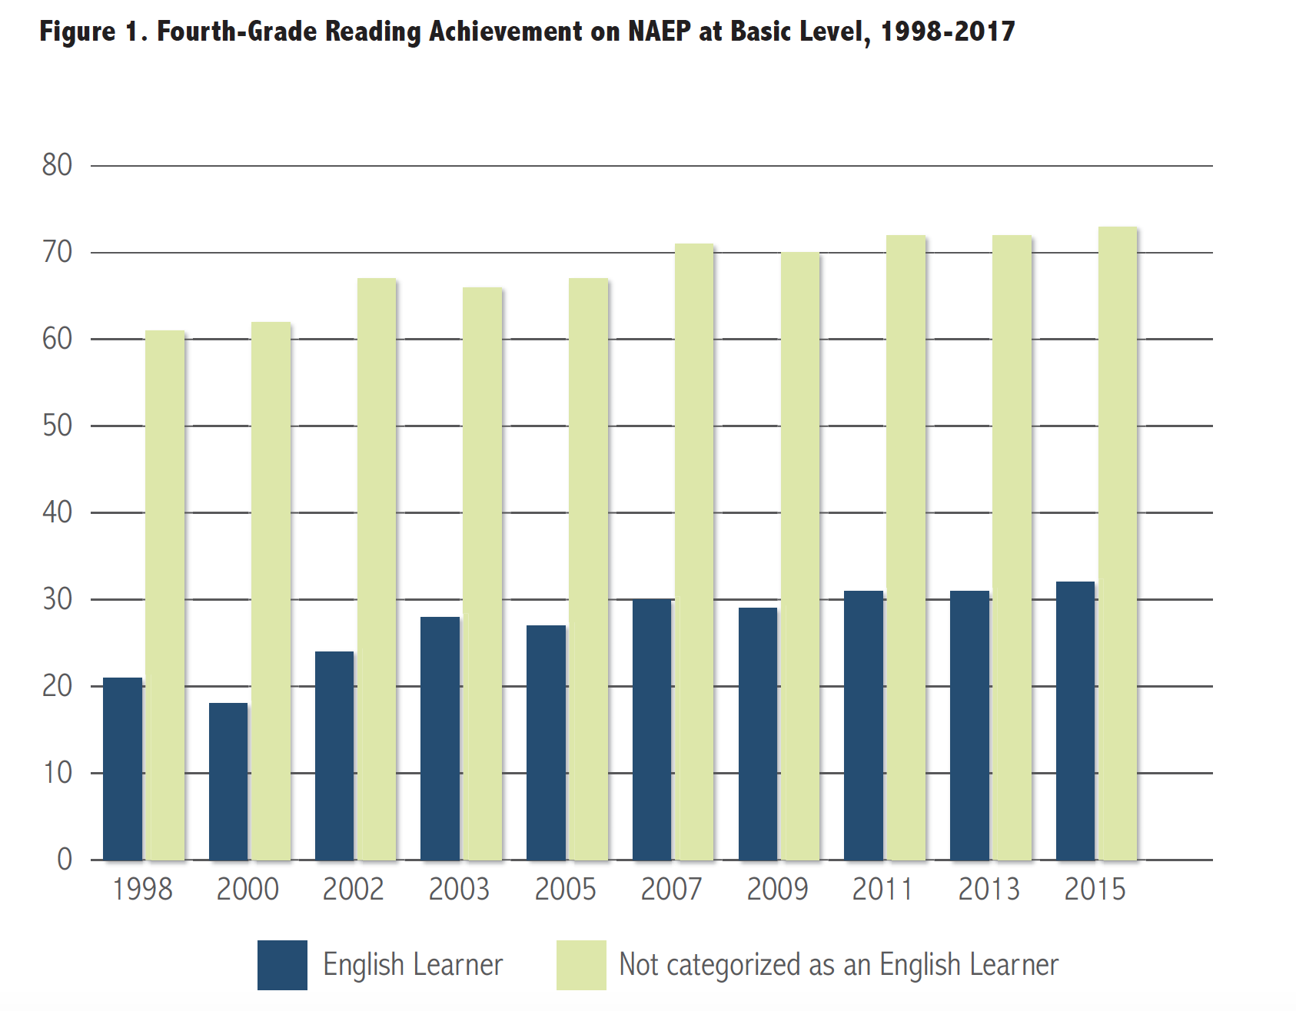

Slide 4

1. Daily, systematic English language instruction.
High levels of English proficiency needs to be a priority
Conversational English is not enough for academic success
Discipline-specific vocabulary and grammar, rhetorical conventions, and academic explanations and argument all are part of academic language
Academic language enables a more thorough or denser presentation of ideas, with more explicit connections, than is common in conversational English
Effective second-language instruction can provide explicit teaching in English while giving opportunities to use the first language

Slide 5
Daily, systematic English language instruction (cont.)
Explicit teaching of English includes teaching of vocabulary, syntax, language conventions, and strategies in how to learn language such as dictionary use, note taking, summarizing, etc.
Such instruction has been most successful when provided daily in a separate time block dedicated to English instruction
A two-pronged approach—explicit teaching and full academic participation—requires that EL students also be included in meaningful classroom tasks that promote interaction with English-speaking students.

Slide 6
2. Explicit instruction in key literacy components.
English Learners need to learn the same things about reading that native speakers need to learn
The National Reading Panel revealed clear learning benefits from teaching native speakers phonemic awareness, phonics, oral reading fluency, vocabulary and comprehension (later analyses found similar benefits from teaching writing)
The National Literacy Panel for Language Minority Children and Youth found that instruction in those same areas were beneficial to English Learners – though the effect sizes differed

Slide 7
Explicit instruction in key literacy components (cont.)
The payoffs from teaching phonemic awareness, phonics, oral reading fluency, reading comprehension, and writing were consistently smaller than for native speakers
However, the effects of vocabulary instruction were substantially higher for English Learners
Basically, English Learners have to learn English PLUS all of those components of literacy learning

Slide 8
Explicit instruction in key literacy components (cont.
However, just because the same things have to be learned, we should not assume that all of the effective instructional moves would be the same
For example, phonemic awareness is highly generalizable across languages – a student who can demonstrate adequate phonemic awareness in a home language will not need a full dose of such teaching in English (perhaps only in English pronunciation patterns not available in the home language)
Or, a comprehension lesson may encourage English Learners to talk about the text in the home language prior to trying to answer teacher’s questions

Slide 9
3. Foster high expectations for EL students’ learning.
Teacher expectations affect student learning
If teachers believe their students are unlikely to learn, they tend to teach in ways that make this expectation a reality
Many things spur low expectations: race, ethnicity, language, family income level, and indicators of past academic performance
Teachers with low expectations for English Learners give them less feedback and explanation when they err, provide less positive feedback when they succeed, spend less time responding to their questions, and give them fewer learning opportunities

Slide 10
Foster high expectations for EL students’ learning (cont.)
Objective measures (e.g., nonverbal IQ, LD incidence) suggest English learners as a population are not different from native speakers
They are as capable of learning as native speakers, so low expectations for ELs are as unwarranted as they are damaging
Two reasons EL students lag in reading:
(1) ELs must learn much more than their native-speaking
classmates (they have to learn everything plus English)
(2) Teachers may be ill equipped to adequately support English l
learners

Slide 11
4. Respect ELs and their home languages.
A second language is an asset
Some teachers may still discourage students’ use of the home language, with the idea that this would help them progress faster in English ( a prejudice out of line with the research)
Instead of making students feel safe and welcome, these practices inadvertently discourage English learners

Slide 12
Respect ELs and their home languages (cont.)
We need to display positive attitudes and high expectations for the ongoing, long-term success of the English learners
Use the Seal of Biliteracy to express high expectations and respect for multilingualism is approving a seal of biliteracy
Encourage professional development efforts that provide teachers with an understanding of language acquisition, cultural and linguistic assets of EL, and effective instructional approaches for them

Slide 13
5. Encourage the development of positive and supportive relationships with families.
Parents and families of English learners have a strong impact on their children’s academic success
Often, teachers underestimate the interest/commitments of these parents have for their children’s education
We often and fail to take advantage of this valuable resource or even to keep EL parents in the loop
Studies show that parents of ELs can, will, and do help their children with school, especially when aware of problems their children may be having
When schools send home instructional activities focused on early literacy, the parents of English learners complete this work with their children

Slide 14
Encourage the development of positive and supportive relationships with families (cont.)
When schools send home instructional activities focused on early literacy, the parents of English learners typically complete this work with their children (don’t avoid sending home such work)
Reading and other literacy work in a home language positively influences children’s reading progress in English
Parents should be encouraged to read to their children, to encourage their children to read books at home, and to discuss with their children what they are reading, in whatever language they are comfortable with (e.g., parent might read book to child in English and then discuss in Spanish)

Slide 15
Encourage the development of positive and supportive relationships with families (cont.)
Parents need to feel welcome at their kids’ schools and be included in school meetings and events
Sending invitations to parent nights and other meetings in the family’s language shows that their language is respected and that they are part of a family-school partnership
Teachers may use interpreters, as needed, to help with ongoing communication with parents about their children’s progress -- school staff should be trained in how to work with interpreters and the children themselves should not be use for that

Slide 16
Encourage the development of positive and supportive relationships with families (cont.)
Many states and local districts provide an English learner parent handbook that invites parent involvement and provides an orientation to policies and practices in schools
Project FLAME employed parent/teacher meetings and guided classroom tours to welcome parents to the school community

Slide 17
6. Ensure that high-quality professional development is provided for teachers.
Professional attitudes and practices underpin quality instruction, high expectations, and positive home-school relations
Professional development can enhance attitudes toward English learners and improve instructional effectiveness
Effective professional development is ongoing, integrates research with practical demonstrations; provides time for practice, feedback, and coaching; and includes administrators and supervisory personnel so that they have a clear idea of what teachers are trying to accomplish
Texas teacher certification requirements are supportive of best practice in this regard

Slide 18
7. Encourage appropriate assessments and their appropriate use.
There are different kinds of assessment
Standardized tests may be used to determine students’ current achievement status in a way that allows for comparison with a criterion or the normative performance of a group
It is important to ensure that such tests are valid when they are used with English Learners -- provide appropriate accommodations to ensure that these are not just English proficiency tests
Depending on the test purpose appropriate accommodations may include reading instructions aloud, translating instructions, orally explaining a task

Slide 19
7. Encourage appropriate assessments and their appropriate use.
Teachers also should assess frequently to monitor progress and to determine when reteaching may be needed
These kinds of informal classroom assessments may include skills checklists, exit tickets (end-of-lesson response cards), observations, and participation rubrics to gauge EL students’ understanding
Examining student work also yields valuable data about where additional teaching is necessary
Annual English proficiency assessment data can be used diagnostically, too

Slide 20
8. Provide appropriate instructional interventions in reading.
Increasingly, school districts are trying to meet the needs of students who may be struggling academically with “response to intervention” or multitiered response systems
The idea of these efforts is to monitor students’ progress closely and to provide additional targeted interventions (Tier 2 interventions) aimed at giving additional assistance to the strugglers with the lagging skills
For instance, beginning readers often struggle with decoding, so a tier 2 intervention might offer additional phonics or phonemic awareness or fluency

Slide 21
Provide appropriate instructional interventions in reading (cont.)
Unfortunately, many schools only provide these foundational skills interventions
English Learners may manifest decoding problems too, so those interventions can be beneficial
However, many English Learners have sufficient decoding skills but need high-quality language/literacy instruction and these kinds of interventions are often not provided

Slide 22
How do we support English Learners?
Daily, systematic English language instruction
Explicit instruction in key literacy components
Foster high expectations for EL students’ learning
Respect ELs and their home languages
Encourage positive/supportive relations with families
High-quality professional development for teachers and principals
Encourage appropriate assessments and their appropriate use
Provide appropriate instructional interventions in reading

