Slide 1
Disciplinary literacy in elementary education
Timothy Shanahan
University of Illinois at Chicago
www.shanahanonliteracy.com

Slide 2
Disciplinary literacy
Disciplinary literacy is a term used to refer to the unique or highly specialized ways that reading and writing are used in the various disciplines
Mathematicians, scientists, historians, and literary critics create, disseminate, and evaluate knowledge differently—and, consequently, the texts they create are different
Secondary schools are now required to help their students deal with these specialized text and to read and write like the specialists in those fields
Elementary teachers have no such responsibility, but can do a lot to help prepare kids for later success

Slide 3
History and social studies standards
Cite specific textual evidence to support analysis of primary and secondary sources, attending to such features as the date and origin of the information.
Analyze in detail a series of events described in a text and the causes that link the events; distinguish whether earlier events caused later ones or simply preceded them.
Identify aspects of a text that reveal an author’s point of view or purpose (e.g., loaded language, inclusion or avoidance of particular facts).
Compare the point of view of two or more authors by comparing how they treat the same or similar historical topics, including which details they include and emphasize in their respective accounts.
Interpret the meaning of words and phrases in a text, including how an author uses and refines the meaning of a key term over the course of a text (e.g., how Madison defines faction in federalist no. 10 and no. 51).
Evaluate authors’ differing points of view on the same historical event or issue by assessing the authors’ claims, evidence, and reasoning.
.

Slide 4
History & social studies Standards (cont.)
Distinguish among fact, opinion, and reasoned judgment in a historical account.
Compare and contrast treatments of the same topic in several primary and secondary sources.
Evaluate an author’s premises, claims, and evidence by corroborating or challenging them with other sources of information.
Integrate information from diverse sources, both primary and secondary, into a coherent understanding of an idea or event, noting discrepancies among sources.
Distinguish among facts, reasoned judgment based on research findings, and speculation in a text.
Follow precisely a complex multistep procedure when carrying out experiments, taking measurements, or performing technical tasks, attending to special cases or exceptions defined in the text.
.

Slide 5
Science & Technical subjects standards
Determine the meaning of symbols, key terms, and other domain-specific words and phrases as they are used in a specific scientific or technical texts and topics.
Integrate quantitative or technical information expressed in words in a text with a version of that information expressed visually (e.G., In a flowchart, diagram, model, graph, or table).
Distinguish among facts, reasoned judgment based on research findings, and speculation in a text.
Follow precisely a complex multistep procedure when carrying out experiments, taking measurements, or performing technical tasks, attending to special cases or exceptions defined in the text.

Slide 6
Science & Technical Subjects standards
Analyze the structure of the relationships among concepts in a text, including relationships among key terms (e.G., Force, friction, reaction force, energy).
Translate quantitative or technical information expressed in words in a text into visual form (e.G., A table or chart) and translate information expressed visually or mathematically (e.G., In an equation) into words.
Compare and contrast findings presented in a text to those from other sources (including their own experiments), noting when the findings support or contradict previous explanations or accounts.

Slide 7
Science & Technical Subjects standards (cont.)
Cite specific textual evidence to support analysis of science and technical texts, attending to important distinctions the author makes and to any gaps or inconsistencies in the account.
Follow precisely a complex multistep procedure when carrying out experiments, taking measurements, or performing technical tasks; analyze the specific results based on explanations in the text.
Synthesize information from a range of sources (e.G., Texts, experiments, simulations) into a coherent understanding of a process, phenomenon, or concept, resolving conflicting information when possible.

Slide 8
LITERATURE STANDARDS
Determine two or more themes or central ideas of a text and analyze their development over the course of the text, including how they interact and build on one another to produce a complex account; provide an objective summary of the text.
Analyze the impact of the author’s choices regarding how to develop and relate elements of a story or drama (e.G., Where a story is set, how the action is ordered, how the characters are introduced and developed).
Determine the meaning of words and phrases as they are used in the text, including figurative and connotative meanings; analyze the impact of specific word choices on meaning and tone, including words with multiple meanings or language that is particularly fresh, engaging, or beautiful. (Include Shakespeare as well as other authors.)

Slide 9
LITERATURE STANDARDS
Analyze a case in which grasping a point of view requires distinguishing what is directly stated in a text from what is really meant (e.G., Satire, sarcasm, irony, or understatement).
Analyze multiple interpretations of a story, drama, or poem (e.G., Recorded or live production of a play or recorded novel or poetry), evaluating how each version interprets the source text. (Include at least one play by shakespeare and one play by an american dramatist.)
Demonstrate knowledge of eighteenth-, nineteenth- and early-twentieth-century foundational works of american literature, including how two or more texts from the same period treat similar themes or topics.

Slide 10
Disciplinary literacy (cont.)
Elementary teachers are not responsible for teaching disciplinary literacy
But they do have a responsibility for preparing students to eventually succeed with such standards

Slide 11
1. Build Basic Skills
Phonemic awareness instruction ensures that children can perceive sounds within words, hold them in memory, and operate on them
Phonics instruction enables children to translate letters and spelling patterns into sounds and pronunciations (translating written to oral language)
Oral reading fluency instruction supports children’s ability to decode accurately and with sufficient speed to make sense of text
Reading comprehension instruction guides students to expect text to be meaningful and to think in ways, while reading, that support understanding and recall

Slide 12
Phonological awareness
PA is the ability to detect, manipulate, or analyze the auditory aspects of spoken language—independent of meaning (e.g., word separations, syllables, rhymes, phonemes)
Instruction aims to teach students to perceive the sounds in spoken words (full segmentation)
Students can be taught to perceive the phonemes in spoken words in preschool, kindergarten, and grade 1 and this has a positive impact on learning to read (Adams, 1990; National Reading Panel, 2000; National Early Literacy Panel, 2008)

Slide 13
decoding
English is an alphabetic language – that means word construction (the spelling of words) represents oral sounds, not meanings
Decoding instruction teaches students to use the sounds of letters and the pronunciations of spelling patterns to decode words (without reliance on context, pictures, guessing) and to spell words
Research shows that explicit and systematic decoding instruction in preschool, kindergarten, and Grades 1-2 leads to improved word reading, oral reading fluency, spelling, and reading comprehension (Adams, 1990; National Reading Panel, 2000; National Early Literacy Panel, 2008)

Slide 14
Oral reading fluency
Oral reading fluency refers to the ability to read text accurately, with sufficient speed, and proper expression
Oral reading fluency instruction focuses on repeated oral reading of challenging texts with feedback
Research shows that oral reading fluency instruction in grades 1-4, and with struggling readers in grades 1-2 improves word reading, oral reading fluency, and reading comprehension (National Reading Panel, 2000; Kuhn & Stahl, 2003)

Slide 15
Vocabulary
Vocabulary refers to knowing the meanings of words (or of the meaningful parts of words)
Vocabulary instruction teaches students the meanings of specific words and word parts, how to use context to infer word meanings, and how to use references like dictionaries
Research shows that vocabulary instruction throughout the grades improves reading comprehension (National Reading Panel, 2000)

Slide 16
Comprehension strategies
Reading (and listening) comprehension strategies refer to intentional actions that readers take in order to better understand or remember the information from text
Comprehension strategy instruction teaches the what, when, why, and how of several specific ways of thinking about text including summarization, self-questioning, visualizing, and using text structure
Research shows that vocabulary instruction throughout the grades improves listening and reading comprehension (National Reading Panel, 2000; Shanahan, et al., 2010)

Slide 17
2. Develop extensive content knowledge
Even before they become readers, kids can start learning about their social and natural worlds
Disciplinary literacy depends heavily on disciplinary knowledge

Slide 18
Develop extensive content knowledge
Many schools reduce the amount of social studies, sciences, arts, etc. to try to enhance reading achievement
Or, they provide such instruction but pay little attention to it because meeting the standards in those subjects “doesn’t count”
But research shows that “prior knowledge” plays an important role in reading comprehension
Opportunities lost in reading instruction in not having kids read texts that both support learning to read and learning content
Some teachers don’t value the knowing of information since “anyone can look that up on Google”—big mistake, knowledge matters

Slide 19
Develop extensive content knowledge
Teach content subjects in the elementary grades and protect this instructional time
Adopt content learning standards for your reading texts (not just your content texts)—that is specify what it is that kids are going to learn about the social or natural world from the texts that are to be read
Engage students in project-based learning in their content classes

Slide 20
Project-based learning
Project-Based Learning poses a challenging problem or question for students, encourages and supports sustained inquiry, that has some degree of authenticity, involving student voice and choice, reflection, and critique and revision (Buck Institute)
Duke, et al., 2019: provided 80 PBL lessons (45 mins each) to second-grade social studies students—the units covered: (1) Producers and Producing in Our Community(economics); (2) Brochure about the Local Community (geography); (3) Postcards about the Community’s Past (history); and (4) The Park/Public Space Proposal Project (civics and government)
This approach increased both social studies knowledge and literacy significantly above traditional social studies instruction
Inside Information by Nell Duke (2014)
Notes:
opportunities for informational text reading and writing
Economics unit involved creating an informational flier about a local business for that business’ use and creating and selling their own good or service to raise money for a cause. The business chosen, the good or service created and sold, and the cause were all decided by each class.
Geography project involved developing a brochure to persuade people visiting or considering settling in the local community that it has compelling natural and human characteristics. Local community varied by district, and the natural and human characteristics were chosen by each child—for example, one child might choose to feature the local athletic center, whereas another might choose to feature the local public library. In the
History unit, the project involved students developing postcards about the history of the local community to display or sell in a local institution, such as a library or historical society (again with the community varying by with the teacher or students deciding which historical sites to feature, whether to sell or display their postcards, and location(s) where postcards are shared.
Civics/government project involved developing a proposal, conveyed in letters and in a group presentation, to persuade the local city government to make improvements to a local park or other public space selected by the teacher and/or teacher and students collectively.

Slide 21
3. Expose students to disciplinary texts
Students should have access to disciplinary texts in science, history, math, and literary texts
Informational texts should have a wide range of text types, modalities, and purposes

Slide 22
Expose students to disciplinary texts
Include informational texts in reading instruction itself
Include informational texts in classroom libraries
Don’t be afraid of informational texts for read-alouds
Many districts don’t provide texts for the various subjects (for instance, they try to only teach “hands on science”—BIG MISTAKE)
Use appropriate texts in science, social studies, etc.

Slide 23
Instructional level fears
Many teachers avoid content texts because of their relative difficulty
In many classrooms, reading is taught in leveled-reader groups to ensure that students are reading at their “instructional level”
Social studies or science texts are typically a single book and make no accommodations for reading levels—so teachers either don’t use them or have them read aloud

Slide 24
Instructional level (Cont)
Idea of instructional level originated with Emmett Betts (1946)
He claimed everyone had three reading levels (independent, instructional, frustration)
He came up with the way to determine levels—informal reading inventory
He developed the operational criteria (95-98% word reading accuracy, 75-89% reading comprehension)

Slide 25
Instructional level (Cont)
Killgallon (1942): only looked at relationship of oral reading fluency and reading comprehension—not learning
Powell (1968): same methodology as Killgallon, but more grade levels and different results
Dunkeld (1971): students taught at frustration level made greatest learning gains
Jorgensen, et al. (1977): no relation between placement and achievement gains

Slide 26
Instructional level (Cont)
Morgan, et al. (2000): frustration level placements led to greater learning gains
Brown et al. (2017): replicates this result with third grade
O’Connor et al (2002, 2010): only benefit was for students reading at grade 1 level, but this benefit went away if scaffolding was equated
Kuhn et al (2006): frustration level placement led to greater learning gains
Homan, et al., (2010): teaching 6th graders with instructional level text gave no advantage over teaching with text one year above instructional level

Slide 27
4. Guide reading of disciplinary Texts
Require that students read disciplinary texts and hold them accountable for making sense of these
Provide guidance to teach them how to read these texts independently
A typical text-centered content lesson is done through round robin reading with the teacher elaborating on the text (a very weak introduction to disciplinary text!)

Slide 28
Guide reading of disciplinary Texts
Informational texts at these levels tend to describe, compare, or sequence or make causal connections or problem-solution connections
Set purposes that are in line with what the text is going to provide
Read the next page to find out about the similarities and differences between… read to find out about what causes… read to find out how the text describes… read to find out what solutions there are to this problem… read to find out the order in which these things occurs

Slide 29
Guide reading of disciplinary Texts
Review the text for Tier 2 words the students might not know
Focus on academic words rather than content words
Examples: however, next, because, first, since, etc.
Only an introduction of these words is necessary (no guessing, tell them or show them)

Slide 30
Guide reading of disciplinary Texts
Set a reasonable amount of text for students to read and by Grade 2 have them read it silently
This might be as little as a single page
Over time expand the amount of reading you ask them to do silently (build stamina)

Slide 31
Guide reading of disciplinary Texts
Accountability can take many forms
Easiest, perhaps, is a guided discussion—teacher asks questions about what the students found out
This kind of work can also be done through writing
Other outcomes possible too: completing a graphic that summarizes the text, or a project

Slide 32
5. Develop disciplinary vocabulary
Teach students the vocabulary of the subject areas
Build their knowledge of morphemes relevant to those subject areas
Develop their ability to make sense of vocabulary from text

Slide 33
Develop disciplinary vocabulary
Vocabulary is the intersection of content and language
Teach students both the specialized vocabulary of the content that you teach and other key words that matter to comprehension
Don’t preteach all the words (for instance, most technical terms in science books are defined in the text—those should not be pretaught)

Slide 34
6. Work with multiple texts
Some subjects (e.g., social studies) depend upon the reading of multiple texts
Students should have the opportunity to work with multiple texts in such subjects
Other subjects (e.g., science) depend upon the reading of multi-modal text
Students should have the opportunity to work with those “multiple” texts, too

Slide 35
Work with multiple texts
History knowledge is not “factual,” but plausible
Historians develop their plausible interpretations of what happened and why based on their analysis of evidence drawn from multiple perspectives
Having students synthesizing texts—comparing them to determine their agreements and disagreements is valuable
Historical Scene Investigation https://hsi.wm.edu/

Slide 36
Work with multiple texts
Science attempts to describe phenomena and processes in the natural world
Language is not sufficient for accurately summarizing scientific knowledge
For this reason, scientific communication depends upon language, graphics, and mathematics
Guiding students to identify the purpose of graphics, teaching them how to interpret graphics, and showing them how to compare graphics with the text all should have a place in the science class

Slide 37
Synthesis
 | UNIQUE | REDUNDANT | CONTRADICTORY
Coniferous forest
Deciduous forest
Rain forest

Slide 38
Multiple Text Discussion Web
YES
NO
Text 1 Evidence
Text 1 Evidence
Text 2 Evidence
Is global warming
a threat to the US?
Text 2 Evidence
Our View
Text 3 Evidence
Text 3 Evidence

Slide 39
7. Teach disciplinary writing, too
One of the most effective ways of teaching text characteristics, formatting, and the like is to have students trying to use these features productively in their writing
Students should have opportunities to write papers and to produce presentations that effectively communicate information about content

Slide 40
Teach disciplinary writing, too
Research shows that writing about text increases student learning (Graham & Hebert, 2010)
Having students write summaries of text are particularly valuable in the elementary grades
There are also benefits for having students write explanation in mathematics
And, for having students synthesize information across texts

Slide 41
Writing about Text
Text modeling
Summaries
Analysis and critique
Synthesis

Slide 42
Writing To Text Models
Good writers usually become good writers because they imitate when they write
They imitate structure, style, language
Writing on the basis of models –that is trying to imitate features of what we read—can both improve reading and writing
To do this requires analytical reading that looks carefully at how the text was composed
And for the writer it provides valuable scaffolding

Slide 43
Text Modeling
Select strong text examples
Read and reread the text trying to identify or describe its features
Decide which features need to be repeated
Then try to compose your own text by varying the key features
Re-read the original text and revise

Slide 44
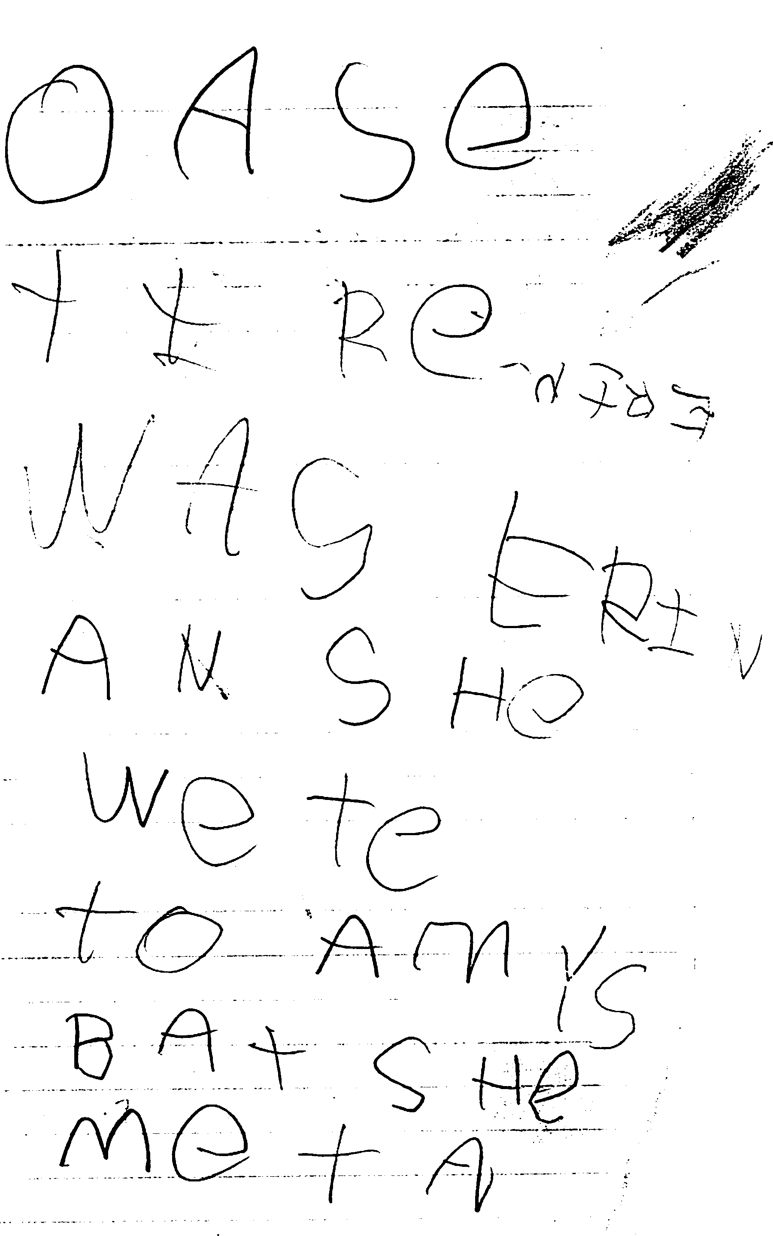

Slide 45
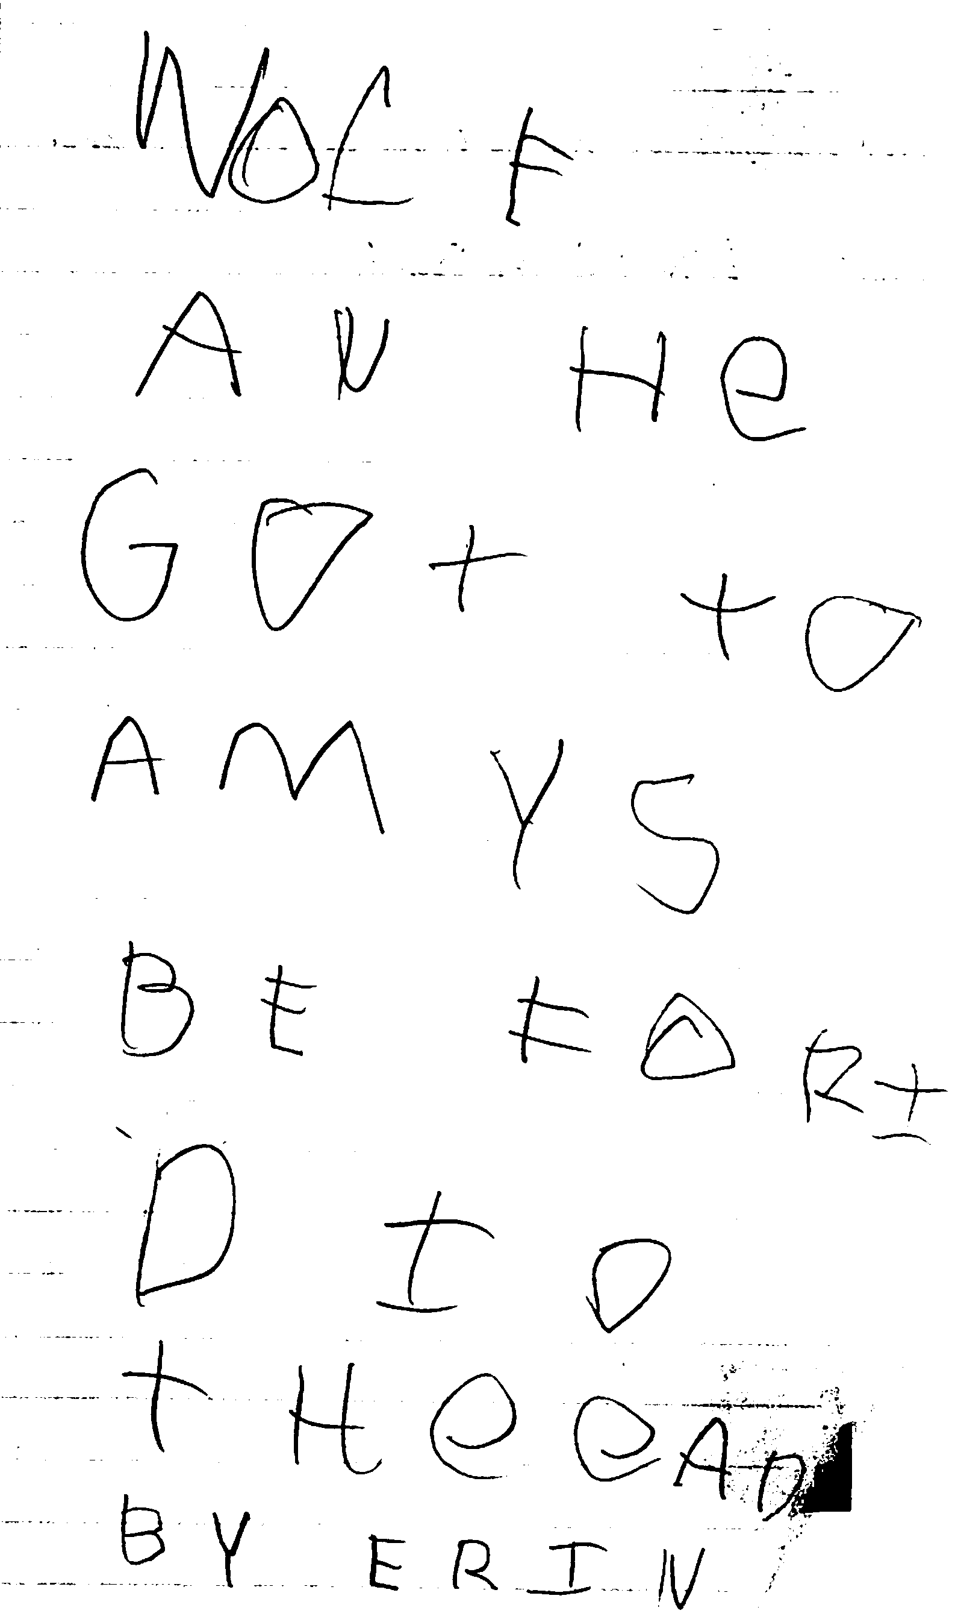

Slide 46
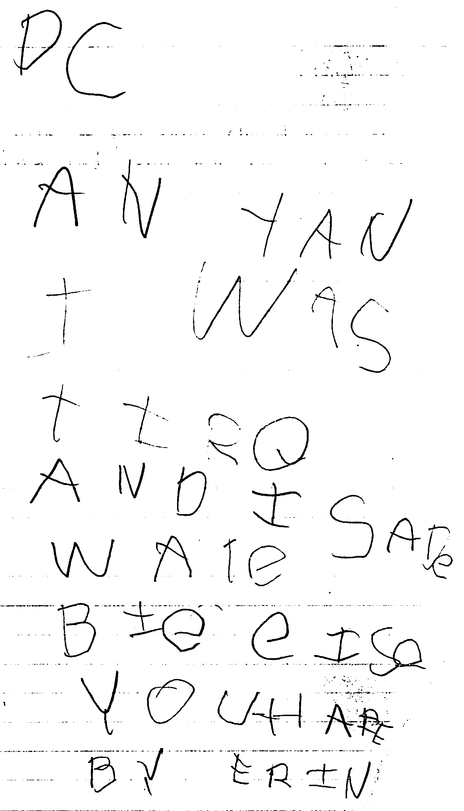

Slide 47
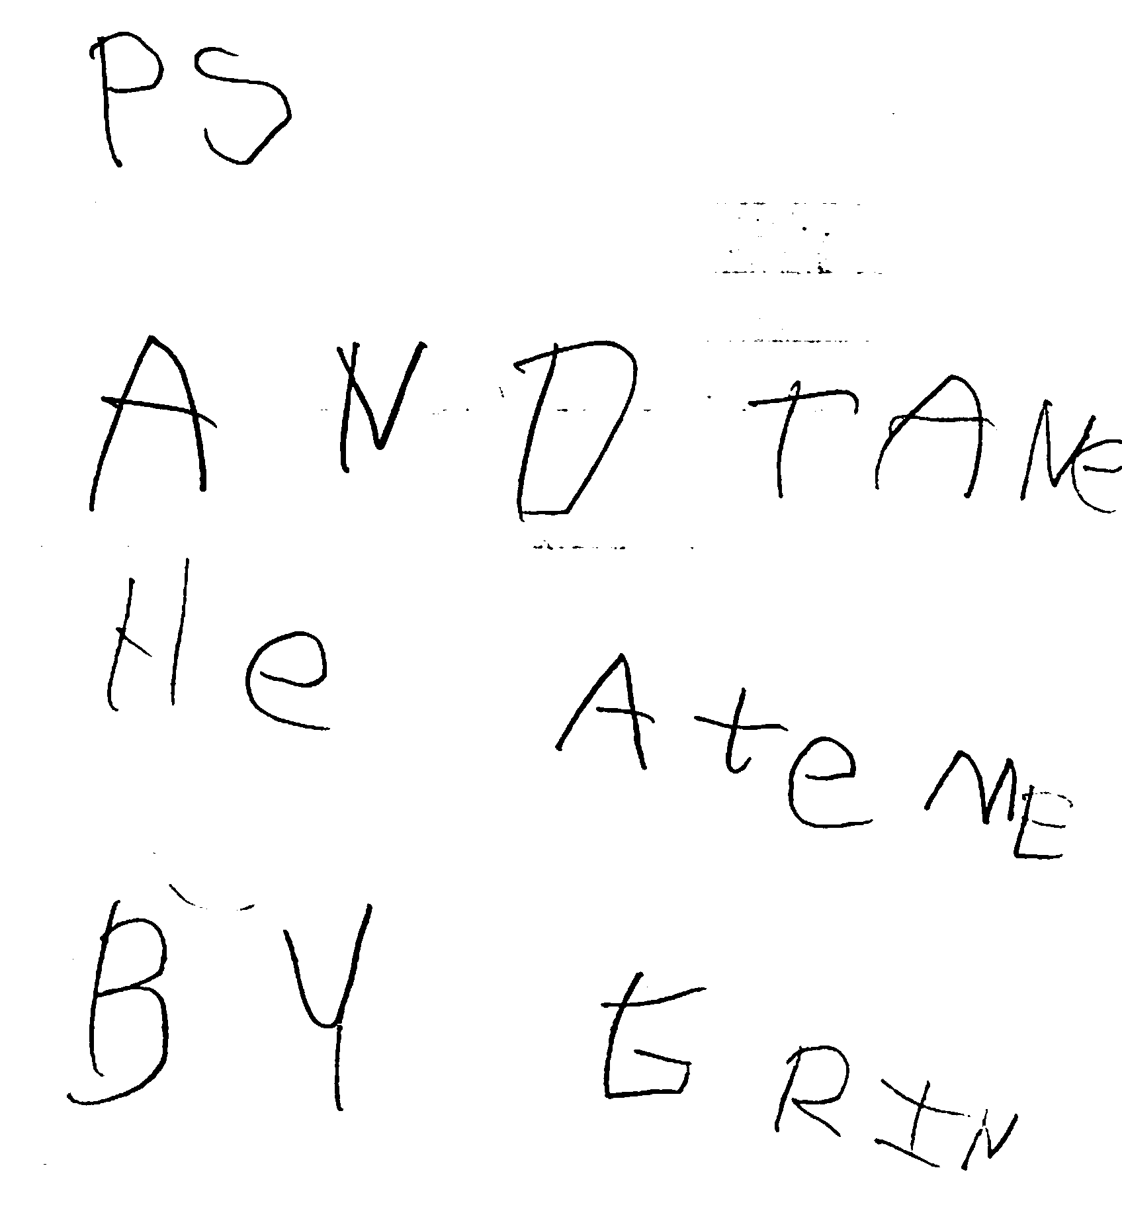

Slide 48
Summarization
Writing about text is effective because it encourages students to think about what the author wrote (more effective with elementary than secondary)
Requires students to identify the key ideas and details and to think about how those ideas are organized
More explicit consideration of the text than if the reader were only reading

Slide 49
Graham & Perin Results
 | d | n
Strategy instruction | .82 | 20
Summarization | .82 | 4
Peer assistance | .75 | 7
Product goals | .70 | 5
Word processing | .55 | 18
Sentence combining | .50 | 5
Prewriting | .32 | 5
Process approach | .32 | 21
Inquiry | .32 | 5
Models | .25 | 6
Grammar | -.43 | 11

Slide 51
Summaries of Short Texts:
Identify/select the main idea of a paragraph
Delete trivial information
Delete redundant information
Write a one sentence synopsis of the main and supporting information for each paragraph

Slide 52
a. Read the text
You can see some small things with your eyes. With a microscope, however, you can see much smaller details. Think of a butterfly’s wing. You can see it with your eyes. But a microscope can show you small parts of the wing called scales.

Slide 53
b. Identify main idea
You can see some small things with your eyes. With a microscope, however, you can see much smaller details. Think of a butterfly’s wing. You can see it with your eyes. But a microscope can show you small parts of the wing called scales.

Slide 54
c. Delete trivia
You can see some small things with your eyes. With a microscope, however, you can see much smaller details. Think of a butterfly’s wing. You can see it with your eyes. But a microscope can show you small parts of the wing called scales.

Slide 55
d. Write one sentence summary
Microscopes let you see things so small that you can’t see them with just your eyes.
(written with text removed)

Slide 56
Summaries of Longer Texts:
Identify/select the main idea of a text
Create a skeleton outline using the subheadings from the text
Identify 2-3 important ideas for each subheading
Convert the outline into a summary

Slide 57
GIST
1. Read text (section)
2. Identify 5Ws and H
3. Write 20 word summary
__________ __________ __________ __________
__________ __________ __________ __________
__________ __________ __________ __________
__________ __________ __________ __________
__________ __________ __________ __________

Slide 58
Summary Writing Skills
Comprehension of the text
Identification of key ideas and details
Identification of the text structure
Ability to paraphrase and translate ideas into your own words
Ability to combine subpoints into generalizations

Slide 59
8. Introduce disciplinary approaches
To the extent that available texts allow, introduce students to the reading routines and special text characteristics of the disciplines

Slide 60
The American Revolution

Slide 61
The Fall of Fort Ticonderoga
After the battles of Lexington and Concord, the British army stayed in Boston. The American forces camped around Boston, waiting for the British to move.
Meanwhile, a young New Englander named Benedict Arnold had been appointed to lead 400 soldiers at Fort Ticonderoga in New York. After arriving there, he joined forces with Vermont’s rough and rugged Ethan Allen. Allen led a group of rebels called the “Green Mountain Boys.”
Before dawn on May 10, 1775, the Americans attacked Fort Ticonderoga. The British were sleeping peacefully. Allen woke up the commander by banging on his door and shouting, “Come out of there, you old rat!” The Americans captured the fort without firing a shot. Inside, they found something they needed desperately—heavy iron cannons.

Slide 62
The Battle of Bunker Hill
A month later on the night of June 16, British troops in Boston heard strange noises on nearby Charlestown Peninsula. When the sun rose, they could not believe their eyes. The day before, the peninsula had been empty. Now its two small hills—Bunker Hill and nearby Breed’s Hill—were alive with Americans. In just one night they had built a fort of dirt and logs on Breed’s Hill.
The British knew they had to attack quickly. If the Americans could drag the cannons taken at Fort Ticonderoga up to the hilltops, they would be able to pound Boston and the British ships in the harbor.
On the next day 2,000 of the king’s troops lined up at the base of Breed’s Hill. General William Howe ordered them to march to the top and take the American fort. The Redcoats sweated heavily in the hot June sun as they struggled up Breed’s Hill.

Slide 63
In the hilltop fort, fingers tightened on triggers. Fighting to control their fear, the Americans reported their order—“Don’t fire till you see the whites of their eyes.” As the red line of troops moved closer, a gray-haired farmer prayed, “I thank thee, O Lord, for sparing me to fight this day.”
When the British were almost on top of them, the Americans fired. Huge gaps appeared in the line of redcoats. The surprised British fell back and then made a second attack. Again they were mowed down by American gunfire.
General Howe regrouped his men and sent them up the hill a third time. Once more, the Redcoats’ front line was ripped apart by gunfire. As soldiers in the back lines advanced, they tripped over their fallen comrades. But this time the British troops reached the top. By now the Americans had run out of gunpowder and were retreating to safer ground. The canons captured at Fort Ticonderoga had never left New York.

Slide 64
By evening the British had taken over the Charlestown Peninsula. But as the dead and wounded were counted, General Howe found that the victory had been “too dearly bought.” He had lost more than 1,000 soldiers that day. The Americans had lost over 400.
Even though most of the fighting took place on Breed’s Hill, this bloody conflict was remembered as the Battle of Bunker Hill. After that battle, the British would never again doubt that Americans could and would fight.

Slide 65
The Second Continental Congress
While New England went to war, representatives from the colonies were meeting in Philadelphia. This was the Second Continental Congress. John Adams asked the Congress to set up a “Grand American Army” with troops from every colony. To lead this army, Adams suggested “a gentleman whose skill as an officer…would command respect of America.” The man was George Washington of Virginia.
The Congress asked Washington to serve as commander-in-chief of the new Continental Army. Washington agreed, saying he would use “every power I possess… for the support of the glorious cause.”
Adams believed that the colonies should declare their independence, or complete freedom, from Great Britain. But the Congress was not ready to take such a step. Most Americans still felt loyal to King George III. The idea of independence scared them.

Slide 66
The Congress tried to make peace and voted to send another petition to King George III. This petition asked the king to help end the war. It was called the Olive Branch Petition because the olive branch is the symbol of peace.
King George refused to read the petition from what he called an “illegal congress.” He saw the actions of the Congress as treason. In Britain the punishment of treason was death.

Slide 67
Washington Takes Command
As George Washington rode toward Boston he knew that the odds were against him. How, he wondered, could the colonies stand up to Britain—the world’s most powerful country? How could rebel farmers defeat the world’s strongest army and navy?
Yet Great Britain faced two large problems. One was distance—America lay across a vast ocean. Sending troops and supplies across the Atlantic Ocean was both slow and costly. Britain’s second problem was the size of the colonies. To crush the rebellion, the British would have to take control of a huge territory.
Washington also faced great problems. The Continental Army was poorly trained and lacked supplies. The colonies did not have a navy. Worse still, many people did not support the war. Only about two fifths of the colonists called themselves Patriots and supported the fight against Britain. One fifth were Loyalists, people who felt loyal to Great Britain and opposed the war. The remaining two fifths did not take sides and could not be counted on to fight.

Slide 68
Early in July 1775, General Washington took command of the troops camped around Boston. Everywhere he looked he saw “confusion and disorder.” Men obeyed only those orders they liked. Washington worked hard to bring order to the army. Soon one soldier wrote, “Everyone is made to know his place and keep it… It is surprising how much work has been done!”

Slide 69
The British Leave Boston
For months nothing happened. The British hoped the Patriots would grow tired of their rebellion and go home. To Washington’s dismay, many of his troops did just that. The Americans hoped that King George III would pull his troops out of Boston. Instead, he hired German mercenaries to help crush the rebellion. Mercenaries are soldiers hired to fight in another country’s war.
Washington desperately needed cannons to drive the British out of Boston. He finally sent a former bookseller, Henry Knox, to get the iron cannons that had been captured at Fort Ticonderoga. Somehow Knox’s men loaded 59 huge cannons onto sleds. Then they dragged them for more than 300 miles (480 km) across the snowy hills and frozen rivers to Boston.

Slide 70
On March 4, 1776, Boston awoke to a surprise. The day before, nearby Dorchester Heights had been bare hills. Then overnight those hills had sprouted cannons—cannons aimed at the city. The British general announced that if the Americans did not allow him to leave peacefully, he would destroy Boston. Washington wisely agreed to let the British troops move out. A few days later the redcoats sailed for Canada. With them went over 1,000 American loyalists.

Slide 71
A Good Beginning
American Patriots were overjoyed by this news. In the past year, they had shown the British they could fight. They had formed a Continental Army with George Washington as their leader. And they had driven the British out of the colonies.
Many people thought the war was over. But Washington knew better. The British would be back. Still, the Patriots had made a good beginning.

Slide 72
History Events Chart
TEXT | WHO? | WHAT? | WHERE? | WHEN? | WHY?
Relation:
2
Relation:
3
Relation
4
Main point:
Notes:
In the history meetings, the team liked a number of strategies and made suggestions for improvement. One such strategy was the history events chart. Coherence and understanding how the stories of history connect to each other is crucial to understanding narrative history. As students read about a particular event, they write down answers to the questions of who, what, where, when, how, and why in order to summarize the key narrative events. They do the same with each event they read about. However, the compelling task — the one that addresses a specific disciplinary problem in reading history — is to determine what the relationship is between the first and second event, between the second and third event, and so on. Students are asked to think about the most likely connections and to write these on the chart. The historians were approving of this task because it mirrored the kind of thinking that historians do. That is, historians infer cause-and-effect relationships when they study events and what precedes and follows them. These relationships are not necessarily visible in the events themselves, nor are they always made explicit in high school history texts, so they must be surmised. And, if they are made explicit in the text, students generally regard the connection as “truth” rather than as the construction of the writer. The task, then, not only mirrored historians’ thinking, but also offered the opportunity for students to construct the cause-and-effect relationships themselves.
The high school teachers have tried out several promising strategies in the classroom, including the ones described above. One of the history teachers engaged in a quasi-experimental study of another history strategy — one he called “The Multiple Gist” strategy. In this strategy, students read one text and summarize it, read another text and incorporate that text into the summary, then read another text and incorporate that text into the summary, and so on. The summary has to stay the same length, essentially, and this forces a student to use words such as similarly or in contrast when incorporating texts that compare or contrast with each other. His preliminary results reveal that students who learned the multiple-gist strategy wrote longer, more coherent answers to essay questions.

Slide 73
History Events Chart
TEXT | WHO? | WHAT? | WHERE? | WHEN? | WHY?
Fall of Fort Ticonderoga | American forces (Arnold & Allen) & British forces | Americans capture Fort Ticonderoga | New York | May 10, 1775 | Americans capture cannons
Relation: Americans finally had cannons, but failed to get them from NY to Boston.
Battle of Bunker Hill | American forces & British forces | British win the battle. | Boston | June 16, 1775 | Americans failed to get cannons to Boston
Relation: American army has to be unified if they are going to win.
Notes:
In the history meetings, the team liked a number of strategies and made suggestions for improvement. One such strategy was the history events chart. Coherence and understanding how the stories of history connect to each other is crucial to understanding narrative history. As students read about a particular event, they write down answers to the questions of who, what, where, when, how, and why in order to summarize the key narrative events. They do the same with each event they read about. However, the compelling task — the one that addresses a specific disciplinary problem in reading history — is to determine what the relationship is between the first and second event, between the second and third event, and so on. Students are asked to think about the most likely connections and to write these on the chart. The historians were approving of this task because it mirrored the kind of thinking that historians do. That is, historians infer cause-and-effect relationships when they study events and what precedes and follows them. These relationships are not necessarily visible in the events themselves, nor are they always made explicit in high school history texts, so they must be surmised. And, if they are made explicit in the text, students generally regard the connection as “truth” rather than as the construction of the writer. The task, then, not only mirrored historians’ thinking, but also offered the opportunity for students to construct the cause-and-effect relationships themselves.
The high school teachers have tried out several promising strategies in the classroom, including the ones described above. One of the history teachers engaged in a quasi-experimental study of another history strategy — one he called “The Multiple Gist” strategy. In this strategy, students read one text and summarize it, read another text and incorporate that text into the summary, then read another text and incorporate that text into the summary, and so on. The summary has to stay the same length, essentially, and this forces a student to use words such as similarly or in contrast when incorporating texts that compare or contrast with each other. His preliminary results reveal that students who learned the multiple-gist strategy wrote longer, more coherent answers to essay questions.

Slide 74
Character Change Chart
What is main character like at the beginning of the story? | What is the main character like at the end of the story? How has he or she changed?
Crisis
Given this character change, what do you think the author wanted you to learn? ________
________________________________________________________________________
________________________________________________________________________

Slide 75
Elementary teachers can contribute to growth in disciplinary literacy by…
BUILDING BASIC LITERACY SKILLS
DEVELOPING CHILDREN’S CONTENT KNOWLEDGE
EXPOSING KIDS TO DISCIPLINARY TEXT
GUIDING STUDENTS TO READ DISCIPLINARY TEXT
DEVELOPING DISCIPLINARY VOCABULARY
WORKING WITH MULTIPLE TEXTS
TEACHING DISCIPLINARY WRITING
INTRODUCING DISCIPLINARY APPROACHES

Slide 76
Disciplinary literacy in elementary education
Timothy Shanahan
University of Illinois at Chicago
www.shanahanonliteracy.com

