Slide 1
Reconceptualizing Reading and Reading Instruction
Timothy Shanahan
University of Illinois at Chicago
www.shanahanonliteracy.com

Slide 2
Standardized Testing Has Shaped Our Conceptions of Reading
Even educators who hate standardized testing have come to view reading through the testing prism
Currently, our states adopt standards that are basically lists of reading skills
Those skills then are built into accountability tests through questions that mirror the skills lists
And, then textbook publishers and teachers construct lessons aimed at teaching those skills
The idea being that if kids get enough practice with these skills then they will become better readers

Slide 3
Examples of Reading Skills
Refer
Refer to details and examples in a text when explaining what the text says explicitly and when drawing inferences from the text.
Determine
Determine a theme of a story, drama, or poem from details in the text; summarize the text.
Describe in
Describe in depth a character, setting, or event in a story or drama, drawing on specific details in the text (e.g., a character's thoughts, words, or actions).
Determine
Determine the meaning of words and phrases as they are used in a text, including those that allude to significant characters found in mythology (e.g., Herculean).
Compare and contrast
Compare and contrast the point of view from which different stories are narrated, including the difference between first- and third-person narrations.

Slide 4
Example of Related Test Item
Refer to details and examples in a text when explaining what the text says explicitly and when drawing inferences from the text.
--------------------------------------------------------------------------------------------------
Matthew and his family go to the farmer's market regularly. Pick the two details from the passage that best support this inference.
◻︎ Kayla helps load the crates onto the truck.
◻︎ Matthew knows his friend Jose will be there.
◻︎ Grandmother bakes pies to sell at the market.
◻︎ Dad knows the name of the parking attendant.
◻︎ Matthew thinks the rain will allow them to stay home

Slide 5
So the Tests Measure the Standards?
Not exactly
The standards specify the skills the children are to learn
The test items are designed based on those standards
But the test does not reveal how well students learn any of the specific standards

Slide 6
Common Core Aligned
The assessment system covers the full range of college- and career-ready knowledge and skills in the Common Core State Standards. To do this, each test item is based on overall content claims and assessment targets.
Content claims are summary statements about the knowledge and skills students are expected to demonstrate on the assessment related to a particular aspect of the standards. Within each claim area, assessment targets were developed to ensure that Item writers and reviewers address the standards, learning progressions, and the Depth of Knowledge levels.”
What the Tests Do – Content Claims

Slide 7
TEST’S ELA Content Claim
“Students can read closely and analytically to comprehend a range of increasingly complex literary and informational texts.”
The test results tell us how students did with regard to this content claim, not on any of the standards themselves

Slide 8
Why don’t the tests offer an evaluation of student performance on the skills?
Because they cannot
Reading is not a collection of such skills and reading comprehension tests cannot measure them in any meaningful or useful way

Slide 9
Where did these questionable skills come from?
In 1917, Thorndike found that readers comprehended better when they answered questions about a text
Basal readers started publishing lesson plans during the 1920s
If answering questions improved comprehension, it must be guiding readers to think about the text in a useful way
And, perhaps, different kinds of questions would get students to think about texts in particular ways
The tests followed suit—testing the kinds of skills the programs were teaching

Slide 10
Research has cast doubt on the reality or the value of this skills orientation
These studies go back to the 1940s and their pattern of results is pretty consistent
Here is just one example of these findings
However, what you need to remember is that this is an example and what I am showing you is true for all standardized comprehension tests
But can tests measure these skills?

Slide 11
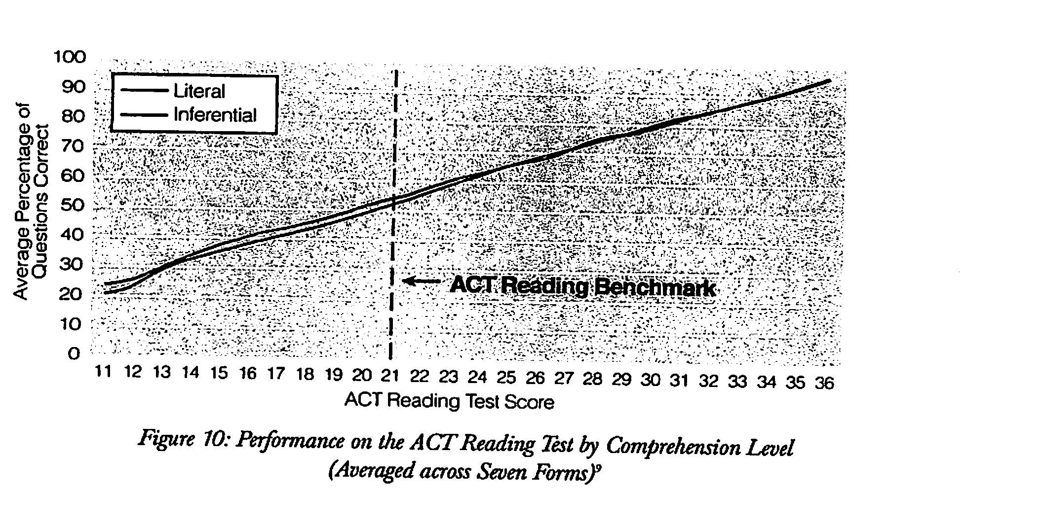
No performance differences due to question types (skills)

Slide 12
No performance differences due to question types (cont.)

Slide 13
Text differences affect reading performance

Slide 14
The Usual Way of Doing this Study
In 1944, Frederick Davis noted that the reading tests of the day claimed to measure 8 skills (since they were asking 8 different kinds of questions)
He factor analyzed a popular standardized reading comprehension test of the time
The result: the test measured only a single factor

Slide 15
Reconceptualization of reading
Reading comprehension is not the ability to answer certain kinds of text questions
Reading is the ability to make sense of ideas expressed in text—the ability to negotiate the linguistic and conceptual barriers or affordances of a text

Slide 16
Reading requires skills, but not reading comprehension skills, per se (or at least not skills that match up with answering particular kinds of questions)
Readers need to be able to perceive the language sounds within words (phonemic awareness) and that’s a skill
They must be able to decode print to pronunciation fluently and that’s a skill
And there are others, too (vocabulary meaning)
Skills require a certainty of outcome and a regularity in their execution (something like main idea is not a skill)
But isn’t reading a skilled activity?

Slide 17
The role of questions
Answering questions is useful because it encourages readers to think about the text content (so does discussion, writing, and using the information in projects)
Particular kinds of questions can guide reader attention (e.g., focus on numerals or dates, signal words)
However, that only works if readers are able to identify that information easily within text
Of all the reading strategies tested, schemes aimed at answering certain kinds of questions (e.g., Bloom’s taxonomy, QAR) have the least impact on comprehension

Slide 18
Another reason to reject the skills approach and to reconceptualize reading instruction is because of the important role that prior knowledge plays in reading comprehension
Studies show that readers do not just comprehend text by analyzing the texts but that comprehension requires knowledge
We use knowledge to draw inferences, to disambiguate text, to reduce demands on working memory, etc.
The role of knowledge in compre-hension

Slide 20
"The procedure is actually quite simple. First you arrange items into different groups. Of course one pile may be sufficient depending on how much there is do. If you need to go somewhere else due to a lack of facilities, then this is the next step; otherwise, you are pretty well set. It is important not to overdo things. That is, it is better to do too few things at once than too many. In the short run, this may not seem important, but complications can easily arise. A mistake can be expensive as well. At first, the whole procedure will seem complicated. Soon, however, it will become just another facet of life. It is difficult to foresee any end to the necessity for this task in the future, but then, one can never tell. After the procedure is completed, one arranges the materials into different piles again. Eventually they will be used one more and the whole cycle will then have to be repeated. However, that is part of life."

Slide 21
Washing Clothes
"The procedure is actually quite simple. First you arrange items into different groups. Of course one pile may be sufficient depending on how much there is do. If you need to go somewhere else due to a lack of facilities, then this is the next step; otherwise, you are pretty well set. It is important not to overdo things. That is, it is better to do too few things at once than too many. In the short run, this may not seem important, but complications can easily arise. A mistake can be expensive as well. At first, the whole procedure will seem complicated. Soon, however, it will become just another facet of life. It is difficult to foresee any end to the necessity for this task in the future, but then, one can never tell. After the procedure is completed, one arranges the materials into different piles again. Eventually they will be used one more and the whole cycle will then have to be repeated. However, that is part of life."

Slide 22
Building Knowledge
Knowledge is crucial to reading, but we don’t do a sufficient amount to increase student knowledge
Building knowledge through reading is more important than emphasizing certain kinds of questions
Need less emphasis on answering certain kinds of questions and more emphasis on remembering the information from text
One example: instead of practicing answering particular kinds of questions on the weekly or unit tests—review the content of the texts

Slide 23
Building Knowledge (cont.)
Need to protect science, social studies, and the arts in the curriculum
Need to be more knowledge-oriented throughout the curriculum including in the reading texts that we use
Classroom libraries and read-alouds should skew more towards content, too

Slide 24
Another reason to rethink reading…
Reading ability is not as generalizable as once believed
We read differently across the disciplines

Slide 25
Disciplinary Literacy
No one is surprised that the vocabulary of the different disciplines differs
But are you aware that the grammar differs markedly, too
So does text structure
And how graphic elements are used
They also differ in terms of what tools readers can use to make sense of text and in the kinds of information that are considered to be important
It is not enough to teach general literacy abilities
Students need to learn how to read these more specialized texts

Slide 26
Reading and writing, too
Reading is widely recognized as an essential skill and one deserving of much curricular, instructional, and assessment attention
Writing on the other hand is usually seen as the “red headed” stepchild
However, research shows that close ties between reading and writing – both in the their use and their learning

Slide 27
Every Skill Should Be Taught Both Ways
Phonemic awareness/phonics: invented spelling
Oral reading fluency: non-stop writing
Reading comprehension: written language (vocabulary, sentence combining, cohesion revision, text structure…)

Slide 28
First-grader’s attempt to represent 59 phonemes

Slide 29
Cohesion revision
Only once a year, on his birthday, did Charlie Bucket ever get to taste a bit of chocolate. The whole family saved up their money for that special occasion, and when the great day arrived, Charlie was always presented with one small chocolate bar to eat all by himself. And each time he received it, on those marvelous birthday mornings, he would place it carefully in a small wooden box that he owned, and treasure it as though it were a bar of solid gold; and for the next few days, he would allow himself only to look at it, but never to touch it. Then at last, when he could stand it no longer, he would peel back a tiny bit of the paper wrapping at one corner to expose a tiny bit of chocolate, and then he would take a tiny nibble — just enough to allow the lovely sweet taste to spread out slowly over his tongue. The next day, he would take another tiny nibble, and so on, and so on. And in this way, Charlie would make his sixpenny bar of birthday chocolate last him for more than a month

Slide 30
Cohesion revision
Only once a year, on his birthday, did Charlie Bucket ever get to taste a bit of chocolate. The whole family saved up their money for that special occasion, and when the great day arrived, Charlie was always presented with one small chocolate bar to eat all by himself. And each time he received it, on those marvelous birthday mornings, he would place it carefully in a small wooden box that he owned, and treasure it as though it were a bar of solid gold; and for the next few days, he would allow himself only to look at it, but never to touch it. Then at last, when he could stand it no longer, he would peel back a tiny bit of the paper wrapping at one corner to expose a tiny bit of chocolate, and then he would take a tiny nibble — just enough to allow the lovely sweet taste to spread out slowly over his tongue. The next day, he would take another tiny nibble, and so on, and so on. And in this way, Charlie would make his sixpenny bar of birthday chocolate last him for more than a month

Slide 31
Cohesion revision
Only once a year, on Charlie’s birthday, did Charlie Bucket ever get to taste a bit of chocolate. The whole family saved up the whole family’s money for Charlie’s birthday, and when Charlie’s birthday arrived, Charlie was always presented with one small chocolate bar for Charlie to eat. And each birthday he received a bit of chocolate, on those marvelous birthday mornings, Charlie would place the chocolate carefully in a small wooden box that Charlie owned, and treasure the chocolate as though the chocolate were a bar of solid gold; and for the next few days, Charlie would allow Charlie only to look at the chocolate, but never to touch the chocolate. Then at last, when Charlie could stand the wait no longer, Charlie would peel back a tiny bit of the paper wrapping at one corner to expose a tiny bit of chocolate, and then Charlie would take a tiny nibble — just enough to allow the lovely sweet taste to spread out slowly over Charlie’s tongue. The next day, Charlie would take another tiny nibble, and so on, and so on. And in this way, Charlie would make his sixpenny bar of birthday chocolate last Charlie for more than a month

Slide 32
Story Map
Setting :
Main Character:
Problem:
Internal Response:
Attempt:
Outcome:
Reaction:
Theme:

Slide 33
Summary
We need to reconceptualize reading instruction…
Reading passages that matter, not the question types
Developing rich knowledge should matter more than practicing reading skills
Teach not just general literacy ability, but how to read within the disciplines
Skills should be developed in both directions

