Slide 1
Gradual Release of Control and Complex Text
Timothy Shanahan
University of Illinois at Chicago
www.shanahanonliteracy.com

Slide 2
20th Century Reading Instruction
Reading instruction has been dominated by the idea of the “instructional level”
Teachers were told to identify children’s reading levels and to match books to these levels (delivering reading instruction in small groups)
The idea has been that these texts would introduce very few new words or other reading demands and that students could figure these out with a minimum of instruction
Growth would be facilitated by the texts getting gradually more demanding over time and by answering particular kinds of questions about the texts

Slide 3
Problems with this approach
Teaching with gradually more difficult text works (most kids have learned to read using some variant of these procedures)
But schools spend lots of time teaching kids with below grade level texts (Shanahan, 2013; Griffith & Duffett, 2018)
Consequently, studies show that significant percentages of students can’t read necessary texts when they leave high school (Achieve, 2015; Military Officers Association of America, 2018; Neale, et al., 1998; Williamson, 2006; Workforce Readiness Project, 2006)

Slide 4
Problems with this approach (cont.)
Teaching “comprehension skills” by having students answer particular kinds of questions (e.g., main ideas, supporting details, drawing conclusions, inferences) has not worked
These skills are not researched and they are not identifiable, separable, or teachable skills

Slide 5
Common Core State Standards
In 2010, more than 40 states adopt standards that require that students be taught to read texts of particular levels of difficulty (some non-CCSS states have, too)
The idea was to require that students learn to read particular levels of text (which means relying solely on “instructional level” text would not be supported

Slide 6
Standards Assign Higher Texts to Grades 2-12
Grades | Lexile Bands | CCSS Bands
K-1 | N/A | N/A
2-3 | 450L-730L | 420L-820L
4-5 | 640L-850L | 740L-1010L
6-8 | 860L-1010L | 925L-1185L
9-10 | 960L-1120L | 1050L-1335L
11-CCR | 1070L-1220L | 1185L-1385L

Slide 7
Instructional Response So Far
RAND (2016) conducted nationwide survey of elementary and secondary teachers
77% of elementary teachers thought that teaching students with texts at their reading levels was aligned with the standards
45% of secondary teachers believed this
Only about one-third of elementary teachers and ½ secondary teachers thought that they should assign a grade level text for a class to read
Teachers who knew the standards were less likely to use leveled readers to teach reading

Slide 8
Instructional Response So Far (cont.)
Thomas Fordham Foundation conducted national survey of teachers in 2018 and found that teachers were less likely to have students read grade level texts for reading than was true in 2010 when they previously surveyed
What these studies tell us is that teachers often lack understanding of their state’s educational standards and that students are less likely to be taught to read complex texts than before so many states mandated it

Slide 9
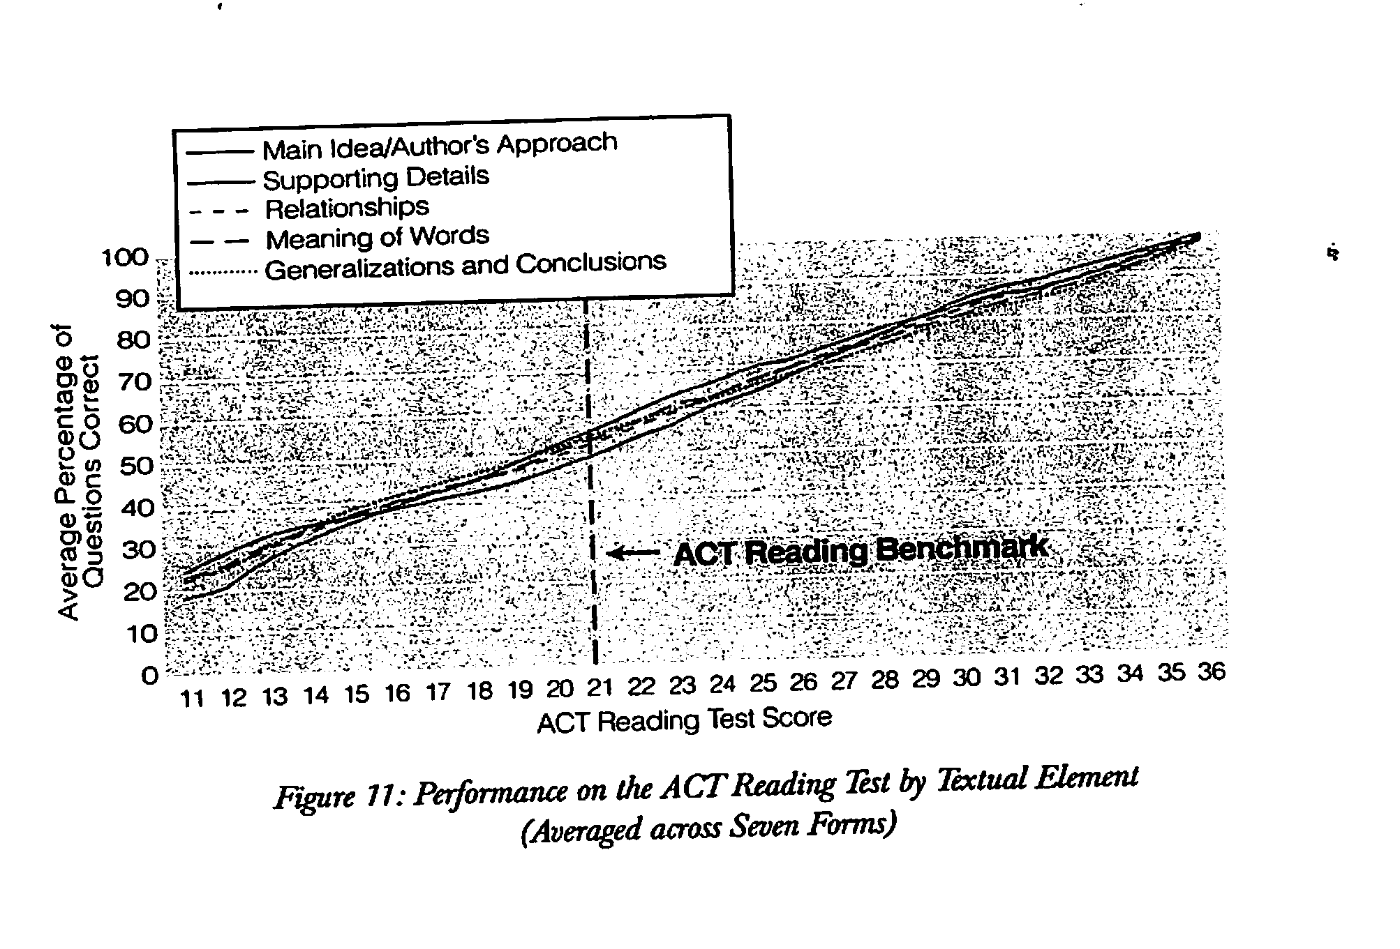
No performance differences due to question types

Slide 10
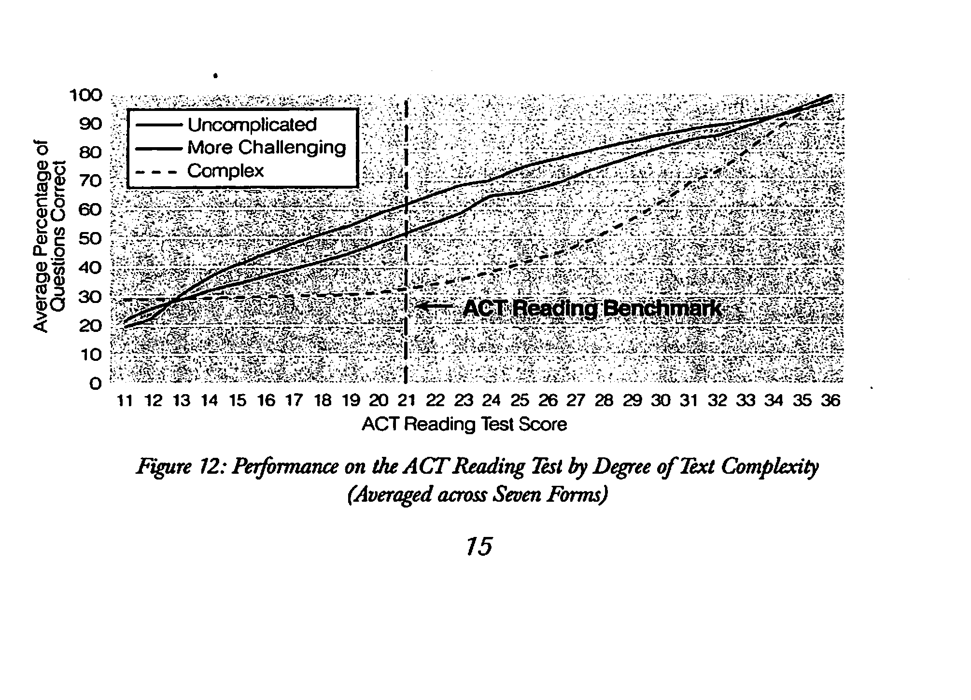
Text levels affect performance

Slide 11
Basic Argument Over What Approach is Best
On the one hand, if the texts aren’t hard enough, most kids won’t develop the ability to read sufficiently difficult texts
On the other, the claim has long been that kids can’t learn to read from texts above their reading levels

Slide 12
No Research Support for “Instructional Level”
Killgallon (1942): relationship between accuracy and comprehension, but no link to learning
Powell (1968): same methods as Killgallon, but more grade levels and different results
Dunkeld (1982): harder placements associated with more learning
Jorgensen, et al. (1977): no relation between placement and achievement gains
Morgan, et al. (2000): frustration level placements led to greater learning gains

Slide 13
No Research Support for “Instructional Level” (cont.)
O’Connor et al (2002, 2010): only benefit was for students reading at grade 1 level, but even this benefit went away if scaffolding was equated
Kuhn et al (2006): frustration level placement led to greater learning gains
Homan, et al., (2010): teaching 6th graders with instructional level text gave no advantage over teaching with text one year above instructional level
Brown et al (2017): replicated Morgan

Slide 14
Need for a reconceptualization of reading instruction
Students can learn to read from texts more difficult than their “instructional level” suggests
Reading is not the ability to answer certain kinds of text questions
Reading is the ability to make sense of ideas expressed in text—the ability to negotiate the linguistic and conceptual barriers or affordances of text

Slide 15
But Can’t Just Throw Kids into Complex Text
That kids can learn from more challenging text does not necessarily mean that they will
Kids learn from observation, explicit explanation, discovery, gradual release of responsibility
Relatively easy text and discovery go together; difficult text requires more teacher involvement

Slide 16
Gradual Release of Control
Gallagher & Pearson (1983), on the basis of Vygotsky, proposed this basic idea of progressing from modeling to guided practice to independent practice (I do it, we do it, you do it)
What Works Clearinghouse (Shanahan, et al., 2010) indicated that there was strong research evidence supporting this approach to teaching reading comprehension
However, that kind of instruction usually has focused on teaching comprehension strategies (intentional actions readers can take)

Slide 17
Does gradual release make sense for teaching complex text?
No research on this, but it makes sense that such an approach would make sense
The idea that reading text is an automatic activity is sensible in terms of decoding, but readers always have to monitor their reading to make sure that it is making sense and they should be aware of actions that they can take to resolve whatever is blocking their understanding

Slide 18
Review texts for potential barriers
Review the texts that you will use for teaching and
Identify possible barriers to comprehension (these may include unknown vocabulary, especially long sentences, dependent clauses, confusing cohesive links, figurative language, subtle tone alternations, ambiguity, use of graphic devices, complex structure, etc.)
Develop questions that allow evaluation of students’ ability to negotiate the potential barrier
Find out if all students can make sense of that barrier

Slide 19
Example
“While filling out my certificate, Baba realized that he didn’t know my sex for sure but that didn’t matter; he’d always known I was a boy, had spoken to me as a boy while I was in Mama, and as he approached the box that contained the question, NAME OF CHILD, he wrote with a quivering hand and in his best English cursive, Nidal (strife; struggle).”

Slide 20
Example
“While filling out my certificate, Baba realized that he didn’t know my sex for sure but that didn’t matter; he’d always known I was a boy, had spoken to me as a boy while I was in Mama, and as he approached the box that contained the question, NAME OF CHILD, he wrote with a quivering hand and in his best English cursive, Nidal (strife; struggle).”
68 words
7 commas or semi-colons
parentheses
typographic cues (caps)

Slide 21
Example
“While filling out my certificate, Baba realized that he didn’t know my sex for sure but that didn’t matter; he’d always known I was a boy, had spoken to me as a boy while I was in Mama, and as he approached the box that contained the question, NAME OF CHILD, he wrote with a quivering hand and in his best English cursive, Nidal (strife; struggle).”
What did Baba do when he had to fill out the certificate?
Why was that action a problem?

Slide 22
Model how you would make sense of this text
If students have had difficulty surmounting this barrier, then go back to the text and model how you would make sense of it
Explain what you would do, how you would do it, and why you would do it

Slide 23
Example
“While filling out my certificate, Baba realized that he didn’t know my sex for sure but that didn’t matter; he’d always known I was a boy, had spoken to me as a boy while I was in Mama, and as he approached the box that contained the question, NAME OF CHILD, he wrote with a quivering hand and in his best English cursive, Nidal (strife; struggle).”
Admit confusion
Tell why you think it is confusing
Tell them how you will try to solve the problem

Slide 24
Example
First, I’ll break this sentence down by its punctuation. Authors use commas and semi-colons to give clues as to how that sentence should be read—where to pause and which parts go together. I’ll try that first.
“While filling out my certificate, Baba realized that he didn’t know my sex for sure but that didn’t matter; he’d always known I was a boy, had spoken to me as a boy while I was in Mama, and as he approached the box that contained the question, NAME OF CHILD, he wrote with a quivering hand and in his best English cursive, Nidal (strife; struggle).”

Slide 25
Example
“While filling out my certificate,
Baba realized that he didn’t know my sex for sure but that didn’t matter;
he’d always known I was a boy,
had spoken to me as a boy while I was in Mama,
and as he approached the box that contained the question,
NAME OF CHILD,
he wrote with a quivering hand and in his best English cursive,
Nidal
(strife;
struggle).”

Slide 26
Example
Second, I’ll try to find all the verbs. The verbs are the action words—they’ll tell me what is happening and that will help me to understand this.
“While filling out my certificate,
Baba realized that he didn’t know my sex for sure but that didn’t matter;
he’d always known I was a boy,
had spoken to me as a boy while I was in Mama,
and as he approached the box that contained the question,
NAME OF CHILD,
he wrote with a quivering hand and in his best English cursive,
Nidal
(strife;
struggle).”

Slide 27
Example
“While filling out my certificate,
Baba realized that he didn’t know my sex for sure but that didn’t matter;
he’d always known I was a boy,
had spoken to me as a boy while I was in Mama,
and as he approached the box that contained the question,
NAME OF CHILD,
he wrote with a quivering hand and in his best English cursive,
Nidal
(strife;
struggle).”

Slide 28
Example
To make clearer, I’m going to break this down even more—I want to deal with each verb separately:
“While filling out my certificate,
Baba realized that he didn’t know my sex for sure but that didn’t matter;
he’d always known I was a boy,
had spoken to me as a boy while I was in Mama,
and as he approached the box that contained the question,
NAME OF CHILD,
he wrote with a quivering hand and in his best English cursive,
Nidal
(strife;
struggle).”

Slide 29
Example
Now, I need to make sure I know who is doing each of these actions.
“While filling out my certificate,
Baba realized
that he didn’t know my sex for sure
but that didn’t matter;
he’d always known I was a boy,
had spoken to me as a boy
while I was in Mama,
and as he approached the box
that contained the question,
NAME OF CHILD,
he wrote with a quivering hand and in his best English cursive,
Nidal
(strife;
struggle).”

Slide 30
Example
Now, I need to make sure I know who is doing each of these actions (the subjects of the verbs)
“While filling out my certificate,
Baba realized
that he didn’t know my sex for sure
but that didn’t matter;
he’d always known I was a boy,
had spoken to me as a boy
while I was in Mama,
and as he approached the box
that contained the question,
NAME OF CHILD,
he wrote with a quivering hand and in his best English cursive,
Nidal
(strife;
struggle).”

Slide 31
Example
Now, I need to make sure I know who is doing each of these actions (the subjects of the verbs)
“While [Baba was] filling out my certificate,
Baba realized
that he didn’t know my sex for sure
but that didn’t matter;
he’d always known I was a boy ,
had spoken to me as a boy
while I was in Mama,
and as he approached the box
that contained the question,
NAME OF CHILD,
he wrote with a quivering hand and in his best English cursive,
Nidal
(strife;
struggle).”

Slide 32
Example
Now, I need to make sure I know who is doing each of these actions (the subjects of the verbs)
“While [Baba was] filling out my certificate,
Baba realized
that he [Baba] didn’t know my sex for sure
but that didn’t matter;
he’d always known I was a boy ,
had spoken to me as a boy
while I was in Mama,
and as he approached the box
that contained the question,
NAME OF CHILD,
he wrote with a quivering hand and in his best English cursive,
Nidal
(strife;
struggle).”

Slide 33
Example
Now, I need to make sure I know who is doing each of these actions (the subjects of the verbs)
“While [Baba was] filling out my certificate,
Baba realized
that he [Baba] didn’t know my sex for sure
but that [Baba not knowing my sex] didn’t matter;
he’d always known I was a boy ,
had spoken to me as a boy
while I was in Mama,
and as he approached the box
that contained the question,
NAME OF CHILD,
he wrote with a quivering hand and in his best English cursive,
Nidal
(strife;
struggle).”

Slide 34
Example
Now, I need to make sure I know who is doing each of these actions (the subjects of the verbs)
“While [Baba was] filling out my certificate,
Baba realized
that he [Baba] didn’t know my sex for sure
but that [Baba not knowing my sex] didn’t matter;
he’d [Baba’d] always known I was a boy ,
had spoken to me as a boy
while I was in Mama,
and as he approached the box
that contained the question,
NAME OF CHILD,
he wrote with a quivering hand and in his best English cursive,
Nidal
(strife;
struggle).”

Slide 35
Example
Now, I need to make sure I know who is doing each of these actions (the subjects of the verbs)
“While [Baba was] filling out my certificate,
Baba realized
that he [Baba] didn’t know my sex for sure
but that [Baba not knowing my sex] didn’t matter;
he’d [Baba’d] always known I was a boy ,
[Baba] had spoken to me as a boy
while I was in Mama,
and as he approached the box
that contained the question,
NAME OF CHILD,
he wrote with a quivering hand and in his best English cursive,
Nidal
(strife;
struggle).”

Slide 36
Example
Now, I need to make sure I know who is doing each of these actions (the subjects of the verbs)
“While [Baba was] filling out my certificate,
Baba realized
that he [Baba] didn’t know my sex for sure
but that [Baba not knowing my sex] didn’t matter;
he’d [Baba’d] always known I was a boy ,
[Baba] had spoken to me as a boy
while I [narrator] was in Mama,
and as he approached the box
that contained the question,
NAME OF CHILD,
he wrote with a quivering hand and in his best English cursive,
Nidal
(strife;
struggle).”

Slide 37
Example
Now, I need to make sure I know who is doing each of these actions (the subjects of the verbs)
“While [Baba was] filling out my certificate,
Baba realized
that he [Baba] didn’t know my sex for sure
but that [Baba not knowing my sex] didn’t matter;
he’d [Baba’d] always known I was a boy ,
[Baba] had spoken to me as a boy
while I [narrator] was in Mama,
and as he [Baba] approached the box
[the box] that contained the question,
NAME OF CHILD,
he wrote with a quivering hand and in his best English cursive,
Nidal
(strife;
struggle).”

Slide 38
Example
Now, I need to make sure I know who is doing each of these actions (the subjects of the verbs)
“While [Baba was] filling out my certificate,
Baba realized
that he [Baba] didn’t know my sex for sure
but that [Baba not knowing my sex] didn’t matter;
he’d [Baba’d] always known I was a boy ,
[Baba] had spoken to me as a boy
while I [narrator] was in Mama,
and as he [Baba] approached the box
[the box] that contained the question,
NAME OF CHILD,
he [Baba] wrote with a quivering hand and in his best English cursive,
Nidal
(strife;
struggle).”

Slide 39
Guide students through this process.
After 2-3 models have been shared, guide students through the process
Instead of the teacher doing all the work, the students now need to respond to the teachers guidance
Once students are able to respond, then ask them to determine the steps, or to add the explanations themselves

Slide 40
Example
“I dropped my phone and the glass was cracked, but the screen still worked, so I was relieved.”

Slide 41
Example
“I dropped my phone and the glass was cracked, but the screen still worked, so I was relieved.”
18 words
2 commas

Slide 42
Example
Break this up by punctuation first.
“I dropped my phone and the glass was cracked, but the screen still worked, so I was relieved.”

Slide 43
Example
“I dropped my phone and the glass was cracked,
but the screen still worked,
so I was relieved.”

Slide 44
Example
Find the verbs:
“I dropped my phone and the glass was cracked,
but the screen still worked,
so I was relieved.”

Slide 45
Example
Find the verbs:
“I dropped my phone and the glass was cracked,
but the screen still worked,
so I was relieved.”

Slide 46
Example
Break up the multiple verbs, too:
“I dropped my phone and the glass was cracked,
but the screen still worked,
so I was relieved.”

Slide 47
Example
Break up the multiple verbs, too:
“I dropped my phone
and the glass was cracked,
but the screen still worked,
so I was relieved.”

Slide 48
Example
Make sure you know the subject of each verb:
“I dropped my phone
and the glass was cracked,
but the screen still worked,
so I was relieved.”

Slide 49
Example
Make sure you know the subject of each verb:
“I [the person telling the story] dropped my phone
and the glass was cracked,
but the screen still worked,
so I was relieved.”

Slide 50
Example
Make sure you know the subject of each verb:
“I [the person telling the story] dropped my phone
and the glass [of the screen] was cracked,
but the screen still worked,
so I was relieved.”

Slide 51
Example
Make sure you know the subject of each verb:
“I [the person telling the story] dropped my phone
and the glass [of the screen] was cracked,
but the screen [of my phone] still worked,
so I was relieved.”

Slide 52
Students can be taught to negotiate many text barriers to understanding in that way
The gradual release of control is terrific for guiding students to developing a meta-cognitive awareness of their own understanding
That means don’t try to head off the problem, try to deal with it
It can help them to recognize what might be blocking them:
--Do I know the meanings of these words? Can I figure them out?
--Can I figure out who is doing what?
--Can I follow each character or subject across a text?
--Can I untangle complicated sentences so that I know what they are saying?

Slide 53
Students can be taught to negotiate many text barriers to understanding in that way
Effective teaching practices include focusing on one or two problems at a time
Stay with an issue until students are able to demonstrate some proficiency with the problem:
-- recognizing when they aren’t understanding the text
--recognizing what the problem might be
--recognizing how to deal with the problem

Slide 54
Students can be taught to negotiate many text barriers to understanding in that way
Text has to be hard enough that it poses comprehension challenges to the students or there is nothing to learn
You need to have a way of identifying whether a particular text feature was blocking understanding (questions)
Initially, it might be enough that they develop an awareness that they aren’t understanding
Students can learn to avoid a teacher’s questions by admitting a lack of comprehension and by learning to make this specific (“I don’t know this word?”, “I can’t understand this sentence?” “It says, ‘he’, but I don’t know who ’he’ is.)

Slide 55
Fluency Support
Teaching students how to cope with complex features like vocabulary, syntax, cohesion, organization, tone, figurative language, and graphic features can all be taught with gradual release of control
But difficulty with decoding benefits from a more skills-based approach such as oral reading, repeated reading, and the like
When students are having fluency problems with text, provide them with sufficient fluency practice in addition to the comprehension teaching

Slide 56
Gradual Release of Control and Complex Text
Timothy Shanahan
University of Illinois at Chicago
www.shanahanonliteracy.com

