Slide 1

What Research Says about Teaching Children to Read
Timothy Shanahan
University of Illinois at Chicago
www.shanahanonliteracy.com

Slide 2
Literacy is Important
Literacy attainment has strong impact on overall academic achievement (ACT, 2006; Baer, Cook, & Baldi, 2006)
Literacy attainment has strong impact on economic well being (Ritchie & Bates, 2013; U.S. Department of Labor, 1992)
Literacy attainment affects civic involvement (Venezky, Kaestle, & Sum, 1986 )
Literacy attainment affects health (Baker, et al., 1996; National Center for Education Statistics, 2006)
Literacy attainment affects social participation (Venezky, Kaestle, & Sum, 1986)

Slide 3
Literacy Levels Languish
But nationwide literacy levels aren’t appreciably higher than in 1971 (NAEP)—though they are higher than in 1992
Only 37% of American students are proficient or higher in reading
Early literacy performance usually persists throughout schooling Cunningham, & Stanovich, 1997; Duncan, Dowsett, Claessens, Magnuson, et al., 2007; Juel, 1988; Smart, Prior, Sansor, & Oberkind, 2005; Snow, Tabors, & Dickinson, 2001
Need to achieve higher levels of literacy than in the past—both individually and for the society

Slide 4
Reading Instruction is Controversial
“Reading Wars” of the 1990s—divisive arguments over the best way to teach reading
Contentious and continuing arguments in the Twitterverse
Current dyslexia debates
Problem is that “everything works”—opportunity costs

Slide 5
Purpose of Presentation
To summarize what research tells us about teaching children to read
To answer your questions

Slide 6

What does it take to improve achievement?

Slide 7
Let’s turn to the research—but which research?
Idea that research can prove anything
Not all research is equal
Research can differ in its suitability to answer questions (descriptive vs. experimental research)
Research can differ in its quality

Slide 8

Preventing Reading Difficulties
National Research Council appointed a group of literacy experts to provide research-based recommendations on how to address early literacy
They issued a report in 1998 focused on preschool, kindergarten, and primary grade reading instruction and support

Slide 9
COMMITTEE ON THE PREVENTION OF READING DIFFICULTIES IN YOUNG CHILDREN
CATHERINE SNOW (Chair), Graduate School of Education, Harvard University, Chair
MARILYN JAGER ADAMS, Bolt, Beranek, and Newman Inc., Cambridge, Massachusetts
BARBARA T. BOWMAN, Erikson Institute, Chicago, Illinois
BARBARA FOORMAN, Depart of Pediatrics, University of Texas, and Houston Medical School
DOROTHY FOWLER, Fairfax County Public Schools, Annandale, Virginia
CLAUDE N. GOLDENBERG, Department of Teacher Educ, California State University, Long Beach
EDWARD J. KAME'ENUI, College of Education, University of Oregon, Eugene
WILLIAM LABOV, Department of Linguistics and Psychology, University of Pennsylvania
RICHARD K. OLSON, Department of Psychology, University of Colorado, Boulder
ANNEMARIE SULLIVAN PALINCSAR, School of Education, University of Michigan, Ann Arbor
CHARLES A. PERFETTI, Department of Psychology, University of Pittsburgh
HOLLIS S. SCARBOROUGH, Brooklyn College, City University of New York, and Haskins
Laboratories, New Haven, Connecticut
SALLY SHAYWITZ, Department of Pediatrics, Yale University
KEITH STANOVICH, Ontario Institute for Studies in Education, University of Toronto
DOROTHY STRICKLAND, Graduate School of Education, Rutgers University
SAM STRINGFIELD, Center for the Social Organization of Schools, Johns Hopkins University
ELIZABETH SULZBY, School of Education, University of Michigan, Ann Arbor

Slide 10

National Reading Panel
In 1998, Congress asked for a review of what works in reading instruction
U.S. Department of Education and the National Institute of Child Health and Human Development appointed a panel
Panel reviewed more than 500 studies on reading instruction (K-12)

Slide 11
National Reading Panel
Donald Langenberg, University of Maryland, Chair
Gloria Correro, Mississippi State University
Linnea Ehri, City University of New York
Gwenette Ferguson, Houston Public Schools
Norma Garza, parent
Michael L. Kamil, Stanford University
Cora Bagley Marrett, University of Massachussetts-Amherst
S.J. Samuels, University of Minnesota
Timothy Shanahan, University of Illinois at Chicago
Sally E. Shaywitz, Yale University
Thomas Trabasso, University of Chicago
Joanna Williams, Columbia University
Dale Willows, University of Toronto
Joanne Yatvin, Portland State University

Slide 12

National Early Literacy Panel
National Early Literacy Panel (2003-2008) reviewed research on the teaching of reading in preschool and kindergarten
Largest meta-analysis of research data on the teaching of reading during these years (examined 400-500 studies)
Set out to determine which skills needed to be taught early on and what confers literacy learning advantages to young children

Slide 13
National Early Literacy Panel
Timothy Shanahan, University of Illinois at Chicago, Chair
Anne Cunningham, University of California Berkeley
Kathy C. Escamilla, University of Colorado
Janet Fischel, State University of New York at Stony Brook
Susan Landry, University of Texas Health Science Center at Houston
Christopher J. Lonigan, Florida State University
Victoria J. Molfese, University of Louisville
Chris Schatschneider, Florida State University
Dorothy Strickland, Rutgers University

Slide 14
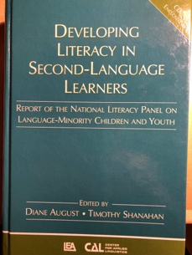
National Literacy Panel for Language Minority Children and Youth
National Early Literacy Panel (2003-2006) reviewed research on the teaching of reading to children (ages birth to 18) from language minority families
Largest analysis of research data on the teaching of reading during this population
Set out to make a wide range of determinations concerning what facilitates the English-langauge literacy learning of non-English speakers (including young children)

Slide 15
National Panel for Language Minority Children and Youth
Timothy Shanahan, University of Illinois at Chicago, Chair
Diane August, Center for Applied Linguistics
Isabel L. Beck, University of Pittsburgh
Margarita Calderón, Johns Hopkins University
David J. Francis, University of Houston
Georgia Earnest García, University of Illinois at Urbana-Champaign
Fred Genesee, McGill University
Esther Geva, University of Toronto
Claude Goldenberg, California State University, Long Beach
Michael L. Kamil, Stanford University
Keiko Koda, Carnegie Mellon University
Gail McKoon, Ohio State University
Robert S. Rueda, University of Southern California
Linda S. Siegel, University of British Columbia

Slide 16
What Works Clearinghouse
U.S. Department of Education
Panels of experts assembled based on particular topics
Panels can make any recommendations that they choose, but WWC evaluates supporting research and indicates the strength of the underlying evidence

Slide 17
What Works Clearinghouse Panelists (sample)
Carol Connor, Florida State University
Janice Dole, University of Utah
Nell Duke, Michigan State University
Jill Fitzgerald, University of North Carolina
Barbara Foorman, Florida State University
Steve Graham, Arizona State University
Laura Justice, Ohio State University
Michael L. Kamil, Stanford University
James Kim, Harvard University
P. David Pearson, University of California, Berkeley
Timothy Shanahan, University of Illinois at Chicago
Joe Torgesen, Florida State University

Slide 18

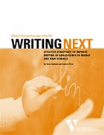
Carnegie Corporation Meta-Analyses
For the most part, government reports have focused on reading alone, with little consideration of writing
Carnegie has supported Steve Graham’s meta-analyses on writing instruction (and he has done additional ones)
All of these have been published in high quality, rigorously reviewed journals

Slide 19

Visible Learning
Compendium of over 800 meta-analyses relating to achievement (Hattie, 2008)
Used as a source of data – not depending on Hattie’s synthesis of these

Slide 20
This Presentation
Will rely heavily on the evidence included in these public reports
Along with more recent studies
And my own experience as Director of Reading for the Chicago Public Schools

Slide 21


Learning is Individual
We learn through our own experiences (and when it comes to academic learning, the only thing that matters is our academic experiences)
The only actions that can enhance learning are actions that alter experiences in some way

Slide 22
Three Aspects of Experience
Amount of instruction or experience
Content or focus of that experience
Quality (effectiveness or efficiency) of that experience

Slide 23
Amount of Instruction
Research suggests that amount of instruction is the single most important alterable determinant of learning

Slide 24
Amount of Teaching
What evidence is there that amount of teaching/experience makes a difference?
The ”immediate, powerful” positive impact of amount of instruction and study time on learning is the most “consistent finding of all psychological research on academic learning” (Walberg, 2002)
Evidence of increases in learning due to increases in amount of instruction/academic experience is extensive, consistent, and overwhelming

Slide 25
Disparities in Early Vocabulary Experience
30 million word gap
1200
Professional Families
600
Working Class Families
Child’s Cumulative Vocabulary (Words)
Welfare
Families
200
16 mos.
24 mos.
36 mos.
Child’s Age (Months)
Source: Hart & Risley (2003)

Slide 26
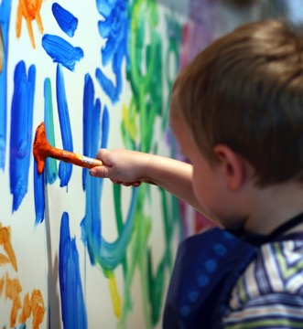
Effects of full-day kindergarten
Full-day kindergarten increases academic experience by about one month per year
Full-day kindergartens consistently outscore half-day kindergartens on achievement tests
Full-day kindergarten has stronger, longer lasting
benefits for children from low-income families or with few educational resources prior to kindergarten

Slide 27
Number of Instructional Days in School Year by Country
International Average = 193 School Days/Year
SOURCE: Trends in International Mathematics and Science Study (TIMSS) 2003

Slide 28

Extended school year
In a study in Chicago, extending the school year by 30 days led to increases in student learning in reading and math (Frazier & Morrison, 1998)
This study increased kindergarten by 30 days and raised reading achievement by about 1 full year in reading over comparison children

Slide 29

Use of School Day
Concept of Academic Learning Time (Fisher, Marliave, Filby, 1978)—big differences in the use of time from class to class
Beat the odds comparisons showed that effective teachers in grades K-3 keep students on task/engaged 96% of the time, students of less effective teachers only 63% (Taylor, 1999, 2006).

Slide 30
Kennewick School
Annual Growth for All Students… Catch-up Growth for Those Who are Behind by Lynn Fielding, Nancy Kerr, and Paul Rosier
Tells of experiences in Kennewick, WA school that successfully raised reading achievement
They estimate that 60-80 minutes of reading instruction (per day/per year) will raise achievement one year
So, a youngster who enters 3rd grade 2 years behind in reading, will need about 240 minutes of instruction daily to catch up

Slide 31
Washington Elementary School
Growth in % of 3rd grade students meeting grade level standards
School Year
95 96 97 98 99 00 01 02 03 04 05 06
Percent at Grade level
57 72 72 68 78 94 96 99 94 98 99 98
Began providing intensive interventions in the afternoon to many students
Working harder and more effectively at 3rd grade
Result of improvement at both 2nd and 3rd Grade
Baseline year
Began testing in 2nd grade and focusing on earlier improvement

Slide 32
Other time data
Preschool
Absenteeism
After-school programs
Summer school programs
Snow days
Days with unplanned teacher absences

Slide 33
Content of Instruction
The second biggest determinant of school learning is content coverage—what we teach

Slide 34

What needs to be taught?
Teach those things that research has supported… what needs to be learned to make someone a reader?
Long lists of skills and standards…. Unwieldy, unmanageable...
Organize into clusters and divide the time roughly equally among them

Slide 35
Components of Literacy
Knowledge of Words and Parts of Words (phonological awareness, phonemic awareness, alphabet, phonics, spelling, sight vocabulary, morphology, word meaning)
Oral Reading Fluency (accuracy, speed, prosody)
Reading Comprehension/Learning from Text (reading comprehension strategies, text structure, cohesion, grammar, learning)
Writing (narration, exposition, argument, writing process, summarization, analysis, synthesis, coherence, elaboration, focus, voice, diction, conventions)

Slide 36
Phonological Awareness
Phonological Awareness is the ability to hear and manipulate language sounds including word and syllable separations and the phonemic within spoken words
Phonemic Awareness refers to the ability to hear and manipulate the smallest sounds within words (it is a part of Phonological Awareness)
PA is not phonics
Development of PA progresses from gross sounds (words, syllables) to finer-grained sounds (phonemes)
The instructional goal is to enable children to be able to easily and quickly fully segment the phonemes within words

Slide 37
Phonological Awareness (cont.)
National Early Literacy Panel (2008) reviewed nearly 70 studies showing that phonological awareness was a strong predictor of later reading achievement
NELP meta-analyzed approximately 50 studies finding that instruction in PA in pre-K and/or K (alone, combined with AK, combined with phonics) led to significant impacts on PA, AK, Reading, Spelling
NRP meta-analyzed more than 51 studies finding that phonemic awareness instruction in K, 1, and remediation led to significant improvements in phonemic awareness, decoding, reading comprehension, and spelling (NICHD, 2000)

Slide 38
Examples of PA Skills
PA Skill | Example
Word separation | The---man---ran---up---the---hill.
Syllabic segmentation | Ti--mo--thy--Shan--a--han
Onset/rime | b—ig; m—an; r—ug; l--amb
Phoneme identity | ball, game, baby, bat
Phoneme isolation | p—an, pa—n
Phoneme blending | /p/-/a/-/n/
Phoneme segmentation | m/a/p, t/a/b/l
Phoneme addition | re, red, redea, redeam, redeams
Phoneme substitution | map, cap, pap, rap, sap—sam, sad, saf, sag
Phoneme deletion | Ready, read, re, r

Slide 39
Phonics
Phonics refers to instruction aimed at teaching the alphabetic system of English; includes sound-symbol correspondences and the relationships between spelling patterns and pronunciations of words. Decoding from print to pronunciation.

Slide 40
Phonics (cont.)
NELP examined 70 studies on decoding instruction found that such instruction in Pre-K and K had moderate to large impacts on students’ reading and spelling development and on various emergent literacy skills
NRP examined 38 studies on phonics instruction and found that such teaching in grades K-2 and with older remedial readers had a positive impact on decoding and fluency and on reading comprehension and spelling as well K-2.
No point during these PreK-2 years when code-focused instruction is not beneficial to students (and the benefits appear to be long lasting)

Slide 41
Phoneme-Grapheme Correspondences
Phoneme | Word Examples | Common spellings
/p/ | pit, spider, stop | p
/b/ | bit, brat, bubble | b
/m/ | mitt, comb, hymn | m, mb, mn
/t/ | tickle mitt, sipped | t, tt, ed
/d/ | die, loved | d, ed
/n/ | nice, knight, gnat | n, kn, gn
/k/ | cup, kite, duck, chorus, folk, quiet | k, c, ck, ch, lk, q
/g/ | girl, Pittsburgh | g, gh
/ng/ | sing, bank | ng, n
/f/ | fluff, sphere, tough, calf | f, ff, ph, lf
/v/ | van, dove | v, ve
/s/ | sit, pass, science, psychic | s, ss, sc, ps

Slide 42
Phoneme-Grapheme Correspondence
Phoneme | Word Examples | Common spellings
/z/ | zoo, jazz, nose, as, xylophone | z, zz, se, s, x
/th/ | thin, breath, ether | th
/th/ | this, breathe, either | th
/sh/ | shoe, mission, sure, charade, precious, notion, mission, special | sh, ss, s, ch, sc, ti, si, ci
/zh/ | measure, azure | s, z
/ch/ | cheap, future, etch | ch, tch
/j/ | judge, wage | j, dge, ge
/l/ | lamb, call, single | l, ll, le
/r/ | reach, wrap, her, fur, stir | r, wr, er/ur/ir
/y/ | you, use, feud, onion | y (u, eu), i
/w/ | witch, queen | w, (q)u
/wh/ | where | wh
/h/ | house, whole | h, wh

Slide 43
Phoneme-Grapheme Correspondence
Phoneme | Word Examples | Common spellings
/ē/ | see, these me, eat, key, happy, chief, either | ee, e__e, -e, ea, ey, -y, ie, ei
/ĭ/ | sit, gym | i, y
/ā/ | make, rain, play, great, baby, eight, vein, they | a__e, ai, ay, ea, -y, eigh, ei, ey
/ě/ | bed, breath | e, ea
/ă/ | cat | a
/ī/ | time, pie, cry, right, rifle | i__e, ie, -y, igh, -i
/ŏ/ | fox, swap, palm | o, wa, al
/ŭ/ | cup, cover, flood, tough | u, o, oo, ou
/aw/ | saw, pause, call, water, brought | aw, au, all, w, ough
/ō/ | vote, boat, toe, snow, open | o_e. oa, oe, ow, o-
/ŏŏ/ | took, put, could | oo, u, ou
/ū/ [ōō] | moo, tube, blue, chew, suit, soup | oo, u_e, ue, ew, ui, ou

Slide 44
Phoneme-Grapheme Correspondence
Phoneme | Word Examples | Common spellings
/y/ /ū/ | use, few, cute | u, ew, u_e
/oi/ | boil, boy | oi, oy
/ow/ | out, cow | ou, ow
/er/ | her, fur, sir | er, ur, ir
/ar/ | cart | ar
/or/ | sport | or

Slide 45
Syllable Patterns
Syllable type | Definition | Examples
Closed | Syllable with short vowel spelled with a single vowel letter ending in one or more consonants | dap-ple, hos-tel, bev-erage
Vowel-C-e (Magic e) | Syllable with a long vowel spelled with one vowel + one consonant + silent e | com-pete, -des-pite
Open | Syllable that ends with a long vowel sound, spelled with single vowel letter | pro-gram, ta-ble, re-cent
Vowel team | Syllables that use 2-4 letters to spell the vowel | beau-ti-ful, train-er, con-geal, spoil-age
Vowel-r (r-controlled) | Syllable with er, ir, or ur | in-jur-ious, con-sort, char-ter
Consonant-le | Unaccented final syllable containing a consonant before /l/ followed by a silent e | drib-ble, bea-gle, lit-tle

Slide 46
Vocabulary
National Reading Panel reviewed 45 studies and found that direct instruction in words and/or the meaningful parts of words (morphology) has a positive impact on reading comprehension (studies from grades 1-12)
NLP studies showed the special importance of vocabulary to second-language learners: effect size is bigger

Slide 47
Oral Reading Fluency
Oral reading fluency refers to the ability to read text accurately, quickly, and with proper expression
National Reading Panel reviewed 52 studies and found that oral reading fluency instruction improved decoding, word reading, fluency, and reading comprehension in Grades 1-4 and with remedial students Grades 1-12
Fluency is best predictor of reading comprehension in lower grades (2nd: 73% of comprehension variance explained by fluency; this declines to 25% by grade 8)

Slide 48
Reading Comprehension
National Reading Panel reviewed 204 studies of reading comprehension strategy instruction (K-12)
What Works Clearinghouse (Shanahan, Carlson, Carriere, Duke, et al., 2010) concluded that reading comprehension strategy instruction was effective with students in the primary grades

Slide 49
Reading Comprehension (cont.)
Effective instruction focuses on summarization, questioning, monitoring, visualization, story mapping
Multiple strategies are most effective

Slide 50
Reading Comprehension (cont.)
Vocabulary instruction is usually treated as part of comprehension work (and as already explained, vocabulary instruction improves comprehension)
Sentence combining (sentence reducing) improves understanding of syntax and transfers to comprehension
Text structure and cohesion work improves reading comprehension, too

Slide 51
Writing
Writing—the ability to communicate one’s ideas effectively through written/printed words
Writing is important in its own right
Emphasis here is on the value that writing has to reading achievement

Slide 52
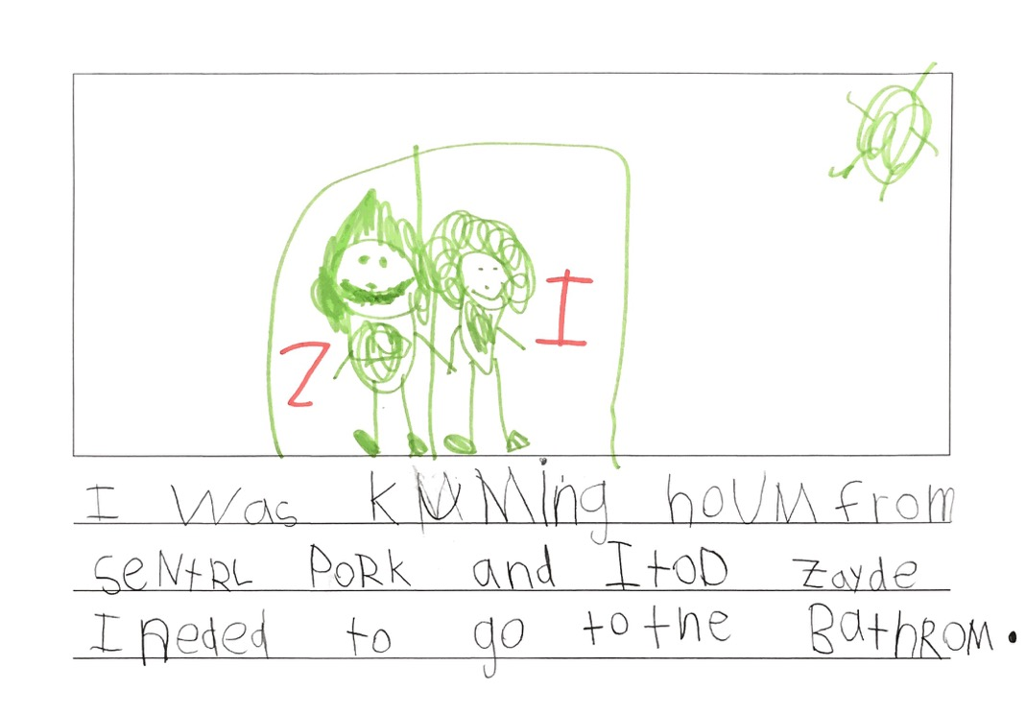
First-grader’s attempt to represent 59 phonemes

Slide 53
Writing about Text
Graham & Hiebert meta-analyzed more than 100 studies that required students to write about text
93% of the findings were positive
Writing about text was better than just reading the text, better than reading and rereading, better than reading and discussing in terms of improving comprehension and learning from text

Slide 54
Writing about Text
Modeling
Summarizing
Analysis/critique
Synthesis

Slide 55

Summary of Content
Research shows clear causal relationship between teaching the following and reading achievement:
Phonological awareness (including letters)
Phonics (including sight words)
Vocabulary
Oral Reading Fluency
Reading comprehension strategies
Writing

Slide 56

Quality of Instruction
There are quality factors in teaching as well—and they too can have an impact on achievement

Slide 57
Quality of Instruction
Only a negative definition of this
Instructional features that influence learning without increasing amount of instruction or altering the content to be taught

Slide 58
Quality of Instruction (cont.)
Clear purposes
Explicit instruction
Amount of reading/language use within lessons
Thoroughness/intensity of instruction
Amount of interaction
Depth of information
Quality of explanation
Motivation

Slide 59
If you want to improve reading…
Time
Make sure kids get a lot of teaching and experience
Content
Make sure the right things are being taught
Quality
Make sure the instruction is good

Slide 60

Common Parent Questions
How early should we teach reading?
What is dyslexia?
Should our kids get homework?
What books should my children read?
How can we help our children succeed in reading?
How can we know if our children are doing well?
Who does better, boys or girls?
How much screen time should we allow?
Etc. etc. etc.?

Slide 61
Some Current Controversies
“Science of Reading”
Common Core State Standards
Importance of knowledge
Response to Intervention
Independent Reading
Disciplinary Literacy
Testing
Text complexity

