Slide 1

The Science of Reading: Improving Reading Achievement
Timothy Shanahan
University of Illinois at Chicago
www.shanahanonliteracy.com

Slide 2
Literacy is Important
Literacy attainment has strong impact on overall academic achievement (ACT, 2006; Baer, Cook, & Baldi, 2006)
Literacy attainment has strong impact on economic well being (Ritchie & Bates, 2013; U.S. Department of Labor, 1992)
Literacy attainment affects civic involvement (Venezky, Kaestle, & Sum, 1986 )
Literacy attainment affects health (Baker, et al., 1996; National Center for Education Statistics, 2006)
Literacy attainment affects social participation (Venezky, Kaestle, & Sum, 1986)

Slide 3
Literacy Levels Languish
But nationwide literacy levels aren’t appreciably higher than in 1971 (NAEP)—though they are higher than in 1992
Early literacy performance usually persists throughout schooling (Cunningham, & Stanovich, 1997; Duncan, Dowsett, Claessens, Magnuson, et al., 2007; Juel, 1988; Smart, Prior, Sansor, & Oberkind, 2005; Snow, Tabors, & Dickinson, 2001)

Slide 4
The Science of Reading
Recently, Emily Hanford’s radio documentary on the “science of reading” has brought attention to the role of phonemic awareness and phonics in reading
Hanford (and her many listeners) are persuaded by the substantial research showing that instruction in PA and phonics raises reading achievement
She also has reported how neglected this research has been which has caused political pressure in many school districts

Slide 5
But what is the science of reading?
Any science of reading would obviously include all studies of reading (literacy)—how it is used, what it means, how it is learned, and so on
We are really focused on the science of reading instruction which is, of course, a narrower concept
It focuses on those studies that have direct implications for pedagogy

Slide 6
A science of reading instruction?
A science of reading instruction would:
identify what needs to be taught (curricular research)
the most effective ways of teaching it (instructional research)
how we would know it has been taught (assessment research)

Slide 7
Science of reading instruction? (cont.)
Other studies come into this as well… once studies show that something needs to be taught or that a particular way of teaching is effective, then other research that helps you to understand those phenomena become part of the science of reading instruction, too
Thus, studies show that explicit phonics instruction helps kids to become better readers, then those descriptive studies that tell us how such instruction affects the brain or those linguistic studies that identify essential phonemic units become part of the science of reading instruction, too
But the core element of a science of reading instruction has to be focused on research that reveals how to improve reading achievement

Slide 8
Not Everyone Likes the Science of Reading
Critics argue that their “studies of reading” should be treated as part of the “science of reading instruction” even though they have never tested their variables to see if they offer any kind of learning benefit
Thus, those who examine oral language learning and then prescribe reading instruction based on that information, are not really drawing on the science of reading instruction (though their work may eventually become part of that)

Slide 9

What does the “science of reading” say improves reading achievement?

Slide 10
Let’s turn to the research—but which research?
Idea that research can prove anything
Not all research is equal
Research can differ in its suitability to answer questions (descriptive vs. experimental research)
Research can differ in its quality

Slide 11
Preventing Reading Difficulties
National Research Council appointed a group of literacy experts to provide research-based recommendations on how to address early literacy
They issued a report in 1998 focused on preschool, kindergarten, and primary grade reading instruction and support

Slide 12


Slide 13
COMMITTEE ON THE PREVENTION OF READING DIFFICULTIES IN YOUNG CHILDREN
CATHERINE SNOW (Chair), Graduate School of Education, Harvard University, Chair
MARILYN JAGER ADAMS, Bolt, Beranek, and Newman Inc., Cambridge, Massachusetts
BARBARA T. BOWMAN, Erikson Institute, Chicago, Illinois
BARBARA FOORMAN, Depart of Pediatrics, University of Texas, and Houston Medical School
DOROTHY FOWLER, Fairfax County Public Schools, Annandale, Virginia
CLAUDE N. GOLDENBERG, Department of Teacher Educ, California State University, Long Beach
EDWARD J. KAME'ENUI, College of Education, University of Oregon, Eugene
WILLIAM LABOV, Department of Linguistics and Psychology, University of Pennsylvania
RICHARD K. OLSON, Department of Psychology, University of Colorado, Boulder
ANNEMARIE SULLIVAN PALINCSAR, School of Education, University of Michigan, Ann Arbor
CHARLES A. PERFETTI, Department of Psychology, University of Pittsburgh
HOLLIS S. SCARBOROUGH, Brooklyn College, City University of New York, and Haskins
Laboratories, New Haven, Connecticut
SALLY SHAYWITZ, Department of Pediatrics, Yale University
KEITH STANOVICH, Ontario Institute for Studies in Education, University of Toronto
DOROTHY STRICKLAND, Graduate School of Education, Rutgers University
SAM STRINGFIELD, Center for the Social Organization of Schools, Johns Hopkins University
ELIZABETH SULZBY, School of Education, University of Michigan, Ann Arbor

Slide 14
National Reading Panel
In 1998, Congress asked for a review of what works in reading instruction
U.S. Department of Education and the National Institute of Child Health and Human Development appointed a panel
Panel reviewed more than 500 studies on reading instruction (K-12)

Slide 15


Slide 16
National Reading Panel
Donald Langenberg, University of Maryland, Chair
Gloria Correro, Mississippi State University
Linnea Ehri, City University of New York
Gwenette Ferguson, Houston Public Schools
Norma Garza, parent
Michael L. Kamil, Stanford University
Cora Bagley Marrett, University of Massachussetts-Amherst
S.J. Samuels, University of Minnesota
Timothy Shanahan, University of Illinois at Chicago
Sally E. Shaywitz, Yale University
Thomas Trabasso, University of Chicago
Joanna Williams, Columbia University
Dale Willows, University of Toronto
Joanne Yatvin, Portland State University

Slide 17
National Early Literacy Panel
National Early Literacy Panel (2003-2008) reviewed research on the teaching of reading in preschool and kindergarten
Largest meta-analysis of research data on the teaching of reading during these years (examined 400-500 studies)
Set out to determine which skills needed to be taught early on and what confers literacy learning advantages to young children

Slide 18


Slide 19
National Early Literacy Panel
Timothy Shanahan, University of Illinois at Chicago, Chair
Anne Cunningham, University of California Berkeley
Kathy C. Escamilla, University of Colorado
Janet Fischel, State University of New York at Stony Brook
Susan Landry, University of Texas Health Science Center at Houston
Christopher J. Lonigan, Florida State University
Victoria J. Molfese, University of Louisville
Chris Schatschneider, Florida State University
Dorothy Strickland, Rutgers University

Slide 20
National Literacy Panel for Language Minority Children and Youth
National Early Literacy Panel (2003-2006) reviewed research on the teaching of reading to children (ages birth to 18) from language minority families
Largest analysis of research data on the teaching of reading during this population
Set out to make a wide range of determinations concerning what facilitates the English-langauge literacy learning of non-English speakers (including young children)

Slide 21
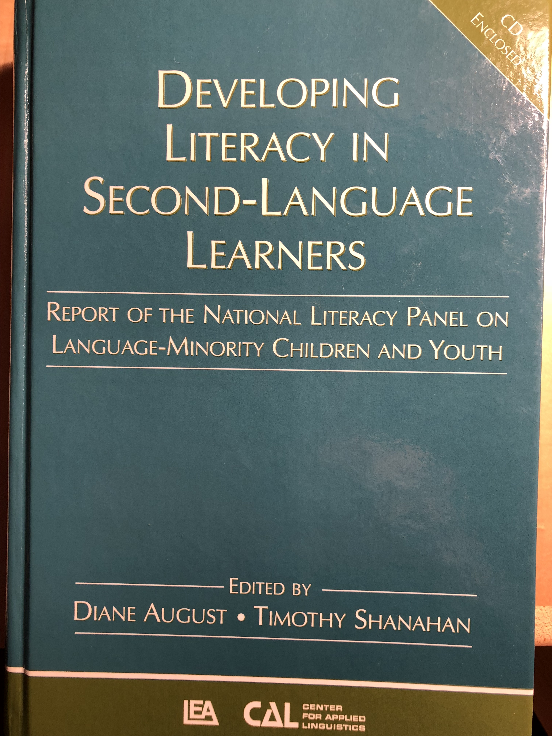

Slide 22
National Panel for Language Minority Children and Youth
Timothy Shanahan, University of Illinois at Chicago, Chair
Diane August, Center for Applied Linguistics
Isabel L. Beck, University of Pittsburgh
Margarita Calderón, Johns Hopkins University
David J. Francis, University of Houston
Georgia Earnest García, University of Illinois at Urbana-Champaign
Fred Genesee, McGill University
Esther Geva, University of Toronto
Claude Goldenberg, California State University, Long Beach
Michael L. Kamil, Stanford University
Keiko Koda, Carnegie Mellon University
Gail McKoon, Ohio State University
Robert S. Rueda, University of Southern California
Linda S. Siegel, University of British Columbia

Slide 24
What Works Clearinghouse
U.S. Department of Education
Panels of experts assembled based on particular topics
Panels can make any recommendations that they choose, but WWC evaluates supporting research and indicates the strength of the underlying evidence

Slide 25
What Works Clearinghouse Panelists (sample)
Carol Connor, Florida State University
Janice Dole, University of Utah
Nell Duke, Michigan State University
Jill Fitzgerald, University of North Carolina
Barbara Foorman, Florida State University
Steve Graham, Arizona State University
Laura Justice, Ohio State University
Michael L. Kamil, Stanford University
James Kim, Harvard University
P. David Pearson, University of California, Berkeley
Timothy Shanahan, University of Illinois at Chicago
Joe Torgesen, Florida State University

Slide 26
Learning is Individual
We learn through our own experiences (and when it comes to academic learning, the only thing that matters is our academic experiences)
The only actions that can enhance learning are actions that alter experiences in some way

Slide 27
There are 3 Aspects of Experience
Amount of experience (time)
Content of experience (curriculum)
Quality of experience (teaching)

Slide 28
Amount of Instruction
Research suggests that amount of instruction is the single most important alterable determinant of learning

Slide 29
Amount of Teaching
The ”immediate, powerful” positive impact of amount of instruction and study time on learning is the most “consistent finding of all psychological research on academic learning” (Walberg, 2002)

Slide 30
Disparities in Early Vocabulary Experience
30 million word gap
1200
Professional Families
600
Working Class Families
Child’s Cumulative Vocabulary (Words)
Welfare
Families
200
16 mos.
24 mos.
36 mos.
Child’s Age (Months)
Source: Hart & Risley (2003)

Slide 31
Explanation of Hart & Risley Results
Major concerns about the Hart & Risley study: small size, methods that may have suppressed language of lowest SES population
Gilkerson, et al. (2015): replicated the study, but with a larger sample of kids (329) and greater amount of data (and without researchers present—LENA); found that lower SES kids vocalized less than other kids and this explained 7-16% of the variance in oral language development---found a 4 million word gap by age of three
Sperry, Sperry, & Miller, (2018): no differences (but didn’t include a high SES group and counted ambient language)

Slide 32

Effects of full-day kindergarten
Full-day kindergarten increases academic experience by about one month per year
Full-day kindergartens consistently outscore half-day kindergartens on achievement tests
Full-day kindergarten has stronger, longer lasting
benefits for children from
low-income families or with
few educational resources
prior to kindergarten.

Slide 33

Use of School Day
Concept of Academic Learning Time (Fisher, Marliave, Filby, 1978)—big differences in the use of time from class to class
Beat the odds comparisons showed that effective teachers in grades K-3 keep students on task/engaged 96% of the time, students of less effective teachers only 63% (Taylor, 1999, 2006).

Slide 34
Kennewick School
Annual Growth for All Students… Catch-up Growth for Those Who are Behind by Lynn Fielding, Nancy Kerr, and Paul Rosier
Tells of experiences in Kennewick, WA school that successfully raised reading achievement
They estimate that 60-80 minutes of reading instruction (per day/per year) will raise achievement one year
So, a youngster who enters 3rd grade 2 years behind in reading, will need about 240 minutes of instruction daily to catch up

Slide 35
Washington Elementary School
Growth in % of 3rd grade students meeting grade level standards
School Year
95 96 97 98 99 00 01 02 03 04 05 06
Percent at Grade level
57 72 72 68 78 94 96 99 94 98 99 98
Began providing intensive interventions in the afternoon to many students
Working harder and more effectively at 3rd grade
Result of improvement at both 2nd and 3rd Grade
Baseline year
Began testing in 2nd grade and focusing on earlier improvement

Slide 36
Remedial instruction
When students are struggling in reading, schools often provide them with “pull-out” instruction (e.g., Title I reading, RtI)
Unfortunately, a large percentage of those programs replace one form of reading instruction with another (rendering these programs ineffective)

Slide 37
Independent reading
Teachers love kids and want to encourage kids to read—and there are plenty of ”experts” saying that kids should be reading on their own
However, do students learn more when they read on their own or when they work with a teacher on reading?
Research suggests 4-8 times the learning benefit from instruction than from independent reading
Get kids to read on their own away from school

Slide 38
Minimize unnecessary repetition
Small group instruction is more effective than whole class teaching
However, that isn’t the appropriate comparison (since students get less teaching when they work in small groups)
When amounts of instruction are equalized, there is no consistent benefit from small group teaching
Don’t teach individually what can be accomplished equally well in small group, don’t teach small group what can be accomplished equally in whole class
Don’t organize time around size of group, but what you are trying to teach

Slide 39
Other time data
Preschool
Absenteeism
After-school programs
Summer school programs
Snow days
Days with unplanned teacher absences

Slide 40
How much teaching do our kids get?
How much reading instruction do the students get at your school?
How does amount of reading instruction differ by grade level?
How much reading instruction do the lowest kids receive?
Does Tier 2 instruction increase the amount of teaching received by all students?

Slide 41
Content of Instruction
The second biggest determinant of school learning is content coverage—what we teach

Slide 42
What needs to be taught?
Teach those things that research has supported… what needs to be learned to make someone a reader?
Long lists of skills and standards…. Unwieldy, unmanageable...
Organize into clusters and divide the time roughly equally among them

Slide 43
Components of Literacy
Knowledge of Words and Parts of Words (phonological awareness, phonemic awareness, alphabet, phonics, spelling, sight vocabulary, morphology, word meaning)
Oral Reading Fluency (accuracy, speed, prosody)
Reading Comprehension/Learning from Text (reading comprehension strategies, text structure, cohesion, grammar, learning)
Writing (narration, exposition, argument, writing process, summarization, analysis, synthesis, coherence, elaboration, focus, voice, diction, conventions)

Slide 44
Phonological Awareness
Phonological Awareness is the ability to hear and manipulate language sounds including word and syllable separations and the phonemic within spoken words
Phonemic Awareness refers to the ability to hear and manipulate the smallest sounds within words (it is a part of Phonological Awareness)
PA is not phonics
Development of PA progresses from gross sounds (words, syllables) to finer-grained sounds (phonemes)
The instructional goal is to enable children to be able to easily and quickly fully segment the phonemes within words

Slide 45
Phonological Awareness (cont.)
National Early Literacy Panel (2008) reviewed nearly 70 studies showing that phonological awareness was a strong predictor of later reading achievement
PA remains a significant predictor even controlling for age, SES, alphabet knowledge, oral language, IQ, or prior decoding ability

Slide 46
Phonological Awareness (cont.)
NELP meta-analyzed approximately 50 studies finding that instruction in PA in pre-K and/or K (alone, combined with AK, combined with phonics) led to significant impacts on PA, AK, Reading, Spelling
Age/developmental level made no difference in the benefits of this kind of teaching, but what was taught varied (larger to smaller units)
NRP meta-analyzed more than 51 studies finding that phonemic awareness instruction in K, 1, and remediation led to significant improvements in phonemic awareness, decoding, reading comprehension, and spelling (NICHD, 2000)
NLP (2008) found that phonemic awareness instruction was beneficial for second-language students

Slide 47
Instruction of PA
Initially, it must be done orally; students have to hear the sounds (without text clues)—but it is reciprocal so letters will come into this
Brief intensive instruction
Instruction should emphasize 1-2 skills at a time
Progression is from grosser sounds to smaller sounds (words-syllables-phonemes)
Should be combined with alphabet instruction
Individual or small group (or with monitoring and follow up)

Slide 48
Phonological Awareness Skills
Word separation
Syllable segmentation
Onset/rime
Phoneme identity
Phoneme isolation
Phoneme blending
Phoneme segmentation
Phoneme addition
Phoneme substitution
Phoneme deletion

Slide 49
Examples of PA Skills
PA Skill | Example
Word separation | The---man---ran---up---the---hill.
Syllabic segmentation | Ti--mo--thy--Shan--a--han
Onset/rime | b—ig; m—an; r—ug; l--amb
Phoneme identity | ball, game, baby, bat
Phoneme isolation | p—an, pa—n
Phoneme blending | /p/-/a/-/n/
Phoneme segmentation | m/a/p, t/a/b/l
Phoneme addition | re, red, redea, redeam, redeams
Phoneme substitution | map, cap, pap, rap, sap—sam, sad, saf, sag
Phoneme deletion | Ready, read, re, r

Slide 50
Alphabet Letters
Letter name knowledge is one of best predictors of later reading achievement (Adams, 1990; Hammill, 2004; Scarborough, 1998; Schatschneider, et al., 2004; National Early Literacy Panel, 2008)
Letter name knowledge is an important indicator of later reading disability (Gallagher, et al., 2000; O’Connor & Jenkins, 1999; Torppa, et al., 2006)
Alphabet knowledge remains significant even when controlling for age, SES, oral language, phonological awareness, or IQ (NELP, 2008)

Slide 51
Alphabet Letters (cont.)
There are studies of the teaching of alphabet knowledge, but none of these studies have reading outcomes
However, studies suggest that letter name teaching in combination with phonological awareness or decoding is beneficial to reading achievement—and phonological awareness development is more rapid when letter names known (Kim et al, 2010)
Studies show the best letter name learning progress occurs when the instruction is combined with letter sounds (Piasta & Wagner, 2010) and that it is important to separate similar letters (visual and aural)

Slide 52
Phonics
Phonics refers to instruction aimed at teaching the alphabetic system of English; includes sound-symbol correspondences and the relationships between spelling patterns and pronunciations of words. Decoding from print to pronunciation.
There has long been controversy over phonics: the controversy is not whether students need to decode or not, just whether such instruction is needed to enable such decoding (Barr, 1972; Biemiller, 1970)

Slide 53
Phonics (cont.)
NELP examined 70 studies on decoding instruction (includes those PA studies noted earlier); found that such instruction in preschool and kindergarten had moderate to large impacts on students’ reading and spelling development and on various emergent literacy skills
NRP examined 38 studies on phonics instruction and found that such teaching in grades K-2 and with older remedial readers had a positive impact on decoding and fluency and on reading comprehension and spelling as well K-2.

Slide 54
Phonics (cont.)
NLP found explicit decoding instruction to be beneficial to English learners as well (though there are only a few studies with this population and the effect sizes were smaller than for native English speakers)
No point during these PreK-2 years when code-focused instruction is not beneficial to students (and the benefits appear to be long lasting)

Slide 55
Phonics (cont.)
Effective phonics instruction was explicit and systematic
Multiple years of phonics instruction were better than single years
Virtually all programs of phonics work with young children (NRP, WWC)—however, thoroughness matters
No single phonics sequence did better than any other
Phonics instruction should include lots of opportunity for students to decode and encode words
Important to develop a “mental set for diversity”
Spelling is part of this, too

Slide 56
Phoneme-Grapheme Correspondences
Phoneme | Word Examples | Common spellings
/p/ | pit, spider, stop | p
/b/ | bit, brat, bubble | b
/m/ | mitt, comb, hymn | m, mb, mn
/t/ | tickle mitt, sipped | t, tt, ed
/d/ | die, loved | d, ed
/n/ | nice, knight, gnat | n, kn, gn
/k/ | cup, kite, duck, chorus, folk, quiet | k, c, ck, ch, lk, q
/g/ | girl, Pittsburgh | g, gh
/ng/ | sing, bank | ng, n
/f/ | fluff, sphere, tough, calf | f, ff, ph, lf
/v/ | van, dove | v, ve
/s/ | sit, pass, science, psychic | s, ss, sc, ps

Slide 57
Phoneme-Grapheme Correspondence
Phoneme | Word Examples | Common spellings
/z/ | zoo, jazz, nose, as, xylophone | z, zz, se, s, x
/th/ | thin, breath, ether | th
/th/ | this, breathe, either | th
/sh/ | shoe, mission, sure, charade, precious, notion, mission, special | sh, ss, s, ch, sc, ti, si, ci
/zh/ | measure, azure | s, z
/ch/ | cheap, future, etch | ch, tch
/j/ | judge, wage | j, dge, ge
/l/ | lamb, call, single | l, ll, le
/r/ | reach, wrap, her, fur, stir | r, wr, er/ur/ir
/y/ | you, use, feud, onion | y (u, eu), i
/w/ | witch, queen | w, (q)u
/wh/ | where | wh
/h/ | house, whole | h, wh

Slide 58
Phoneme-Grapheme Correspondence
Phoneme | Word Examples | Common spellings
/ē/ | see, these me, eat, key, happy, chief, either | ee, e__e, -e, ea, ey, -y, ie, ei
/ĭ/ | sit, gym | i, y
/ā/ | make, rain, play, great, baby, eight, vein, they | a__e, ai, ay, ea, -y, eigh, ei, ey
/ě/ | bed, breath | e, ea
/ă/ | cat | a
/ī/ | time, pie, cry, right, rifle | i__e, ie, -y, igh, -i
/ŏ/ | fox, swap, palm | o, wa, al
/ŭ/ | cup, cover, flood, tough | u, o, oo, ou
/aw/ | saw, pause, call, water, brought | aw, au, all, w, ough
/ō/ | vote, boat, toe, snow, open | o_e. oa, oe, ow, o-
/ŏŏ/ | took, put, could | oo, u, ou
/ū/ [ōō] | moo, tube, blue, chew, suit, soup | oo, u_e, ue, ew, ui, ou

Slide 59
Phoneme-Grapheme Correspondence
Phoneme | Word Examples | Common spellings
/y/ /ū/ | use, few, cute | u, ew, u_e
/oi/ | boil, boy | oi, oy
/ow/ | out, cow | ou, ow
/er/ | her, fur, sir | er, ur, ir
/ar/ | cart | ar
/or/ | sport | or

Slide 60
Syllable Patterns
Syllable type | Definition | Examples
Closed | Syllable with short vowel spelled with a single vowel letter ending in one or more consonants | dap-ple, hos-tel, bev-erage
Vowel-C-e (Magic e) | Syllable with a long vowel spelled with one vowel + one consonant + silent e | com-pete, -des-pite
Open | Syllable that ends with a long vowel sound, spelled with single vowel letter | pro-gram, ta-ble, re-cent
Vowel team | Syllables that use 2-4 letters to spell the vowel | beau-ti-ful, train-er, con-geal, spoil-age
Vowel-r (r-controlled) | Syllable with er, ir, or ur | in-jur-ious, con-sort, char-ter
Consonant-le | Unaccented final syllable containing a consonant before /l/ followed by a silent e | drib-ble, bea-gle, lit-tle

Slide 61
High frequency words
Words differ in their frequency in the language (some words are used a lot and others appear rarely)
In English, the 300 most frequent words in the language (and their derivations) make up about 75% of all the words one sees in texts—it can be useful to know these words especially well
Also, the origins of our language are complex: the alphabetic properties of English are complex—this is particularly true of some of the most common words in the language (e.g., the, of, where); can be easier to memorize these rather than decoding them

Slide 62
High frequency words (cont.)
Sight vocabulary refers to words that someone can read “as if” they were not decoding—appears like they are effortlessly pulling them back from memory and recognizing them as a whole
Given the value of high frequency words it would make sense that students learn these as “sight words”
However, the story is more complex than that—student memory for words is highly dependent upon decoding (phonics makes words “stickier”); sight vocabulary is to a great degree an outcome of decoding (Ehri, 2005)—in other words sight vocabulary is a result of decoding ability

Slide 63
High frequency words (cont.)
Teaching a small number of sight vocabulary can improve fluency and comprehension (Griffin & Murtagh, 2015)
Teach words by focusing attention on the order of letters (not mnemonics, pictures, etc.) and work with them both in isolation—interval training—and in context (Browder & Lalli, 1991; Fossett & Mirenda, 2006)

Slide 64
High frequency words (cont.)
Texts used in K-1 should include decodable text along with high frequency words
Direct work on memorizing words should be minimal (lots of programs are overdoing this now)
Kindergarteners should learn about 20 words
By end of grade 1, kids should know the 100 most frequent words (and should be able to decode ~500 words)
By end of Grade 2, and 300 most frequent by end of Grade 2

Slide 65
the | for | from | when | their
of | on | or | your | if
and | are | one | can | will
a | as | had | said | up
to | with | by | there | other
in | his | word | use | about
is | they | but | an | out
you | I | not | each | many
that | at | what | which | then
it | with | all | she | them
he | his | were | do | these
was | have | we | how | so

Slide 66
some | write | been | made
her | go | call | may
would | see | who | part
make | number | oil | over
like | no | now
him | way | find
into | could | long
time | people | down
has | my | day
look | than | did
two | first | get
more | water | come

Slide 67
Vocabulary
A good deal of vocabulary learning is indirect (from listening, from reading, from learning, from media)
Explicit teaching helps, too
National Reading Panel reviewed 45 studies and found that direct instruction in words and/or the meaningful parts of words (morphology) has a positive impact on reading comprehension (studies from grades 1-12)
NLP studies showed the special importance of vocabulary to second-language learners: effect size is bigger

Slide 68
Vocabulary (cont.)
Vocabulary has the opposite relationship with reading comprehension as fluency (vocabulary explains a small amount of comprehension in the early grades, but this increases as students progress)
Effective instruction is explicit, implicates oral and written language, rich/thorough, focused on relationships among words, personalization, and with adequate ongoing review
Reading to young kids can be a prime source of vocabulary growth (dialogic reading)

Slide 69
Oral Language Predictors

Slide 70
Oral Reading Fluency
Oral reading fluency refers to the ability to read text accurately, quickly, and with proper expression
National Reading Panel reviewed 52 studies and found that oral reading fluency instruction improved decoding, word reading, fluency, and reading comprehension in Grades 1-4 and with remedial students Grades 1-12
Fluency is best predictor of reading comprehension in lower grades (2nd: 73% of comprehension variance explained by fluency; this declines to 25% by grade 8)

Slide 71
Oral Reading Fluency (cont.)
NLP found that oral reading fluency was important with second-language learners, too
Effective instruction engaged kids in oral reading with feedback and repetition and with texts that were relatively difficult
Instructional approaches like paired reading, repeated reading, reading while listening, neurological impress, etc. worked
ORF is a bit of a mash up of fast decoding and initial reading comprehension
Initially we try to teach kids to be disfluent (finger-point reading), but from the time they can do this we teach fluency as defined)

Slide 72
Reading Comprehension
National Reading Panel reviewed 204 studies of reading comprehension strategy instruction (K-12)
What Works Clearinghouse (Shanahan, Carlson, Carriere, Duke, et al., 2010) concluded that reading comprehension strategy instruction was effective with students in the primary grades
WWC also determined that “gradual release of responsibility” instruction was an effective method for improving reading comprehension with primary grade students

Slide 73
Reading Comprehension (cont.)
Effective instruction focuses on summarization, questioning, monitoring, visualization, story mapping/text structure analysis,
Multiple strategies are most effective (such as in reciprocal teaching)
Gradual release of responsibility has strong supporting research evidence (WWC)
Moderate evidence (WWC) supporting the role of motivation in comprehension instruction (choice, collaboration, challenge, control)

Slide 74
Reading Comprehension (cont.)
Other aspects of comprehension instruction with positive results
Vocabulary instruction is usually treated as part of comprehension work (and as already explained, vocabulary instruction improves comprehension)
Sentence combining (sentence reducing) improves understanding of syntax and transfers to comprehension
Text structure and cohesion work improves reading comprehension, too

Slide 75
Writing
Writing—the ability to communicate one’s ideas effectively through written/printed words
Writing is important in its own right
Emphasis here is on the value that writing has to reading achievement

Slide 76
Writing (cont.)
Writing and reading are closely correlated (Shanahan, 2016)
Reading and writing can explain about 75% of the variation in each other
Magnitude of relationships are consistent from grade level to grade level, but the nature of relations change (decoding and spelling overlap more in the early grades, and writing structure/vocabulary and reading comprehension connect more later on)

Slide 77
An example
Studies show a close relationship between reading and writing in the primary grades
The major overlaps at these ages are between the phonological and orthographic aspects of reading and writing
Specifically, decoding skills are related to encoding skills
Engaging students in spelling invention or developmental writing in which children spell words as they think they are spelled is valuable practice

Slide 78
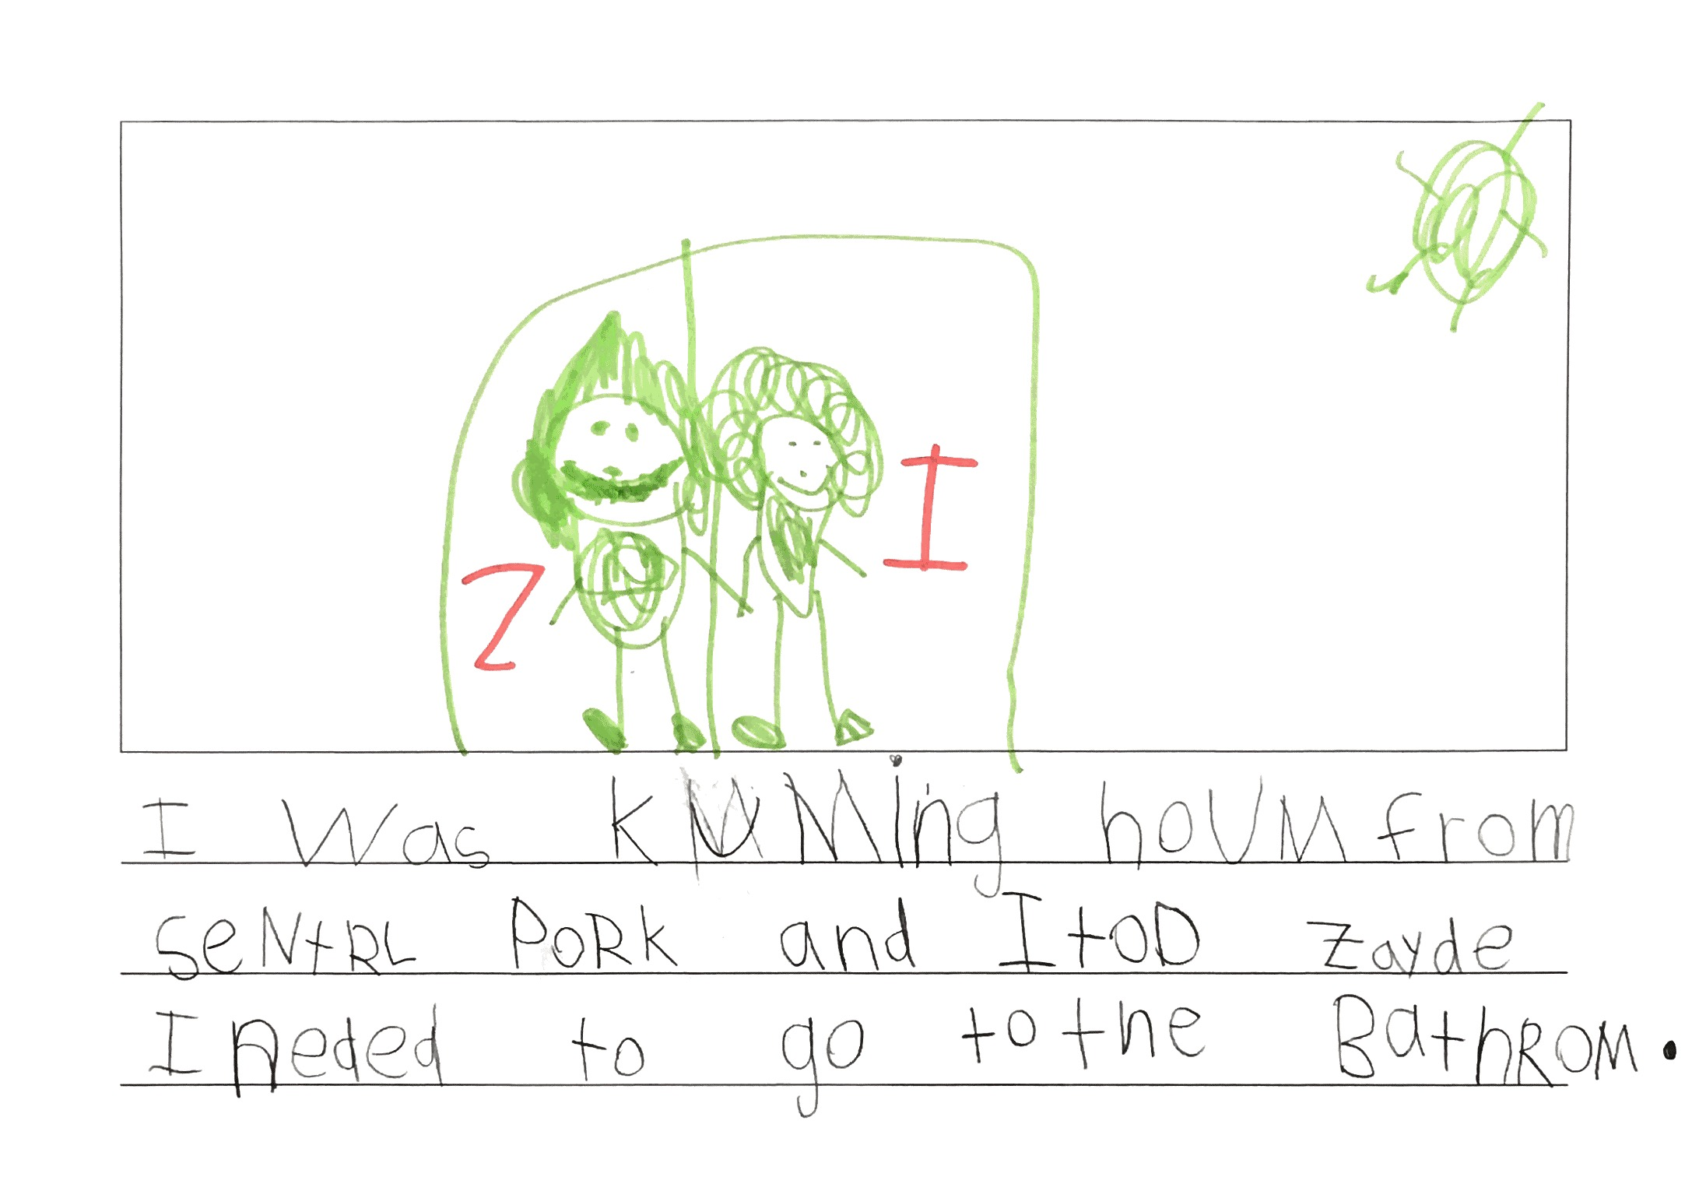
First-grader’s attempt to represent 59 phonemes

Slide 79
Summary of Content
Research shows clear causal relationship between teaching the following and reading achievement:
Phonological awareness (including letters)
Phonics (including sight words)
Vocabulary
Oral Reading Fluency
Reading comprehension strategies
Writing

Slide 80
How much teaching?
How much time daily should be devoted to:
  -- word knowledge (PA, decoding, spelling, high frequency words, morphology, word meanings)?
  -- oral reading fluency?
  -- reading comprehension?
  -- writing?

Slide 81
How well are we doing?
 | Amount of Teaching | Quality of Program | Quality of Teaching | Results
Phonemic awareness
Decoding
Vocabulary/oral language
Oral reading fluency
Reading comprehension
Writing

Slide 82

Quality of Instruction
There are quality factors in teaching as well—and they too can have an impact on achievement

Slide 83
Quality of Instruction
Only a negative definition of this
Instructional features that influence learning without increasing amount of instruction or altering the content to be taught

Slide 84
Quality of Instruction (cont.)
Clear purposes
Amount of reading/language use within lessons
Thoroughness/intensity of instruction
Amount of interaction
Depth of information
Quality of explanation
Motivation

Slide 85
Quality of Instruction (cont.)
Clear purposes (Hattie’s meta-analyses)
Lessons with clear learning goals are most effective
Lessons should have clear goals and students should know what those goals are
Improves teaching
Improves learning

Slide 86
Quality of Instruction (cont.)
Amount of reading within lessons
Studies show the importance of amount of reading
This gets confused as just having kids read on their own (which is fine outside of school)
The important reading in school is done within lessons (teacher selected materials, teacher guidance)

Slide 87
Quality of Instruction (cont.)
Thoroughness/intensity of instruction
Are the lesson’s goals being met?
If not, what is the follow up?
How much opportunity to respond is there for individual children?
How much re-teaching?

Slide 88
Quality of Instruction (cont.)
Depth of information
Reading comprehension depends on knowledge, not just reading skill
The texts that students read should be worth reading (rich in information—social and natural world)
Are kids learning that information?
What about in science, social studies, math, the arts, etc.?

Slide 89
Quality of Instruction (cont.)
Quality of explanation
Reading is a skilled activity
How well teachers can explain a concept or a skill can make a big difference in their learning (Duffy, et al.)
Clarity, efficiency, effectiveness of explanations matters

Slide 90
Quality of Instruction (cont.)
Motivation
Lessons are more effective if students are trying to learn than if they are resisting
Collaboration, curiosity, choice matter in motivation

Slide 91
Quality of Instruction (cont.)
Text appropriateness
Avoiding too much “predictable text”
When kids can read a beginning second-grade level are then in texts that are hard enough

Slide 92
If you want to improve reading…
Make sure kids get a lot of teaching and experience
Make sure the right things are being taught
Make sure the instruction is good

