Slide 1
How and how not to get higher test scores
Timothy Shanahan
University of Illinois at Chicago
www.shanahanonliteracy.com

Slide 2
ACCOUNTABILITY TESTING
SBAC--Smarter Balanced Assessment Consortium
PARCC--Partnership for Assessment of Readiness for College and Career
ACT Aspire
AIR Assessment
Various other state tests (e.g., PSSA)

Slide 3
Most popular approaches to higher scores
Identify “bubble kids”
Teach them like crazy to reach criterion
Identify and remediate deficient skills
Examine prior test data
Look for patterns in the data
Teach/practice the identified weak skills

Slide 4
Problem is that these don’t work
Bubble kid strategies look like they work when you count only the number of students who “meet or exceed” standards
But an examination of average score improvement reveals this to be an ethically corrupt practice
Student A 50 Cut score=46
Student B 49 Targeted instruction moves Student D
Student C 48 from 45 to 46
Student D 45 This increases the percentage of
Student E 41 students who “meet” standards by 33%
Student F 37 Now your average reading performance
Student G 37 is 44
X 43.9 You’ve made it look like kids are doing
significantly better, with no improvement

Slide 5
These don’t WORK (cont.)
Many schools analyze comprehension test data by question-type
Students spend a lot of time practicing the supposedly deficient skills
But tests can’t measure multiple skills
Standardized reading comprehension tests measure a single factor (Davis, 1944; Kirsch, et al., 1993; Spearritt, 1972)

Slide 6
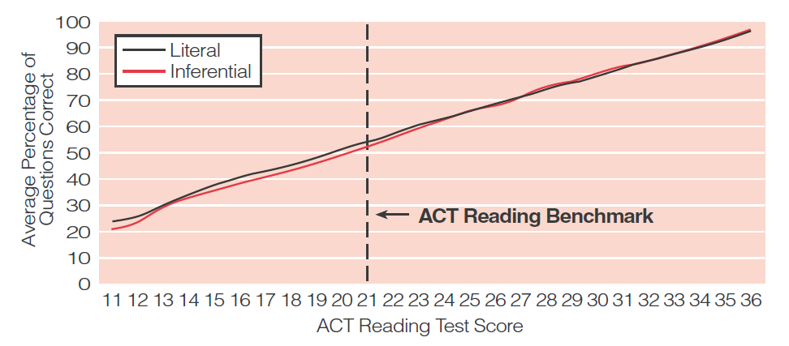
Performance on the ACT Reading Test
by Comprehension Level
(Averaged across Seven Forms)
Notes:
In Reading: Between the Lines, ACT demonstrates that student performance cannot be differentiated in any meaningful way by question type. Students do not perform differently if they are answering literal recall items or inferential items.
KEVIN’S IDEA:
Ask audience to look at the data presented what would they expect to see in terms of student responses to literal versus inferential questions?
What do they see?
Is there any difference?
Katie: notice the very small difference between the lines….because factual questions are easier to answer than the inferential.
Wouldn’t you expect to see a wide gap? Tiny gap

Slide 7
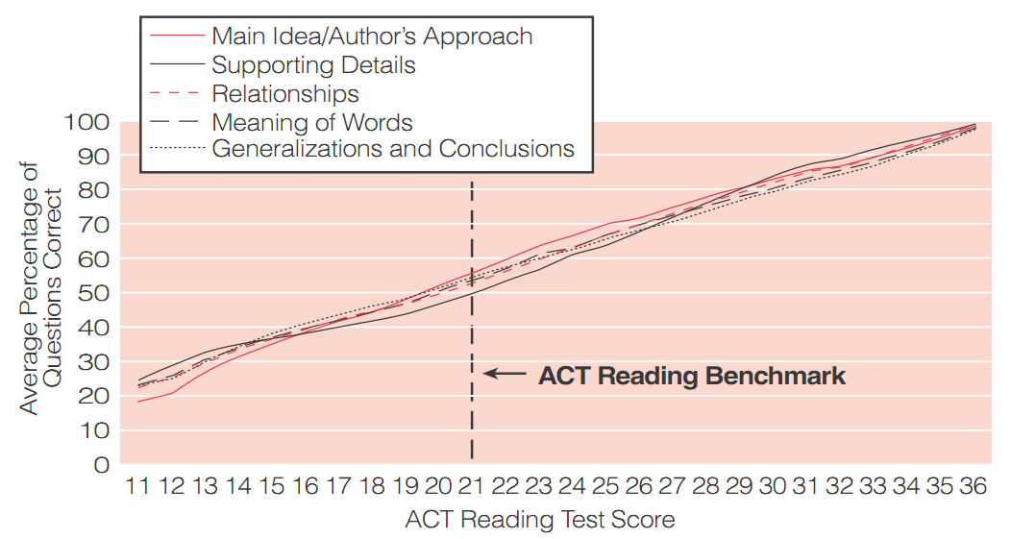
Performance on the ACT Reading Test
by Textual Element
(Averaged across Seven Forms)
Notes:
ACT demonstrates that student performance cannot be differentiated in any meaningful way by question type. Students do not perform differently if they are answering vocabulary items or main idea.
KEVIN’S IDEA:
Ask audience to look at the data presented what would they expect to see in terms of student responses to literal versus inferential questions?
What do they see?
Is there any difference?
Katie: notice the very small difference between the lines….
Wouldn’t you expect to see a wide gap? Tiny gap
Make the point---we spend so much time on skills based instruction, question types, etc. and ACT found no difference.

Slide 8
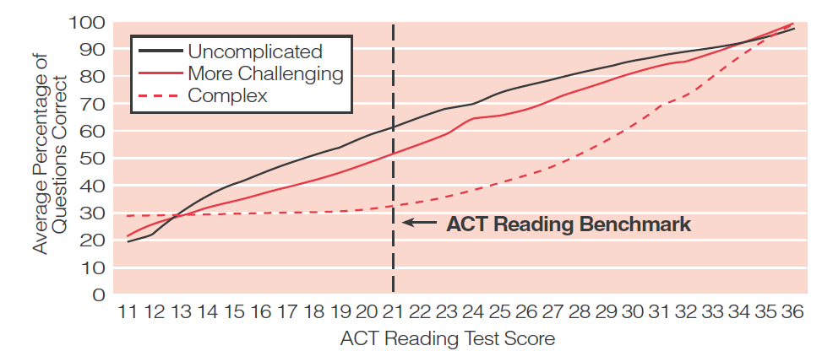
Performance on the ACT Reading Test
by Degree of Text Complexity
(Averaged across Seven Forms)
Notes:
Test performance, according to ACT, is driven by text rather than questions. Thus, if students are asked to read a hard passage, they may only answer a few questions correctly, no matter what types of questions they may be. On the other hand, with an easy enough text, students may answer almost any questions right, again with no differences by question type.

Slide 9
implications
Reading comprehension tests don’t assess individual skills or standards
Reading comprehension isn’t (or isn’t mainly) a “skilled activity”
Reading comprehension tests aren’t diagnostic tests; they can’t/won’t reveal skill differences
Analyzing item performance is a waste of time
To raise reading comprehension performance you have to teach students to read

Slide 10
How Can we Get higher reading scores?
Teach reading!

Slide 11
Let’s think about reading
What does test reading entail?
What will allow students to do better in making sense of the passages that they are asked to read on the tests?

Slide 12
Decoding and fluency matter a lot
To read a text, one has to read the words independently
Most elementary school students who struggle with reading, struggle to decode
Really low students may still need some instruction in phonological awareness and/or phonics
Many know basic sounds and spelling patterns, but their oral reading fluency suffers

Slide 13
Decoding and fluency (cont.)
Often teachers pull back on fluency instruction once accountability testing starts because the tests don’t evaluate oral reading
However, the reason oral reading fluency instruction has been promoted is because of its impact on silent reading achievement (NICHD, 2000)
Effective ORF teaching involves students in reading challenging texts aloud, with repetition, and feedback (not round robin)

Slide 14
Attention to vocabulary
Making sense of text requires knowledge of the meanings of words (vocabulary is important in reading comprehension)
Building vocabulary is a good idea, but its impact on test performance is limited (Stahl & Fairbanks, 1986): 1.00 vs. .30

Slide 15
Attention to vocabulary (cont.)
What can a student do when he/she comes to an unknown word on a test?
Two potential sources of information: morphology, context
However, although we often teach both of these skills, we also tend to undermine their use
Preteaching vocabulary does not always make sense

Slide 16
Which words do you teach?
Photosynthesis may sound like a big word, but it's actually pretty simple. You can divide it into two parts: "Photo" is the Greek word for "Light," and "synthesis," is the Greek word for "putting together," which explains what photosynthesis is. It is using light to put things together. You may have noticed that all animals and humans eat food, but plants don't eat anything. Photosynthesis is how plants eat. They use this process to make their own food. Since they don't have to move around to find food, plants stay in one place, since they can make their food anywhere as long as they have three things.

Slide 17
Which words do you teach?
Photosynthesis may sound like a big word, but it's actually pretty simple. You can divide it into two parts: "Photo" is the Greek word for "Light," and "synthesis," is the Greek word for "putting together," which explains what photosynthesis is. It is using light to put things together. You may have noticed that all animals and humans eat food, but plants don't eat anything. Photosynthesis is how plants eat. They use this process to make their own food. Since they don't have to move around to find food, plants stay in one place, since they can make their food anywhere as long as they have three things.

Slide 18
Which words would you teach?
Some scientists argued that these gases have heated up our atmosphere. They say global warming will affect our climate so dramatically that glaciers will melt and sea levels will rise. In addition, it is not just our atmosphere that can be polluted. Oil from spills often seeps into the ocean.

Slide 19
Common Prefixes
Prefix | Meaning | Example
anti- | against | antisocial
de- | opposite | decode
dis- | not, opposite of | disagree
en-, em- | put into, provide with | enslave, empower
fore- | before | foresee
in-, im- | in | infield
in-, im-, il-, ir- | not | impossible, inaction
inter- | between | intersection
mid- | middle | midway
mis- | wrongly | mispronounce
non- | not | nonsense

Slide 20
Common Prefixes
Prefix | Meaning | Example
over- | over | overwork
pre- | before | prepay
re- | again | remember
semi- | half | semicircle
sub- | under | submarine
super- | above | Superman
trans- | across | transplant
un- | not | unfriendly
under- | under | underwear
White, T.G., Sowell, J., & Yanagihara, A. (1989). Teaching elementary students to use word-part clues. The Reading Teacher, 42, 302-308.

Slide 21
Common suffixes
Suffix | Meaning | Example
-able, ible | can be done | comfortable
-al, ial | having characteristics of | partial
-ed | past-test verbs | helped
-en | made of | golden
-er | one who | player
-er | comparative | faster
-est | comparative | fastest
-ful | full of | careful
-ic | having characteristics of | romantic
-ing | present-tense verbs | running
-ion,-tion,-ation, -ition | act, process | action

Slide 22
Common suffixes
Suffix | Meaning | Example
-ity, -ty | state of | infinity
-ive, -ative, -itive | adjective form of noun | attentive
-less | without | hopeless
-ly | characteristic of | kindly
-ment | action or process | enjoyment
-ness | state of, condition of | happiness
-ous, -eous, -ious | possessing the qualities of | joyous
-s, -es | more than one | cars
-y | characterized by | funny
White, T.G., Sowell, J., & Yanagihara, A. (1989). Teaching elementary students to use word-part clues. The Reading Teacher, 42, 302-308.

Slide 23
vocabulary guidelines
Do not preteach words that are explicitly defined in the text.
Do not preteach words that can be figured out from context or morphology.
Follow up with questions about the words meaning and guided interpretation.

Slide 24
Help with Sentence Structure
Texts may be hard because of grammar or syntax
What can a student do when he/she comes across an especially challenging sentence

Slide 25
Help with Sentence Structure
Guide students to interpret complex sentences (clause and phrase analysis)
In dense prose, help find the subject and verb:
“However, on August 24, 2006, the International
Astronomical Union (IAU), a group of individual
astronomers and astronomical societies from
around the world, made an announcement.”

Slide 26
Help with Sentence Structure
However,
on August 24 2006
the International Astronomical Union (IAU), a group of individual astronomers and astronomical societies from around the world
made
an announcement

Slide 27
Help with Sentence Structure
Who was the sentence about?
the International Astronomical Union (IAU)
Who are they?
a group of individual astronomers and astronomical societies from around the world
What did they do?
made
Made what?
an announcement
When?
on August 24 2006

Slide 28
Sentence structure
“The women of Montgomery, both young and older, would come in with their fancy holiday dresses that needed adjustments or their Sunday suits and blouses that needed just a touch—a flower or some velvet trimming or something to make the ladies look festive.”
--Nikki Giovanni (Rosa)
44 words
2 commas, 1 em-dash

Slide 29
Another example
“The women of Montgomery , both young and older, would come in with their fancy holiday dresses that needed adjustments or their Sunday suits and blouses that needed just a touch—a flower or some velvet trimming or something to make the ladies look festive.”

Slide 30
Another example
“The women of Montgomery would come in with their fancy holiday dresses that needed adjustments or their Sunday suits and blouses that needed just a touch—a flower or some velvet trimming or something to make the ladies look festive.”

Slide 31
Another example
“The women of Montgomery would come in with their fancy holiday dresses that needed adjustments or their Sunday suits and blouses that needed just a touch—a flower or some velvet trimming or something to make the ladies look festive.”

Slide 32
Another example
“The women of Montgomery would come in with their fancy holiday dresses that needed adjustments
or their Sunday suits and blouses that needed just a touch
—a flower or some velvet trimming
or something to make the ladies look festive.”

Slide 33
Another example
“The women of Montgomery would come in with their fancy holiday dresses that needed adjustments
or their Sunday suits and blouses that needed just a touch
—a flower or some velvet trimming or something to make the ladies look festive.”

Slide 34
Another example
“The women of Montgomery would come in with their fancy holiday dresses that needed adjustments
or their Sunday suits and blouses that needed just a touch
—a flower or some velvet trimming or something to make the ladies look festive.”

Slide 35
Another example
“The women of Montgomery would come in with their fancy holiday dresses that needed adjustments
or The women of Montgomery would come in with their Sunday suits and blouses that needed just a touch
—a flower or some velvet trimming or something to make the ladies look festive.”

Slide 36
Another example (Spanish speakers)
One day, when he grows up a bit, Mickey will be a helping dog.

Slide 37
Another example (Spanish speakers)
One day,
when he grows up a bit,
Mickey will be a helping dog.

Slide 38
Another example (Spanish speakers)
One day,
when he grows up a bit,
Mickey
will be
a helping dog.

Slide 39
Guidelines for grammar
Identify complex sentences and design questions aimed at assessing comprehension of those sentences
Complex sentences: particularly long sentences, sentences with internal punctuation, dependent clauses, parentheticals, passive sentences, etc.
Identify sentences that may be problematic for English learners (e.g., Spanish speakers tend to have difficulty with future tense, auxiliary verbs)
Guide students to make sense of these sentences.

Slide 40
Help with Cohesion
Texts can be hard because the relationships and connections may be unclear to readers
The killer whale tosses the penguin into the air and generally torments its prey before it eats it
The killer whale tosses the penguin into the air and generally torments the penguin before eating it.

Slide 41
Help with Cohesion (cont.)
Meanwhile, the nebula continued to orbit the new Sun until it formed a large flat ring around it. Scientists call this ring a “protoplanetary disk.” The disk, or ring, was hottest where it was closest to the Sun, and coolest at its outer edge. As the disk swirled around the Sun, the Sun’s gravity went to work. It pulled and tugged at the bits of rock, dust, ice, and gas until they came together in clumps of material we now call the planets.

Slide 42
Meanwhile, the nebula continued to orbit the new Sun until it formed a large flat ring around it. Scientists call this ring a “protoplanetary disk.” The disk, or ring, was hottest where it was closest to the Sun, and coolest at its outer edge. As the disk swirled around the Sun, the Sun’s gravity went to work. It pulled and tugged at the bits of rock, dust, ice, and gas until they came together in clumps of material we now call the planets.

Slide 43
Meanwhile, the nebula continued to orbit the new Sun until it formed a large flat ring around it. Scientists call this ring a “protoplanetary disk.” The disk, or ring, was hottest where it was closest to the Sun, and coolest at its outer edge. As the disk swirled around the Sun, the Sun’s gravity went to work. It pulled and tugged at the bits of rock, dust, ice, and gas until they came together in clumps of material we now call the planets.

Slide 44
Meanwhile, the nebula continued to orbit the new Sun until it formed a large flat ring around it. Scientists call this ring a “protoplanetary disk.” The disk, or ring, was hottest where it was closest to the Sun, and coolest at its outer edge. As the disk swirled around the Sun, the Sun’s gravity went to work. It pulled and tugged at the bits of rock, dust, ice, and gas until they came together in clumps of material we now call the planets.

Slide 45
Meanwhile, the nebula continued to orbit the new Sun until it formed a large flat ring around it. Scientists call this ring a “protoplanetary disk.” The disk, or ring, was hottest where it was closest to the Sun, and coolest at its outer edge. As the disk swirled around the Sun, the Sun’s gravity went to work. It pulled and tugged at the bits of rock, dust, ice, and gas until they came together in clumps of material we now call the planets.

Slide 46
Meanwhile, the nebula continued to orbit the new Sun until it formed a large flat ring around it. Scientists call this ring a “protoplanetary disk.” The disk, or ring, was hottest where it was closest to the Sun, and coolest at its outer edge. As the disk swirled around the Sun, the Sun’s gravity went to work. It pulled and tugged at the bits of rock, dust, ice, and gas until they came together in clumps of material we now call the planets.

Slide 47
Meanwhile, the nebula continued to orbit the new Sun until it formed a large flat ring around it. Scientists call this ring a “protoplanetary disk.” The disk, or ring, was hottest where it was closest to the Sun, and coolest at its outer edge. As the disk swirled around the Sun, the Sun’s gravity went to work. It pulled and tugged at the bits of rock, dust, ice, and gas until they came together in clumps of material we now call the planets.

Slide 48
Guidelines for cohesion scaffolding
Identify the repetitions, synonyms, pronouns (mark the text to show the connections)
Identify the conjunctions (and, moreover, however, but, consequently, etc.)
Spanish speakers have particular difficulty with abstract pronouns (e.g., one, any) and with gender markers (e.g., his, her, him, it)
Ask questions that require students to make these connections across text
Guide their interpretation of cohesive links

Slide 49
Build silent reading stamina
Most students engage in “conversational reading activities” very well
But the literacy work on a test is more of a monologue
Can they sustain the conversation themselves (with the text as conversational partner)?

Slide 50
Build reading stamina (cont.)
Can they sustain the conversation themselves (with the text as conversational partner)?
Most reading lessons don’t aim directly at building students’ ability to sustain concentration
Typical lesson formats: students either read short portions interspersed with teacher support, or students are sent off to read longer texts on their own with minimal support

Slide 51
Build reading stamina (cont.)
Have students read short text
Follow up with questions
When they read that length of text well, then give longer text
Etc.

Slide 52
Higher test scores
Teach students to read
Make sure kids can decode and read fluently aloud
Teach them to interpret vocabulary on basis of context and morphology
Teach students to break down sentences to make sense of them
Teach them to make cohesive links across texts
Engage students in increasingly long stints of accountable silent reading

