Slide 1
How to Improve Reading Achievement
Timothy Shanahan
University of Illinois at Chicago
www.shanahanonliteracy.com

Slide 2
So what matters?
?

Slide 3
So what matters?
Children’s experience

Slide 4
Experience
Amount of experience
Content of experience
Quality of experience

Slide 5
Amount of Instruction
Amount of teaching or academic experience is the most important factor in children’s reading achievement
Children with the most academic experience make the most progress in reading and as instructional time increases learning tends to go up too

Slide 6
Disparities in Early Vocabulary Experience
30 million word gap
1200
Professional
Families
Working Class
Families
600
Child’s Cumulative Vocabulary (Words)
Welfare
Families
200
16 mos.
24 mos.
36 mos.
Child’s Age (Months)
Source: Hart & Risley (2003)

Slide 7

Effects of full-day kindergarten
Full-day kindergarten increases academic experience by about one month per year
Full-day kindergartens consistently outscore half-day kindergartens
Full-day kindergarten has stronger, longer lasting benefits for children from low-income families or others with fewer
educational resources prior to
kindergarten
Notes:
Gottfried, M. A., & Le, V. N. (2016). Full- versus part-day kindergarten for children with disabilities: Effects on academic and social-emotional outcomes. American Educational Research Journal, 53, .

Slide 8
Number of Instructional Days in School Year by Country
International Average = 193 School Days/Year
SOURCE: Trends in International Mathematics and Science Study (TIMSS) 2003

Slide 9

Extended school year
In a study in Chicago, extending the school year by 30 days led to increases in student learning in reading and math (Frazier & Morrison, 1998)
This study increased kindergarten by 30 days and raised reading achievement by about 1 full year in reading over comparison children

Slide 10

Use of School Day
Concept of Academic Learning Time (Fisher, Marliave, Filby, 1978)
Beat the odds comparison showed that effective teachers in grades K-3 keep students on task/engaged 96% of the time, students of less effective teachers only 63% (Taylor, 1999, 2006).
“Bell to bell” teaching (Mel Riddle)

Slide 11
Kennewick School
Annual Growth for All Students… Catch-up Growth for Those Who are Behind by Lynn Fielding, Nancy Kerr, and Paul Rosier
Tells of experiences in Kennewick, WA school that successfully raised reading achievement
They estimate that 60-80 minutes of reading instruction (per day/per year) will raise achievement one year
So, a youngster who enters 3rd grade 2 years behind in reading, will need about 240 minutes of instruction daily to catch up

Slide 12
Washington Elementary School
Growth in % of 3rd grade students meeting grade level standards
School Year
95 96 97 98 99 00 01 02 03 04 05 06
Percent at Grade level
57 72 72 68 78 94 96 99 94 98 99 98
Began providing intensive interventions in the afternoon to many students
Working harder and more effectively at 3rd grade
Result of improvement at both 2nd and 3rd Grade
Baseline year
Began testing in 2nd grade and focusing on earlier improvement

Slide 13
Other data on amount of instruction
Preschool
Reading First
Absenteeism
After-school programs
Summer school programs
Summer reading
Snow days
Days with unplanned teacher absences

Slide 14
What to do?
Protect children’s “reading” time
Be vigilant about lost time
Seek ways to increase academic time within and beyond the school day/year
Never do in small group what could have been done as well in whole class; never do individually what can be done as well in small group (grouping has clear benefits, but it also has costs)
Multi-tier support needs to be more protective of learning time

Slide 15
Curriculum
What we teach matters
One of the great research findings is that students tend to learn what is taught (Walker & Schefarzik, 1967)
Research finds curriculum to be the second most important influencer of learning (though this is a bit of an intellectual trick)

Slide 16
Curriculum
We don’t know exactly what needs to be taught
There are always examples of children who made good progress without any instruction in particular aspects of reading
However, there is “content” that consistently shows benefits for the group
Essential that we give students every opportunity to learn all of the components of reading that make a learning difference

Slide 17
Phonological Awareness
PA ability detect, manipulate, or analyze the auditory aspects of spoken language independent of meaning (e.g., word separations, syllables, rhymes, phonemes)
Individuals who can “fully segment” words do better in reading than those who cannot
Research has found PA to be a good predictor of later reading achievement (especially of decoding)
Research shows that it is possible to teach children to hear and manipulate the sounds of language in preschool, kindergarten, and grade 1 (and older readers who struggle with this skill)

Slide 18
Phonological Awareness
PA is a continuum—learners go from grosser to finer sounds with the end point being full segmentation
PA instruction has larger effect sizes in “normal classroom” studies than in studies of reading disabled children
Rhyming has the weakest effects of the PA skills
PA instruction is most effective when it is kept simple and when it is combined with letter name training

Slide 19
Phonological Awareness
By kindergarten, kids usually need only about 14-18 hours of phonemic awareness training
Instruction was usually individual or small group

Slide 20
Decoding
Decoding refers to knowledge of letters, letter sounds, and spelling patterns and the ability to use this knowledge to figure out the pronunciation of printed words
Research finds Decoding instruction to be effective in K, Grades 1 and 2, and with older struggling readers (but the biggest payoffs are early on)
Decoding instruction found to improve reading of nonwords and words, oral reading fluency, spelling and reading comprehension with younger readers and word reading and fluency with older struggling readers

Slide 21
Decoding
Systematic phonics instruction better than no phonics instruction or “diagnostic phonics”
Multiple years of phonics training best
Most successful instruction was delivered to individuals or small groups
Importance of a quiet classroom during decoding instruction
No single program had enough research to recommend a program, though all worked to some extent
Include decoding and encoding practice

Slide 22
Vocabulary
Vocabulary refers to knowledge of the meanings and meaningful parts of words
Explicit vocabulary teaching improves reading comprehension
Effective vocabulary instruction focuses on words that are common in text, but not common in oral language, and such instruction emphasizes depth of meaning, relationships among words, vocabulary use, and review
Teaching of morphology is beneficial, too

Slide 23
Oral Reading Fluency
Oral reading fluency refers to the ability to read text accurately, with sufficient speed, and prosody
Oral reading fluency instruction improves word reading, fluency, and reading comprehension (oral and silent)
Oral reading fluency is developmental: initially accuracy is especially important, then speed develops, and later prosody becomes important

Slide 24
Oral Reading Fluency
Fluency instruction has been found to be important (improved comprehension) in grades 1-4, and with remedial readers in grades 1-12
Impact of fluency teaching was equal for regular classroom instruction and with reading disabled students
Correlational studies show that the importance of fluency declines across the years, but that even by Grade 8 fluency differences explain 25% of the variation in reading comprehension

Slide 25
Oral Reading Fluency
Effective fluency instruction focuses on relatively difficult text
It emphasizes oral reading, feedback, modeling, repetition
There are now some computer-driven silent reading programs that seem to be effective
Instructional options: paired reading, partner reading, repeated reading, echo reading, neurological impress, etc.

Slide 26
Reading Comprehension
Reading comprehension is a process in which the reader constructs meaning from the information included in the text and the reader’s knowledge
Comprehension strategy instruction improves reading achievement
Summarization, questioning, monitoring, visualization, text structure, inferencing, and prior knowledge use were all effective comprehension strategies
Strategy instruction was effective across a wide range of grade levels and with both average and disabled readers
Notes:
Boardman, A. G., Buckley, P., Vaughn, S., Roberts, G., Scornavacco, K., et al. (2016). Relationship between implementation of collaborative strategic reading and student outcomes for adolescents with disabilities. Journal of Learning Disabilities, 49, 644-657.
Strategies led to higher achievement
Hebert, M., Bohaty, J.J., Nelson, J. R, & Brown, J. (2016). The effects of text structure instruction on expository reading comprehension: A meta-analysis. Journal of Educational Psychology, 108, 609-629.

Slide 27
Reading Comprehension
Gradual release of responsibility approaches were effective for teaching reading comprehension
Teaching question types is not an effective way of teaching reading comprehension
But prior knowledge matters in reading comprehension and it is critical that we use reading to build knowledge
Even good strategy instruction will place a heavy emphasis on content

Slide 28
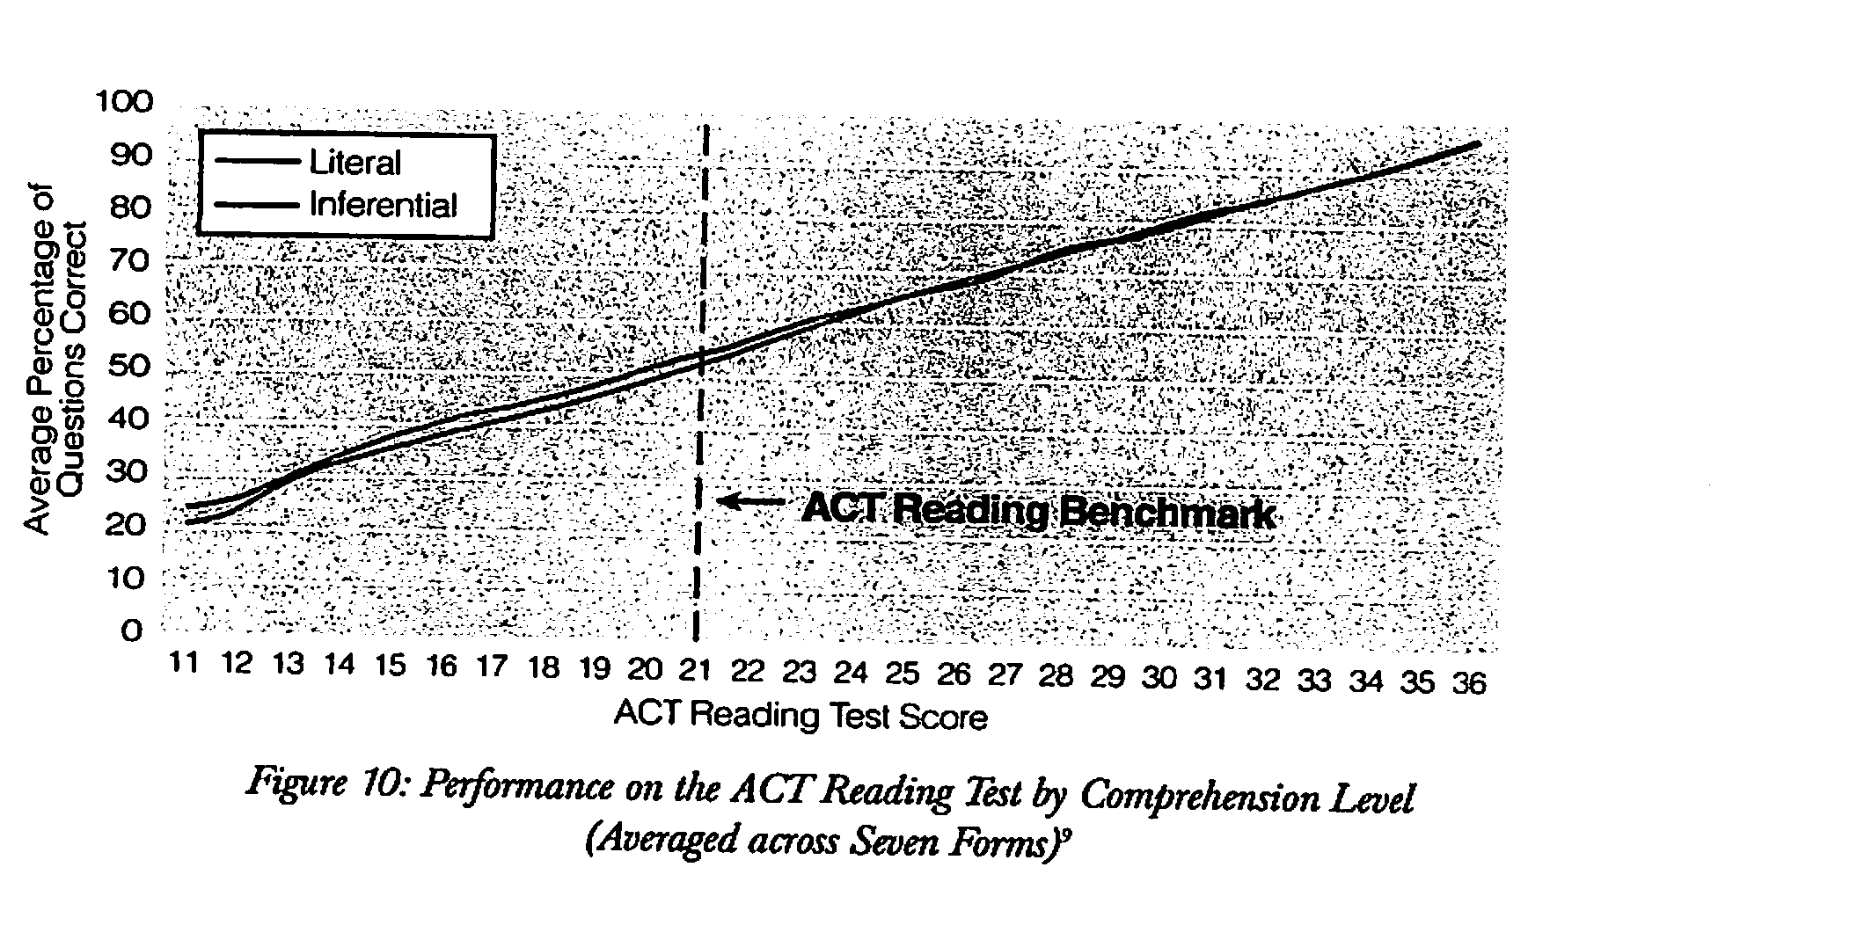
No performance differences due to question types (skills)

Slide 29
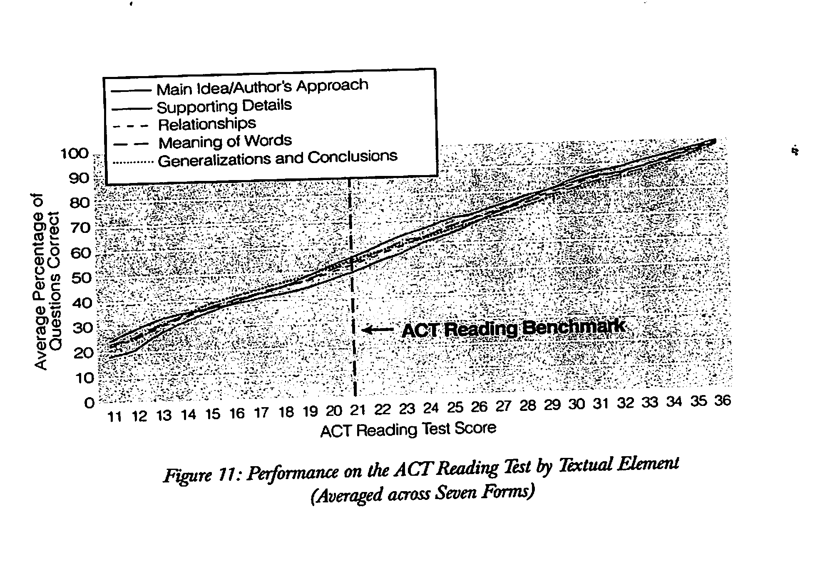
No performance differences due to question types (cont.)

Slide 30
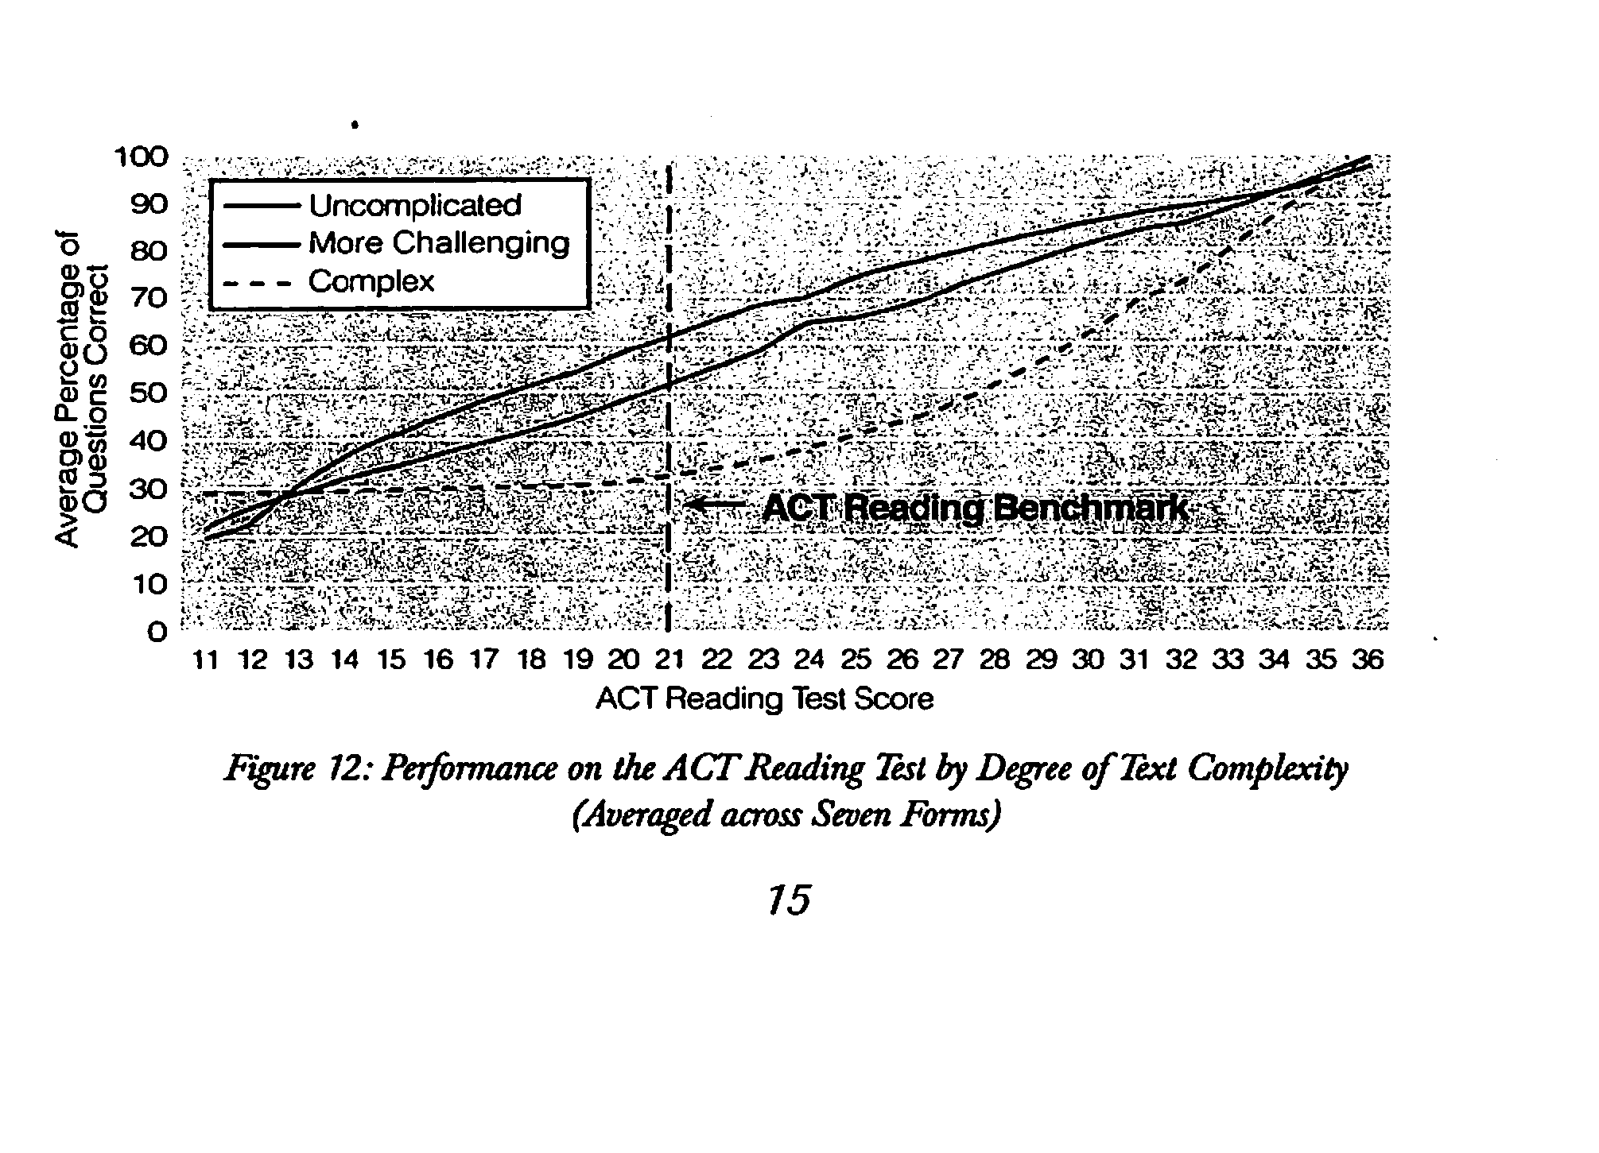
Text differences affect reading performance

Slide 31
Writing
Research shows a close relationship between reading and writing
Lots of skill and strategy overlap, and yet, reading and writing are independent
If they were not, then you would only need to teach one or the other
However, the overlap is what allows the cross-linguistic teaching to pay off
Graham & Hebert (2010): Meta-analyses of experimental studies show that writing about text can have a powerful impact on writing and reading achievement

Slide 32
Some key research results from writing about text
93% of study outcomes in which students wrote about text showed positive impacts (grades 2-12)
There were better effects for the good writers, but when students were explicitly taught how to write (not just assigned writing), then these impacts were equally large for poor readers
Writing about text was more powerful than just reading, or reading/rereading/studying text, or discussing text

Slide 33
Other Possibilities
Oral language
Content information (domain knowledge, knowledge of the world)
Notes:
Catts, H. W., Nielsen, D., Corcoran, A., Bridges, M.S., Liu, Y-S. (2016). Early identification of reading comprehension difficulties. Journal of Learning Disabilities, 49, 451-465.
Kaldenberg, Watt, & Therrieu, 2016: science expository text
de S. B. Kida, Adriana; de Ávila, Clara R. B.; Capellini, Simone A.Author Information . Frontiers in Psychology 7 (Jun 1, 2016).

Slide 34
Quality
Quality is hard to define (harder to measure)
I define it negatively: any feature of instruction associated with learning that is not mediated by amount or curriculum
Basically, if two groups receive the same amount of instruction/practice with the same content—then differences in learning are due to qualitative differences

Slide 35
Quality
Explicit Teaching
Modeling
Guided practice
Collaborative use
Independent practice
Review

Slide 36
Quality
Clear purposes of lessons
Students should know what they are doing and what they are trying to learn

Slide 37
Quality
Opportunities for response and interaction
With teachers
With students
Engagement
Language practice

Slide 38
Quality
Clear explanations

Slide 39
Quality
Reading/writing within instruction
More is better

Slide 40
Summary
More is better than less
PA, phonics, oral reading fluency, vocabulary, comprehension
Need high quality instruction
Important to align supervision, professional development, instructional materials, assessments, and parent support with this framework

