Slide 1
TEACHING DISCIPLINARY LITERACY
Timothy Shanahan
University of Illinois at Chicago
www.shanahanonliteracy.com

Slide 2
Many changes due to Common Core
Challenging texts
Close reading
Writing from sources
Informational text
Multiple texts
Argument
Embedded technology
Disciplinary literacy

Slide 3
Many changes due to Common Core
Challenging texts
Close reading
Writing from sources
Informational text
Multiple texts
Argument
Embedded technology
Disciplinary literacy

Slide 4
Many changes due to Common Core
Challenging texts
Close reading
Writing from sources
Informational text
Multiple texts
Argument
Embedded technology
Disciplinary literacy

Slide 5
Many changes due to Common Core
Challenging texts
Close reading
Writing from sources
Informational text
Multiple texts
Argument
Embedded technology
Disciplinary literacy

Slide 6
Many changes due to Common Core
Challenging texts
Close reading
Writing from sources
Informational text
Multiple texts
Argument
Embedded technology
Disciplinary literacy

Slide 7
Content Area Literacy
Content area literacy has long championed the idea of “every teacher a teacher of reading”
The approach emphasizes teaching English
Language Arts with content texts
Focus is on making students better students
by building up their reading comprehension
and study skills with content textbooks
Goal: To make students better students
What is the same across the disciplines?

Slide 8
Disciplinary Literacy
Disciplinary Literacy is a completely different concept
It is not about bringing ELA standards, methods, or approaches to the subject area classroom
Each discipline has its own ways of using
text to create, disseminate, and evaluate
knowledge, and it is this that the new
standards are asking us to teach
Goal is to apprentice students into the
disciplines
What is different across the disciplines?

Slide 9
Increasing Specialization of Literacy
Disciplinary
Literacy
Intermediate Literacy
Basic Literacy
Notes:
This pyramid illustrates the development of literacy. The pyramid base represents highly generalizable basic skills entailed in all reading tasks, (decoding skills, print and literacy conventions, recognition of high-frequency words, basic punctuation, etc). Most kids master these in the primary grades, and even those who struggle tend to master them before high school entry. As students progress, more sophisticated skills develop. These skills are not as widely applicable to different texts and reading situations, but neither are they linked to particular disciplinary specializations. They include decoding multisyllabic words, less common punctuation (such as split quotes), knowing more vocabulary including words not common in oral language, developing the cognitive endurance to maintain attention to extended discourse, monitoring comprehension, and using fix-up procedures such as rereading. They gain access to more complex forms of text organization, and begin to use author purpose as a tool for critical response. Most students learn these by the end of middle school, but many schoolers struggle with them. In high school, some students even begin to master more specialized reading routines/language uses, but these new routines, though powerful, tend to be constrained in their applicability to most reading tasks. The constraints on the generalizability of literacy skills for more advanced readers — symbolized here by the narrowing of the pyramid — are imposed by the increasingly disciplinary and technical turn in the nature of literacy tasks. Although most students manage to master basic and even intermediate literacy skills, many never gain proficiency with these more advanced skills.
Progressing higher in the pyramid means learning more sophisticated, but less generalizable, skills and routines.

Slide 10
Sources of Disciplinary Literacy
Studies that compare expert readers with novices (Bazerman, 1985; Geisler, 1994; Wineburg, 1991, etc.)
Functional linguistics analyses of the specialized literacy/language practices used in the disciplines (Fang, 2004; Halliday, 1998; Schleppegrell, 2004, etc.)

Slide 11
Example of Expert Reader Study
Wineburg’s study of history reading:
Sourcing: considering the author and author perspective
Contextualizing: placing documents within their historical period and place
Corroboration: evaluating information across sources
Science versions have either ignored literacy issues, or just analyzed expert science reading itself or compared experts

Slide 12
Generalizable vs. Specialized Skills
Content area reading is based on the idea that reading and writing are highly generalizable skills
Thus, literacy can be taught with the texts and content of any field and the same approaches can be applied across the disciplines (e.g., SQ3R, KWL, summarization)
But disciplinary literacy focuses not on what is the same across the disciplines, but what is unique or specialized

Slide 13
Content area literacy instruction provides students with a “toolbox” of strategies to use whenever a text is encountered.
Disciplinary literacy strategies come out of the demands of the text and the purposes of the discipline.

Slide 14
What do students need to learn?
Science content
How science content is created
How scientists think (approach problems, etc.)
How scientists use literacy

Slide 15
Scientific Practices
Asking questions and defining problems
Developing and using models
Planning and carrying out investigations
Analyzing and interpreting data
Using mathematics and computational thinking
Constructing explanations and designing solutions
Engaging in argument from evidence
Obtaining, evaluating and communicating information

Slide 16
Asking questions and defining problems
Formulating empirically answerable questions
Establishing what is already known
Determining which questions have yet to be satisfactorily answered

Slide 17
Developing and Using Models
Development of models and simulations to help develop explanations about natural phenomena
Models make it possible to go beyond observations
And identify flaws in the reasoning

Slide 18
Planning and carrying out investigations
Identification of what is to be recorded
Identification of independent and dependent variables
Collecting and recording data

Slide 19
Analyzing and interpreting data
Putting data into form that allows it to be interpreted (tabulation, graphical interpretation, visual analysis, statistical analysis)
Identification of patterns in data

Slide 20
Using mathematical and computational thinking
Math is used to represent physical variables, their relationships, and phenomena like growth or change or development
Mathematical approaches allow for predictions of future behavior of physical systems

Slide 21
Constructing explanations and designing solutions
Construct logically coherent explanations of phenomena that incorporate explanations that are consistent with available evidence

Slide 22
Engaging in argument from evidence
Reasoning and argument are essential or identifying strengths and weaknesses of a line of reasoning for finding the best explanation
Scientists must defend their explanations through the use of evidence

Slide 23
Obtaining, evaluating, and communicating information
Science cannot advance if scientists can’t communicate their findings clearly and persuasively
A major practice of science is communicating explanations orally and through writing (including graphical information)
Science requires the ability to derive meaning from scientific texts

Slide 24
The Role of Literacy in Science
Literacy is essential to recording methods and results of observations and experiments
These texts must be so explicit and complete that they render an investigation replicable
Researchers depend upon this written record for determining what is known and unknown
Scientists must be able to locate authoritative text and be able to access this make sense of that text

Slide 25
The Role of Literacy in Science (cont.)
Science texts are organized in particular ways (such as the structure of studies)
Science texts offer explanations of scientific phenomena… such explanations will often be accompanied by a description of the sources of the information
0

Slide 26
The Role of Literacy in Science (cont.)
Science texts are organized in particular ways (such as the structure of studies)
Science texts offer explanations of scientific phenomena… such explanations will often be accompanied by a description of the sources of the information
0

Slide 27
Different Outlook about the Goal of Reading
Students:
With the goal of absorbing the information
Scientists:
With the goal of inquiry

Slide 28
Different Approaches to Reading
How do students read:
From beginning to end
How do scientists read:
Skip around
Use headings
Read captions
Compare text descriptions to visual representations
Check their understnding

Slide 29
Disciplinary Literacy and Text Choice
Historians were not anti-textbook—they thought textbooks could play an important role in social studies instruction
However, across several studies, the historians are unified in the idea that history cannot be taught with single texts
The nature of history and the major research approaches used in history (i.e., collecting multiple accounts of events) require multiple texts

Slide 30
Disciplinary Literacy and Text Choice (cont.)
Scientists were skeptical of the idea of multiple texts
In science important to have a single accurate authoritative source
Not particularly interested in critical responses to school text
Their own reading procedures emphasize critical response when reading texts on high knowledge topics and less on other topics (Bazerman, 1985; Shanahan, et al., 2011)

Slide 31
Chemistry Note-taking
Substances | Properties | Processes | Interactions | Atomic Expression
Notes:
Experts, teacher educators and high school teachers displayed reluctance in embracing the idea of strategy instruction. For most, the concept was new, and the reading strategies we shared with them seemed contrived and irrelevant. This reluctance was revealing, because it mirrored the disinclination of the preservice students in the high school literacy class. The chemistry team’s reluctance only changed when we introduced our version of structured summarization, a strategy that we based specifically on their insights about chemistry reading. Using this strategy, students take notes in a chart format. Each section of the chart reflected the information that these chemistry specialists said was essential to reading chemistry text. Because chemistry is about the properties of substances and their reactions, a reader who paid attention to these would be engaging in a disciplinary-focused reading. We had illustrated the chart using information from one of the chemistry textbooks the team members had shared with us. One of the chemists who had been dismissive of teaching content area reading strategies (such as summarization) in chemistry reacted by saying, “Well, if they used this, they would be learning chemistry.” He then suggested a modification (the inclusion of a place to summarize atomic expression). The difference between this strategy and summarization was its subject-matter specificity. This strategy was not just about understanding text; it was also about understanding the essence of chemistry.
This structured-summarization strategy meshed well with concerns the chemists had expressed earlier when they examined high school chemistry textbooks: the need to identify where the chemistry was. That is, although they understood that some of the information in the text was included purely for motivational purposes or to establish context for students, they were concerned that what students were actually supposed to learn about chemistry was obscured and hidden by these devices. One of the chemistry teachers bitterly complained about a text she had to use in which each chapter began with a real-life problem (such as lake pollution) that was then followed by an explanation of the chemistry behind the problem. She complained that the students were not learning the chemistry. Chemistry learning is somewhat hierarchical in nature. The concepts build on each other, and these concepts can then be applied to situations. That is, the principles are taught as abstractions, and the particulars are exemplars of the abstractions. This chemistry book, however, perseverated on the particular, providing students with little real opportunity to learn the abstractions that could be used to solve other problems. Important: charts are used in content area reading, too. But the idea is that this particular chart couldn’t be used anywhere else but in chemistry. That’s what makes it an example of disciplinary literacy.

Slide 32
Content Area Vocabulary
Students need to learn terminology in all fields
The same study techniques would accomplish this no matter what the words
Graphic organizers, semantic maps, word sorts, rate knowledge of words, analyze semantic features of words, categorizing/mapping words, synonym webs, etc.

Slide 33
Disciplinary Literacy Vocabulary
Focus is on specialized nature of vocabulary of the subjects
Science: Greek and Latin roots (precise, dense, stable meanings that are recoverable)
History: metaphorical terms, terms with a political point of view
Notes:
Haploid: cell with a single set of unpaired chromosomes (half the normal number, not from both parents)
Diploid: cell with two complete sets of chromosomes, one from each parent
Meiosis: cell division in which the new cells are not identical to the parent cells osis (less process or action)
Mitosis: cell division in which the new cells are identical to the parent cells (thread process)
Allopatric: non overlapping distribution of species (allo other / patric father/patrilinial)
Sympatric: overlapping distribution of species (sym together or the same)

Slide 34
Disciplinary Literacy Vocabulary
Learning the nature of disciplinary literacy (science constructs words for precision, maximum interpretability/recoverability, relationships, and stability)
How to interpret morphology
How to use of context
Use of appropriate reference guides
Notes:
Haploid: cell with a single set of unpaired chromosomes (half the normal number, not from both parents)
Diploid: cell with two complete sets of chromosomes, one from each parent
Meiosis: cell division in which the new cells are not identical to the parent cells osis (less process or action)
Mitosis: cell division in which the new cells are identical to the parent cells (thread process)
Allopatric: non overlapping distribution of species (allo other / patric father/patrilinial)
Sympatric: overlapping distribution of species (sym together or the same)

Slide 35
Morphology Differs by Discipline
Of course, different disciplines use different words
But the frequency or value of prefixes,
suffixes, and (especially) combining
forms differs by discipline
See: Word ID: Assessment Across
the Content Areas by Linda Gutlohn
& Frances Besselieu

Slide 36
Prefixes
 | ELA | Math | Science | Soc Stuides
com- | X | X | X | X
con- | X | X | X | X
de- | X | X | X | X
dis- |  | X |  | X
ex- | X | X | X | X
in- | X | X | X | X
inter- |  | X
pre- | X
pro- | X | X |  | X
re- | X | X | X | X
sub- | X | X
trans- |  |  | X
un- |  | X
Notes:
Trans – through or beyond

Slide 37
Derivational Suffixes
 | ELA | Math | Science | Soc Stuides
-al | X | X | X | X
-ar |  | X | X
-ary | X |  |  | X
-ate | X | X | X | X
-ation | X | X | X | X
-ent |  | X | X | X
-ic | X | X | X | X
-ism |  |  | X | X
-ist |  |  |  | X
-ity | X | X | X | X
-ive | X | X | X | X
-ize | X |  | X | X
-ment | X | X | X | X

Slide 38
Derivational Suffixes (cont.)
 | ELA | Math | Science | Soc Stuides
-or |  |  | X | X
-sion | X | X | X | X
-tion | X | X | X | X
-ture | X |  |  | X

Slide 39
Greek Combining Forms
 | ELA | Math | Science | Soc Stuides
ana | X
arch |  |  |  | X
auto |  |  |  | X
bio |  |  | X | X
chem |  |  | X
cracy, crat |  |  |  | X
dem, demo |  |  |  | X
eco |  |  |  | X
electro, elect |  |  | X
endo |  |  | X
geo |  |  | X | X
gon |  | X
gram |  | X
Notes:
Arch: initial, beginning, original
Auto:: self
Cracy: denoting a particular kind of government or influence
Demo: people, population

Slide 40
Greek Combining Forms (cont.)
 | ELA | Math | Science | Soc Stuides
graph | X |  |  | X
hedron |  | X
hydro |  |  | X
logy (ology) | X |  | X | X
meter, metr |  | X | X
micro |  |  | X
nym, onym | X
oid |  |  | X
para | X | X
photo |  |  | X
poly |  | X
scope |  |  | X
sphere |  |  | X | X

Slide 41
Greek Combining Forms (cont.)
 | ELA | Math | Science | Soc Stuides
sym- |  | X
syn- | X |  | X
therm, thermo |  |  | X
tri- |  | X

Slide 42
Morpheme Frequency
Gutlohn & Bessellieu (2014) examined frequency of morphemes in 4500 multisyllabic content area words to identify the morpheme frequency
Half the morphemes occurred across content areas, though the words they appeared in may be content specific
The following morphemes were only frequent in science text: trans, chem, electro, elect, endo, hydro, meter, metr, oid, photo, scope, therm, thermo

Slide 43
Morpheme Frequency (cont.)
The following morphemes were frequent only in science and one other discipline: ar, ism, or, bio, geo, logy, ology, sphere, syn

Slide 44
Disciplinary Literacy Emphasizes Specialized Nature of Vocabulary
Focus is on specialized nature of
vocabulary in each subject area
Science: Greek and Latin roots
(precise, dense, stable meanings that
are recoverable)
Example: DNA (deoxyribonucleic
acid) is a nucleic acid, a macromolecule
that stores information.
Notes:
De- less or FROM
Oxy- sugar
Ribo- structurally related to ribose
Nucleus nucleic acid –substance basic to life
A sugar derived from ribose in the form of a deoxyribose (structure) that is basic to life DNA

Slide 45
Specialized Nature of Vocabulary
History: metaphorical terms, terms
with a political point of view
Example: Revolutionary movements
in Europe and Asia were described
to the American public as examples
of Soviet Expansionism….
(Zinn, A People’s History);
Example: Civil War, War between
the states, War of Northern aggression.
Example: The Gilded Age

Slide 46
Specialized Nature of Vocabulary
Literature: Words that evoke emotion, the senses.
Example: …where I would have lived
through all that impassioned,
insane joy of the hunt, when as I
climb the rock, my face contorted,
gasping, shouting voluptuously
senseless words…(Nabokov, Father’s
Butterflies).

Slide 47
Teach students to use context
Most science textbooks are compendiums of definitions/explanations of science concepts and their relationships
Most lesson plans encourage teachers to preteach vocabulary so students don’t get as much practice in making sense of definitions

Slide 48
Which words to preteach?
Photosynthesis may sound like a big word, but it's actually pretty simple. You can divide it into two parts: "Photo" is the Greek word for "Light," and "synthesis," is the Greek word for "putting together," which explains what photosynthesis is. It is using light to put things together. You may have noticed that all animals and humans eat food, but plants don't eat anything. Photosynthesis is how plants eat. They use this process to make their own food. Since they don't have to move around to find food, plants stay in one place, since they can make their food anywhere as long as they have three things.

Slide 49
Which words to preteach?
Photosynthesis may sound like a big word, but it's actually pretty simple. You can divide it into two parts: "Photo" is the Greek word for "Light," and "synthesis," is the Greek word for "putting together," which explains what photosynthesis is. It is using light to put things together. You may have noticed that all animals and humans eat food, but plants don't eat anything. Photosynthesis is how plants eat. They use this process to make their own food. Since they don't have to move around to find food, plants stay in one place, since they can make their food anywhere as long as they have three things.

Slide 50
Which words to preteach?
Some scientists argued that these gases have heated up our atmosphere. They say global warming will affect our climate so dramatically that glaciers will melt and sea levels will rise. In addition, it is not just our atmosphere that can be polluted. Oil from spills often seeps into the ocean.

Slide 51
Teach students to use reference works
Dictionary instruction
But using the more specialized
reference works from a field of study

Slide 52
Sugar example: General dictionary
a sweet crystalline substance obtained from
various plants, especially sugar cane and
sugar beet, consisting essentially of sucrose, and used as a sweetener in
food and drink.

Slide 53
Sugar example: Science dictionary
(saccharide) Any of a group of water soluble carbohydrates of relatively low molecular weight and having a sweet taste. The simple sugars are called monosaccharides. More complex sugars comprise between two and ten
monosaccharides linked together: disaccharides
contain two, trisaccharides, three, and so on.
The name is often used to refer specifically to
sucrose (cane or beet sugar). The suffix -ose
is used in biochemistry to form the names
of sugars.

Slide 54
Sugar example: Science dictionary
(saccharide) Any of a group of water soluble carbohydrates of relatively low molecular weight and having a sweet taste. The simple sugars are called monosaccharides. More complex sugars comprise between two and ten
monosaccharides linked together: disaccharides
contain two, trisaccharides three, and so on. The
name is often used to refer specifically to sucrose
(cane or beet sugar). The suffix -ose is used in
biochemistry to form the names of sugars.

Slide 55
Battleship example (History): General dictionary
Any of a class of warships that are the
Most heavily armored and are equipped
With the most powerful armament.

Slide 56
Battleship example: History dictionary
U.S. battleship is usually distinguished from its foreign
Counterparts by its heavy gun armament, sturdy
protection, and relatively slow speed. Three distinct
subtypes: 27 mixed-battery ships built 1888-1908;
22 all-big-gun “dreadnoughts” (1910-1923); and
10 fast battleships (1937-1944). Stricken from the
Navy’s lists in January 1995. As ship killers, the
battleships saw little action; yet they ultimately justified
their existence in important subsidiary missions, the
most significant being gunfire support for troops
ashore.

Slide 57
Cultural differences across the disciplines
The differences among the disciplines are more than content/information differences
They are separated by differences in how information is created, used, evaluated, in the nature of the language, demands for precision, etc.
Disciplinary Literacy requires
enculturation and acculturation

Slide 58
The Culture of Mathematics
Goal: arrive at “truth”
Importance of “close reading” an intensive consideration of every word in the text
Rereading a major strategy
Heavy emphasis on error detection
Precision of understanding essential

Slide 59
The Culture of Science
Text provides knowledge that allows prediction of how the world works
Full understanding needed of experiments and processes
Close connections among prose, graphs, charts, formulas (alternative representations of constructs an essential aspect of chemistry text)
Major reading strategies include corroboration and transformation

Slide 60
The Culture of History
History is interpretative, and authors and sourcing are central in interpretation (consideration of bias and perspective)
Often seems narrative without purpose and argument without explicit claims (need to see history as argument based on partial evidence; narratives are more than facts)
Single texts are problematic (no corroboration)

Slide 61
Text is central to disciplines
Functional linguists are showing how texts differ across disciplines
But secondary teachers are increasingly trying to teach content without text
And now, CCSS is requiring the teaching of complex texts
Scientific text tends to be multimodal, with the graphic elements as important as the prose
Often ignored instructionally

Slide 62
Graphic Elements in the Disciplines
Think of the differences between the graphics in a math book and science book
Math books embed the formulas and graphic elements—controlling how the
text is read (precision)
Science books require reader to move back and forth between graphics and prose (conceptual-multiple versions)

Slide 63
Scientific Graphics
There are a large number of tables, charts, graphics, 3-dimensional representations, scientific drawings, flowcharts, photographs, etc. used in scientific communication (and many ways to categorize these)
No attempt to show all possible graphics, just some major ones
Focus is on teaching students to identify their purposes and to interpret them appropriately (in relation to the rest of the scientific information)

Slide 64
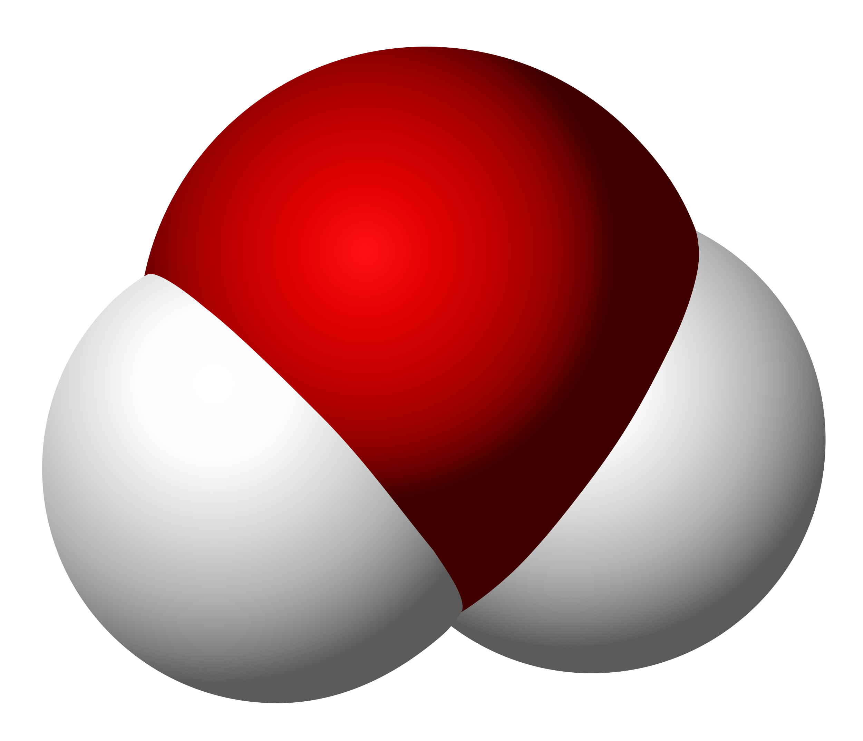
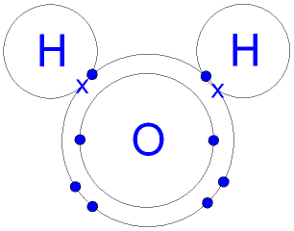
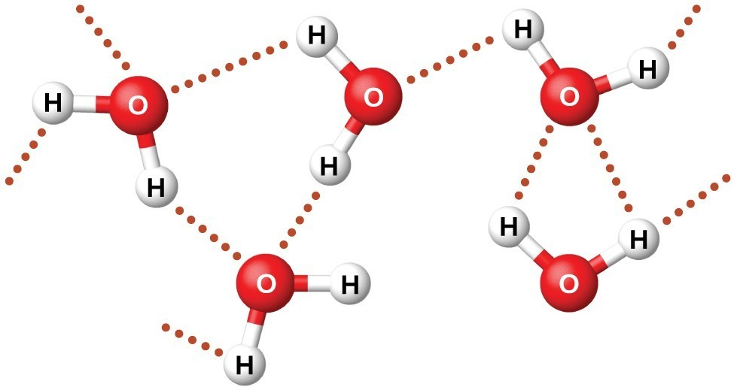
What do these have in common?
Notes:
Comparison of different graphics of water molecule– the purpose here is to show that these graphics, though they look quite different are actually the same thing (though they might be emphasizing different aspects of this molecule.

Slide 65
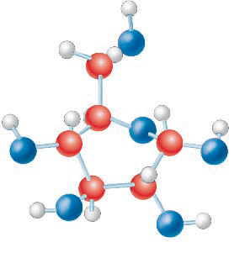
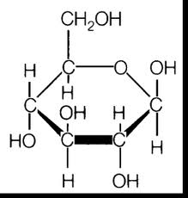
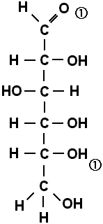
What do these have in common?
Notes:
Comparison of different graphics of sugar (glucose) molecule.

Slide 66
Graphics Purposes
Spatial graphics: represent spatial placement of objects or the physical relationships among objects or parts (e.g., photos, scientific drawings)
An understanding of spatial graphics is demonstrated by being able to describe (or remember) the relative placements of the items in the graphics
Not enough to remember the actual items represented—understanding their relationships is key

Slide 67
Graphics Purposes (cont.)
Sequential graphics: represent the steps in a process or cycle (e.g., flow charts)
An understanding of sequential graphics requires that readers be able to describe the steps in the process in an appropriate sequence (and key features of the process such as asymmetricity, circularity, etc.)

Slide 68
Graphics Purposes (cont.)
Comparative graphics: reveal similarities and differences in phenomena or processes (includes scientific drawings, tables, bar graphs, etc.)
Understanding comparative graphics requires that readers recognize what is being compared and to be able to draw appropriate generalizations from the comparisons

Slide 69
Graphics Purposes
Classification/Hierarchical graphics: reveal taxonomic or rank relationships or arrangements among phenomena, objects, processes, etc. (includes tree diagrams, category graphs, etc.)
Understanding classification/hierarchical graphics requires recognizing what is being compared and whether the nature of the relations being pictured (e.g., superior to inferior, general to specific)

Slide 70
Graphics Purposes
Causal graphics: reveal what conditions or actions lead to particular outcomes (can take many forms, but be especially careful of graphics that illustrate relationships between two variables-–those are not necessarily causal, but may be correlational)
Understanding requires being able to describe the antecedent the consequent and how the the former impacts the latter

Slide 71
Graphics Purposes
Spatial graphics
Sequential graphics
Comparative
Classification/Hierarchical
Causal

Slide 72
Spatial
Sequential
Comparative
Classif/Hierarch
Causal
Notes:
Most spiral galaxies consist of a flat, rotating disk containing stars, gas and dust, and a central concentration of stars known as the bulge. ... Together with irregular galaxies, spiral galaxies make up approximately 60% of galaxies in today'suniverse.
NOUN
SPATIAL

Slide 73
Spatial
Sequential
Comparative
Classif/Hierarch
Causal
Notes:
Process/verb: Water cycle
The water cycle describes how water evaporates from the surface of the earth, rises into the atmosphere, cools and condenses into rain or snow in clouds, and falls again to the surface as precipitation.
Transpiration: plants give off water through their pores
Infiltration: water seeping through the soil to the water table

Slide 74
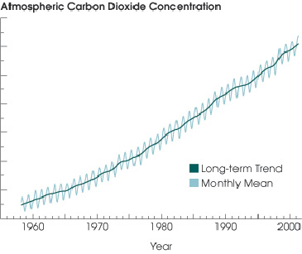
Spatial
Sequential
Comparative
Classif/Hierarch
Causal
Notes:
This is a comparison… it allows one to compare how much atmospheric carbon dioxide there was each decade since 1960

Slide 75
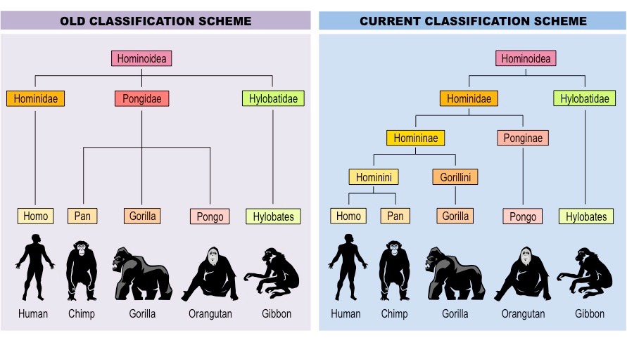
Spatial
Sequential
Comparative
Classif/Hierarch
Causal
Notes:
Classification and Comparison
Classification of hom-in-oid-ea;
We used to think man was a distinct or unique member of the hominoidea family… newer classification schemes recognize more fine grained distinctions and closer connections with some other members of the family.

Slide 76
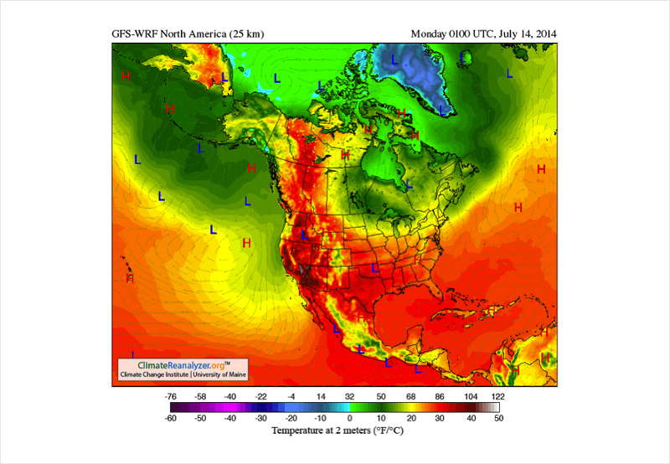
Spatial
Sequential
Comparative
Classif/Hierarch
Causal
Notes:
Spatial / Comaprative
Shows temperature locations

Slide 77
Spatial
Sequential
Comparative
Classif/Hierarch
Causal
Notes:
Classification (taxonomy) in hierarchical tree form (general to specific)

Slide 78
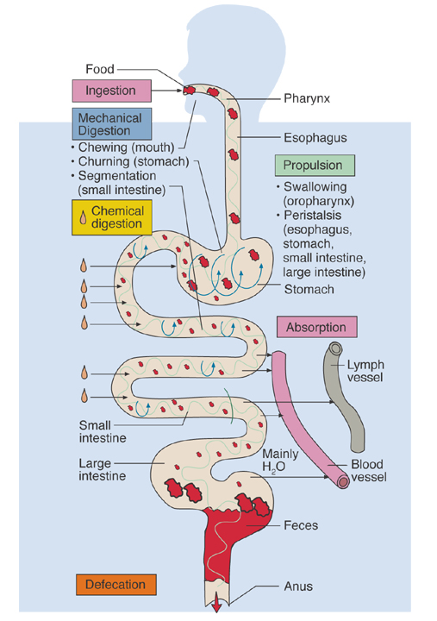
Spatial
Sequential
Comparative
Classif/Hierarch
Causal
Notes:
Sequential—illustrates the digestion process
Spatial—shows the placement of the digestion system

Slide 79
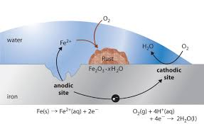
Spatial
Sequential
Comparative
Classif/Hierarch
Causal
Notes:
Shows iron rusting
Causal– shows how Oxygen merges into water and how the oxygen from water bonds with iron to create rust
Sequential—it is a process

Slide 80
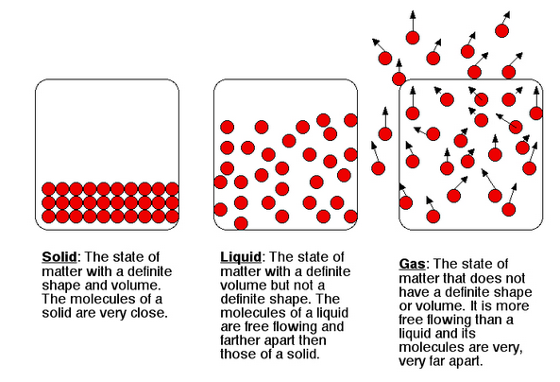
Spatial
Sequential
Comparative
Classif/Hierarch
Causal
Notes:
Comparison of different forms of H2O

Slide 81
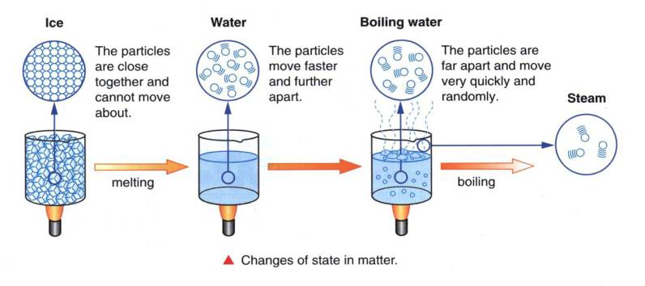
Spatial
Sequential
Comparative
Classif/Hierarch
Causal
Notes:
Causation—the areas show how the state of matter is changed by heat
Comparison

Slide 82
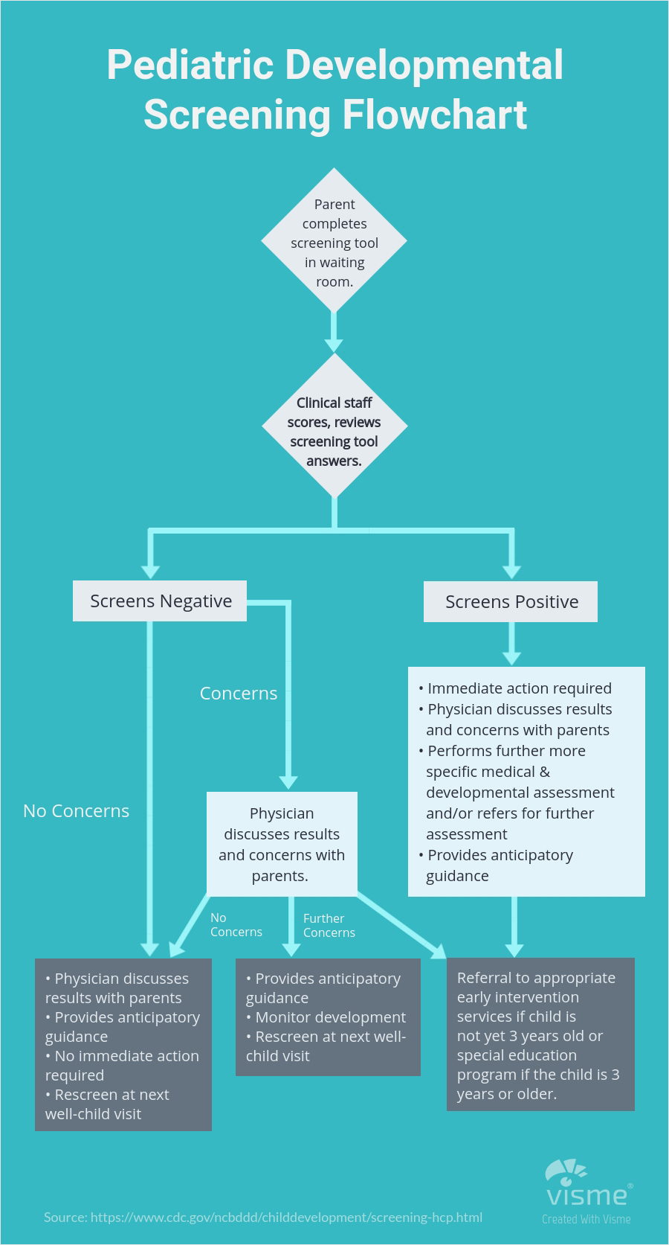
Spatial
Sequential
Comparative
Classif/Hierarch
Causal
Notes:
Sequence process flowchart

Slide 83
Spatial
Sequential
Comparative
Classif/Hierarch
Causal
Notes:
Causal relationships

Slide 84
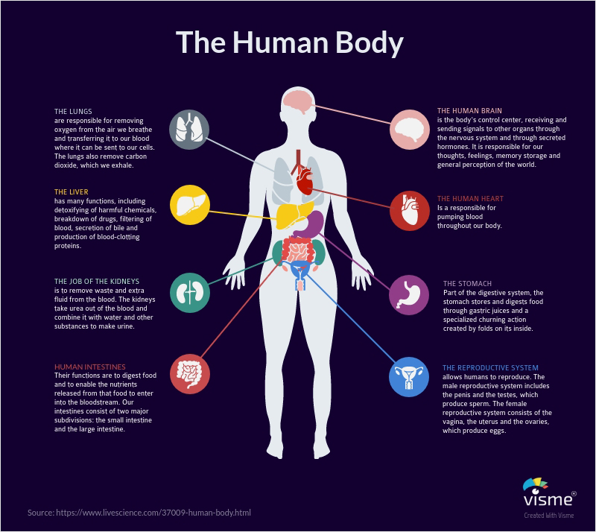
Spatial
Sequential
Comparative
Classif/Hierarch
Causal
Notes:
Spatial, classification

Slide 85
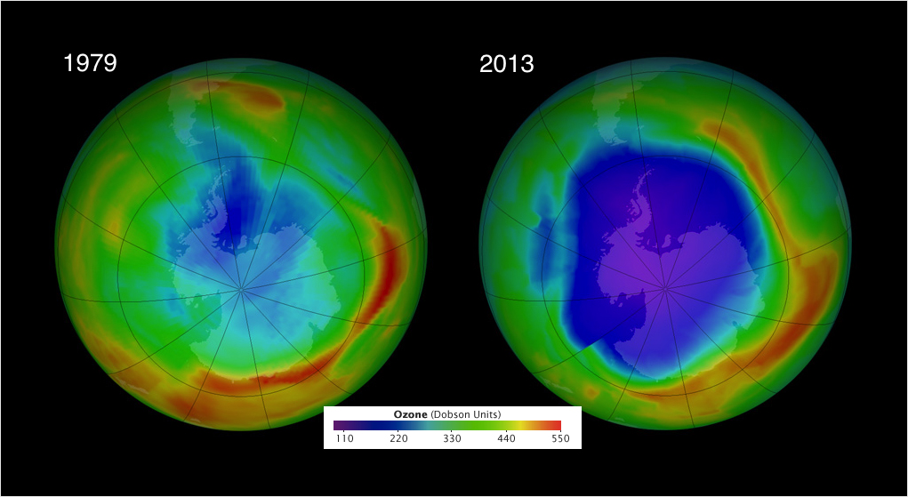
Spatial
Sequential
Comparative
Classif/Hierarch
Causal
Notes:
Comparison of ozone layer at two different times

Slide 86
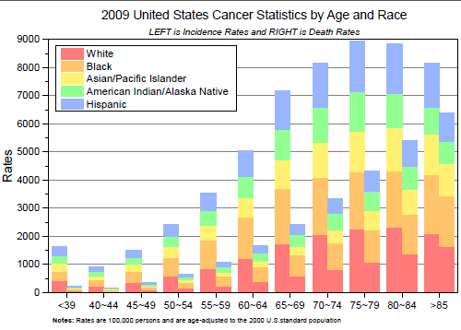
Spatial
Sequential
Comparative
Classif/Hierarch
Causal
Notes:
Comparison

Slide 87
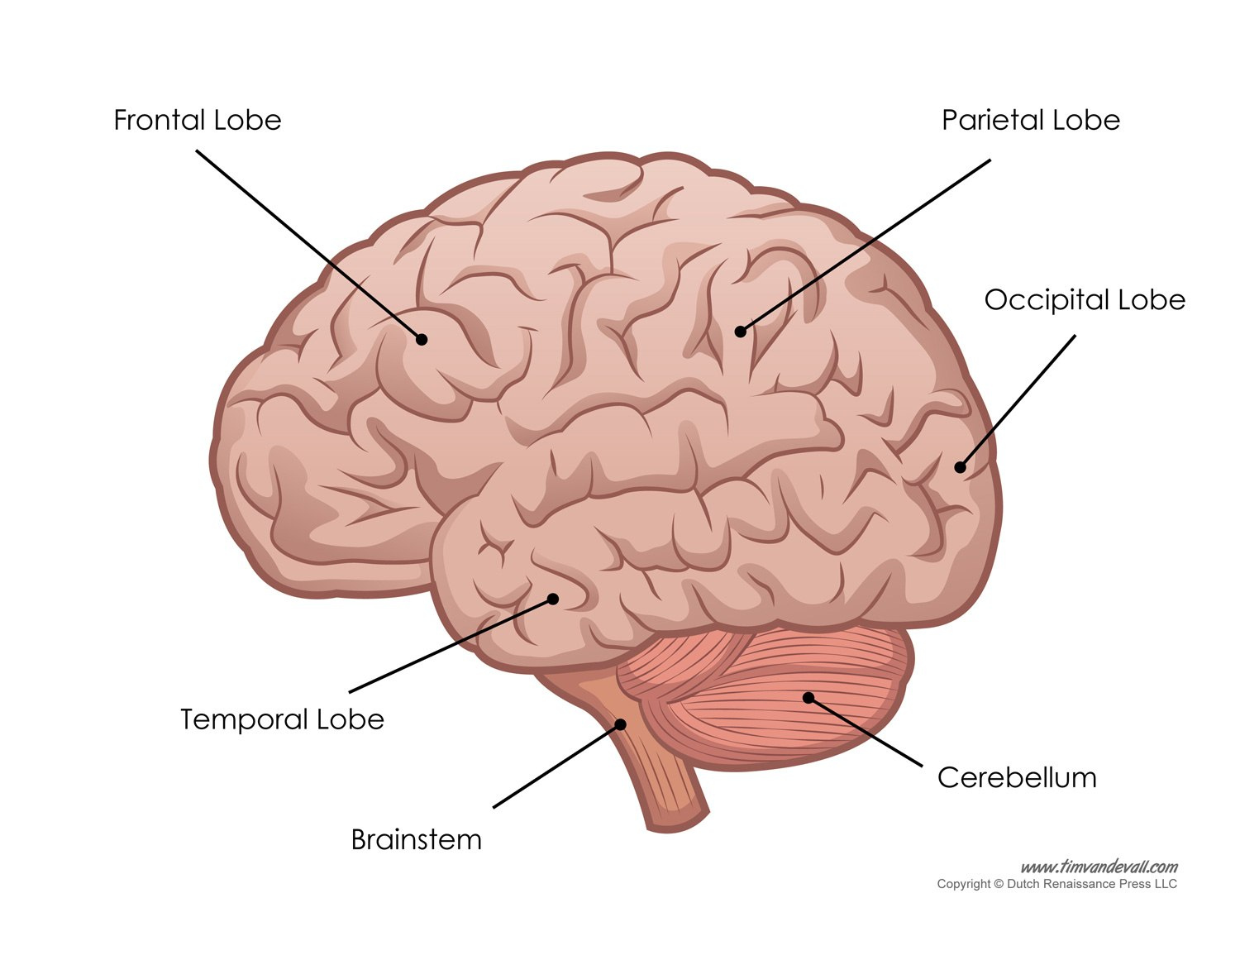
Spatial
Sequential
Comparative
Classif/Hierarch
Causal
Notes:
Spatial structure of human brain

Slide 88
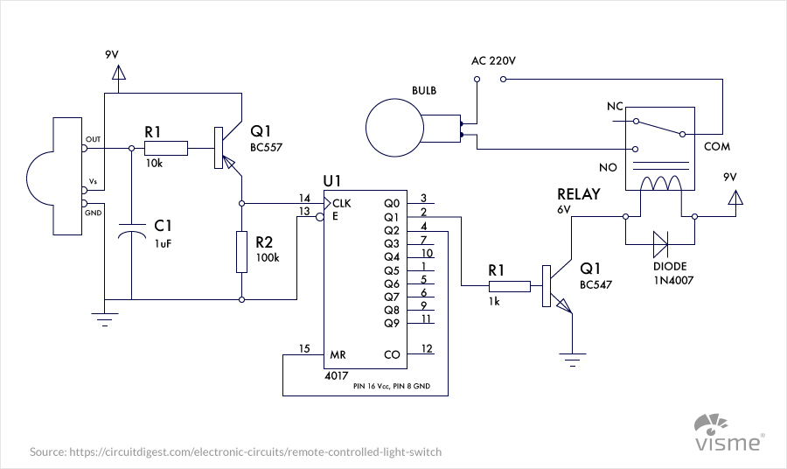
Spatial
Sequential
Comparative
Classif/Hierarch
Causal
Notes:
Spatial – engineering blueprint… showing circuits

Slide 89
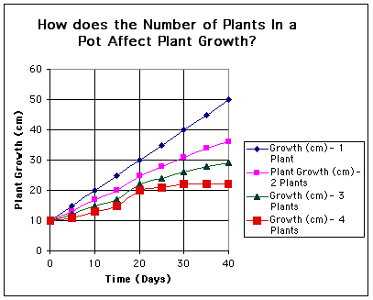
Spatial
Sequential
Comparative
Classif/Hierarch
Causal
Notes:
Causal—relationship of growth rates in an experiment (crowding impact on growth)
Comparison

Slide 90
Spatial
Sequential
Comparative
Classif/Hierarch
Causal
Notes:
Classification and Comparison
Classification of hom-in-oid-ea;
We used to think man was a distinct or unique member of the hominoidea family… newer classification schemes recognize more fine grained distinctions and closer connections with some other members of the family.

Slide 91
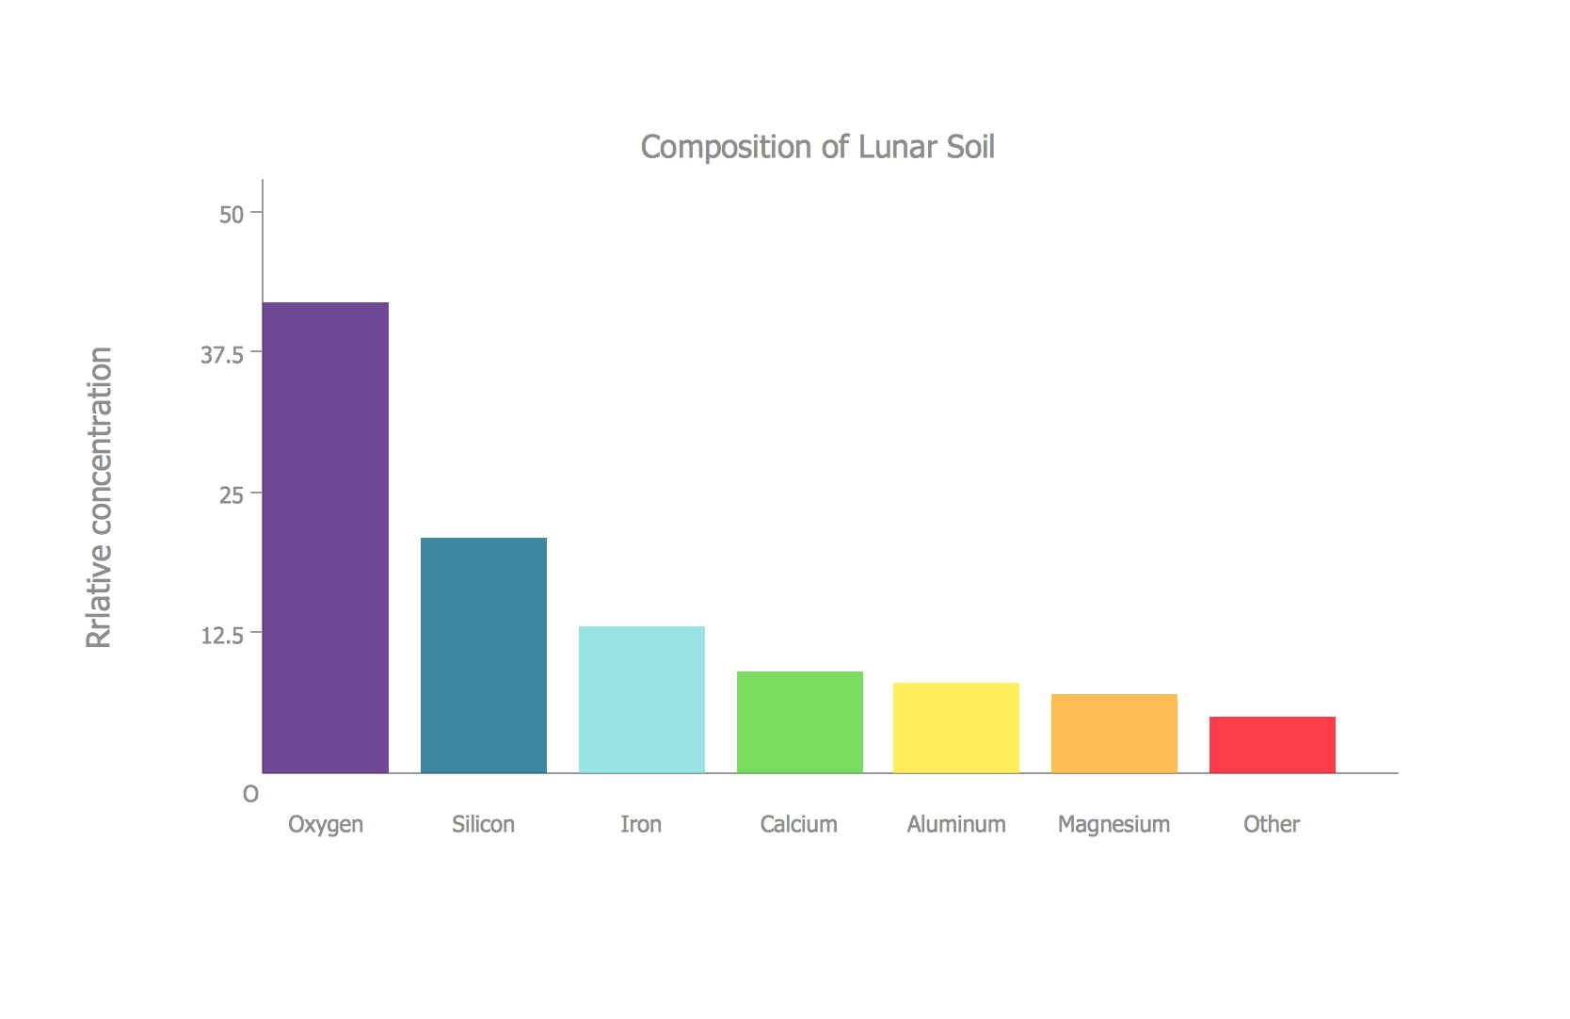
Spatial
Sequential
Comparative
Classif/Hierarch
Causal
Notes:
Comparison of lunar soil elements

Slide 92
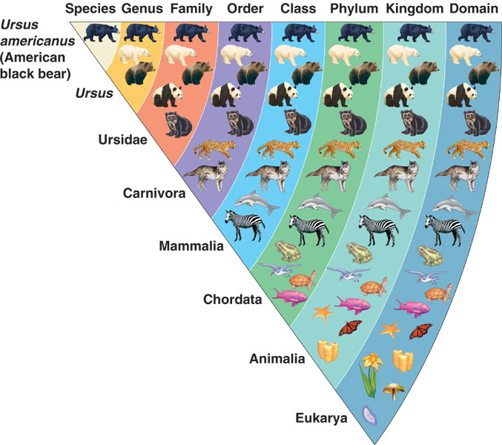
Spatial
Sequential
Comparative
Classif/Hierarch
Causal
Notes:
Classification – Classifying where the American black bear fits in biological classification system (taxonomy ranks)
Comparative

Slide 93
New standards are an outcome of this work
Common Core State Standards for English Language Arts
and Literacy in History/Social Studies &
Science/Technical subjects

Slide 94
Literacy in Science/Technical Subjects
Determine the meaning of symbols, key terms, and other domain-specific words and phrases as they are used in a specific scientific or technical texts and topics.
Integrate quantitative or technical information expressed in words in a text with a version of that information expressed visually (e.g., in a flowchart, diagram, model, graph, or table).
Distinguish among facts, reasoned judgment based on research findings, and speculation in a text.
Follow precisely a complex multistep procedure when carrying out experiments, taking measurements, or performing technical tasks, attending to special cases or exceptions defined in the text.
Analyze the structure of the relationships among concepts in a text, including relationships among key terms (e.g., force, friction, reaction force, energy).
Translate quantitative or technical information expressed in words in a text into visual form (e.g., a table or chart) and translate information expressed visually or mathematically (e.g., in an equation) into words.
Compare and contrast findings presented in a text to those from other sources (including their own experiments), noting when the findings support or contradict previous explanations or accounts.
Cite specific textual evidence to support analysis of science and technical texts, attending to important distinctions the author makes and to any gaps or inconsistencies in the account.
Follow precisely a complex multistep procedure when carrying out experiments, taking measurements, or performing technical tasks; analyze the specific results based on explanations in the text.
Synthesize information from a range of sources (e.g., texts, experiments, simulations) into a coherent understanding of a process, phenomenon, or concept, resolving conflicting information when possible.

Slide 95
Literacy in History/Social Studies
Cite specific textual evidence to support analysis of primary and secondary sources, attending to such features as the date and origin of the information.
Analyze in detail a series of events described in a text and the causes that link the events; distinguish whether earlier events caused later ones or simply preceded them.
Identify aspects of a text that reveal an author’s point of view or purpose (e.g., loaded language, inclusion or avoidance of particular facts).
Compare the point of view of two or more authors by comparing how they treat the same or similar historical topics, including which details they include and emphasize in their respective accounts.
Interpret the meaning of words and phrases in a text, including how an author uses and refines the meaning of a key term over the course of a text (e.g., how Madison defines faction in Federalist No. 10 and No. 51).
Evaluate authors’ differing points of view on the same historical event or issue by assessing the authors’ claims, evidence, and reasoning.
Distinguish among fact, opinion, and reasoned judgment in a historical account.
Compare and contrast treatments of the same topic in several primary and secondary sources.
Evaluate an author’s premises, claims, and evidence by corroborating or challenging them with other sources of information.
Integrate information from diverse sources, both primary and secondary, into a coherent understanding of an idea or event, noting discrepancies among sources.
.

Slide 96
Disciplinary Literacy in Science
https://www.projectreadi.org/
https://www.projectreadi.org/readi-science-materials/
http://www.scienceandliteracy.org/
http://www.argumentationtoolkit.org/
http://sciencearguments.weebly.com/

