Slide 1

Effective English Literacy Instruction for English Learners
Diane August
Center for Applied Linguistics
Timothy Shanahan
University of Illinois at Chicago

Slide 2
The Role of Research
No need for statistics showing the challenges facing English learners
Teachers doing the best they can to meet the needs of ELs
Best chance of improvement is to rely on previously successful approaches
Research is the best way to determine what has been successful

Slide 3
The Nature of the Evidence
National Literacy Panel for Language Minority Children and Youth provided comprehensive review of research evidence
We will summarize the findings from the experimental studies
Also, have been working on an update (including new studies through 2009 and different ways of analyzing these data)
Providing some examples to help you to make them work

Slide 4
1. Effective instruction for ELs emphasizes literacy components.
English Learners benefit from explicit instruction in:
Phonological awareness and decoding (n= 22, g = .48)
Oral reading fluency (n= 10, g = .37)
Vocabulary (n=13, g = .43)
Reading comprehension (n=27, g = .57)
Writing (N=5)
This means there are growing numbers of studies that are revealing the kinds of instructional practices that make a difference in teaching these aspects of literacy to EL students

Slide 5
Application: Literacy Elements
Need to teach all aspects of literacy
Assessment and monitoring is critical for determining what is needed when a student lags

Slide 6
Application: Word reading
22 studies with PA, ABC, word reading, and decoding outcomes (.48)
Only one negative finding: a study of PA teaching with older normal ELs
RCTs higher than QEDs (.57 vs. .37)
Poor readers versus normal (.57 vs. .41)
Non-Spanish versus Spanish (.60 vs. .37)
Positive results from exposure, but larger from explicit teaching

Slide 7
Application: Oral Reading Fluency
10 studies with oral reading outcomes
Enriched book environment study was removed from the set
Phonics and repeated reading approaches were beneficial (also in single subject design studies)

Slide 8
Application: Vocabulary
Concurrent translations and a phonics study with no word meaning teaching were removed
Proximal versus distal (no differences)
RCT vs. QED (.75 versus .24)
No age differences
Normal vs. struggling readers (.69 vs. .09)
Non-Spanish vs. Spanish (.71 vs. .34)

Slide 9
Application: Comprehension
27 studies, g=. 57
QED vs. RCT (.59 versus .46)
Age differences (.62 vs. .49)
Normal vs. struggling readers (.61 vs. .37)
Non-Spanish vs. Spanish (.60 vs. .47)
Meaning vs. Decoding (.61 vs. .41)

Slide 10
2. Effective instruction for ELs is similar to what works with native speakers.
The same kinds of commercial programs are effective with both groups
The same kinds of instructional approaches or procedures are effective with both groups

Slide 11
Application: Instruction Beneficial to All
  Benefits of explicit instruction in the components (including cross-component benefits)
  Decoding instruction delivered in small groups
  Vocabulary instruction that teaches individual words and word-learning strategies, provides rich and varied language experiences, and develops word consciousness
  Comprehension instruction that engages students in making meaning
  Writing instruction that provides practice in social interactions around revision
  For products look at What Works Clearinghouse

Slide 12
3. Effective curriculum and instruction must be adjusted to the needs of ELs.
To be maximally effective, instruction needs some adjustment
A problem with the research: It has not been explicit about how basic instructional routines were altered to maintain effectiveness

Slide 13
Application: Strategic Use of the First Language
Preschool children hear storybooks read in their primary language at home followed by classroom storybook reading in English
Elementary school children preview and review vocabulary lessons in their first language
Middle school children participate in reciprocal teaching to develop comprehension first in Chinese and then in English

Slide 14
Application: Adjustments for Differences in Knowledge
Phonemic awareness instruction that emphasizes English sounds like ‘v’ that might be difficult for Spanish speakers
Vocabulary instruction that helps students draw on first language knowledge
Reading and writing programs that take into consideration first language reading and writing skills

Slide 15
Adjustments for Differences in Knowledge
15

Slide 16
Adjustments for Differences in Knowledge
16

Slide 17
Adjustments for Differences in Knowledge
17

Slide 18
Adjustments for Differences in Knowledge
18

Slide 19
Application: Enhanced Instructional Delivery
Providing more time to complete the lessons
Instruction in small groups so teachers can better target instruction
More scaffolding:
  Use of visuals and gestures
  Clarifying difficult words and passages through instructional conversations
  Additional modeling

Slide 20

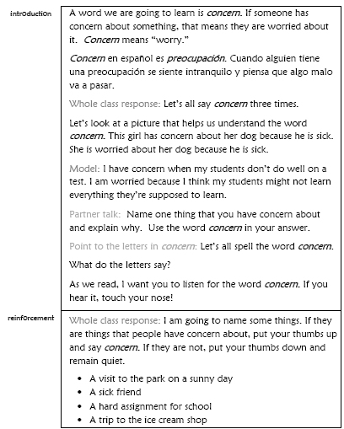
Enhanced Instructional Delivery

Slide 21
Enhanced Instructional Delivery

Slide 22
Enhanced Instructional Delivery

Slide 23
4. Effective instruction for ELs is comprehensive and multidimensional.
Sufficient amount of time
Complete curriculum (all of the components earlier noted)
Skills coupled with enhanced meaning-emphasis
Enhanced interactions among students and with teacher
Parent involvement

Slide 24
Application:
Comprehensive & Multi-faceted Instruction
Most studies focused on teaching one or two skills and were not comprehensive (however, there were exceptions such as SFA or Instructional Conversations)
Effective comprehensive programs for ELs embody all the attributes of effective programs for English-speaking students: amount of instruction, quality of instruction, quality teachers, valid monitoring of learning, differentiated teaching, sound interventions, etc.)

Slide 25
Application: Comprehensive and Multi-faceted Instruction
With ELs pay particular attention to:
  Respecting diversity
  Teaching all students to high standards
  Building on students’ background knowledge
  Differentiating instruction to accommodate students’ strengths and needs

Slide 26
5. Effective instruction for ELs develops oral English proficiency.
Comparison of L1 and L2 for phonemic awareness, phonics, spelling
Comparison of L1 and L2 for reading comprehension
Relation of oral English with reading comprehension in English
Effectiveness of vocabulary instruction versus other aspects of literacy instruction

Slide 27
Application:
Developing Oral English Proficiency
Clarifying difficult words and concepts in the basal readers
Grouping ELs with English proficient speakers to provide opportunities for meaningful interaction in English
Using interactive shared reading methods

Slide 28
Developing Oral Proficiency

Slide 29
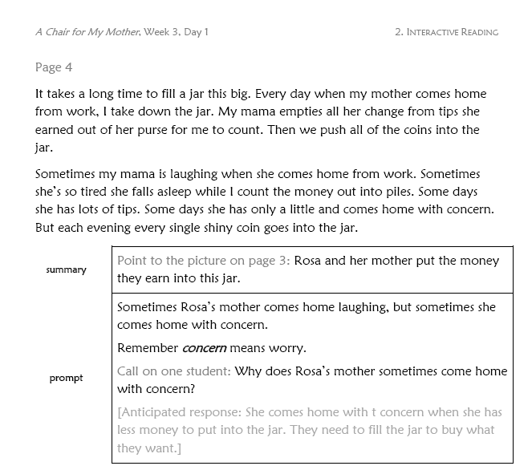
Developing Oral Proficiency
Focus on target word

Slide 30
Developing Oral Proficiency

Slide 31
6. Effective instruction for ELs is differentiated.
Reading proficiency
English proficiency
Older recently arrived immigrants
English learners with special education needs

Slide 32
Application: Differentiation
Adjustments for long-term ELs at the intermediate ELD level
Adjustments for schools with small numbers of newcomers
Grouping for ESOL/ELD instruction
Grouping for literacy instruction
  Similarities and differences for ELs and English proficient students
Changes in grouping over time
Providing access to native English-speaking peers while differentiating instruction for ELs

Slide 33
7. Effective instruction for ELs requires well-prepared teachers.
Professional development for teachers
Emphasis on practices as well as on beliefs and values

Slide 34
Application: Well prepared teachers
Importance of:
  Mainstream teachers who know how to scaffold instruction for ELs and develop their English proficiency
  EL specialists with content area knowledge
Role of the ESL/ELD teacher and the mainstream teacher in ELs’ literacy development
Role of the ESL/ELD teacher and content area teacher in ELs’ development of subject matter knowledge

Slide 35
Application: Well-prepared Teachers

Slide 36
Application: Well-prepared Teachers

Slide 37
8. Effective literacy instruction for ELs is respectful of home language.
Instruction in home language improves literacy (even with older students)
Use of home language as a valuable adjustment to instruction

