Slide 1
Instructional Practices in the Early Grades that Foster Language & Comprehension Development
Timothy Shanahan
University of Illinois at Chicago
www.shanahanonliteracy.com

Slide 2
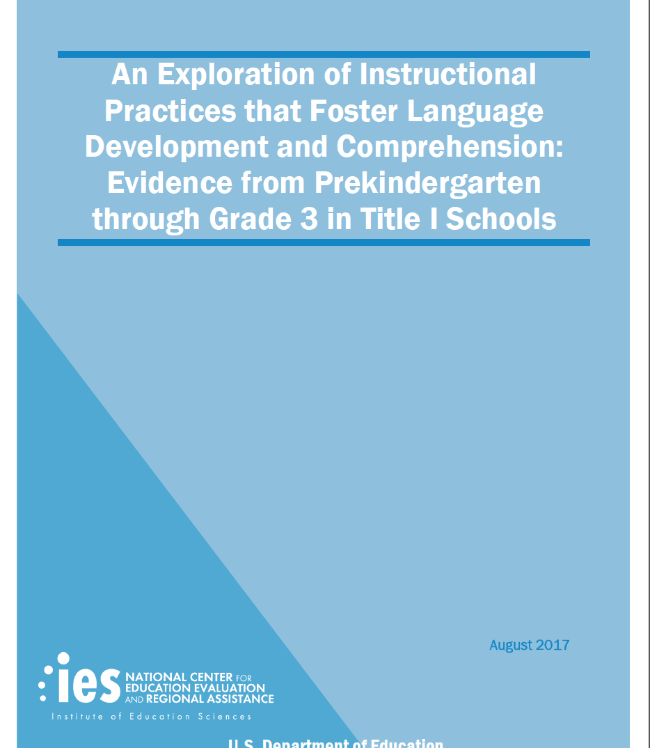

Slide 3
1999 Status of Reading Comprehension
In 1999, the National Assessment of Educational Progress (NAEP) reported that, for 4th graders, scores increased during the 1970s
But then there had been no further improvement since 1980
1998 reading comprehension scores were slightly higher than in 1971 (208 to 215)
--Campbell, Hombo, & Mazeo, 2000

Slide 4
Reforms Aimed at Improving Reading
Even Start
Reading Excellence Act
Reading First
Early Reading First
Head Start
Response to Intervention (RtI)
Various state initiatives aimed at PreK-3 reading improvement

Slide 5
2018 Status of Reading Comprehension
In 2018, the National Assessment of Educational Progress (NAEP) reported that, for 4th graders, scores increased during the 2000s
Scores improved from 1998 to 2005, but have been flat since then
Most recent scores are slightly higher than they were in 1998 (215 to 222)
Indiana has done a bit better than the nation: Hoosier 4th graders scored the same as U.S. 4th graders in 1998, but now outperform them slightly (215 to 226)

Slide 6
Dissatisfaction with Progress
Despite the expenditure of billions of dollars targeted on improving beginning reading achievement, reading comprehension gains have been small and inconsistent
Various research syntheses (National Research Council, 1998; National Institute of Child Health and Human Behavior, 2000; National Institute for Literacy, 2008) have revealed the importance of foundational reading skills and these have been emphasized in public initiatives with some positive results
But what’s missing?

Slide 7
Need for Reading Comprehension Study
U.S. Department of Education requested that an exploratory study be conducted to try to identify other instructional variables (beyond phonemic awareness, phonics, and oral reading fluency) that may be implicated in the early learning of reading comprehension

Slide 8
Reading and Language
It is possible to look at reading comprehension growth in Grades 2 and 3, but what about Grades K and 1?
Most children are not reading by start of grade 1
However, oral language development is closely related to reading comprehension growth (at least when oral language is measured more comprehensively— expressive vocabulary, concepts/following directions, word classes, sentence structure, listening comprehension)
Accordingly, this study analyzed growth in oral language and reading comprehension (as appropriate to the grade levels)—and background knowledge

Slide 9
Study Design
Identified a diverse (in terms of reading performance) sample of Title I schools
10 large school districts from across country (9 states)
83 schools (5 schools identified in each district that were relatively high achieving and 5 schools randomly selected from the rest of the population)
1,035 classrooms (up to 3 classrooms from each grade level PreK-3 from each school)
4,969 students (random selection of ~5 students from each participating classroom)
Conducted 4 half-days of observation in each classroom to observe 285 different instructional variables (~100 certified observers who received 10 days of training, 2 days of practice)

Slide 10
Instructional Variables
Teachers’ use of language
Text-related instruction
Vocabulary teaching
Comprehension strategy instruction
Development of world knowledge
Encouragement of higher-order thinking
Observations looked for the occurrence of certain activities, the intensity of the occurrence, and the frequency
Items factor-analyzed to develop sets that were then correlated with the gains students made in language and achievement

Slide 11
Analysis
Observations looked for the occurrence of certain activities, the intensity of the occurrence, and the frequency
Items factor-analyzed to develop sets of reliable items
These sets of observation variables were then correlated with the gains students made in language and comprehension to identify which were differentiating performance in Grades PreK-1 and Grades 2-3
Purpose is to identify those instructional practices that contribute to learning

Slide 12
Cautions
This is a correlational study—it only measures relationships among existing variables
It is not an experiment in which these variables are varied systematically to test an outcome
The results identify promising practices—as opposed to proven ones
Research is now needed to determine the effectiveness of these variables with greater certainty
Nevertheless, these are promising practices (there are theories supporting each and some other empirical evidence)

Slide 13
1. Encouraging students’ oral language
Teachers who encouraged students’ oral language spent a lot of time talking with students
These teachers consistently used clear and correct language
They encouraged student oral language by reminding/supporting students’ use of complete sentences, asking open-ended questions, providing sufficient wait time
Students who were in high oral language classrooms ended up with greater amounts of background knowledge

Slide 14
2. Vocabulary teaching
Teachers who emphasized defining/explaining new words had positive impacts on language growth (PreK-K), background knowledge (Grade 1), and reading comprehension (Grades 2-3)
Emphasizing the definition of words during reading was associated with language growth in PreK and K students and increased background knowledge in Grade 1
Emphasizing the definition of words after reading a text was associated with improved reading comprehension in Grades 2-3 (and emphasizing definitions during reading was negatively related to reading growth)

Slide 15
3. Focus on meaning during pre-reading
Focusing on text meaning—discussing content, characters or plot, etc.—prior to reading had a positive impact on young children’s oral language growth
Teachers who focused on skills like phonics or grammar as lead-ins to text reading were not as effective in building language
Similar emphases on meaning during and after reading were not found to have a similar effect (possibly because this is more common so there is less variance in this behavior)

Slide 16
4. Prior knowledge & other reading strategies
Teaching students how to focus on meaning effectively through various intentional actions had various positive outcomes
Guiding students to make connections during reading to their prior knowledge was linked to higher listening comprehension growth in PreK-K, higher growth in knowledge (Grade 1), and higher reading comprehension (Grades 2-3)
Teaching students to use other comprehension strategies (e.g., predicting, summarizing, questioning) was related to improved listening comprehension in Grades 1-3

Slide 17
5. Focusing on world knowledge
Teachers vary in the degree to which they place emphasis on the development of young students’ knowledge of the social and scientific world
This practice was positively associated with growth in language skills in Grades PreK-1, but not in grades 2-3

Slide 18
6. Higher order thinking
Emphasis on practices that required higher order thinking were associated with greater language growth in grades PreK and K and improved background knowledge in Grade 1
These practices included asking questions or setting tasks that required analysis, evaluation, or synthesis of information, or the application of new knowledge, or the explanation of one’s thinking

Slide 19
Summary
None of those results are particularly startling—all these practices are widely recommended and encouraged
What is startling is that we were able to correlate these practices significantly with the amount of learning growth that students were making
The only way that can happen is if there is sufficient variation in the occurrence, frequency, and intensity of these practices
In other words, these practices were not consistently used in PreK-3rd grade classrooms—and the correlations suggest that this inconsistency of application may be holding kids back

Slide 20
Second-Language Learners?
Different patterns of effective practices were evident for second-language learners
In PreK-K: focus on meaning during pre-reading, connecting text to prior knowledge, and emphasis on higher order thinking were associated with learning gains
In Grades 1-3: encouraging oral language, defining words during reading, defining words outside of reading, emphasizing meaning post reading, focusing on reading strategies (other than prior knowledge), and emphasizing higher order thinking were associated with learning gains

Slide 21
Low Achievers?
The patterns of effective practices were pretty consistent across different levels of students in PreK and K, but there were more extensive differences in Grades 1-3
Practices associated with learning gains of low achievers in Grades 1-3 included: encouraging students’ oral language, engaging students in vocabulary definition (pre, during, and post reading, and separate from reading), focusing on text meaning pre and during reading, teaching students to use reading strategies (other than prior knowledge)

Slide 22
Examples of Frequencies
Instructional Activity | Frequency
Words defined during pre-reading | 81%
Emphasis on meaning during read-alouds | 88%
Words defined during reading | 6%
Connection of text ideas with prior knowledge | 9%
Students asked to explain their answers | 3%
Specific guidance on how to use reading strategies | 22%
Specific guidance on when to use a strategy | 2%
Average number of observation segments that included world knowledge (of 15) | 3.6
Average number of observation segments that included emphasis on higher order thinking | 2.3

Slide 23
Instructional Practices in the Early Grades that Foster Language & Comprehension Development
Timothy Shanahan
University of Illinois at Chicago
www.shanahanonliteracy.com

