Slide 1
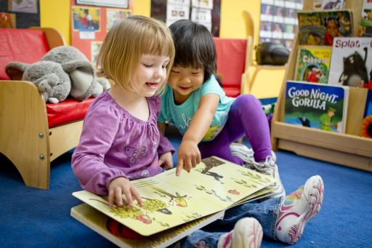
Improving Early Literacy
Timothy Shanahan
University of Illinois at Chicago
www.shanahanonliteracy.com

Slide 2
Purpose of Presentation
To provide a framework for thinking about the improvement of early literacy (PreK-3)
To provide a review of the major evidence-based findings from the public research reports

Slide 3
Learning is Individual
We learn through our own experiences (and when it comes to academic learning, the only thing that matters is our academic experiences)
The only actions that can enhance learning are actions that alter experiences in some way

Slide 4
There are 3 Aspects of Experience
Amount of experience (time)
Content of experience (curriculum)
Quality of experience (teaching)

Slide 5
Amount of Instruction
Research suggests that amount of instruction is the single most important alterable determinant of learning

Slide 6
Amount of Teaching
What evidence is there that amount of teaching/experience makes a difference?
Evidence of increases in learning due to increases in amount of instruction/academic experience is extensive, consistent, and overwhelming

Slide 7
Disparities in Early Vocabulary Experience
30 million word gap
1200
Professional Families
600
Working Class Families
Child’s Cumulative Vocabulary (Words)
Welfare
Families
200
16 mos.
24 mos.
36 mos.
Child’s Age (Months)
Source: Hart & Risley (2003)

Slide 8
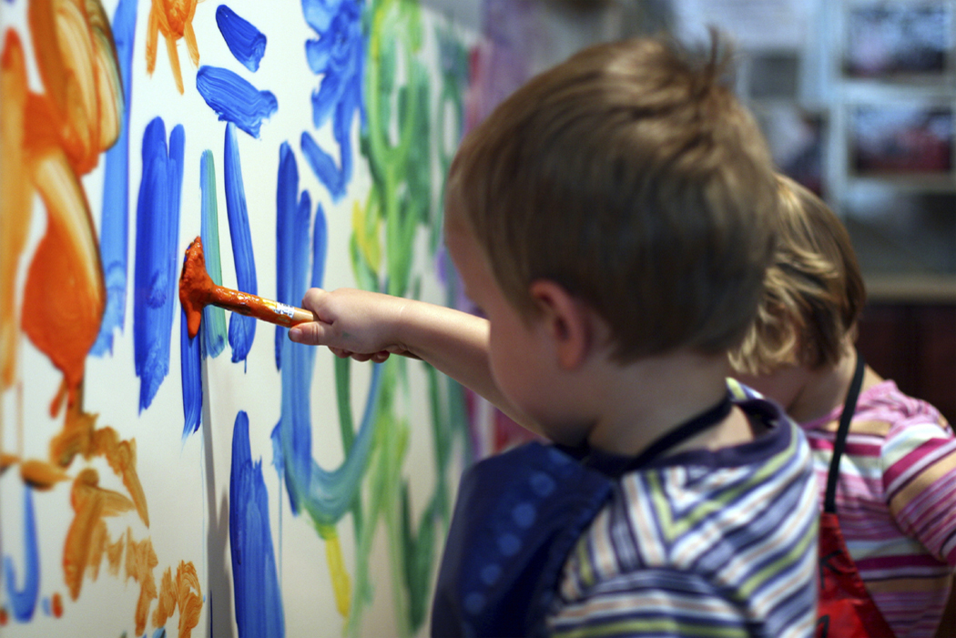
Effects of full-day kindergarten
Full-day kindergarten increases academic experience by about one month per year
Full-day kindergartens consistently outscore half-day kindergartens on achievement tests
Full-day kindergarten has stronger, longer lasting
benefits for children from
low-income families or with
few educational resources
prior to kindergarten.

Slide 9
Number of Instructional Days in School Year by Country
International Average = 193 School Days/Year
SOURCE: Trends in International Mathematics and Science Study (TIMSS) 2003

Slide 10

Extended school year
In a study in Chicago, extending the school year by 30 days led to increases in student learning in reading and math (Frazier & Morrison, 1998)
This study increased kindergarten by 30 days and raised reading achievement by about 1 full year in reading over comparison children

Slide 11

Use of School Day
Concept of Academic Learning Time (Fisher, Marliave, Filby, 1978)—big differences in the use of time from class to class
Beat the odds comparisons showed that effective teachers in grades K-3 keep students on task/engaged 96% of the time, students of less effective teachers only 63% (Taylor, 1999, 2006).
“Bell to bell” teaching (Mel Riddle)

Slide 12
Kennewick School
Annual Growth for All Students… Catch-up Growth for Those Who are Behind by Lynn Fielding, Nancy Kerr, and Paul Rosier
Tells of experiences in Kennewick, WA school that successfully raised reading achievement
They estimate that 60-80 minutes of reading instruction (per day/per year) will raise achievement one year
So, a youngster who enters 3rd grade 2 years behind in reading, will need about 240 minutes of instruction daily to catch up

Slide 13
Washington Elementary School
Growth in % of 3rd grade students meeting grade level standards
School Year
95 96 97 98 99 00 01 02 03 04 05 06
Percent at Grade level
57 72 72 68 78 94 96 99 94 98 99 98
Began providing intensive interventions in the afternoon to many students
Working harder and more effectively at 3rd grade
Result of improvement at both 2nd and 3rd Grade
Baseline year
Began testing in 2nd grade and focusing on earlier improvement

Slide 14
Carroll Model of Learning (1963)
Aptitude: how much time needed
Opportunity: how much time is provided
Perseverance: amount of time student is willing to devote to learning
Quality of instruction: lower the quality, the more time that is needed
Ability to understand: the harder instruction is to understand the more time that is needed

Slide 15
Other time data
Preschool
Absenteeism
After-school programs
Summer school programs
Snow days
Days with unplanned teacher absences

Slide 16
Content of Instruction
The second biggest determinant of school learning is content coverage—what we teach

Slide 17
What needs to be taught?
Teach those things that research has supported… what needs to be learned to make someone a reader?
Long lists of skills and standards…. Unwieldy, unmanageable...
Organize into clusters and divide the time roughly equally among them

Slide 18
Phonological Awareness
Phonological Awareness refers to the ability to hear and manipulate language sounds including word and syllable separations and the sounds within spoken words
Phonemic Awareness refers to the ability to hear and manipulate the smallest sounds within words (it is a part of Phonological Awareness)
PA is not phonics
Development of PA progresses from gross sounds (words, syllables) to finer-grained sounds (phonemes)
The instructional goal is to enable children to be able to easily and quickly fully segment the phonemes within words

Slide 19
Phonological Awareness (cont.)
National Early Literacy Panel (2008) reviewed nearly 70 studies showing that phonological awareness was a strong predictor of later reading achievement
PA remains a significant predictor even controlling for age, SES, alphabet knowledge, oral language, IQ, or prior decoding ability
NELP meta-analyzed approximately 50 studies finding that instruction in PA in pre-K and/or K (alone, combined with AK, combined with phonics) led to significant impacts on PA, AK, Reading, Spelling
Age/developmental level made no difference in the benefits of this kind of teaching, but what was taught varied (larger to smaller units)

Slide 20
Phonological Awareness (cont.)
NRP meta-analyzed more than 51 studies finding that phonemic awareness instruction in K, 1, and remediation led to significant improvements in phonemic awareness, decoding, reading comprehension, and spelling (NICHD, 2000)
NLP (2008) found that phonemic awareness instruction was beneficial for second-language students

Slide 21
Instruction of PA
Has to be done orally; students have to hear the sounds (not with text clues)
Brief intensive instruction
Instruction should emphasize 1-2 skills at a time
Progression is from grosser sounds to smaller sounds (words-syllables-phonemes)
Should be combined with alphabet instruction
Individual or small group

Slide 22
Phonological Awareness Skills
Word separation
Syllable segmentation
Onset/rime
Phoneme identity
Phoneme isolation
Phoneme blending
Phoneme segmentation
Phoneme addition
Phoneme substitution
Phoneme deletion

Slide 23
Examples of PA Skills
PA Skill | Example
Word separation | The---man---ran---up---the---hill.
Syllabic segmentation | Ti--mo--thy--Shan--a--han
Onset/rime | b—ig; m—an; r—ug; l--amb
Phoneme identity | ball, game, baby, bat
Phoneme isolation | p—an, pa—n
Phoneme blending | /p/-/a/-/n/
Phoneme segmentation | m/a/p, t/a/b/l
Phoneme addition | re, red, redea, redeam, redeams
Phoneme substitution | map, cap, pap, rap, sap—sam, sad, saf, sag
Phoneme deletion | Ready, read, re, r

Slide 24
Letters
Letter name knowledge is one of best predictors of later reading achievement (Adams, 1990; Hammill, 2004; Scarborough, 1998; Schatschneider, et al., 2004; National Early Literacy Panel, 2008)
Letter name knowledge is an important indicator of later reading disability (Gallagher, et al., 2000; O’Connor & Jenkins, 1999; Torppa, et al., 2006)
Alphabet knowledge remains significant even when controlling for age, SES, oral language, phonological awareness, or IQ (NELP, 2008)

Slide 25
Letters (cont.)
There are studies of the teaching of alphabet knowledge, but none of these studies have reading outcomes
However, studies suggest that letter name teaching in combination with phonological awareness or decoding is beneficial to reading achievement—and phonological awareness development is more rapid when letter names known (Kim et al, 2010)
Studies show the best letter name learning progress occurs when the instruction is combined with letter sounds (Piasta & Wagner, 2010) and that it is important to separate similar letters (visual and aural)

Slide 26
Phonics
Phonics refers to instruction aimed at teaching the alphabetic system of English; includes sound-symbol correspondences and the relationships between spelling patterns and pronunciations of words. Decoding from print to pronunciation.
There has long been controversy over phonics: the controversy is not whether students need to decode or not, just whether such instruction is needed to enable such decoding (Barr, 1972; Biemiller, 1970)

Slide 27
Phonics (cont.)
NELP examined 70 studies on decoding instruction (includes those PA studies noted earlier); found that such instruction in preschool and kindergarten had moderate to large impacts on students’ reading and spelling development and on various emergent literacy skills
NRP examined 38 studies on phonics instruction and found that such teaching in grades K-2 and with older remedial readers had a positive impact on decoding and fluency and on reading comprehension and spelling as well K-2.

Slide 28
Phonics (cont.)
NLP found explicit decoding instruction to be beneficial to English learners as well (though there are only a few studies with this population and the effect sizes were smaller than for native English speakers)
No point during these years when code-focused instruction is not beneficial to students (and the benefits appear to be long lasting)

Slide 29
Phonics (cont.)
Effective phonics instruction was explicit and systematic
Multiple years of phonics instruction were better than single years
Virtually all programs of phonics work with young children (NRP, WWC)—however, thoroughness matters
No single phonics sequence did better than any other
Phonics instruction should include lots of opportunity for students to decode and encode words
Important to develop a “mental set for diversity”

Slide 30
Phoneme-Grapheme Correspondences
Phoneme | Word Examples | Common spellings
/p/ | pit, spider, stop | p
/b/ | bit, brat, bubble | b
/m/ | mitt, comb, hymn | m, mb, mn
/t/ | tickle mitt, sipped | t, tt, ed
/d/ | die, loved | d, ed
/n/ | nice, knight, gnat | n, kn, gn
/k/ | cup, kite, duck, chorus, folk, quiet | k, c, ck, ch, lk, q
/g/ | girl, Pittsburgh | g, gh
/ng/ | sing, bank | ng, n
/f/ | fluff, sphere, tough, calf | f, ff, ph, lf
/v/ | van, dove | v, ve
/s/ | sit, pass, science, psychic | s, ss, sc, ps

Slide 31
Phoneme-Grapheme Correspondence
Phoneme | Word Examples | Common spellings
/z/ | zoo, jazz, nose, as, xylophone | z, zz, se, s, x
/th/ | thin, breath, ether | th
/th/ | this, breathe, either | th
/sh/ | shoe, mission, sure, charade, precious, notion, mission, special | sh, ss, s, ch, sc, ti, si, ci
/zh/ | measure, azure | s, z
/ch/ | cheap, future, etch | ch, tch
/j/ | judge, wage | j, dge, ge
/l/ | lamb, call, single | l, ll, le
/r/ | reach, wrap, her, fur, stir | r, wr, er/ur/ir
/y/ | you, use, feud, onion | y (u, eu), i
/w/ | witch, queen | w, (q)u
/wh/ | where | wh
/h/ | house, whole | h, wh

Slide 32
Phoneme-Grapheme Correspondence
Phoneme | Word Examples | Common spellings
/ē/ | see, these me, eat, key, happy, chief, either | ee, e__e, -e, ea, ey, -y, ie, ei
/ĭ/ | sit, gym | i, y
/ā/ | make, rain, play, great, baby, eight, vein, they | a__e, ai, ay, ea, -y, eigh, ei, ey
/ě/ | bed, breath | e, ea
/ă/ | cat | a
/ī/ | time, pie, cry, right, rifle | i__e, ie, -y, igh, -i
/ŏ/ | fox, swap, palm | o, wa, al
/ŭ/ | cup, cover, flood, tough | u, o, oo, ou
/aw/ | saw, pause, call, water, brought | aw, au, all, w, ough
/ō/ | vote, boat, toe, snow, open | o_e. oa, oe, ow, o-
/ŏŏ/ | took, put, could | oo, u, ou
/ū/ [ōō] | moo, tube, blue, chew, suit, soup | oo, u_e, ue, ew, ui, ou

Slide 33
Phoneme-Grapheme Correspondence
Phoneme | Word Examples | Common spellings
/y/ /ū/ | use, few, cute | u, ew, u_e
/oi/ | boil, boy | oi, oy
/ow/ | out, cow | ou, ow
/er/ | her, fur, sir | er, ur, ir
/ar/ | cart | ar
/or/ | sport | or

Slide 34
Syllable Patterns
Syllable type | Definition | Examples
Closed | Syllable with short vowel spelled with a single vowel letter ending in one or more consonants | dap-ple, hos-tel, bev-erage
Vowel-C-e (Magic e) | Syllable with a long vowel spelled with one vowel + one consonant + silent e | com-pete, -des-pite
Open | Syllable that ends with a long vowel sound, spelled with single vowel letter | pro-gram, ta-ble, re-cent
Vowel team | Syllables that use 2-4 letters to spell the vowel | beau-ti-ful, train-er, con-geal, spoil-age
Vowel-r (r-controlled) | Syllable with er, ir, or ur | in-jur-ious, con-sort, char-ter
Consonant-le | Unaccented final syllable containing a consonant before /l/ followed by a silent e | drib-ble, bea-gle, lit-tle

Slide 35
High frequency words
Words differ in their frequency in the language (some words are used a lot and others appear rarely)
In English, the 300 most frequent words in the language (and their derivations) make up about 75% of all the words one sees in texts—it can be useful to know these words especially well
Also, the origins of our language are complex: the alphabetic properties of English are complex—this is particularly true of some of the most common words in the language (e.g., the, of, where); can be easier to memorize these rather than decoding them

Slide 36
High frequency words (cont.)
Sight vocabulary refers to words that someone can read “as if” they were not decoding—appears like they are effortlessly pulling them back from memory and recognizing them as a whole
Given the value of high frequency words it would make sense that students learn these as “sight words”
However, the story is more complex than that—student memory for words is highly dependent upon decoding (phonics makes words “stickier”); sight vocabulary is to a great degree an outcome of decoding (Ehri, 2005)

Slide 37
High frequency words (cont.)
Teaching sight vocabulary can improve fluency and comprehension (Griffin & Murtagh, 2015)
Teach words by focusing attention on the order of letters (not mnemonics, pictures, etc.) and work with them both in isolation—interval training—and in context (Browder & Lalli, 1991; Fossett & Mirenda, 2006)

Slide 38
High frequency words (cont.)
Texts used in K-1 should include decodable text along with high frequency words
Direct work on memorizing words should be minimal (lots of programs are overdoing this now)
My goal: 100 most frequent words by end of Grade 1, and 300 most frequent by end of Grade 2

Slide 39
the | for | from | when | their
of | on | or | your | if
and | are | one | can | will
a | as | had | said | up
to | with | by | there | other
in | his | word | use | about
is | they | but | an | out
you | I | not | each | many
that | at | what | which | then
it | with | all | she | them
he | his | were | do | these
was | have | we | how | so

Slide 40
some | write | been | made
her | go | call | may
would | see | who | part
make | number | oil | over
like | no | now
him | way | find
into | could | long
time | people | down
has | my | day
look | than | did
two | first | get
more | water | come

Slide 41
Oral Reading Fluency
Oral reading fluency refers to the ability to read text accurately, quickly, and with proper expression
National Reading Panel reviewed 52 studies and found that oral reading fluency instruction improved decoding, word reading, fluency, and reading comprehension in Grades 1-4 and with remedial students Grades 1-12
Fluency is best predictor of reading comprehension in lower grades (2nd: 73% of comprehension variance explained by fluency; this declines to 25% by grade 8)

Slide 42
Oral Reading Fluency (cont.)
NLP found that oral reading fluency was important with second-language learners, too
Effective instruction engaged kids in oral reading with feedback and repetition and with texts that were relatively difficult
Instructional approaches like paired reading, repeated reading, reading while listening, neurological impress, etc. worked
ORF is a bit of a mash up of fast decoding and initial reading comprehension

Slide 43
Vocabulary
National Reading Panel reviewed 45 studies and found that direct instruction in words and/or the meaningful parts of words (morphology) has a positive impact on reading comprehension (studies from grades 1-12)
NLP studies showed the special importance of vocabulary to second-language learners: effect size is bigger
Vocabulary has the opposite relationship with reading comprehension as fluency (vocabulary explains a small amount of comprehension in the early grades, but this increases as students progress)

Slide 44
Vocabulary (cont.)
Effective instruction is explicit, implicates oral and written language, rich/thorough, focused on relationships among words, personalization, and with adequate ongoing review
Kids learn a lot of words indirectly too (from reading, listening to reading, media, etc.)

Slide 45
Reading Comprehension
National Reading Panel reviewed 204 studies of reading comprehension strategy instruction (K-12)
What Works Clearinghouse (Shanahan, Carlson, Carriere, Duke, et al., 2010) concluded that reading comprehension strategy instruction was effective with students in the primary grades
WWC also determined that “gradual release of responsibility” instruction was an effective method for improving reading comprehension with primary grade students

Slide 46
Reading Comprehension (cont.)
Effective instruction focuses on summarization, questioning, monitoring, visualization, and/or story mapping
Multiple strategies are most effective (such as in reciprocal teaching)
Gradual release of responsibility has strong supporting research evidence (WWC)
Moderate evidence (WWC) supporting the role of motivation in comprehension instruction (choice, collaboration, challenge, control)

Slide 47
Writing
Writing—the ability to communicate one’s ideas effectively through written/printed words
Writing is important in its own right
Emphasis here is on the value that writing has to reading achievement

Slide 48
Writing (cont.)
Writing and reading are closely correlated (Shanahan, 2016)
Reading and writing can explain about 75% of the variation in each other
Magnitude of relationships are consistent from grade level to grade level, but the nature of relations change (decoding and spelling overlap more in the early grades, and writing structure/vocabulary and reading comprehension connect more later on)

Slide 49
Writing (cont.)
Graham & Hebert, 2010 meta-analyzed more than 100 studies that looked at impact of writing on reading comprehension and learning from text
93% of the effects were positive and statistically significant
Writing about text had a bigger impact on learning than reading, reading and rereading, reading and discussing

Slide 50
Summary of Content
Research shows clear causal relationship between teaching the following and reading achievement:
Phonological awareness (including letters)
Phonics (including sight words)
Oral Reading Fluency
Vocabulary
Reading comprehension strategies
Writing

Slide 51
Anything Else?
No other content has this kind of evidence (large numbers of experimental studies showing clear benefits from being taught this information/skill)
However, there are two other areas that seem very promising: oral language development, content/world/domain knowledge

Slide 52

Quality of Instruction
There are quality factors in teaching as well—and they too can have an impact on achievement

Slide 53
Quality of Instruction
Only a negative definition of this
Instructional features that influence learning without increasing amount of instruction or altering the content to be taught

Slide 54
Quality of Instruction (cont.)
Clear purposes
Amount of reading/language use within lessons
Thoroughness/intensity of instruction
Amount of interaction
Depth of information
Quality of explanation
Motivation

Slide 55
If you want to improve reading…
Make sure kids get a lot of teaching and experience
Make sure the right things are being taught
Make sure the instruction is good

