Slide 1
Evidence-Based Literacy Improvement Timothy Shanahan www.shanahanonliteracy.com @ReadingShanahan

Slide 2
Literacy is important
It matters that our kids learn to read and write well

Slide 3
Literacy Matters
Economics
Literacy attainment explains 55% of the economic growth in nations (Coulombe, Trembley, & Marchand, 2004)
Second-grade literacy explains economic success of individuals at age of 42 (Ritchie & Bates, 2013)

Slide 4
Literacy Matters
Health
Reading is associated to extended lifespan (Levy, 2016) probably because it improves cell interconnectivity
Reading reduces stress by 68% (Lewis, 2009)
Reading slows cognitive decline (Wilson, et al., 2019)

Slide 5
Literacy Matters
Civics
Low readers are less apt to be knowledgeable of issues, candidates and current events (Venezky, et al., 1987)
Literacy rate affects voting rate (Rodriguez, 2014)

Slide 6
Literacy Matters
Social Participation
Reading helps individuals to recognize the mental states of others (Kidd & Castano, 2013)
Reading improves empathy (Castano, 2013)

Slide 7
Our kids do not read well

Slide 8
Reading Proficiency in Ohio

Slide 9
How do we decide how to respond to Ohio reading needs?

Slide 10
What is the source of our educational practices?
Use

Slide 11
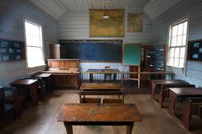
Tradition– we may do things the way we always have

Slide 12
Published programs– we do it if our district bought it

Slide 13
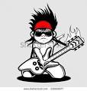
Authority– we do it if a guru says to do it

Slide 14
Fads– we do it if everybody else is doing it

Slide 15
Inspiration– we do it if it feels right

Slide 16
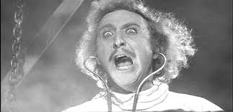
Research– we do what can be proven to help kids learn

Slide 17
Why research is best? What Research is best?

Slide 18
Why research?
We are all capable of learning from experience
But we all suffer from narrow perspective, wishful thinking, and opportunity cost
Research provides us with the tools to know things that go beyond our experience
Research allows us to advance in socially acceptable way

Slide 19
Which research?
Reading Wars of 1990s
Not all research is equal
Federal response was to put in place several supports in place for schools to ensure that they could and would use research
Definition of research and evidence-based practice
Research panels
What Works Clearinghouse

Slide 20
Evidence-based practice
Evidence-based practices are those “effective educational strategies supported by evidence and research” (ESEA)
Essentially the instructional practice has a sound record of success
This record of success is valid and reliable
Educational practices should be based upon appropriate, sound, accumulation of research

Slide 21
Research
Research does not refer to anything that is published
Research requires the collection and analysis of data in a systematic, rule-based way
Research is published through a refereeing system
Nevertheless, not all research is equal—there are differences in appropriateness to particular claims and quality

Slide 22
Appropriateness of Research
There are different kinds of research and they answer different kinds of questions
Descriptive studies describe
Correlational studies relate
Experimental studies identify causal relationships
Claims should match the nature of evidence

Slide 23
Sound Research
Objective—data that any evaluator would identify and interpret similarly
Valid—data that adequately represent the tasks that children need to accomplish to be successful readers
Reliable—data will remain essentially unchanged if collected on a different day or by a different person
Systematic—data that were collected according to a rigorous design of either experimentation or observation
Refereed—data that have been approved for publication by a panel of independent reviewers

Slide 24
Accumulation of research
Most educational experiments are small
Replication is essential to getting it right
Education studies vary in many ways
Unfortunately, this can encourage cherry-picking (“you can prove anything with research”)
Research synthesis (especially meta-analysis) has become the accepted way to scientifically combine studies

Slide 25
Meta-analyses
Collection of methods used to identify and combine studies into synthesis
Meta-analysis actually combines the data from multiple studies in a way that properly weights the contribution of each
Allows for a systematic accounting of the differences in findings and for dealing with flaws in original researcher
Leads to consistency of conclusions

Slide 26
Some Evidence worth paying attention to

Slide 27
Preventing Reading Difficulties
National Research Council appointed a group of literacy experts to provide research-based recommendations on how to address early literacy
They issued a report in 1998 focused on preschool, kindergarten, and primary grade reading instruction and support

Slide 29
COMMITTEE ON THE PREVENTION OF READING DIFFICULTIES IN YOUNG CHILDREN
CATHERINE SNOW (Chair), Graduate School of Education, Harvard University, Chair
MARILYN JAGER ADAMS, Bolt, Beranek, and Newman Inc., Cambridge, Massachusetts
BARBARA T. BOWMAN, Erikson Institute, Chicago, Illinois
BARBARA FOORMAN, Depart of Pediatrics, University of Texas, and Houston Medical School
DOROTHY FOWLER, Fairfax County Public Schools, Annandale, Virginia
CLAUDE N. GOLDENBERG, Department of Teacher Educ, California State University, Long Beach
EDWARD J. KAME'ENUI, College of Education, University of Oregon, Eugene
WILLIAM LABOV, Department of Linguistics and Psychology, University of Pennsylvania
RICHARD K. OLSON, Department of Psychology, University of Colorado, Boulder
ANNEMARIE SULLIVAN PALINCSAR, School of Education, University of Michigan, Ann Arbor
CHARLES A. PERFETTI, Department of Psychology, University of Pittsburgh
HOLLIS S. SCARBOROUGH, Brooklyn College, City University of New York, and Haskins Laboratories, New Haven, Connecticut
SALLY SHAYWITZ, Department of Pediatrics, Yale University
KEITH STANOVICH, Ontario Institute for Studies in Education, University of Toronto
DOROTHY STRICKLAND, Graduate School of Education, Rutgers University
SAM STRINGFIELD, Center for the Social Organization of Schools, Johns Hopkins University
ELIZABETH SULZBY, School of Education, University of Michigan, Ann Arbor

Slide 30
National Reading Panel
In 1998, Congress asked for a review of what works in reading instruction
U.S. Department of Education and the National Institute of Child Health and Human Development appointed a panel
Panel reviewed more than 500 studies on reading instruction (K-12)

Slide 32
National Reading Panel
Donald Langenberg, University of Maryland, Chair
Gloria Correro, Mississippi State University
Linnea Ehri, City University of New York
Gwenette Ferguson, Houston Public Schools
Norma Garza
Michael L. Kamil, Stanford University
Cora Bagley Marrett, University of Massachussetts-Amherst
S.J. Samuels, University of Minnesota
Timothy Shanahan, University of Illinois at Chicago
Sally E. Shaywitz, Yale University
Thomas Trabasso, University of Chicago
Joanna Williams, Columbia University
Dale Willows, University of Toronto
Joanne Yatvin, Portland State University

Slide 33
National Early Literacy Panel
National Early Literacy Panel (2003-2008) reviewed research on the teaching of reading in preschool and kindergarten
Largest meta-analysis of research data on the teaching of reading during these years (examined 400-500 studies)
Set out to determine which skills needed to be taught early on and what confers literacy learning advantages to young children

Slide 34
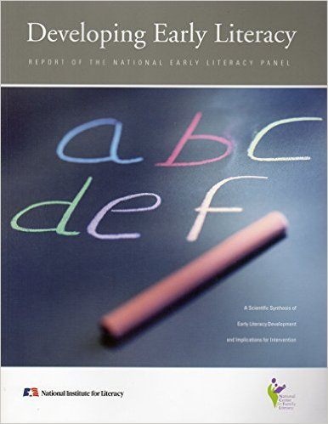

Slide 35
National Early Literacy Panel
Timothy Shanahan, University of Illinois at Chicago, Chair
Anne Cunningham, University of California Berkeley
Kathy C. Escamilla, University of Colorado
Janet Fischel, State University of New York at Stony Brook
Susan Landry, University of Texas Health Science Center at Houston
Christopher J. Lonigan, Florida State University
Victoria J. Molfese, University of Louisville
Chris Schatschneider, Florida State University
Dorothy Strickland, Rutgers University

Slide 36
National Literacy Panel for Language Minority Children and Youth
National Early Literacy Panel (2003-2006) reviewed research on the teaching of reading to children (ages birth to 18) from language minority families
Largest analysis of research data on the teaching of reading during this population
Set out to make a wide range of determinations concerning what facilitates the English-langauge literacy learning of non-English speakers (including young children)

Slide 37
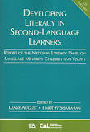

Slide 38
National Panel for Language Minority Children and Youth
Timothy Shanahan, University of Illinois at Chicago, Chair
Diane August, Center for Applied Linguistics
Isabel L. Beck, University of Pittsburgh
Margarita Calderón, Johns Hopkins University
David J. Francis, University of Houston
Georgia Earnest García, University of Illinois at Urbana-Champaign
Fred Genesee, McGill University
Esther Geva, University of Toronto
Claude Goldenberg, California State University, Long Beach
Michael L. Kamil, Stanford University
Keiko Koda, Carnegie Mellon University
Gail McKoon, Ohio State University
Robert S. Rueda, University of Southern California
Linda S. Siegel, University of British Columbia

Slide 39
What Works Clearinghouse
U.S. Department of Education
Panels of experts assembled based on particular topics
Panels can make any recommendations that they choose, but WWC evaluates supporting research and indicates the strength of the underlying evidence

Slide 41
What Works Clearinghouse Panelists (sample)
Carol Connor, Florida State University
Janice Dole, University of Utah
Nell Duke, Michigan State University
Jill Fitzgerald, University of North Carolina
Barbara Foorman, Florida State University
Steve Graham, Arizona State University
Laura Justice, Ohio State University
Michael L. Kamil, Stanford University
James Kim, Harvard University
P. David Pearson, University of California, Berkeley
Timothy Shanahan, University of Illinois at Chicago
Joe Torgesen, Florida State University

Slide 42
Review of Educational Research

Slide 43
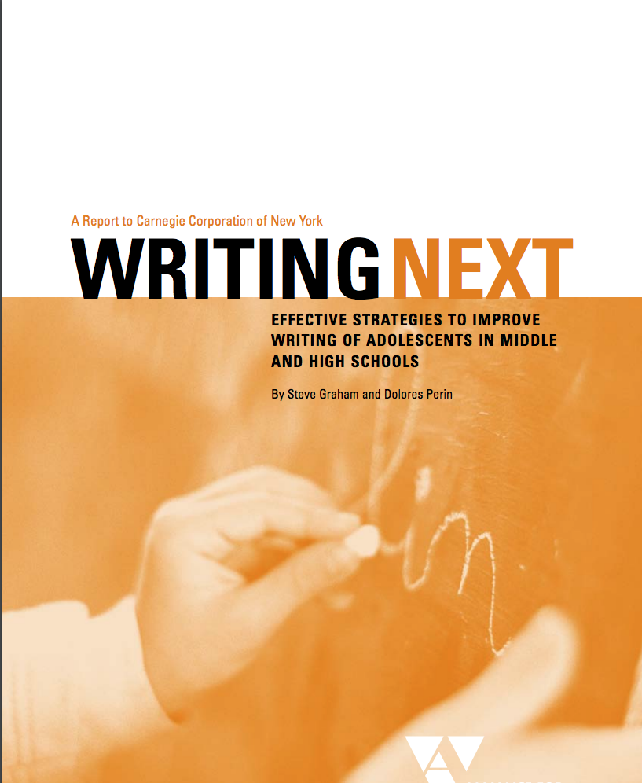
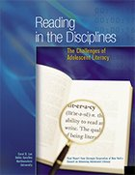
Carnegie Corporation

Slide 44
John Hattie

Slide 45
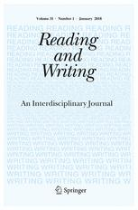
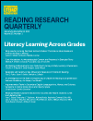
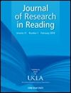
Other highly ranked reading research journals

Slide 46
Basic findings

Slide 47
Key research findings on literacy
Phonemic awareness
Phonics
Oral reading fluency
Vocabulary
Reading comprehension strategies
Writing

Slide 48
One big caveat

Slide 49
Limits of evidence-based teaching
Evidence-based does not mean that something will work
It only means that it has worked
And accumulations of research mean that it has worked over and over
There are no automatic gains in education
Quality supervision, sufficient amounts of instructional time, high quality well prepared teachers, supportive parents, and our daily commitment to meeting the literacy needs of our students is needed to make any “evidence-based” approach work

Slide 50
Summary
It is essential that we improve reading achievement
The most certain and professional way to accomplish that goal is through a reliance on accumulations of the best existing research
We need to teach PA, phonics, fluency, comprehension, and writing
But evidence-based approaches give us no excuse to relax in our commitment to providing the most intensive and supportive teaching that we can provide

