Slide 1
What Does Rigor Really Mean in Reading Education?
Timothy Shanahan
University of Illinois at Chicago
www.shanahanonliteracy.com

Slide 2
Dissatisfaction with Education
NAEP scores
International comparisons
College faculty polls
Employer polls
Military recruitment problems

Slide 3
Calls for Rigor
School Reform Groups
U.S. Department of Education
Common Core State Standards

Slide 4
Definitions of Rigor
Merriam-Webster:
Harsh inflexibility in opinion, temper, judgment (severity)
The quality of being unyielding, inflexible (strictness)
Severity of life (austerity)

Slide 5
How Rigor Plays Out in Reading
Weekly or biweekly testing
Teaching large numbers of sight words to beginners
Fast phonics
Lots of homework
Teaching the standards
Harder and more

Slide 6
Problems with Rigor
All of these examples show teachers requiring that students do more or do harder things
But in none of these examples is there any certainty or likelihood that kids will learn anymore than they do now

Slide 7
What Would Rigor Really Look Like?

Slide 8
Harder… But with Guidance
Text complexity
Recognition that comprehension skills are meaningless outside of the context of particular levels of text complexity
Students can apply almost any comprehension skill in a simple text, and almost none in a sufficiently complex text
Reading ability is more related to the texts that can be read than to the skills which can be applied

Slide 9
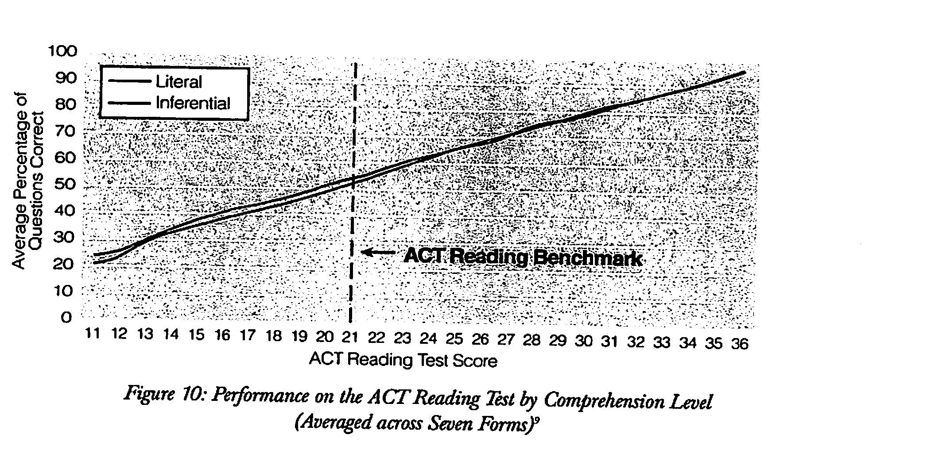
No performance differences due to question types (skills)

Slide 10
No performance differences due to question types (cont.)

Slide 11
Texts affect reading performance

Slide 12
Reconceptualizing Reading
Reading is not the ability to answer certain kinds of questions
Reading is the ability to make sense of ideas expressed in text—the ability to negotiate the linguistic and conceptual barriers or affordances of a text

Slide 13
Texts Are Getting Harder
Since 2010 all/most publishers have started making their Reading/ELA textbooks markedly harder from grades 2-12
Even non-textbook approaches like Guided Reading have started to match kids to harder books (despite their basic premise that students should be in books that “match their reading levels”)
Harder texts included in online teacher lesson plan sharing websites like Teachers Pay Teachers

Slide 14
Standards assign higher difficulty levels in grades 2-12
ATOS, Degrees of Reading Power, Flesch-Kincaid, Lexiles, Reading Maturity, Source Reader
Set higher than in the past” (75-89% comprehension to ???)
Grades | Lexile Bands | CCSS Bands
K-1 | N/A | N/A
2-3 | 450L-730L | 420L-820L
4-5 | 640L-850L | 740L-1010L
6-8 | 860L-1010L | 925L-1185L
9-10 | 960L-1120L | 1050L-1335L
11-CCR | 1070L-1220L | 1185L-1385L

Slide 15
Problems
Many administrators think they have solved the reading rigor problem by adopting new textbooks or by requiring that particular Lexile levels of text be used
The texts are harder so the kids will learn more
But is that how it really works?

Slide 16
Four Common Classroom Responses to Text Difficulty
Move students to easier text (so called “instructional level”)
Read text to students (communicates the information, but doesn’t increase student reading ability)
Tell students what texts say (same as reading to kids in its impact)
Ignore the problem (more drawbacks than the previous approaches)

Slide 17
But That Won’t Work!

Slide 18
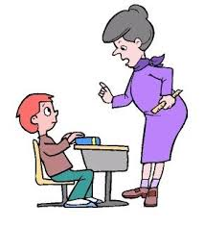
Need for Scaffolding
Many administrators believe they have solved the rigor problem by purchasing textbooks that have higher Lexiles than in the past
But if teachers do not know how to scaffold student reading with these harder books—without reading the texts to the students or telling them what the book say—then learning will not be the result

Slide 19
Substantial Evidence
Bonfiglio, Daly, Persampieri, & Andersen, 2006
Burns, 2007
Burns, Dean, & Foley, 2004
Carney, Anderson, Blackburn, & Blessings, 1984
Daly & Martens, 1994
Eckert, Ardoin, Daisey, & Scarola, 2000
Faulkner & Levy, 1999
Gickling & Armstrong, 1978
Hall, Sabey, & McClellan, 2005

Slide 20
Substantial Evidence (cont.)
Levy, Nicholls, & Kohen, 1993
McComas, Wacker, & Cooper, 1996
Neill, 1979
O’Shea, Sindelar, & O’Shea, 1985
Pany & McCoy, 1988
Rasinski, 1990
Reitsma, 1988
Rose & Beattie, 1986
Sanford & Horner, 2013

Slide 21
Substantial Evidence (cont.)
Sindelar, Monda, & O’Shea, 1990
Smith, 1979
Stoddard, Valcante, Sindelar, O’Shea, et al., 1993
Taylor, Wade, & Yekovich, 1985
Turpie & Paratore, 1995
VanWagenen, Williams, & McLaughlin, 1994
Weinstein & Cooke, 1992
Wixson, 1986

Slide 22
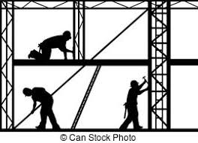
Scaffolding Challenging Text
Scaffolding Text Features
Complexity of ideas/content
Match of text and reader prior knowledge
Complexity of vocabulary
Complexity of syntax
Complexity of coherence
Familiarity of genre demands
Complexity of text organization
Subtlety of author’s tone
Sophistication of literary devices or data-presentation devices

Slide 23
Scaffolding Challenging Text
Other Approaches
Provide sufficient fluency
Use stair-steps or apprentice texts
Teach comprehension strategies
Motivation

Slide 24
Scaffolding Resources
Shanahan, T., Fisher, D., & Frey, N. (2012), March. The challenge of challenging text. Educational Leadership.
Shanahan, T. (2013). Letting the text take center stage. American Educator.

Slide 25
Not necessarily more… But more thorough
In the name of rigor, many programs are increasing the numbers of sight words that they are teaching—particularly in kindergarten
Another manifestation is to accelerate phonics learning—fast phonics
The idea is that these efforts will make kids better readers earlier in the past

Slide 26
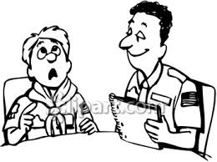
But is that how it really works?
Sight vocabulary refers to words that someone can read without obvious mediation
Sight vocabulary appears to be recognized rather decoded
Sight vocabulary learning initially depends upon rote memorization, and tends to focus heavily on high frequency words
Expanding the amount of sight vocabulary that we try to teach shifts early reading from being mainly about decoding to being more about memorization

Slide 27
Sight Vocabulary
National Academy of Sciences (1998) concluded that kindergartners should be expected to learn about 15-20 words (including their names)
And at Grade 1, students should master the hundred most frequent words, along with being able to decode perhaps another 400-500
Analysis suggests that even supposedly non-decodable words are at least partially decodable and that decoding progress seems to speed sight vocabulary acquisition

Slide 28
50 Most Frequent Words
the you are be by we an if
of that as this words when each
and it with have but your which
a he his from not can she
to was they or what said do
in for at one all there how
is on it had were use their

Slide 29
Phonetically Regular Words
the you are be by we an if
of that as this words when each
and it with have but your which
a he his from not can she
to was they or what said do
in for at one all there how
is on it had were use their

Slide 30
Phonetically Regular Word Parts
the you are be by we an if
of that as this words when each
and it with have but your which
a he his from not can she
to was they or what said do
in for at one all there how
is on it had were use their

Slide 31
Decoding, Not Memorization
Instead of having kindergartners memorizing 92 words, the rigorous approach would be to limit this to a much smaller number of words
With a substantial investment in early decoding instruction
Getting little ones to memorize large numbers of words is not rigorous, it is a distraction from real rigor

Slide 32
But Not “Fast Phonics”
A related idea about early rigor is to speed up the phonics sequence
The National Reading Panel (2000) found that teaching phonemic awareness in K-1 and phonics in Grades K-2 improved decoding, fluency, spelling, and reading comprehension
NRP found 3 years of phonics to be more beneficial than 2 years of phonics
Phonics programs teach a small number of sound-symbol relations/spelling patterns— the issue is whether to intro them fast or teach them thoroughly

Slide 33
Aggressive, But Intelligently Aggressive
Studies show that young children who fail to progress well in early reading learning continue to lag academically
Consequently, a number of measures have been developed to allow for monitoring of early literacy skills (e.g., DIBELS, TPRI, PALS, AIMSweb)
In the name of rigor, many districts/schools/states have mandated frequent testing in the primary grades

Slide 34
But does that make sense?
The idea certainly sounds rigorous: monitor student learning closely, so that no one slips through the cracks
Test kids weekly and you’ll always no how they are progressing, right?
Unfortunately, assuming perfectly reliable tests does not make them perfectly reliable
In many fields (e.g., nutrition, investing), early or frequent assessment appears to cause more problems than it solves—and the same is true with early reading assessment

Slide 35
Standard Error of Measurement
All tests, including early reading monitors, have standard errors of measurement (SEM)
Tests do not arrive at a “true score” but an approximate score
If students were tested repeatedly—with no learning or forgetting—the scores would change
You need to pay attention to normal rate of growth in the tested skill and the SEM of the test—in most cases, you’ll find that you can’t test usefully more than 2-4 times per year

Slide 36
Local Norms
If you really want to be rigorous in this early testing, use your data to develop local norms
Each of these tests has target or cut scores that are supposed to indicate that students are on-track to succeed
But that is on average… how is it working in your district?
Analyze your data and adjust those cut-scores so that you are increasing educational opportunity for students who are likely to fail in your system

Slide 37
Rigor is Not about Making Instruction Look Like a Test
Many schools have attempted to improve achievement by focusing teaching on what will be tested
For example, writing tends not to get as much emphasis as reading when it comes to testing—so principals often want teachers to prioritize reading over writing

Slide 38
Writing to Comprehend
Graham & Hebert (2010) reviewed more than 100 studies
Writing about text improves comprehension and learning from text (more than 93% of the outcomes were positive)
Writing about text was more powerful than just reading
Writing about text was more powerful than reading and rereading
Writing about text was more powerful than reading and discussing

Slide 39
Why we learn from writing
Writing about text is effective because it encourages deeper thinking about ideas
Requires students to draw on their own knowledge and experience
Helps them to consolidate and review information
Inspires the reformulation of thinking
Requires the organization and integration of ideas
Fosters explicitness
Facilitates reflection
Encourages personal involvement
Requires translation into one’s own words

Slide 40
Writing about Text
Engage students in writing
To text models
Summaries
Analysis and critique
Synthesis

Slide 41
What About Eternal Verities?
Encouraging use of and growth in students’ oral language.
Teaching vocabulary.
Focusing attention on meaning prior to, during, and after reading.
Guiding students to connect text with prior knowledge.
Teaching students to use reading comprehension strategies.
Building world/domain/content knowledge.
Focusing on higher order thinking.

Slide 42
Title I Study
Despite the rhetoric, how focused on rigor are we?
U.S. Department of Education study released earlier this year
We conducted 4 half-days of observation in more than 1000 preschool and primary grade classrooms
We identified Title I schools that consistently scored relatively high in reading along with randomly selected Title I schools from the same districts

Slide 43
How often did these take place?
Allowed adequate wait time .76
Asked open-ended questions .68
Had students speak with partners .03
Had students speak with peers (<4 mins) .08
Had students speak with peers (>4 mins) .04
Students wrote 1 sentence or more .15
Students wrote about text content .05
Teachers asked questions .80

Slide 44
How often did these take place? (cont.)
Pre-reading talked about text content .26
Pre-reading talked about reading strategies .04
Pre-reading talked about vocabulary .05
During reading, talked about text content .33
During reading, talked about reading strategies .06
During reading talked about vocabulary .10
After reading, talked about text content .16
After reading, talked about reading strategies .03
After reading, talked about vocabulary .03

Slide 45
How often did these take place? (cont.)
Number of minutes focused on world knowledge (about 3.6 minutes out of 15)
Number of minutes focused on higher level thinking (about 2.4 minutes out of 15)

Slide 46
Title I Study Findings
Those behaviors are related to growth in reading comprehension and oral language development
But most of those behaviors are rare in our classrooms

Slide 47
Conclusions
If you really want to be rigorous...
It is fine to teach things that are harder, but provide adequate and appropriate guidance
Rigor doesn’t always mean more, but more thorough (hurrying through a lot of skills is not rigorous)
Be aggressive about kids’ learning, but intelligently rigorous (the idea is to be aggressive not to look aggressive)
Don’t be so focused on test outcomes that you neglect writing, social studies, and science

Slide 48
Conclusions (cont.)
If you really want to be rigorous...
Build oral language and teach vocabulary
Emphasize the mastery of world knowledge
Engage kids in higher order thinking
Emphasize meaning before, during, and after reading
Help kids connect content with their own knowledge
Teach students to use comprehension strategies

Slide 49
What Does Rigor Really Mean in Reading Education?
Timothy Shanahan
University of Illinois at Chicago
www.shanahanonliteracy.com

