Slide 1
Literacy in Social Studies
Cynthia Shanahan
University of Illinois at Chicago
chynd@uic.edu
312-593-3698

Slide 2
We want students to read like the experts,
BUT
There are many experts in social studies

Slide 3
Who are the experts?
Economists
Political Scientists
Geographers
Psychologists
Sociologists
Historians
Linguists
Anthropologists
Archaeologists
Philosophers
Etc.

Slide 4
Social Studies….
Is a fairly recent development (about 1930) that is based upon what is taught in school rather than what a particular field might study.
It is a combination of a number of different fields.

Slide 5
So, what’s the problem?
The experts in each of these fields have somewhat different epistemological understandings, purposes, methods, knowledge bases, and, hence, communication practices.
In order to read like experts, students taking social studies need to be able to change the way they read depending upon type of information they are studying at the moment.

Slide 6
Ten Themes of social studies
Culture
Time, Continuity, and Change
People, places, and environments
Individual development and identity
Individuals, groups, and institutions
Power, authority, and governance
Production, distribution, and consumption
Science, technology, and society
Global connections
Civic ideas and practices

Slide 7
In today’s secondary schools
Social Science takes into account mainly these fields:
  Economics/Finance
  Geography (e.g. World Geography)
  Civics (Government)
  History (World History; US History)
Other areas are considered within the lenses of these fields, such as
  Art/culture
  Religion
  Technology
  Anthropology

Slide 8
Can you tell which field this text is from? What characteristics do you notice?
Rapid land use change has taken place in many coastal regions of China such as the Zhujiang Delta over the past two decades due to accelerated industrialization and urbanization. In this paper, land use change dynamics were investigated by the combined use of satellite remote sensing, geographic information systems (GIS), and stochastic modelling technologies. The results indicated that there has been a notable and uneven urban growth and a tremendous
loss in cropland between 1989 and 1997. The land use change process has shown no sign of becoming stable. The
study demonstrates that the integration of satellite remote sensing and GIS was an effective approach for analyzing the
direction, rate, and spatial pattern of land use change. The further integration of these two technologies with Markov
modelling was found to be beneficial in describing and analyzing land use change process. full text G
Notes:
Use of graphic elements (in full text), specialized vocabulary, nominalizations (land use change process; satellite remote sensing; land use change dynamics; Markov modeling). This is, essentially, science text. Language is tightly knit. Readers have to understand relationships that are implicit and have to integrate words and graphic elements for a full understanding of the information.

Slide 9
Geographers
Describe the physical features of the earth and atmosphere and how they affect and are affected by humans (e.g. distribution of populations, resources, land use, and industries.
Information is multimodal, as in science.
Information is tightly packed, as in science.
There is lots of specialized vocabulary, as in science
Like in economics and science, information can be studied statistically. But interpretation of data requires judgment.

Slide 10
Geography text
Information is multimodal, as in science.
Information is tightly packed, as in science.
There is lots of specialized vocabulary, as in science
Like in economics and science, information can be studied statistically. But interpretation of data requires judgment.

Slide 11
What about this text?
In the last two decades, Brazil’s health care system has undergone major transformations: universalization and municipalization. Prior to 1988, the administration of the health care system was centralized in the management and delivery of health care. National funding was channeled, via contracts, to the private sector, and inequalities in the provision of services were pervasive. A large portion of the population did not have access to health care, either because they were uninsured or because there were no health facilities in the areas where they lived.
full text PS
Notes:
Political science: nominalization (universalization; municipalization), but language not as tightly packed and not as many noun phrases as in geography. More general vocabulary that will need to be understood. In this particular text, there are no graphic elements, and overall, the proportion of graphic elements to text is less than in geography and are not as central to understanding.

Slide 12
Political science
Presents the systematic study of government and politics.
Makes generalizations and analyses about political systems and behavior and uses these to predict future behavior.
In school, texts usually teach Civics, which includes the study of government and political systems.

Slide 13
Political science text
Highlights the interpretation of quantitative information (such as the results of opinion polls, statistical information), like science text
Analyzes abstract logical relationships and to present reasoned and persuasive arguments, like history text.
Students studying civics need to use this information in order to be more informed citizens.

Slide 14
And this?
The Boston Massacre, March 5, 1770, has different meanings to different persons, varying as seen from individual standpoints. To some minds the resistance then made to British authority was the outcropping of a thoroughly lawless and riotous spirit of a mob, utterly beyond all excuse; while to others it was the last expression of a deep hostility to the mother country, which was not only justifiable but praiseworthy. For some years before the massacre a feeling of strong animosity against England was growing rapidly among the colonists, though there was no one then so wild as to expect or even to favor independence. During this period the gulf between the two parties was gradually widening, and the general trend of public affairs was against reconciliation. full text H
Notes:
Like political science, fewer noun phrases, less reliance on graphic elements. In history, there is usually more than one side to a story, even if only one is given, combination of narrative and expository structures, Focus on actors (colonists), motivations or causes (hostility) actions (Boston Massacre) goals (???), tactics or manner (massacre), reactions or effects (inexcusability, justified). Nominalization? Reconciliation, mostly general academic word meanings. People, places, events, etc.

Slide 15
Historians
Interpret the past, using available resources from the historical record and the work of other historians.
They create interpretations of cause/effect, significance, the motivations and actions of historical actors, etc.

Slide 16
History text
Often narrative, with implicit or embedded arguments about cause/effect, significance, change over time, etc.
Sources of data often absent from text and/or subordinate to the coherent story.
Graphic elements often illustrative (e.g. a photograph or painting.
Text is about characters, goals, actions, tactics, results of actions.

Slide 17
And this?
We present evidence consistent with Schumpeter’s view that the financial system can promote economic growth, using data on 80 countries over the 1960-1989 period. Various measures of the level of financial development are strongly associated with real per capita GDP growth, the rate of physical capital accumulation, and improvements in the efficiency with which economics employ physical capital. Further the predetermined component of financial development is robustly correlated with future rates of economic growth, physical capital accumulation, and economic efficiency improvements. full text E
Notes:
Like geography, lots of noun phrases (real per capita GDP growth; physical capital accumulation; economic efficiency improvements). More like science text; however, this text shows that interpretation of economic growth grows out of particular theories that can.t be proven in the same way that scientific theory can be proven (Controlled experimentation), so often information is speculative and open to more than one interpretation, like in science. Although not illustrated in this text, economists use graphic information.

Slide 18
Economists
Study how societies use scarce resources for production and distribution.
Are concerned with relationships between humans and the resources they access.
Economists collect and analyze data, study economic trends, develop forecasts (energy costs, inflation, interest rates, business cycles, employment levels, etc.)

Slide 19
Economists
extrapolate trends and create actions from data.
Use philosophical or theoretical lenses to make sense of data (e.g. Keynesian or supply-side economics).
Use data that are represented in charts, graphs, formulae, and prose

Slide 20
Economics texts
Multimodal
Requires reciprocally moving among different sources of information, like reading science or mathematics
Accuracy is important—need to pay attention to more than just general information

Slide 21
Characteristics of economics text.
BUT…
Information is also speculative
  What will happen if interest rates are raised?
  How fast will the job market decline/recover?
  When will the stock market see a correction?
Different interpretations are common
  Necessary to read like a historian (source, contextualize, corroborate, pay attention to tone, etc.)

Slide 22
All of these fields have some commonalities
All of these fields have subfields

Slide 23
Important to teach students the reasons why historians, political scientists, economists, and geographers read the way they do
  They create different kinds of knowledge, drawing from different sources
  They have differing criteria for quality
  They have differing conventions of communication.

Slide 24
How do we teach students to read social studies consistent with a disciplinary approach?
Teach students to read reciprocally graphic, numeric, and prose texts.
Teach students to pay attention to source and context.
Teach students to look for overarching principles or lenses that an author uses to make sense of data.
Teach students to recognize and question an author’s argument, even an implicit one (as in history).
Teach students to study vocabulary differently for different purposes

Slide 25
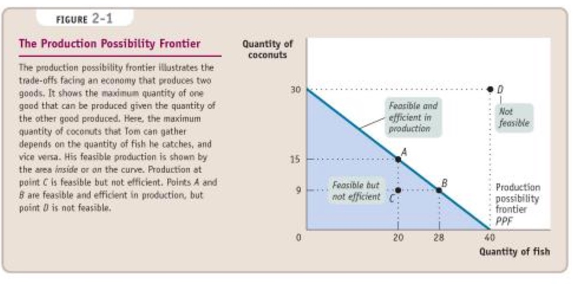
Read Reciprocally

Slide 26
Use Source and Context
Did the U.S. agree to take down US missiles pointing at USSR in order to get USSR to dismantle Cuban missiles?
Two sources:
Attorney General Robert F. Kennedy; Russian Ambassador to the U.S. Dobrynin
Notes:
Ask, how many of you know about the Cuban Missile Crisis? What do you know? Many people don’t know that at the same time Russian missiles were aimed at the United States, we had missiles in Turkey aimed at Russia. The night before…

Slide 27
Dobrynin report to Russian Foreign minister:
If that (the missiles in Turkey) is the only obstacle to achieving the regulation I mentioned earlier, then the president doesn’t see any insurmountable difficulties in resolving this issue,” replied R. Kennedy. ... However, the president can’t say anything public in this regard about Turkey,” R. Kennedy said again.

Slide 28
R. Kennedy report to Dean Rusk, Secretary of State
He then asked me about Khrushchev’s other proposal dealing with the removal of missiles from Turkey. I replied that there could be no quid pro quo—no deal of this kind could be made. This was a matter that had to be considered by NATO and that it was up to NATO to make the decision. I said it was completely impossible for NATO to take such a step under the present threatening position of the Soviet Union....
I repeated that there could be no deal of any kind and that any steps toward easing tensions in other parts of the world largely depended on the Soviet Union and Mr. Khrushchev taking action in Cuba and taking it immediately.

Slide 29
Sources of information
What is different about the two statements?
What explains the differences?
Who is believable?

Slide 30
Overarching interpretive lenses
What should we to stave off a recession?
  Increase the supply of goods by keeping corporate taxes low so businesses will have more money to spend on the production of products (and will hire more people to produce them.
  Increase consumer demand for products by increasing the wealth of people who want to make purchases. This increase in wealth requires taxing the rich and distributing the money to the poor, creating jobs, increasing wages.

Slide 31
Which viewpoint?
With my five-year budget, millions of jobs would be created by cutting the corporate income tax in half, by creating a flat personal income tax of 17%, and by cutting the regulations that are strangling American businesses. The only stimulus ever proven to work is leaving more money in the hands of those who earned it. (Rand Paul, 2013 response to State of the Union Address)

Slide 32
Which viewpoint?
Currently the super-rich and the largest corporations in America don’t pay their fair share of taxes, which means there’s not enough funding for programs that will alleviate systemic inequalities….If you have seen a massive transfer of wealth from the middle class to the top 1/10 of 1%, you know what, we’ve got to transfer that back if we’re going to have a vibrant middle class. (Bernie Sanders)

Slide 33
Interpretive lenses in history
The Civil Rights Movement was:
  Social (e.g. due to issues of race, class, gender, etc.)
  Religious (e.g. due to the the rise of African American church leadership)
  Economic (e.g. due to the inequitable economic opportunities for African Americans)
  Political (e.g. due to the political actions of Eisenhower/Kennedy)
  Because of great men
  Because of grass roots action

Slide 34
The public accommodations section of the Civil Rights Act of 1964 was in fact a constitutional revolution, reversing a Supreme Court decision of 1883 which held a similar measure unconstitutional. It was also true social change, because activities such as eating and sleeping had long been the most sensitive components of the color line in American culture. Was this “merely” social change, or was it an economic issue as well. It certainly had economic consequences. (Gavin Wright, 1999)

Slide 35
Recognition and questioning of an argument
As we have said, the island of Hispaniola was the first to witness the arrival of the Europeans and to suffer the wholesale slaughter of its people and the devastation and depopulation of the land. It all began with the Europeans taking native women and children both as servants and to satisfy their own base appetites (De las Casas, 1542)

Slide 36
Thanks to his (Columbus’s) epochal voyage, an interdependent global economic system emerged on a scale undreamed-of before he set sail. Its workings touched every shore washed by the Atlantic Ocean. Europe provided the markets, the capital, and the technology; Africa furnished the labor; and the New World offered its raw materials, especially its precious metals and its soil for the cultivation of sugar cane. (The American Pageant).

Slide 37
Differing approaches to Vocabulary
General Academic Vocabulary
  Teach only if necessary for understanding a concept.
  Several ways to teach
    Tell students word meaning before reading
    Teach students to determine meaning while reading
      Through context
      From dictionaries or a Thesaurus
      From discussion with peers
Example: sector

Slide 38
Vocabulary, cont.
Technical Terms:
  Definitions are usually presented in the text, so these do not have to be pre-taught (but need to be discussed after reading).
  Students need a system for remembering this vocabulary
    A vocabulary notebook
    Vocabulary card
  This kind of vocabulary needs to be assessed.

Slide 39
General and Technical Vocabulary.
Macroeconomic factors in the U.S. are currently favorable for economic growth. In the words of Fed Chairperson Janet Yellen, the central bank has “confidence in the robustness of the economy and its resilience to shocks.” So investing in a non-cyclical sector, like defense, particularly its attractive stocks, looks to be a good idea now.

Slide 40
Acronyms and Abbreviations
Students should learn the more common ones
  Economics: FHA, APR, IRA, CPI, etc.
  History/ Civics: NAACP, GOP, ACLU
  Geography: PDT, MDC

Slide 41
Vocabulary that signals a position
Students need to pay attention to words that help them determine the position of the author.
  Before long he was generating extra monthly income like $1,200, $1,800, and $2,100... and all in a matter of weeks! His nest egg began to grow exponentially, and before long he had turned a mere $50,000 into a massive $5.3 million.

Slide 42
In summary…
Students need opportunities to read a variety of texts from various perspectives in “social studies” that so they can practice the flexible use of disciplinary strategies appropriate to the information they are studying.
Students need guidance in reading these texts, including guidance in graphic elements.

Slide 43
In summary
Some important areas of instruction:
Integration of graphic, numerical and prose information
Source and Context
Overarching principles or lenses
Identifying and questioning an authors’ argument
Flexible vocabulary study

Slide 44
Thanks!
PowerPoint will be available at:
Shanahanonliteracy.com
Cynthia Shanahan
chynd@uic.edu
312-593-3698

